Slide 1
APUSH Review: Important World War II Conferences
www.Apushreview.com
Everything You Need To Know About World War II Conferences To Succeed In APUSH

Slide 2
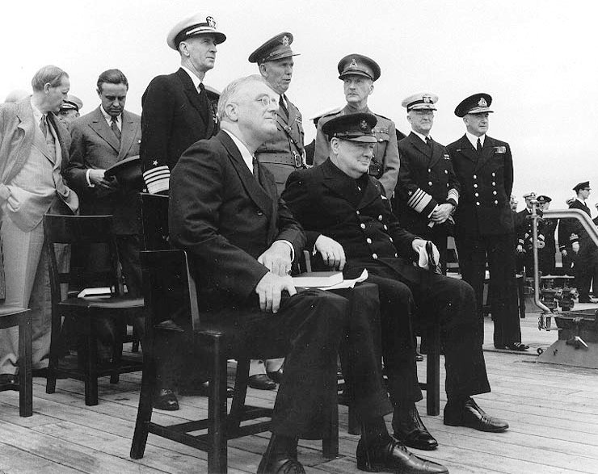
Atlantic Charter
When was it?
  August, 1941
Who was involved?
  US (FDR) and Britain (Churchill)
  First wartime meeting
What did they agree on?
  Outlined the goals for post-WWII
  Goals included self-determination, lower trade barriers, economic cooperation

Slide 3
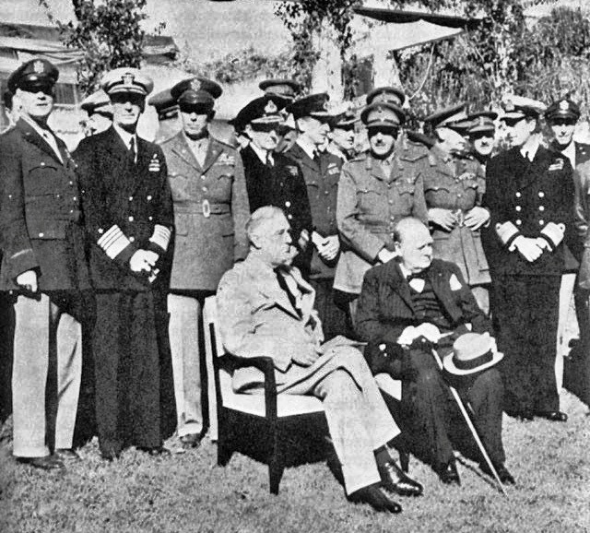
Casablanca Conference
When was it?
  January 1943, Casablanca, Morocco
Who was involved?
  US (FDR) and Britain (Churchill)
  Stalin could not attend - Stalingrad
What did they agree on?
  Casablanca Declaration:
    Called for unconditional surrender of Axis powers

Slide 4
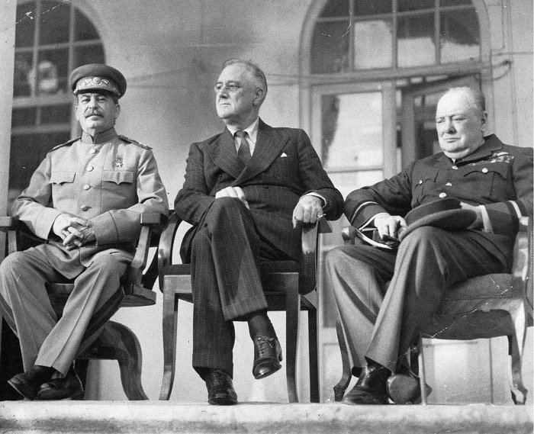
Tehran Conference
When was it?
  Late November – early December 1943
Who was involved?
  US (FDR), Britain (Churchill), Soviet Union(Stalin)
  First “Big Three” wartime meeting
What did they agree on?
  Invasion of Europe in 1944
  USSR would join war against Japan after Germany was defeated
Issues that began to develop
  Stalin wanted to control parts of Eastern Europe

Slide 5
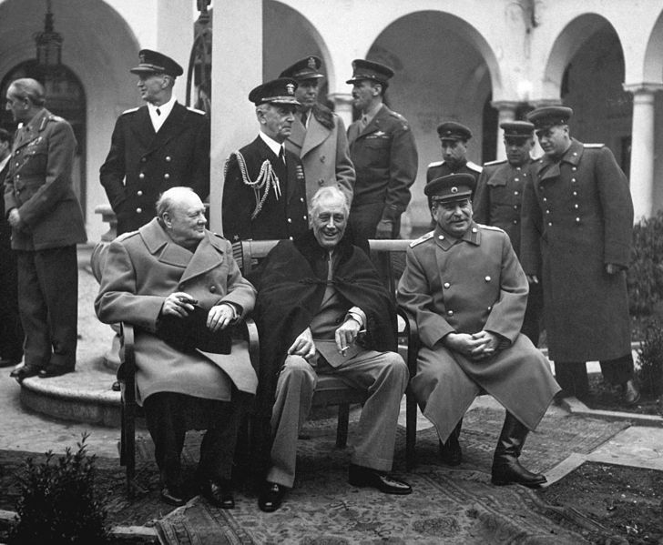
Yalta Conference
When was it?
  February, 1945 – two months prior to FDR’s death
Who was involved?
  US (FDR), Britain (Churchill), Soviet Union(Stalin)
What did they agree on?
  Stalin agreed to free elections in Eastern Europe
    Promised elections in Poland – never came true
  USSR would join the UN
  Germany would be divided into different zones

Slide 6
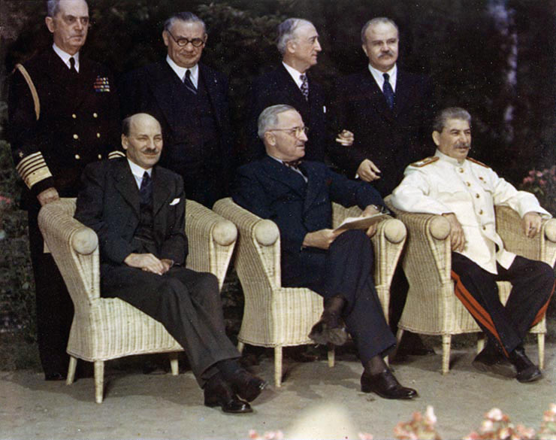
Potsdam Conference
When was it?
  July - August, 1945
Who was involved?
  US (Truman), Britain (Atlee), Soviet Union (Stalin)
What did they discuss?
  Japan given an ultimatum to surrender
    Truman hinted to Stalin about a new weapon
  Truman wanted to hold Stalin to agreements at Yalta
    He saw it as a “pact”
Issues:
  With the war ending, differences quickly emerged

Slide 7
Thanks for watching!
  Subscribe to my channel
  Help spread the word
Questions? Comments? Ideas for videos?
  Leave in comments
Subscribe
Down here!

