Slide 1
APUSH Review: Korematsu v. United States
www.Apushreview.com
Everything You Need To Know About Korematsu v. United States To Succeed In APUSH

Slide 2
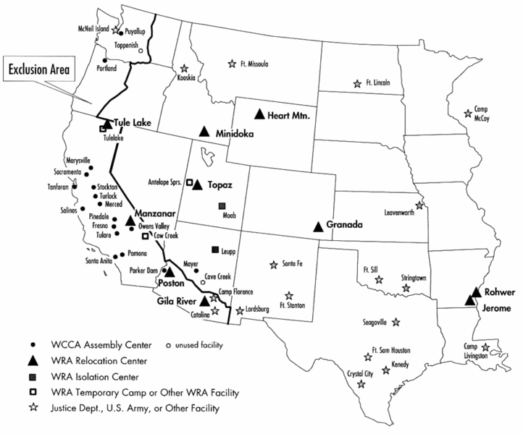
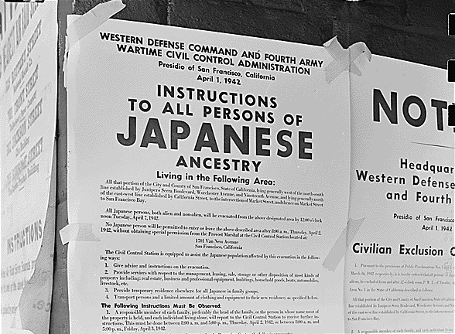
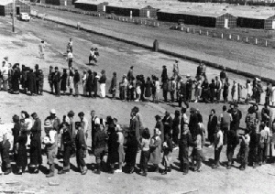
Key Ideas Before The Case
December 7, 1941:
  Japanese attacked Pearl Harbor
    Fear that individuals of Japanese descent would aid Japan during the war
Executive Order 9066 – February 19, 2942
  Established zones in which individuals could be excluded
  Zones were on the west coast, aimed to exclude Japanese (including those born in the US – citizens)
  Many Japanese-Americans were given only a few days notice to move
Many Japanese Americans cooperated with the camps
  Wanted to prove their loyalty to the US

Slide 3
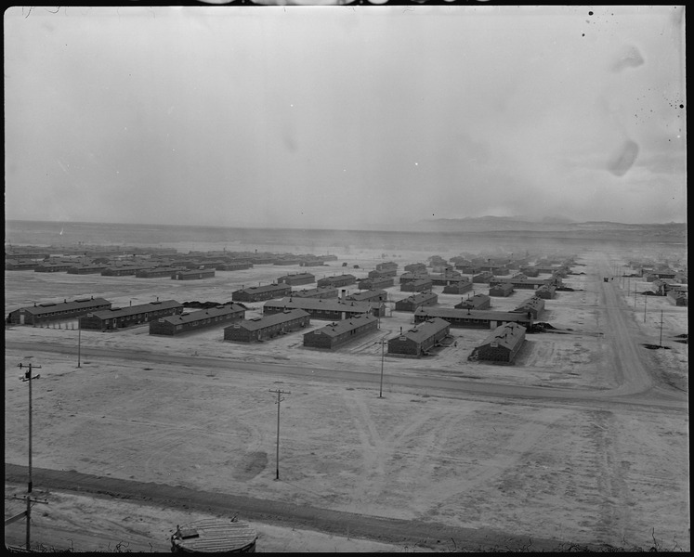
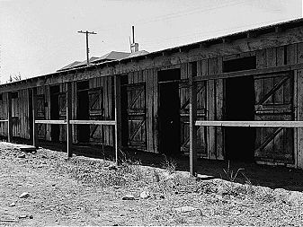
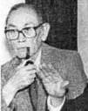
Who was Fred Korematsu?
He was born in Oakland, CA to parents that immigrated from Japan
Ordered to report on May 9, 1942 to soon be moved to an internment camp
  He refused to go, was arrested a few weeks later
  Sent to a camp in Utah
His case went to the Supreme Court
  Korematsu received a lawyer from the ACLU

Slide 4
The Supreme Court decision
In a 6-3 ruling, the Supreme Court declared the camps constitutional
  All 6 judges who favored were appointed by FDR

Slide 5
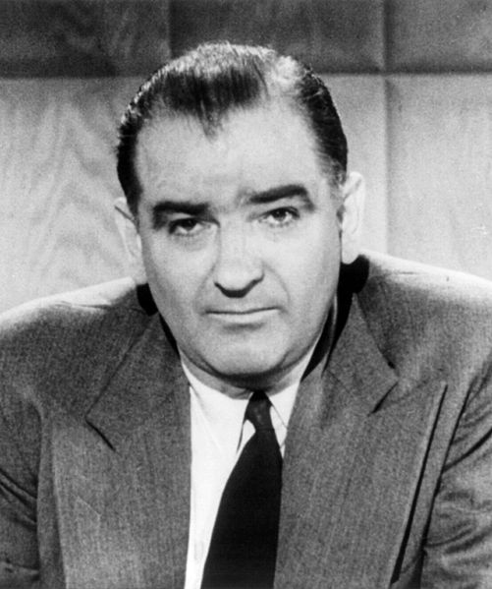
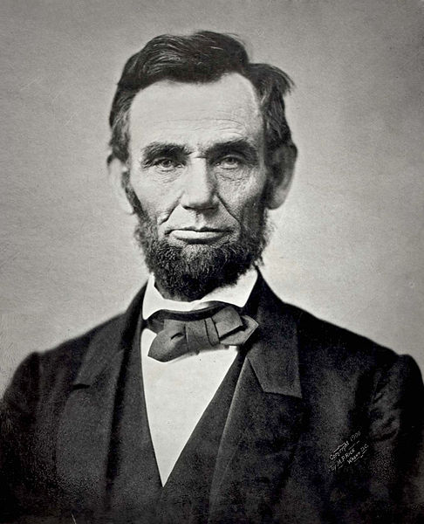
Effects of the Case
In times of war and crisis, personal liberties decrease
  Seen in:
    Alien and Sedition Acts – Quasi War
    The Civil War – suspension of habeas corpus
    World War I – Schenck v. US
    Cold War – 2nd “Red Scare

Slide 6
Test Tips
Multiple-Choice:
  Be able to recognize 9066
  In times of crisis, rights and liberties decrease
Essays:
  Experiences of Japanese Americans during World War II compared to other groups

Slide 7
Thanks for watching!
  Subscribe to my channel
  Help spread the word
  “Like” the video
Questions? Comments?
  Leave in comments
Subscribe
Down here!

