Slide 1
APUSH Review: The Cold War In Cuba
www.Apushreview.com
Everything You Need To Know About The Cold War In Cuba To Succeed In APUSH

Slide 2
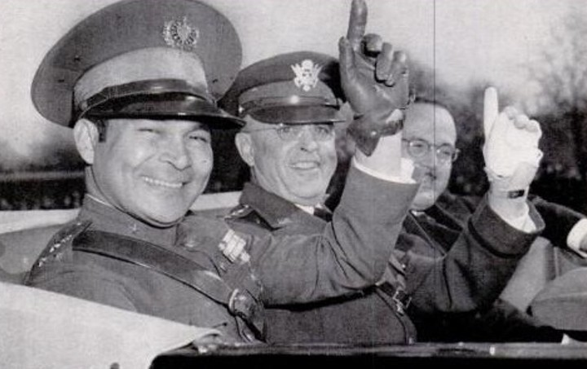
Background On Cuba
Pre-1959:
  US businesses were active in Cuba (mines, farms, hotels, etc.)
January 1, 1959:
  Castro took control of Cuba, Batista is overthrown
US relations with Castro were shaky; he becomes an ally with the Soviet Union
1961, US breaks relations with Cuba

Slide 3
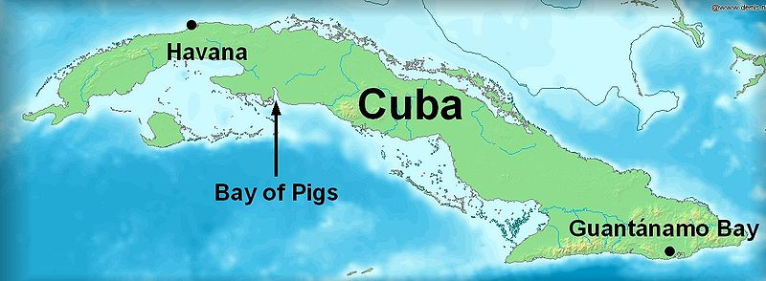
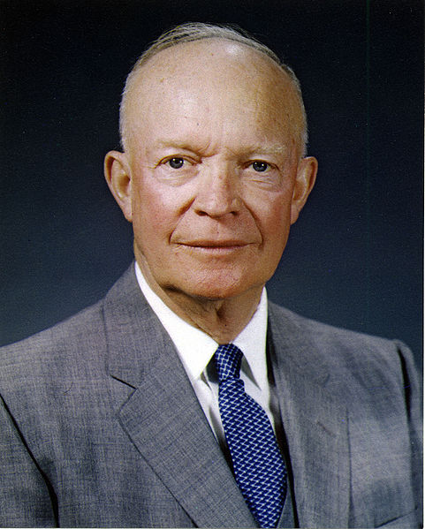
Bay Of Pigs Invasion (1961)
Prior to Eisenhower leaving office, plan was in place to overthrow Castro
  Cuban exiles (trained by US) would invade Cuba
April, 1961 the invasion takes place
  US does not directly get involved
  The invasion is a HUGE failure
Impact:
  Cuba and USSR worry about future invasions

Slide 4
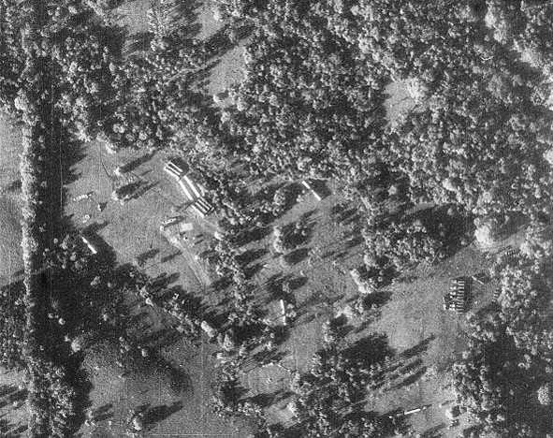
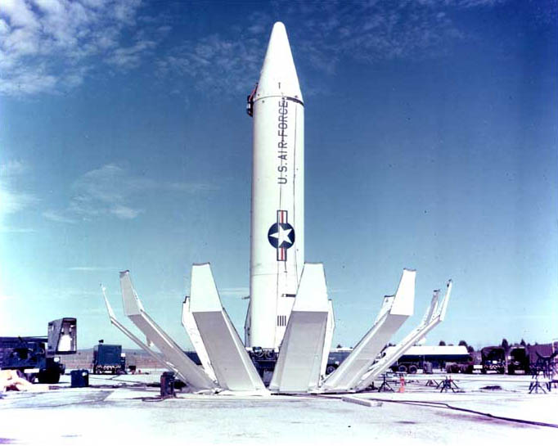
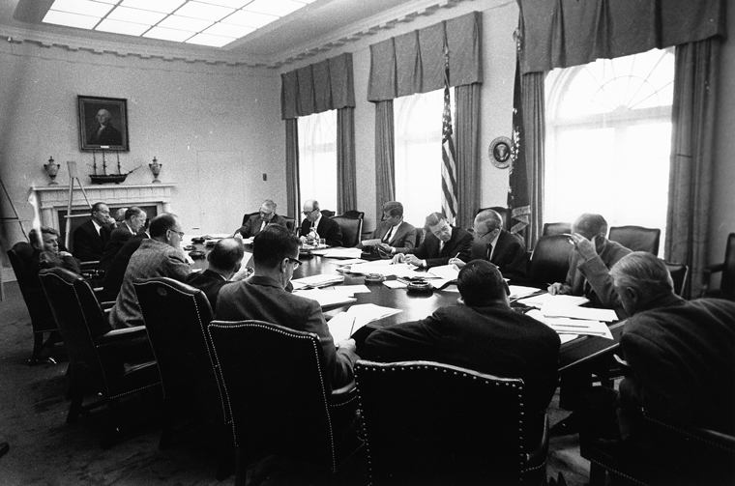
Cuban Missile Crisis (1962)
On October 14, US surveillance discover missiles with nuclear capabilities in Cuba
  Could destroy most of the US
JFK quarantined Cuba
  Would not allow other Soviet ships in
  Preparing for war
  Soviets had 42,000 troops in Cuba – could repel a US attack
Eventually, the Soviet Union withdrew missiles
  US promised not to attack Cuba
  US would withdraw missiles from Turkey
Impact?
  “hot line” established

Slide 5
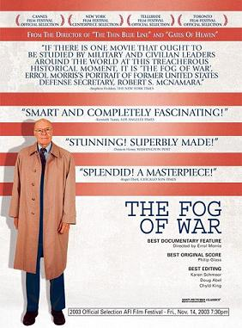
Thanks for watching!
  Subscribe to my channel
  Help spread the word
Questions? Comments? Ideas for videos?
  Leave in comments
Subscribe
Down here!

