Slide 1
APUSH Review: The Election of 1912
www.Apushreview.com
Everything You Need To Know About The Election of 1912 To Succeed In APUSH

Slide 2
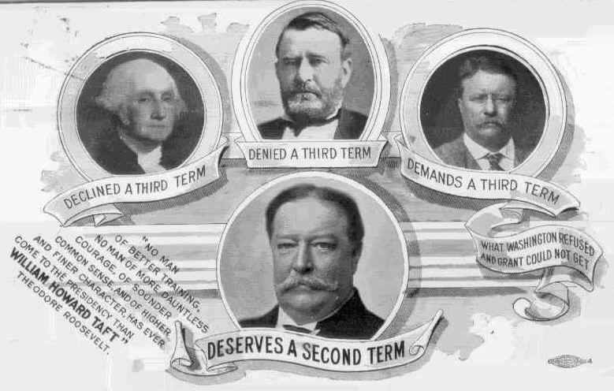
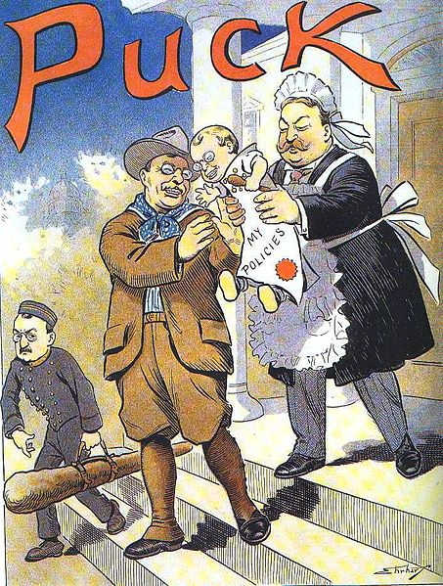
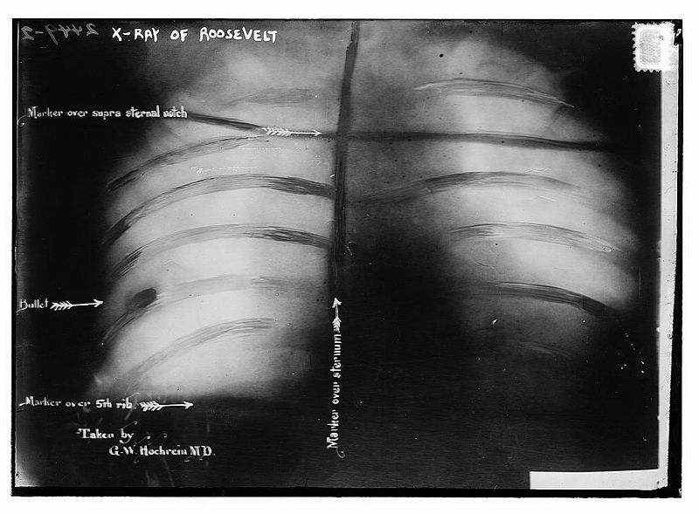
Key Ideas Before The Election
William Howard Taft was the incumbent president
Was hand-picked by Roosevelt to be his successor
Roosevelt feuded with Taft, sought the Republican nomination
Republicans chose Taft
Roosevelt runs on the Progressive Party, or “Bull Moose Party” ticket

Slide 3
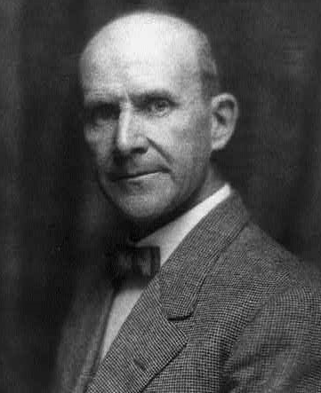
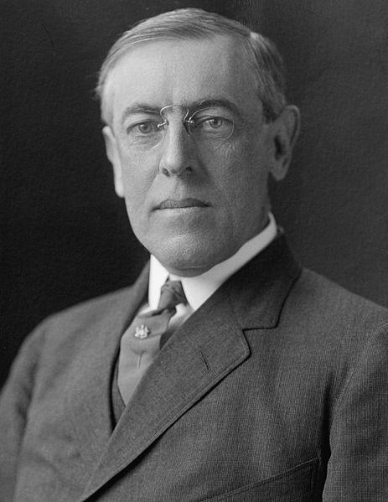
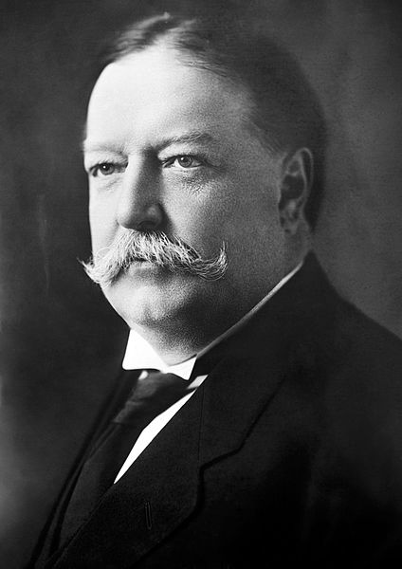
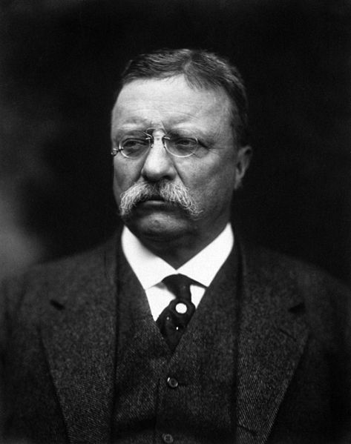
The Candidates
William Howard Taft – Republican Party
Theodore Roosevelt – Progressive Party
Woodrow Wilson – Democratic Party
Eugene Debs – Socialist Party

Slide 4
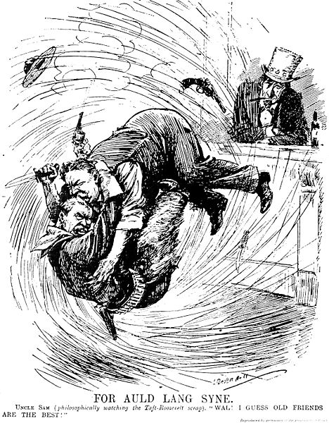
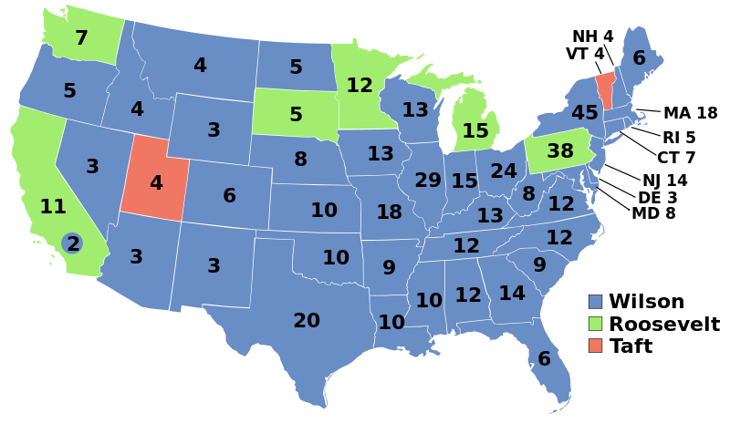
The Results
Two “Republican” candidates help split the vote
Woodrow Wilson easily wins
Eugene V. Debs wins nearly 1,000,000 votes
Socialism is a growing force

Slide 5
Thanks for watching!
Subscribe to my channel
Help spread the word
Questions? Comments? Ideas for videos?
Leave in comments
I told you to subscribe!
Subscribe
Down here!

