Slide 1
APUSH Review: The Election of 1948
www.Apushreview.com
Everything You Need To Know About The Election of 1948 To Succeed In APUSH

Slide 2
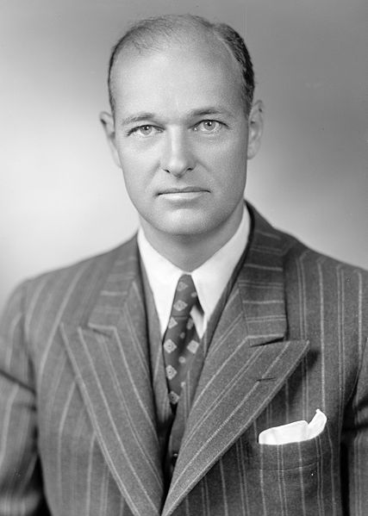
Key Ideas Before The Election
World War II ended in 1945, The Cold War was in full effect
1947
  Containment, Truman Doctrine, and Marshall Plan
  HUAC
Taft Hartley Act (1947)
  Limited the power of unions
  Truman campaigned on overturning this act (never did)

Slide 3
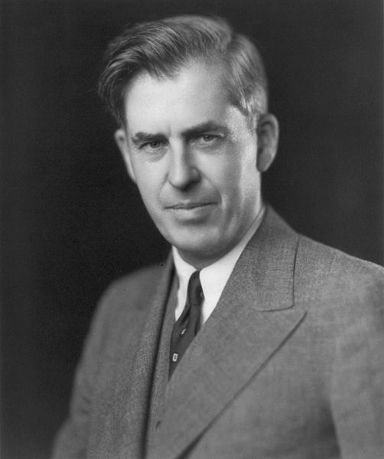
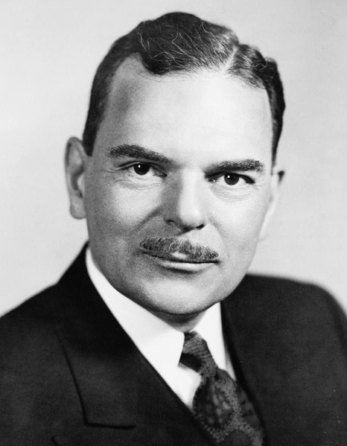
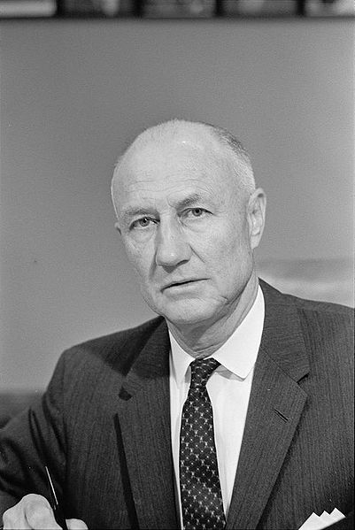
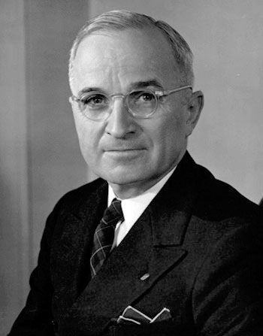
The Candidates
Truman (Democrat) runs for re-election
  Campaigned across the country by train
  A la William Jennings Bryan in 1896
Thomas Dewey (Republican)
  1948 Republican convention was first televised convention
Henry Wallace (Progressive Ticket)
Strom Thurmond (States-Rights’) – Dixiecrat

Slide 4
The Issues and Campaign
Thomas Dewey campaigned on reducing New Deal policies and limiting the power of labor
Truman campaigned for civil rights, increased minimum wage, and continuation of New Deal policies
Wallace campaigned against Truman’s foreign policies
  Thurmond was anti civil rights and pro Jim Crow laws

Slide 5
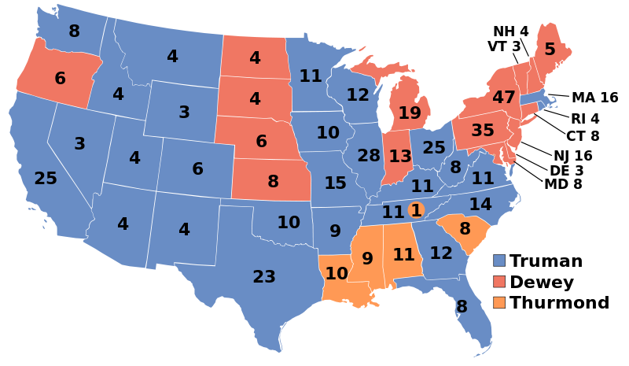
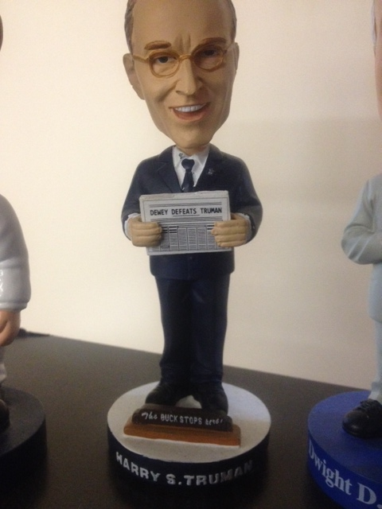
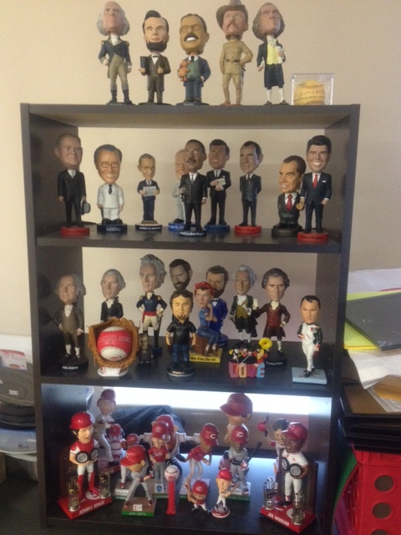
The Results
Considered the greatest upset in presidential history
“Dewey Defeats Truman” – Chicago Tribune
Why did Truman win?
  Unions, farmers, and African Americans overwhelmingly voted for Truman
  Many individuals did not want to “waste” a vote on a third party candidate
Democrats also won both houses of Congress

Slide 6
Thanks for watching!
  Subscribe to my channel
  Help spread the word
Questions? Comments? Ideas for videos?
  Leave in comments
Subscribe
Down here!
Dewey didn’t subscribe

