Slide 1
APUSH Review: The Election of 1960
www.Apushreview.com
Everything You Need To Know About The Election of 1960 To Succeed In APUSH

Slide 2
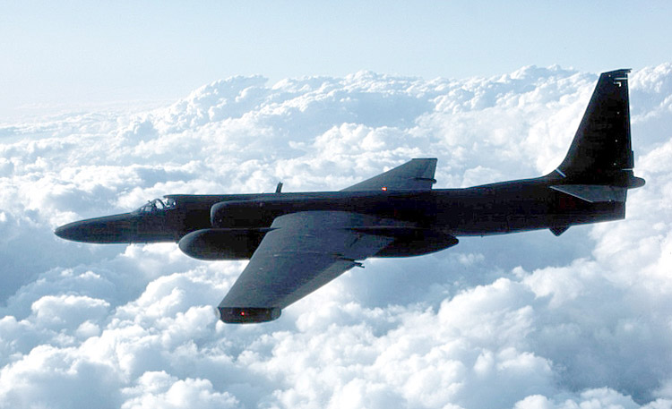
Key Ideas Before The Election
Cold War with Soviet Union
  U2 Spy plane (1960)
    Drastically increased tensions
Civil Rights:
  Desegregation of schools (Brown v. Board)
  Montgomery Bus Boycott

Slide 3
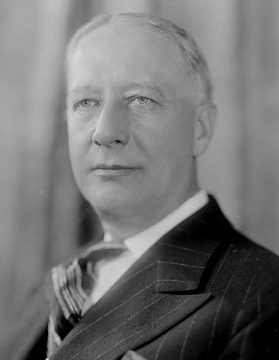
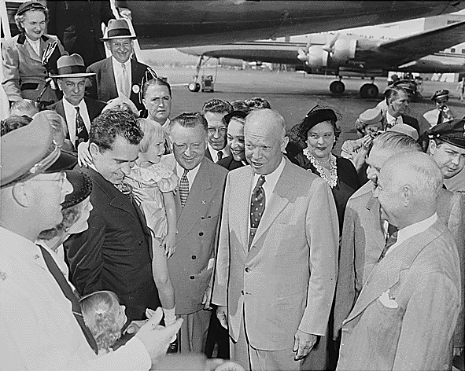
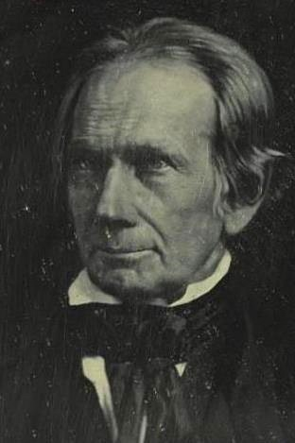
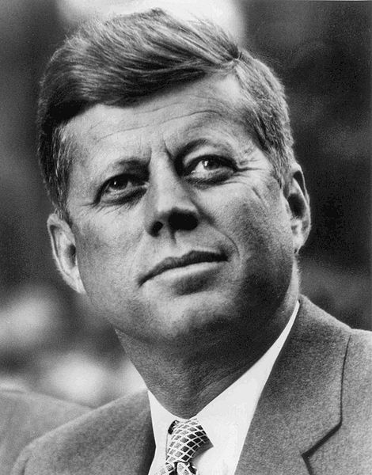
The Candidates
I still won’t go away!!!
John F. Kennedy (Democrat)
  World War II hero – PT109
  Senator – helped choose 5 greatest senators ever
    Selected Henry Clay!
  First Catholic to run for president since Al Smith in 1928
  First Catholic elected president
Richard Nixon (Republican)
  Vice-President under Dwight “Ike” Eisenhower
  Former senator
  Anti-Communist
    Important member of HUAC

Slide 4
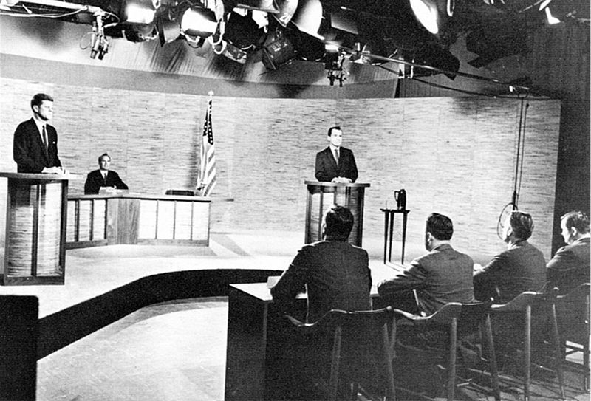
The Campaign
Very close campaign throughout
4 televised debates (September 26 – October 24)
  First presidential debates ever televised
  Kennedy’s charisma and youth helped those watching believe he “won” the debate
  Those listening on the radio thought Nixon “won”

Slide 5
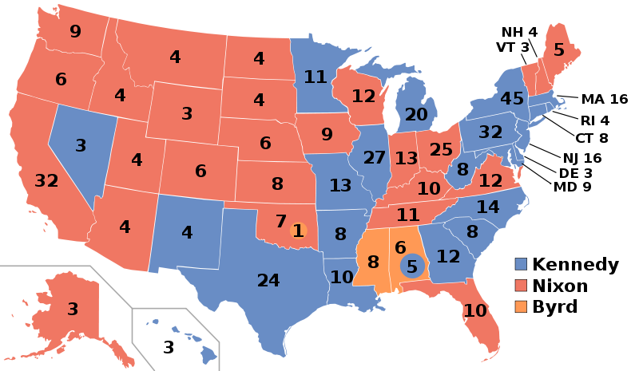
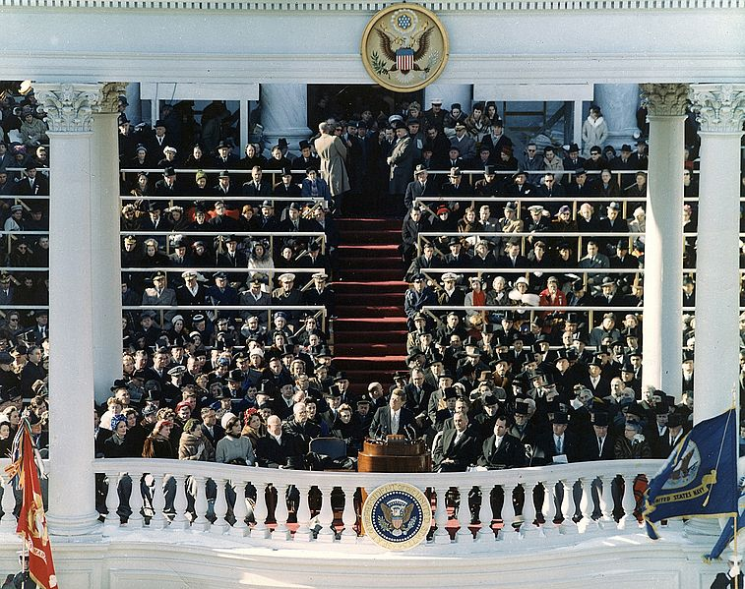
The Results and Impact
Kennedy wins one of closest elections in history
  100,000 vote difference
“Ask Not what your country can do….”
Called for “a struggle against the common enemies of man: tyranny, poverty, disease, and war”
The New Frontier:
  Acceptance speech at Democratic convention
  Called for individuals to accept greatness
    Focused science, space, eliminating prejudice, etc.

Slide 6
Thanks for watching!
  Subscribe to my channel
  Help spread the word
Questions? Comments? Ideas for videos?
  Leave in comments
Subscribe
Down here!
Did you subscribe Mr. President?

