Slide 1
APUSH Review: The Election of 1964
www.Apushreview.com
Everything You Need To Know About The Election of 1964 To Succeed In APUSH

Slide 2
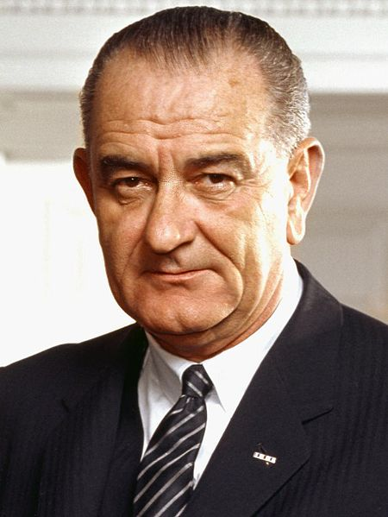
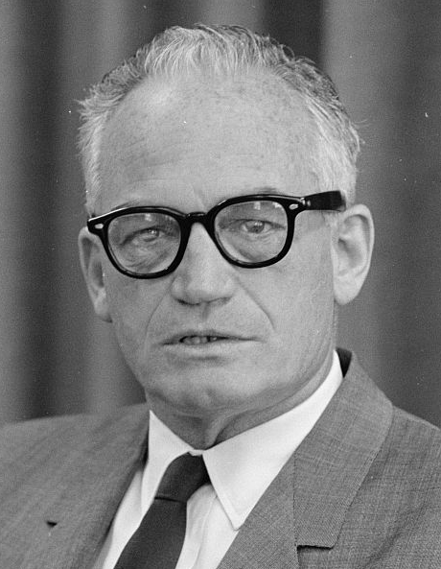
The Candidates
Lyndon B. Johnson (Democratic nominee)
  VP under JFK
  Sworn in on November 22, 1963
  Advocated larger government
Barry Goldwater (Republican nominee)
  Senator from Arizona
  Favored smaller government and a staunch anti-communist
    Not afraid of using nuclear weapons
  The Conscience of a Conservative (1960)

Slide 3
The Campaign
LBJ campaigned on The “Great Society”
  Focused on civil rights, poverty, and education
Barry Goldwater campaigned on anti-New Deal and anti-Great Society
  Anti-liberal programs
  “In your heart, you know he’s right”
    “In your guts, you know he’s nuts” (Democratic response)
“Daisy” commercial
  Aired only once, September 7, 1964

Slide 4
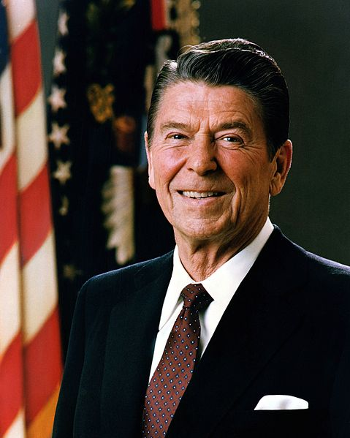
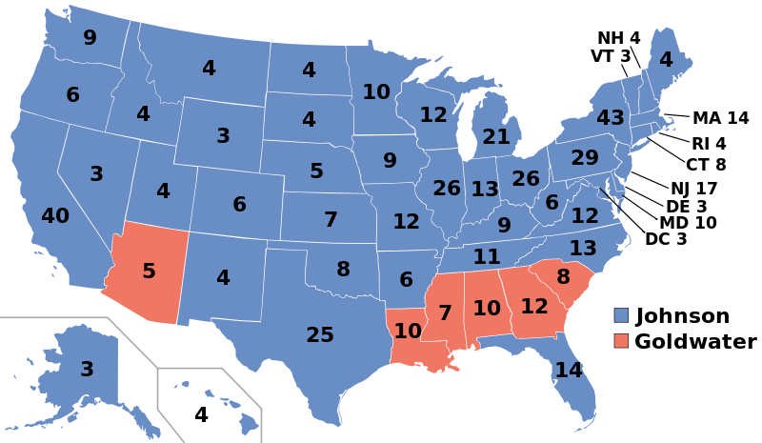
The Results and Impact
LBJ wins 486 - 52
  Democrats gain majorities in both houses of Congress
Increase in government spending as a result of the Great Society
Escalation in Vietnam
Growing conservative movement in the US
  Reagan shared many ideas with Goldwater

Slide 5
Thanks for watching!
  Subscribe to my channel
  Help spread the word
Questions? Comments? Ideas for videos?
  Leave in comments
Subscribe
Down here!

