Slide 1
APUSH Review: The Korean War
www.Apushreview.com
Everything You Need To Know About The Korean War To Succeed In APUSH

Slide 2
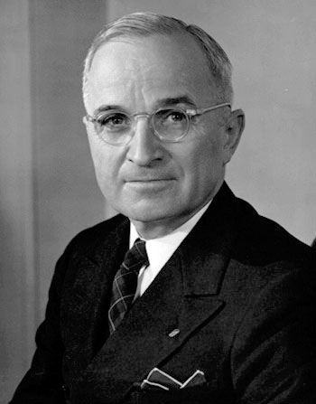
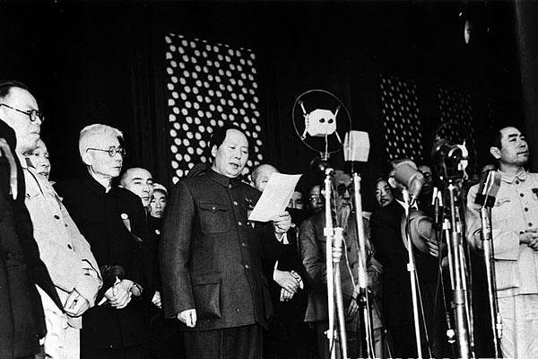
Background Before the War
“Fall of China”
Korea was divided at the 38th parallel
  Divided at the Potsdam Conference
  North = Communist, led by Kim Il-sung
  South = Non-Communist, led by Syngman Rhee
Executive Order 9981 (1948)
  Desegregated the military
Cold War in full effect
  Containment

Slide 3
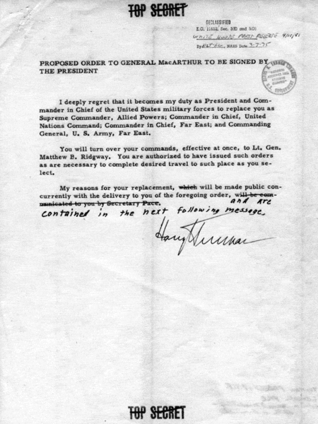
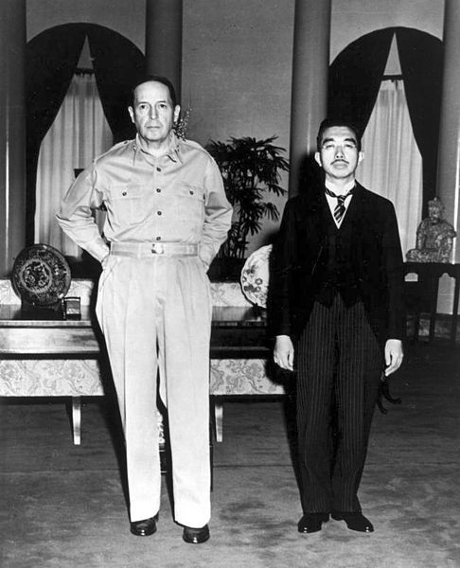
Fighting During The War
In June, 1950, N. Korea invaded S. Korea
  Took over almost all of S. Korean
  Truman saw the invasion as an act by the Soviet Union
US drastically increased its military size and spending
  NSC-68
Eventually N. Korea is pushed back beyond the 38th
China intervened on November 25, on behalf of North Korea
    General MacArthur wanted to fight a large-scale war, attack the Chinese
MacArthur criticized Truman’s plans
  Truman fired MacArthur

Slide 4
End of the War
July, 1953: Ike agreed to a division of North Korea at the 38th parallel; demilitarized zone
36, 940 Americans were killed, 103,284 were wounded
By the end of the war, almost all African Americans fought in integrated units

Slide 5
Impact of the War
Tensions increase between the US and China
First in a series of long, drawn-out wars
Defense spending increased drastically
  New industries develop
Presidential wartime powers increased
  Truman intervened without Congress’ declaration of war

Slide 6
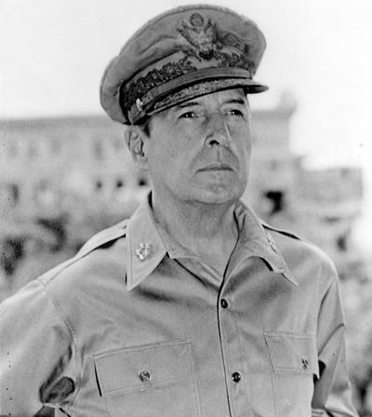
Thanks for watching!
  Subscribe to my channel
  Help spread the word
Questions? Comments? Ideas for videos?
  Leave in comments
Maybe if I subscribed, I wouldn’t have been fired….
Subscribe
Down here!

