Slide 1
APUSH Review: The Supreme Court and The New Deal
www.Apushreview.com
Everything You Need To Know About The Supreme Court and The New Deal To Succeed In APUSH

Slide 2
Butler v. US
Background Info:
  Agricultural Adjustment Act (AAA)
    Paid farmers NOT to grow; purpose was to reduce surpluses
    Farmers were paid via a tax on processors of farm products
Butler v. US:
  One of several cases dealing with the New Deal
  The Supreme Court declared the processing tax unconstitutional
  AAA is no more

Slide 3
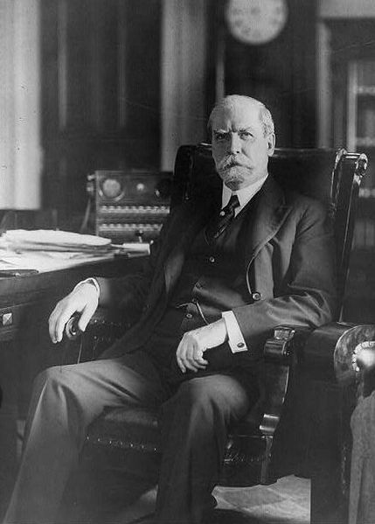

Schechter Poultry v. US
Background Info:
  National Recovery Administration (created by National Industrial Recovery Act):
    Set price and wage controls via “codes”
      Codes were allowed to be created by individuals
      President was given increased powers via the codes
Schechter Poultry v. US
  Two brothers that owned a chicken shop in NYC were charged with violating codes and regulations
  Supreme Court ruled that the NRA could not give legislative authority to codemakers
  Congress could not dictate rules for the Schechter company; they only did business in NYC
This helped lead to…….

Slide 4
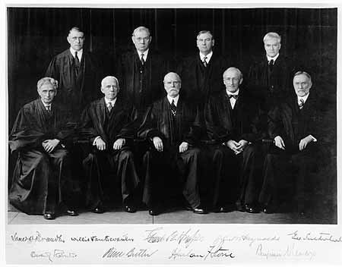
FDR (tries to) Pack the Court
Background:
  FDR was upset with several of his New Deal programs being declared unconstitutional
Judiciary Reorganization Bill (Court Packing Plan):
  Proposed changes to the Supreme Court:
    For every judge 70 ½ years old, FDR could appoint a new judge (up to six)
      Possibly 15 Supreme Court justices!
How was this received?
  Horribly!
  Congress (both parties) and the public were vehemently opposed to the proposals
It never passed, but the Supreme Court began to rule more favorably to New Deal Programs

Slide 5
Test Tips
Essay Topics:
  Effectiveness of the New Deal
  Changing the role and power of the federal government
Tips for Multiple-Choice questions:
  Honestly, everything on here….. Especially the court packing plan
Good Luck!

Slide 6
Thanks for watching!
  Subscribe to my channel
  Press the “Like” button please
  Help spread the word
Questions? Comments? Ideas for videos?
  Leave in comments
It is unconstitutional NOT to subscribe!
Subscribe
Down here!

