Slide 1
APUSH Review: The US’ Transition From Neutrality to World War II
www.Apushreview.com
Everything You Need To Know About The US’ Transition From Neutrality to World War II To Succeed In APUSH

Slide 2
The 1920s….
Was the US really “isolated?”
Not entirely
The US did not take part of any alliances, but they did sign several agreements
Washington Conference (1921 – 1922):
Purpose was to reduce armaments among countries
US, Britain, and Japan agreed on a 5:5:3 ratio of shipbuilding
Kellogg-Briand Pact (1928):
Made war illegal
No enforcement mechanism if treaty was violated

Slide 3
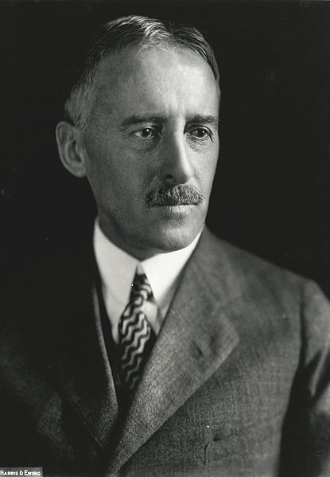
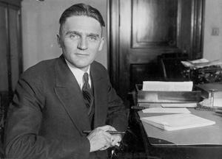
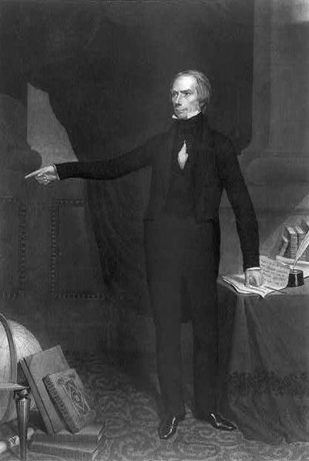
The 1930s…. (Things are heating up)
Happy 157th Birthday To Me!!!!
Japanese invasion of Manchuria (1931)
Led to the Stimson Doctrine
Stated the US would NOT recognize Japanese territorial gains
Nye Committee (April 12, 1934 – HENRY CLAY’S BIRTHDAY!)
Senate committee that alleged that the US entered WWI to make profits for businesses
Helped inspire the……
Neutrality Acts (1935 – 1937):
US could not sell weapons to warring (belligerent) countries
Did not matter who was the aggressor or who was the victim
Non-military goods could be sold via a “cash and carry” policy
US could not provide loans to belligerent nations
US citizens could not travel on ships from warring nations

Slide 4
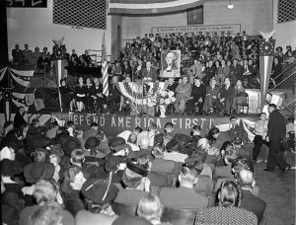
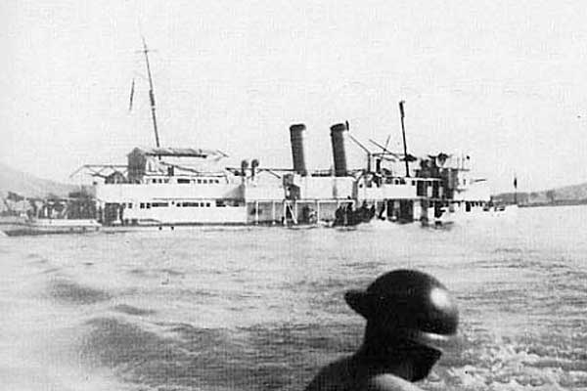
The 1930s Cont.…. (Things are heating up)
Charles Lindbergh
Panay Incident (1937):
Japan attacked a US ship
Japan apologized, American isolationists urged the US to move on
Neutrality Act of 1939:
Passed after Germany’s invasion of Poland
Designed to help France and Britain
US could sell weapons to democracies via “cash and carry”
Countries must pay in cash in full and pick up goods themselves
Two Important US Groups
Committee to Defend America – Interventionists - favored aid
America First Committee – Isolationists (Charles Lindbergh)
Arsenal of Democracy Speech:
FDR speech that claimed the US should aid European countries resisting Germany
Arsenal refers to the US’ ability to make war materials for Allied countries

Slide 5
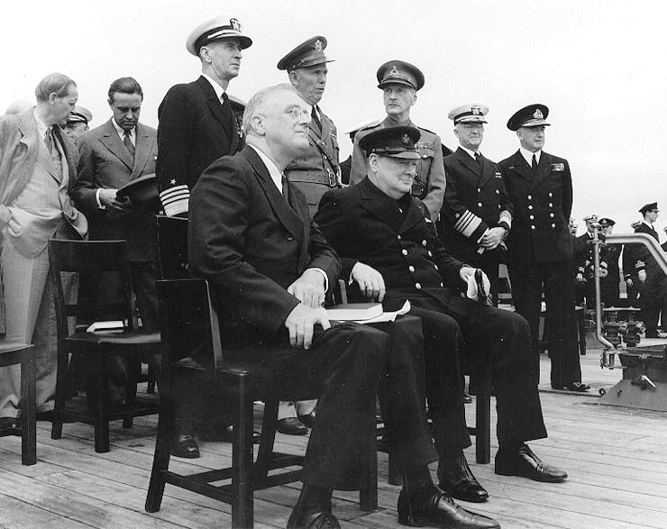
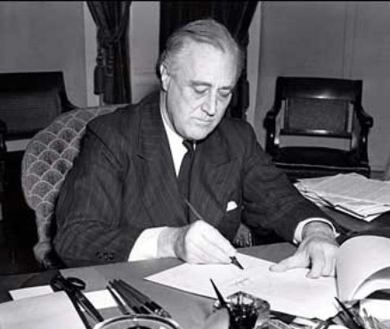
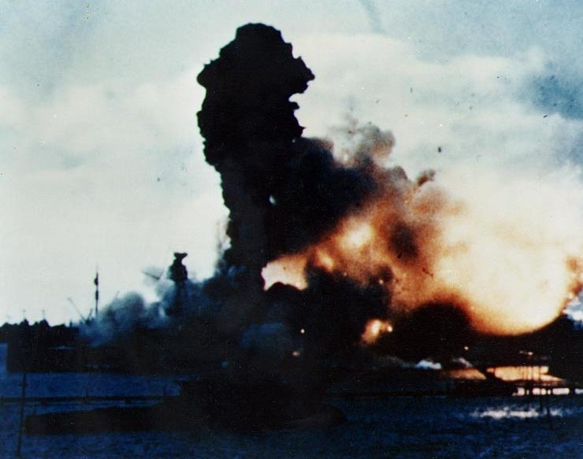
A few More Important Notes
Lend-Lease Act (1941):
Drastically increases US’ involvement in WWII
US could lend crucial supplies to countries the president deems vital
Atlantic Charter (August, 1941)
First wartime meeting between US (FDR) and Britain (Churchill)
Outlined the goals for post-WWI, including: self-determination, lower trade barriers, economic cooperation, etc.
“Shoot-On-Sight” Policy:
Reaction to a conflict between a US boat and German submarine
US ships could shoot German submarines upon seeing them
US and Japan:
US froze Japanese assets in response to aggression
US instituted an embargo
December 7, 1941:
Pearl Harbor was attacked by Japanese
US declared war on Japan and Germany immediately after

Slide 6
Test Tips
Essay Topics:
Change in Foreign Policy leading up to the war
Comparing pre-WWI and pre-WWII US positions
Tips for Multiple-Choice questions:
Nye Committee
Neutrality Acts
Good Luck!

Slide 7
Thanks for watching!
Subscribe to my channel
Help spread the word
Questions? Comments? Ideas for videos?
Leave in comments
Subscribe
Down here!

