Slide 1
APUSH Review: World War II
www.Apushreview.com
Everything You Need to Know About World War II To Succeed In APUSH

Slide 2
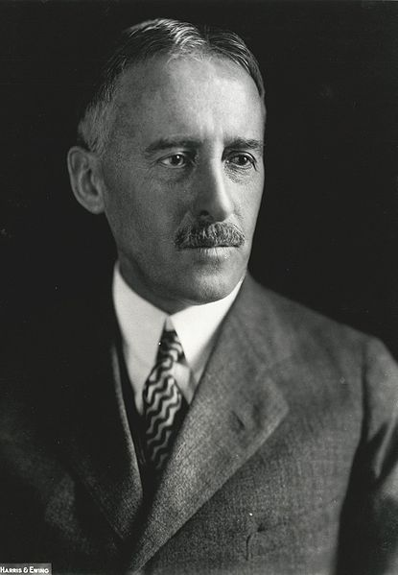
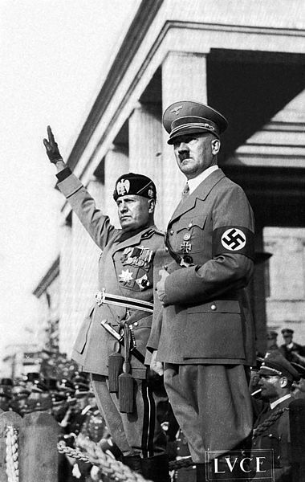
Big Ideas Before the war
Great Depression affected the US and the world drastically
  Many countries focused on isolation, and improving their own situation
Kellogg-Briand Pact (1928):
  Made war illegal
  No enforcement mechanism
Fascist governments:
  Italy – Benito Mussolini
  Germany – Adolph Hitler
Communist governments:
  Soviet Union – Joseph Stalin
Militaristic governments:
  Japan
Stimson Doctrine:
  US response to the Japanese invasion of Manchuria (1931)
  US would not recognize any land gained by Japan

Slide 3
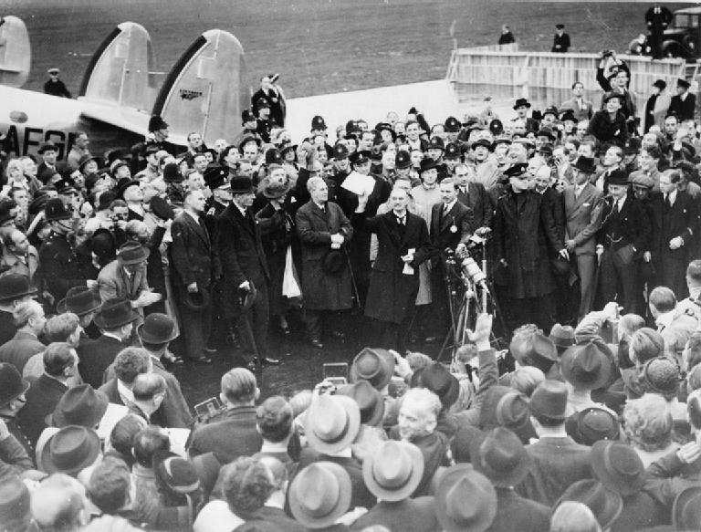
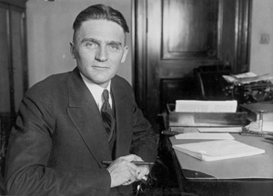
Big Ideas Before the war Continued
Nye Committee
  Alleged that the US entered WWI to make profits for businesses
  Today, it is seen as flawed, however, it helped lead to the……
Neutrality Acts (1935 – 1937):
  US could not trade with warring (belligerent) countries
    Did not matter who was the aggressor or who was the victim
  US citizens could not travel on ships from warring nations
Panay Incident (1937):
  Japan attacked a US ship
  Leads to the Quarantine Speech:
    FDR encouraged economic embargoes on aggressive nations
Appeasement:
  Major cause of the war – giving in to the demands of an aggressor (Hitler)
  Munich Conference (1938):
    Parts of Czechoslovakia were given to Germany; Hitler promised not to take more land

Slide 4
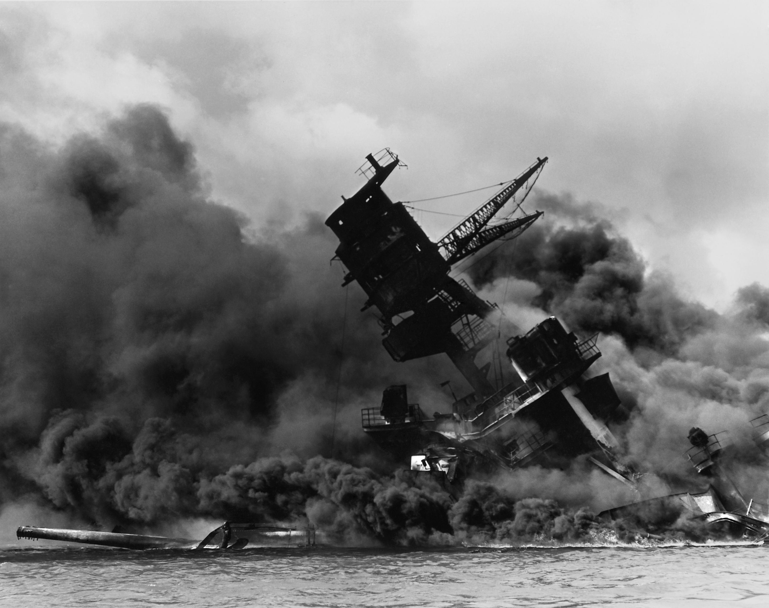
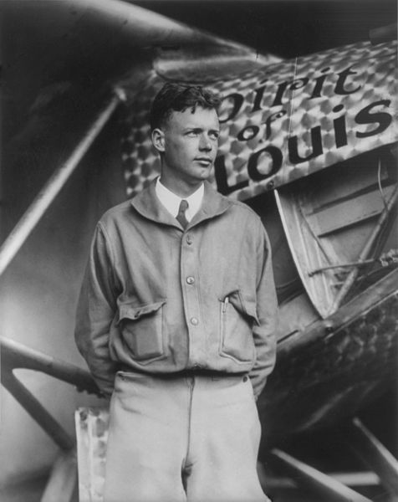
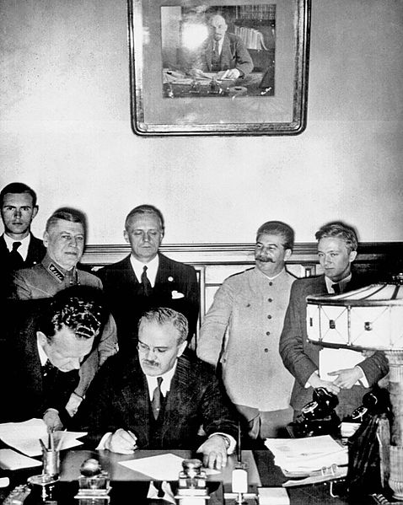
WWII – US Entrance
Nazi-Soviet Nonaggression Pact (August, 1939)
  Not an alliance; agreement to not attack each other
German invasion of Poland, September 1, 1939
  Seen as the start of WWII
  “9/1/39 Hitler says Poland’s mine”
Neutrality Act of 1939:
  US could sell weapons to democracies via “cash and carry”
    Countries must pay in cash in full and pick up goods themselves
Isolationists vs. Interventionists
  Committee to Defend America – Interventionists
  America First Committee – Isolationists (Charles Lindbergh)
Lend-Lease Act (1941):
  US could lend crucial supplies to countries the president deems vital
December 7, 1941:
  Pearl Harbor was attacked by Japanese
  US declared war on Japan and Germany immediately after

Slide 5
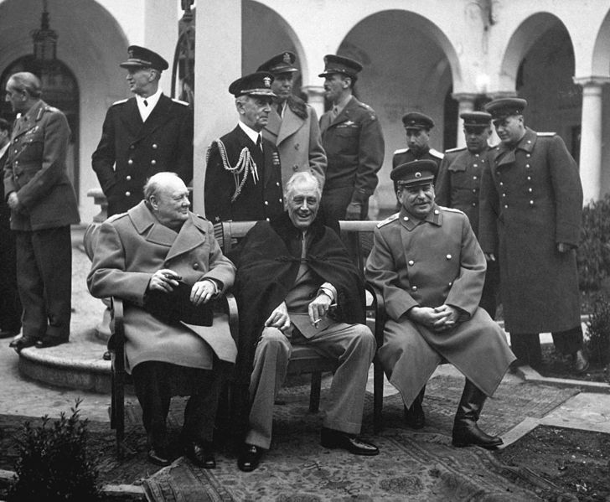
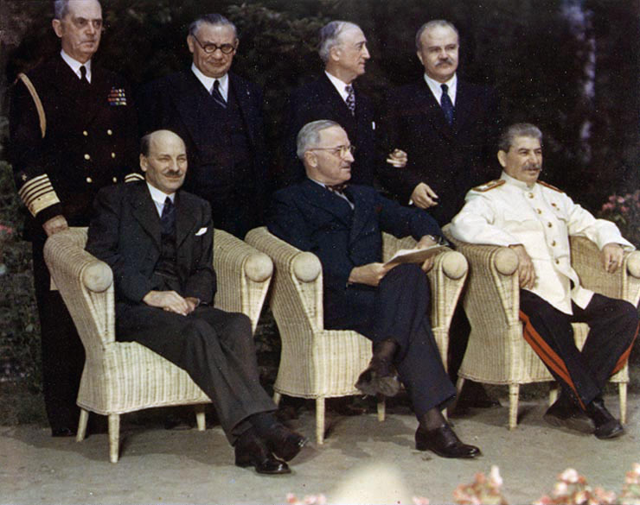
Key events during the war
Manhattan Project:
  Secret project to build a nuclear weapon – Robert Oppenheimer
D-Day: June 6, 1944
  Led by Dwight Eisenhower
Yalta Conference:
  Stalin, FDR, Churchill
    Stalin promised free elections in Eastern Europe
Potsdam Conference
  Japan given an ultimatum to surrender
    Truman hinted to Stalin about a new weapon
  Truman wanted to hold Stalin to agreements at Yalta
Holocaust:
  6 million Jews were killed, millions of non-Jews as well

Slide 6
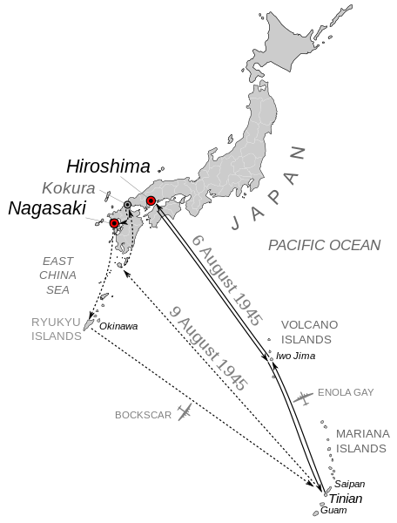
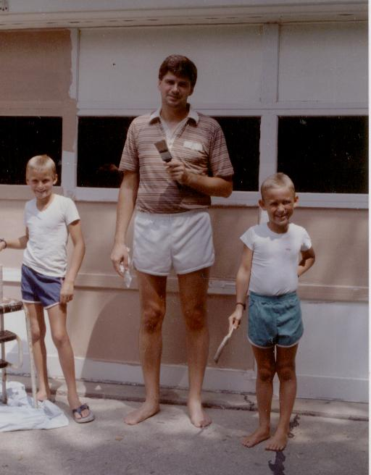
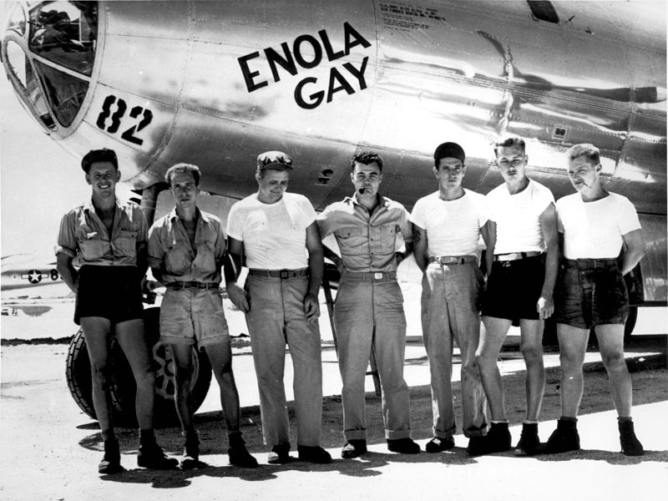
The End of the war…..
August 6, 1045:
  Hiroshima – “Little Boy,” 80,000+ die
  Enola Gay – Paul Tibbets
August 9, 1945:
  Nagasaki – “Fat Man,”
Why did Truman use atomic weapons?
  Many reasons – test purposes: to save American lives
United Nations
  US one of five permanent members of security council
  Took over for the defunct League of Nations (US did not join)
Beginning of The Cold War
  North Atlantic Treaty Organization (NATO)
  First US peace-time alliance in history
Me in 1989!

Slide 7
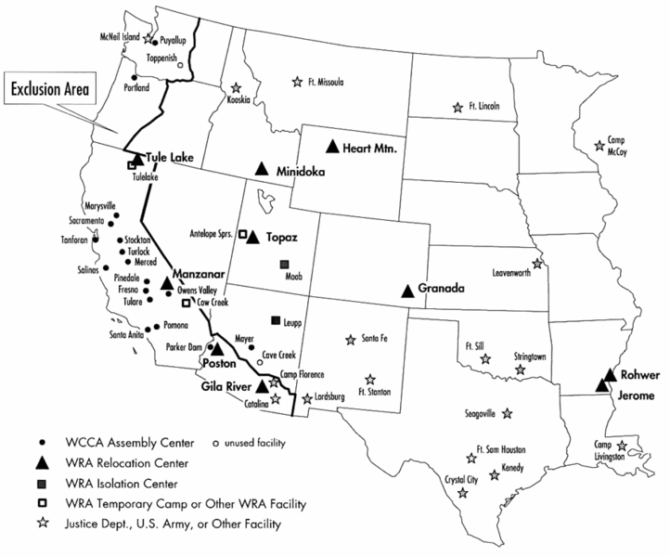
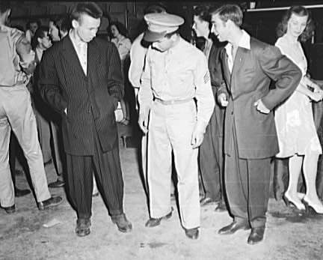
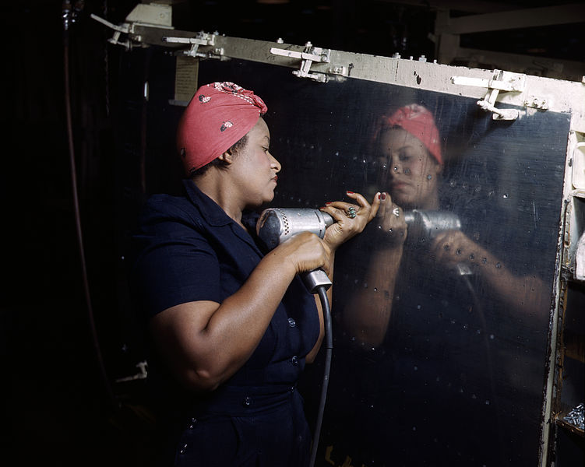
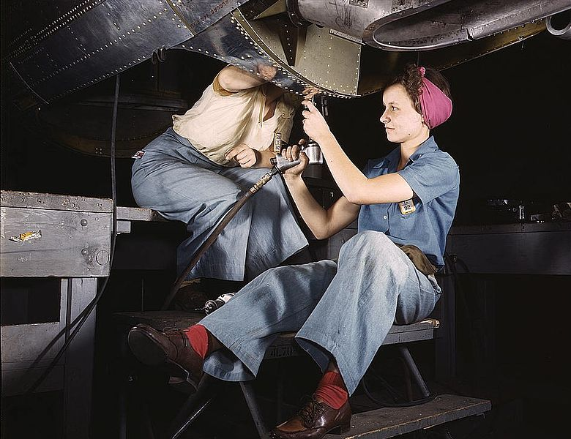
Home front during WWII
Women in WWII
  “Rosie the Riveter” – Films, magazines, etc.
    Millions of women took jobs in factories
    Incomes increased
Japanese Americans
  Executive Order 9066 – Japanese Internment Camps
  100,000+ Japanese-Americans on West coast were moved to camps
  Upheld in Korematsu v. US
Mexican-Americans
  Increase in workers from Mexico through the Bracero Program
  Zoot-Suit Riots: LA, CA
    Conflicts between sailors and marines and Mexican-Americans
Growth of the “Sunbelt” in the SW and Southern US – new industries

Slide 8
Test Tips
Essay Topics:
  Comparing US policies before and after WWI and WWII
  Home front during the war:
    Experiences of specific groups
  How US foreign policy changed AFTER WWII
Tips for Multiple-Choice questions:
  Everything! But especially..
    Korematsu v. US, Nye Committee, Zoot Suit Riot, Truman used the bombs to save AMERICAN lives, and Soviet Union promised free elections in Eastern Europe
Good Luck!

Slide 9
Thanks for watching!
  Subscribe to my channel
  Help spread the word
Questions? Comments? Ideas for videos?
  Leave in comments
Good luck!
We all pledge to subscribe…
Subscribe
Down here!

