Slide 1
American History: Chapter 1 Review Video
www.Apushreview.com
The Collision of Cultures

Slide 2
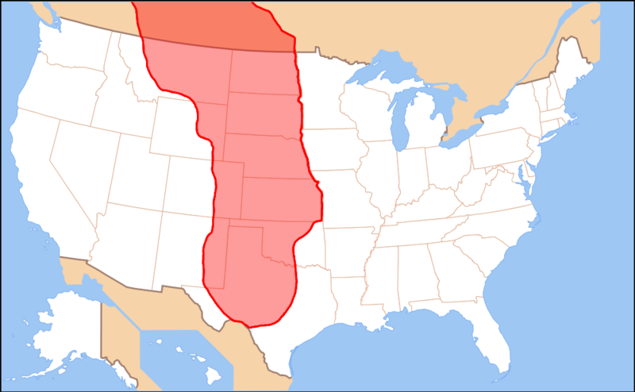
America Before Columbus
Early Migrations:
Many people came to the Americas via the Bering Straight
Some came via boats to Chile and Peru
Civilizations in the Americas:
Incas – located in Peru; largest empire in the Americas
Mayans – located in Central America; developed a written system, calendar, and agricultural advancements
Aztecs – Tenochtitlan – largest city ever to that point
Southwestern US – based on agriculture (maize) and built elaborate irrigation systems
Great Plains and Great Basin – hunted Buffalo; many were nomadic
Northeastern (Iroquois) – developed permanent villages; hunted, gathered, and agriculture dominated society
Many natives were religious – associated with nature
Tribal social roles:
Women raised children, prepared meals, and gathered food
Men hunted
In some societies (Iroquois, women helped make tribal decisions via counsels)

Slide 3
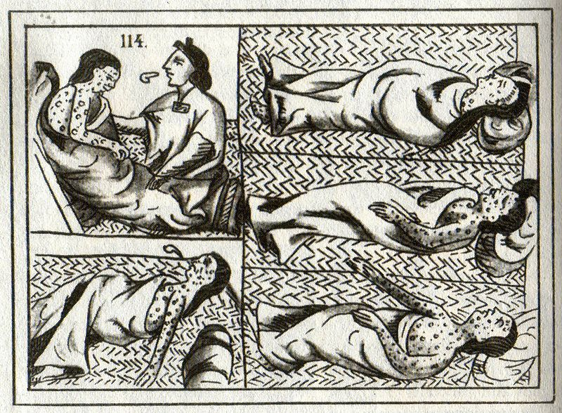
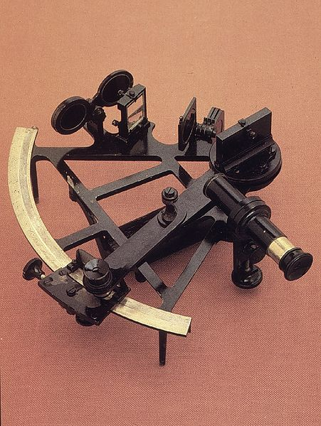
Europe Looks Westward
Reasons for exploration:
Population growth – land in Europe was expensive
Advances in technology – sextant
Desire for new markets and products
As a result of Columbus’s explorations, Spain increased interest in exploration, surpassing Portugal
Spain claimed most of the New World (except for Brazil)
Conquistadores
Cortes (1518) devastated natives (especially via smallpox)
Many Conquistadores saw this as God’s work
Spanish sought gold and silver in the new world
Ordinances of Discovery (1570s) – banned harsh military conquests
Spain required Catholicism be the only religion in their new territories
Set up missions – convert natives to Christianity
Many post-Conquistador Spanish immigrants came to spread religion

Slide 4
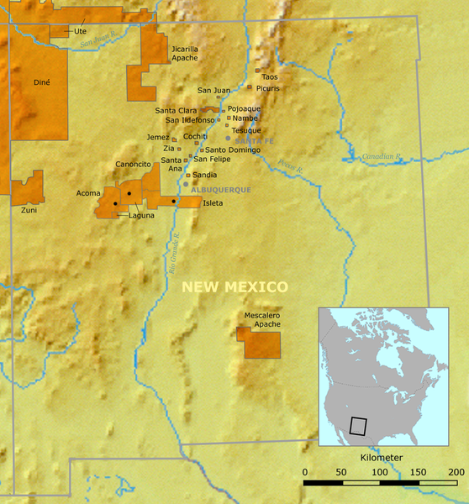
Europe Looks Westward Cont.
St. Augustine, FL – first permanent European settlement
Encomienda System:
Individuals were given land, could demand tribute and labor from natives
Essentially slavery for natives
Pueblo Revolt:
What was it?
Native American Rebellion against the Spanish in New Mexico
Why did it occur?
2,000 Spanish and 30,000 Pueblos
Spanish priests and government suppressed Native practices that were inconsistent with Christianity
Spanish demanded tribute and labor from Natives
What happened?
Pope (Native religious leader) killed hundreds and forced Spanish to flee
Spain regains control in 1696
Significance?
Spanish sought to religiously assimilate the Natives
Pueblos were given more freedoms from the Spanish

Slide 5
Europe Looks Westward Cont.
By end of 1500s, the Spanish monarchy controlled virtually all local government in its new world colonies
Spain was more strict than Britain in terms of imposing economic policies
All trade must go through a few regulated ports
Britain, France, and the Dutch focused on population growth and establishing permanent settlements
Spain did not continue to send large number of immigrants
Columbian Exchange:
Examples of goods:
Americas to Europe and Africa: potatoes, maize (corn), tomatoes
Europe to the Americas: wheat, rice, horses, chickens, oxen
Impact of exchange?
In Europe and Asia: massive population growth due to new food
In Africa: Spanish and Portuguese used Africans from West Africa to be used as slaves in the Americas
In the Americas: spread of diseases (smallpox), social classes (Mestizos), horse transformed Native life (made hunting easier), Encomienda system

Slide 6
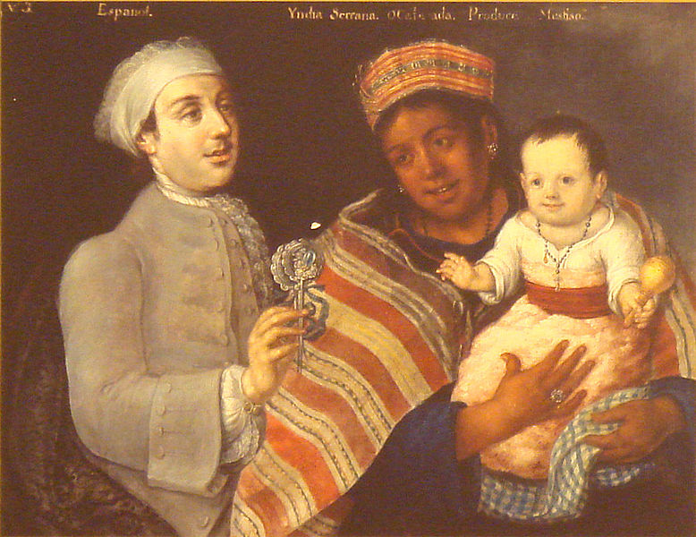
Europe Looks Westward Cont.
Spanish Hierarchy:
People from Spain were at the top, natives and Africans were at the bottom
In the middle emerged a large Mestizo class (mixed native and European ancestry)
African societies:
Tended to be matrilineal, unlike Europeans
Property was inherited from mother’s family, not father’s
Women played a large role in trade
Slavery in Africa existed, but was not usually hereditary like later in the US
The slave trade (dominated by Portugal and Spain) increased for goods such as sugar, and later tobacco
African tribes fought with one another and traded captured enemies to sell as slaves

Slide 7
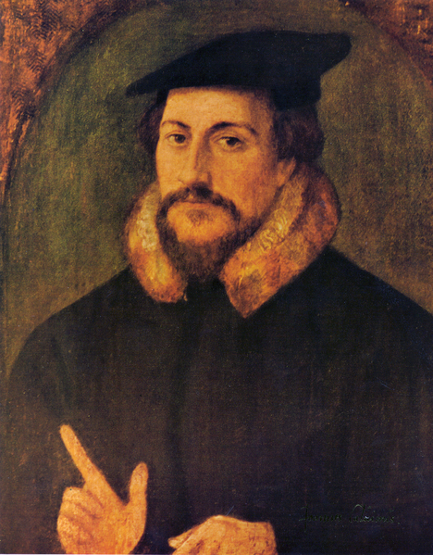
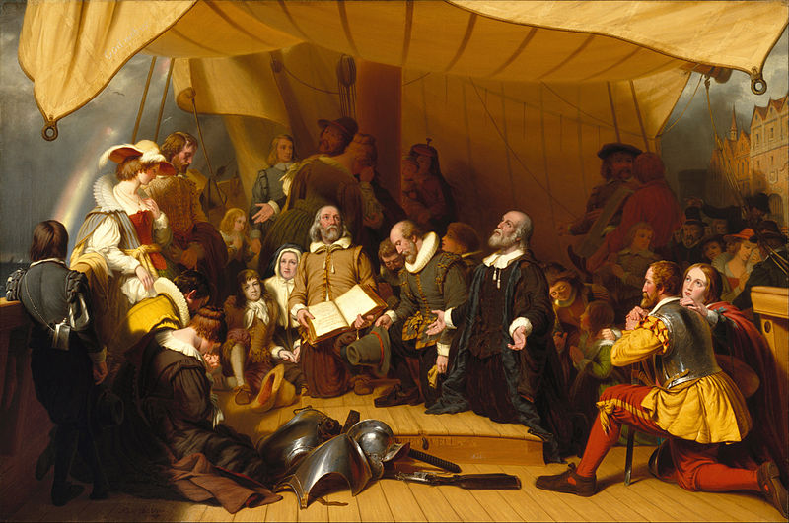
The Arrival of the English
Reasons for English exploration:
Rising population, lack of land
Joint-stock companies – investors would pool $ together and share in profits and losses
Mercantilism:
Goal was to benefit the mother country (England)
Increased desire for colonies to gain wealth
Religion:
Puritans (those that wanted to purify the Anglican Church of Catholic rituals) sought refuge in the Americas
Puritans believed in predestination – introduced by John Calvin
Belief that God chose who to save, fate could not be changed
Separatists – wanted to break away from the Anglican Church (Pilgrims)

Slide 8
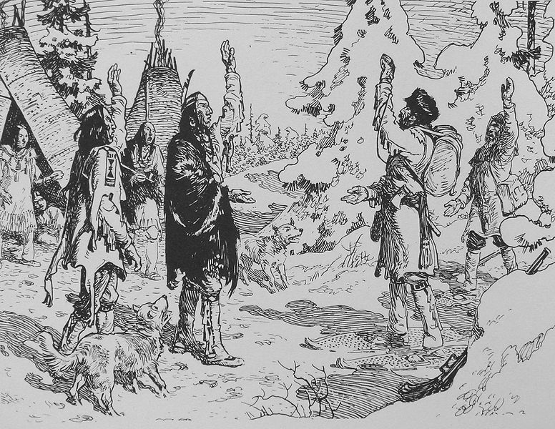
The Arrival of the English Cont.
English experiences in Ireland:
English viewed the Irish, that were mostly Catholic, as savages
Believed the Irish could not be assimilated and must be oppressed
The English would use similar tactics against natives in the Americas
French and Dutch:
Spain barely colonized North America
The French explored into the North American Continent and developed close ties with natives
Coureurs de bois – French fur traders
The French developed an alliance with the Algonquians
The Dutch also traded furs, and were established around New York
Had a smaller population

Slide 9
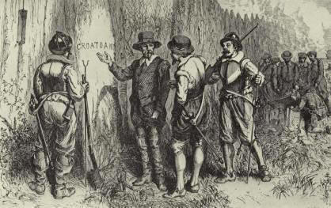
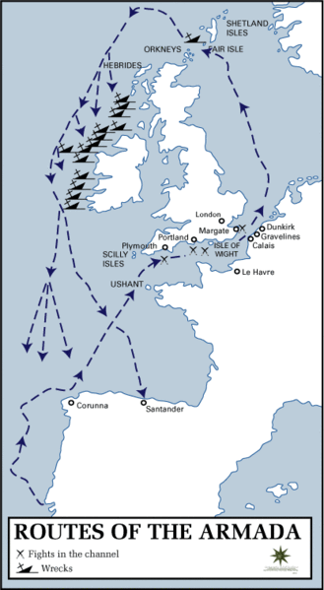
The Arrival of the English Continued
Spanish Armada:
Large Spanish fleet was defeated by the English
England emerged as a naval power
English Settlements:
Roanoke – early English settlement known as the “lost colony”
In 1590, the colony was found deserted with “Croatoan” carved on a post
Jamestown – established in 1607 as a charter by King James I
Would become the 1st permanent English colony

Slide 10
Thanks for watching!
Subscribe to my channel
Press the “Like” button
Questions? Comments?
Ideas for videos?
Leave in comments
subscribe
Subscribe
Down here!

