Slide 1
American History: Chapter 13 Review Video
www.Apushreview.com
The Impending Crisis

Slide 2
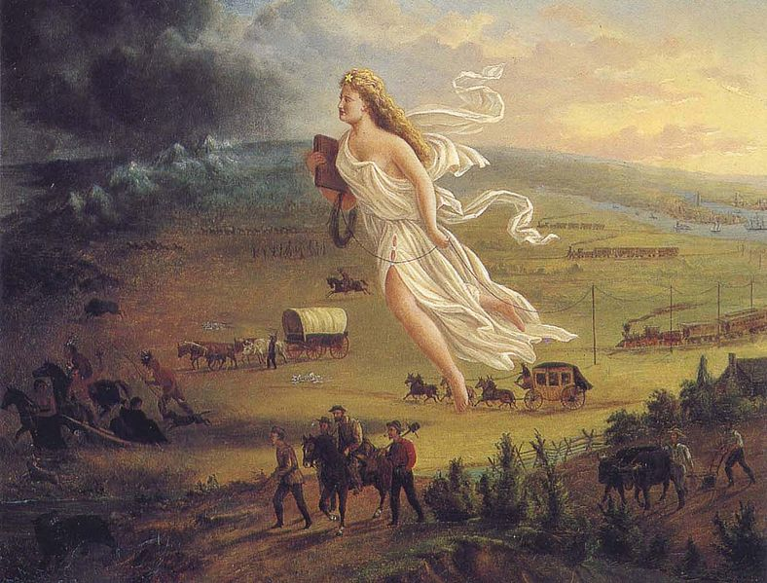
Looking Westward
“Manifest Destiny”
  God-given right to expand from coast to coast
  Coined by John O’Sullivan
Opponents to expansion?
  Henry Clay and some Whigs – feared tensions over slavery
Texas:
  Declared independence in 1836
  Battle of San Jacinto – Santa Anna signed treaty recognizing Texas
  Jackson and Van Buren hesitated to annex Texas – fear of war with Mexico and exacerbating sectional strife

Slide 3
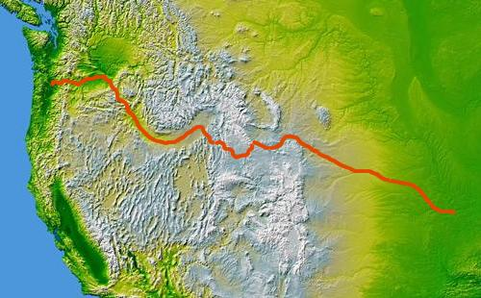
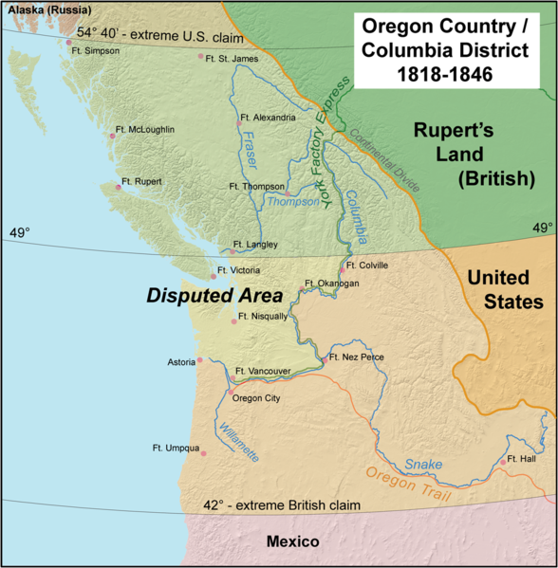
Looking Westward Cont.
Oregon:
  Joint Occupation with Britain
  “54°40’ or Fight!”
  Eventually, the US and Britain settle on the 49th parallel
Who migrated West?
  Prosperous, young people – why?
Why did people move West?
  $$$
Oregon Trail:
  Native Americans played a key role in guiding individuals
  Most individuals walked on the trail

Slide 4
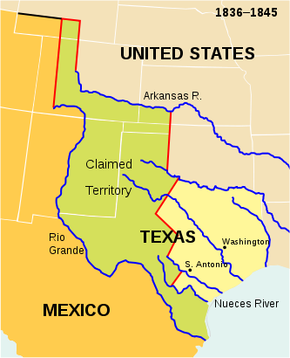
Expansion And War
Annexation of Texas:
  Key issue in the election of 1844
  Polk fully supports annexation
  TX is annexed via a joint resolution in February 1845, admitted into the country in December
Boundary issue:
  TX claimed the Rio Grande, Mexico claimed to the Nueces River
Polk Sought to buy CA from Mexico, they refused

Slide 5
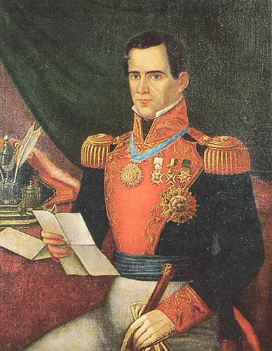
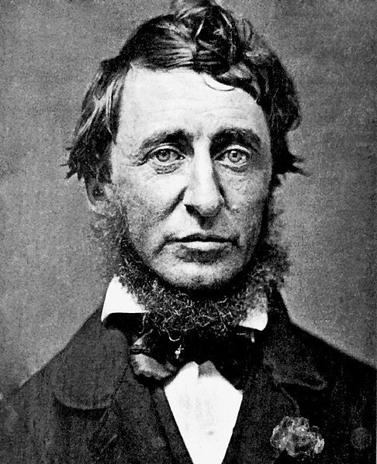
Expansion And War Cont.
The Mexican-American War:
“Spot Resolutions” – “Spotty Lincoln”
Thoreau – Civil Disobedience
Nicholas Trist – negotiated treaty with Mexico
Treaty of Guadalupe Hidalgo:
  US pays $15 million
  US gains Mexican Cession

Slide 6
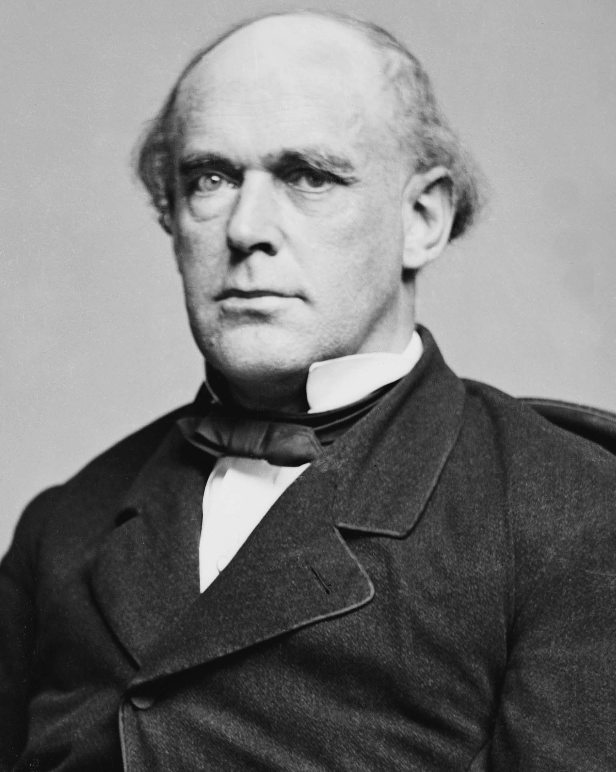
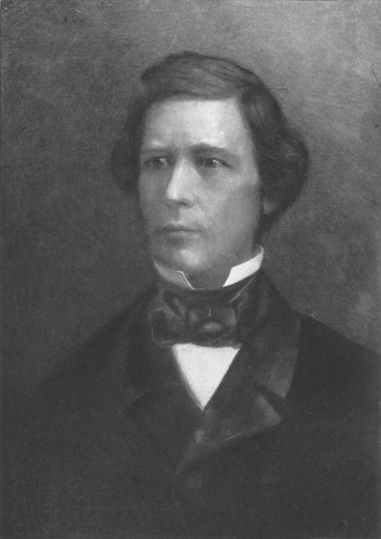
The Sectional Debate
***Wilmot Proviso***
  David Wilmot (D – NY)
  Introduced an amendment to a bill stating slavery would NOT exist in any land gained from Mexico
  Passed the House (more population in North), but NOT the Senate
Free-Soil Party:
  Were against the extension of slavery into territories
  “Free labor, free soil, free men”
Gold Rush:
  John Sutter’s mills
  49ers
  Mostly men – population increases from 14,000 to 220,000 in 4 years

Slide 7
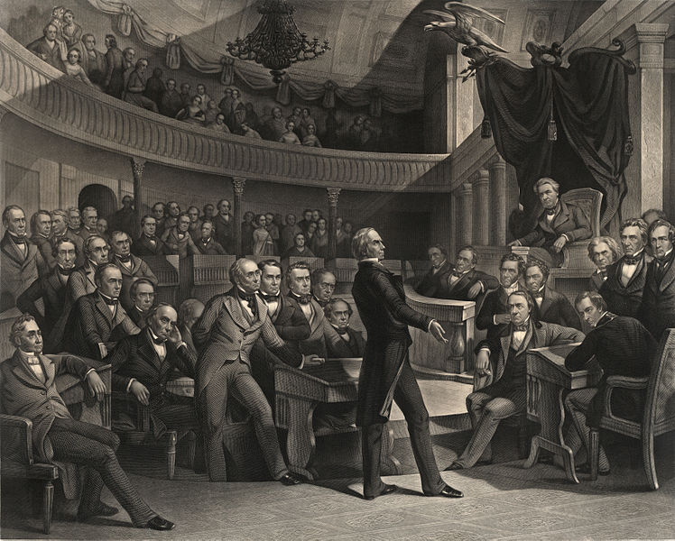
The Sectional Debate Cont.
The fate of the newly acquired land:
  As long as they were territories, the federal government would decide the fate of slavery
**Personal Liberty Laws**:
  Laws passed by Northern states that barred involvement in returning runaway slaves
Compromise of 1850: (5 parts)
  Popular Sovereignty in the Mexican Cession
  California is admitted as a free state (free states have an advantage in the Senate)
  More strict fugitive slave law (leads to more personal liberty laws in the north)
  Slave trade is outlawed in DC
  Texas paid money to relinquish some land in dispute

Slide 8
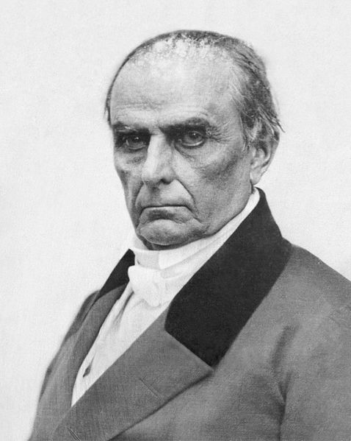
The Sectional Debate Cont.
Compromise of 1850 Continued:
  End of the “Great Triumvirate”
  Daniel Webster’s 7th of March Speech
    Urged Congress to support Fugitive Slave Act to avoid conflict
  Emergence of Stephen Douglas as a national leader
  “Omnibus” vs. individual bills

Slide 9
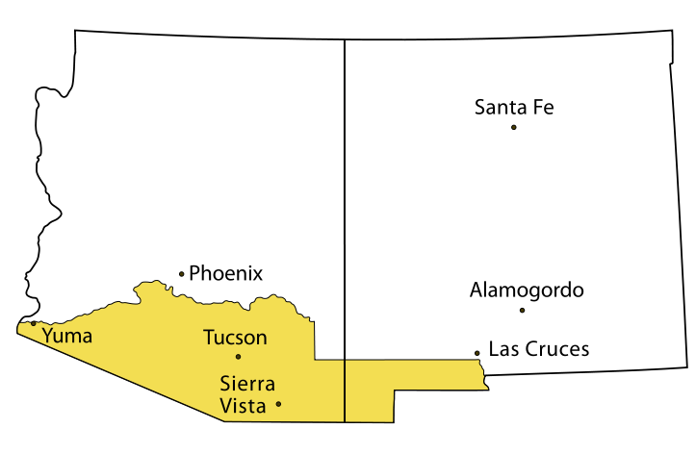
The Crises of the 1850s
North opposes Fugitive Slave Act -> Personal Liberty Laws -> tensions between N and S
Franklin Pierce:
  “Young America”: expansion of US democracy
  Ostend Manifesto:
    Plan to buy Cuba from Spain, if they refused, US would take it by force
    Fear of making Cuba a slave state
Gadsden Purchase:
  Jimmy Fallon “Gadsden Purchase”
  US (Secretary of War - Jefferson Davis) buys land from Mexico for Transcontinental RR

Slide 10
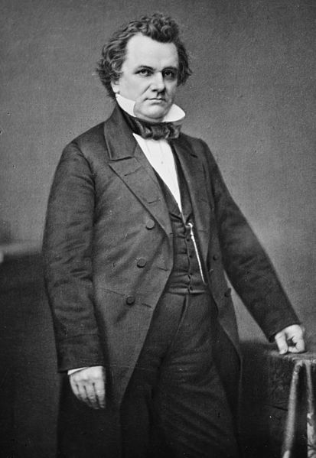
The Crises of the 1850s Cont.
Kansas – Nebraska Act (1854)
  Response to Gadsden Purchase, north wanted RR
  Proposed popular sovereignty in Nebraska Territory
  Overturned MO Compromise
  Presumably, KS would be slave, NB would be free
“Bleeding Kansas”
  Pro and anti-slavery people show up in large numbers to vote
  Burning of Lawrence, KS a free-soil town
  “Caning of Charles Sumner”
  Pottawatomie Creek – response to Lawrence and “Caning”

Slide 11
The Crises of the 1850s Cont.
Free-Soilers:
  Anti-slavery and the extension of slavery
  Believed slavery took away jobs from whites
  Helps morph into the newly formed Republican Party
“Slave Power Conspiracy”
  South sought to expand slavery and must be destroyed
Pro-slavery arguments
  Caused by rebellions and writings
  John C. Calhoun – “A positive good”
  Religious justification
  Racial superiority

Slide 12
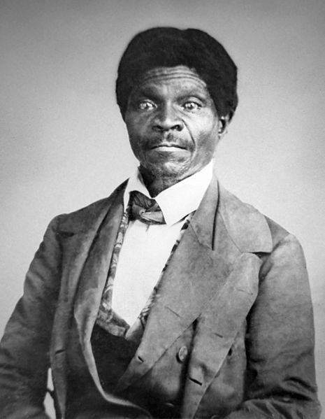
The Crises of the 1850s Cont.
Buchanan (D) elected in 1856 – “Kansas-less”
Panic of 1857:
  “King Cotton” not hit hard…..
Dred Scott v. Sandford (1857):
  Slave that lived in Illinois and Wisconsin, sued for freedom
  Court’s Ruling:
    Scott could not sue because he was not a citizen
    Slaves were property, could not be taken away without “due process” (5th amendment)
    Congress could not eliminate slavery in the territories

Slide 13
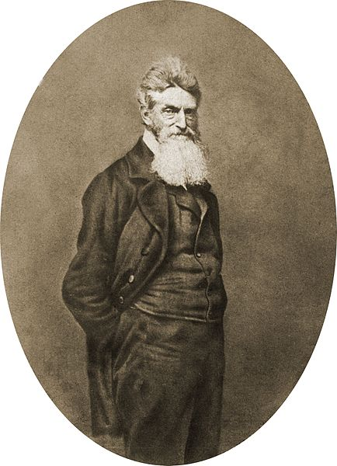
The Crises of the 1850s Cont.
Lincoln
“Lincoln – Douglas” debates
  7 debates for the Senate seat in Illinois
  Douglas (D) wins, but alienates the South in the process
  Lincoln emerges on a national level
John Brown and Harpers Ferry:
  Hoped to incite a slave rebellion
  Many southerners felt that North and Republican Party was filled with “John Browns”
Election of 1860:
  Lincoln wins without receiving a single electoral vote from the South
  Secession begins

Slide 14
Not in the Book, but you should know….
The Impending Crisis of The South
  Written by Hinton Helper
“Fire-eaters”
  Southerners that threatened secession

Slide 15
Thanks for watching!
  Subscribe to my channel
  Help spread the word
Questions? Comments? Ideas for videos?
  Leave in comments
Find out what happened to my wooden leg by watching the Mexican-American War Video
Subscribe
Down here!

