Slide 1
American History: Chapter 14 Review Video
www.Apushreview.com
The Civil War

Slide 2
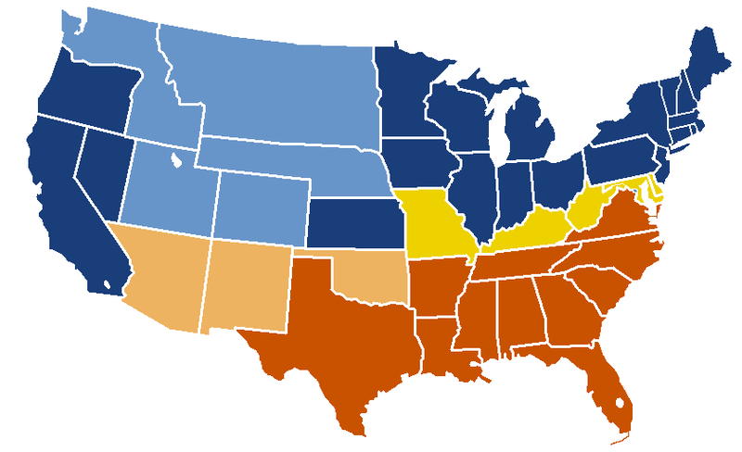
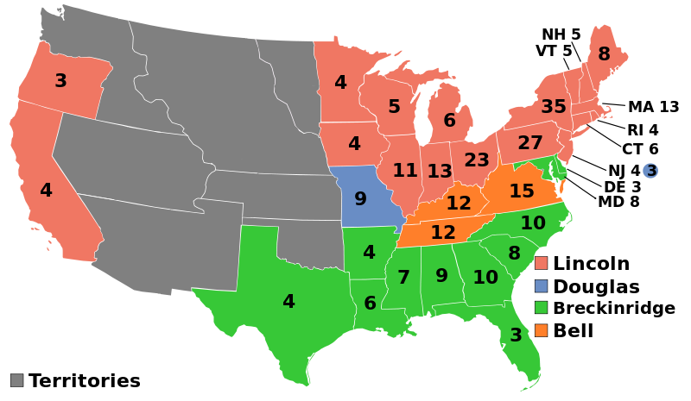
The Secession Crisis
December 20, 1860 – South Carolina convention voted to secede
  6 others followed by March 4, 1861
  Buchanan did little to stop secession in his lame-duck period
Crittenden Compromise:
  Proposed new Constitutional Amendments:
    Guarantee slavery where it was; re-establish MO Compromise line in all US territory (where it was in 1860 and the future)
  Republicans (Lincoln) did not support the plan
    A key part of their platform was the non-extension of slavery
Fort Sumter:
  Confederate leaders ordered the capture of the fort (SC)
  April 12, firing began, on the 14th, the fort surrendered
As Lincoln mobilized for war, 4 more southern states withdrew
  4 slave states remained in the Union (Border States):
    Maryland, Delaware, Kentucky, and Missouri
Note: at the beginning of the war, Lincoln fought “to preserve the union,” NOT TO END SLAVERY

Slide 3
The Secession Crisis Cont.
Northern Advantages:
  Larger population (2 times as much as the South)
  More industry and war production
  Advanced transportation system
Southern Advantages:
  Fighting a defensive war (knew land better)
  Most of white population was united
  Better military leadership
Both the North and South mobilized their economies to fight the war

Slide 4
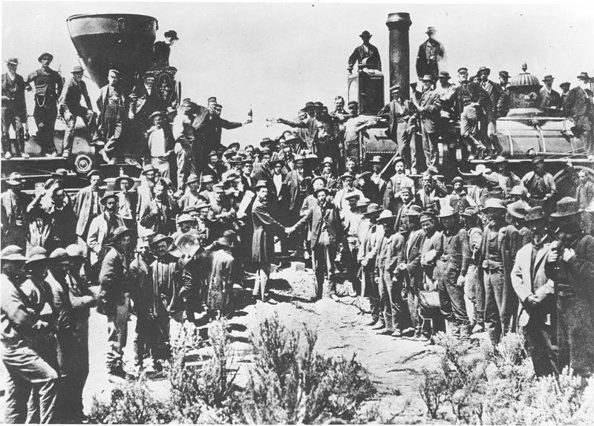
The Mobilization of the North
Economics during the war:
  Homestead Act (1862) – provided 160 acres of land for settlers to move west for a small fee after 5 years
  Morrill Land Grant (1862) – federal land was given to states to use for financing education
    Led to new colleges and universities (Cornell)
  Tariffs were raised to highest level in history to that point
    Republicans dominated Congress, wanted to Raise tariff rates
  Railroad subsidies for transcontinental railroad
    Union Pacific and Central Pacific – met in 1869
  National Bank Acts – banks could join and issue treasury notes
How did the country finance the war?
  Taxes and borrowing $ - bonds

Slide 5
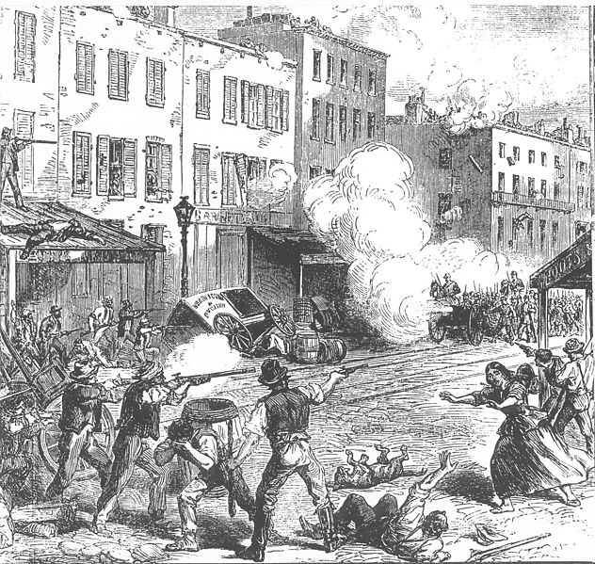
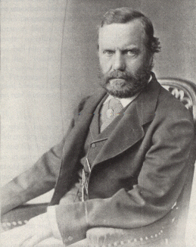
The Mobilization of the North Cont.
Conscription:
  Congress instituted a draft
  Wealthy individuals could hire substitutes for $300
  The Civil War was seen as a “rich man’s war, but a poor man’s fight.”
NYC Draft Riots:
  100 + deaths over 4 day span
Executive power during the war increased drastically:
  Lincoln sent troops into battle and increased military size without Congressional approval
  Suspended habeas corpus (only Congress can) and shut down newspapers in Maryland
Election of 1864:
  Lincoln v. George McClellan (former Union general)
  Lincoln won electoral vote in landslide, close popular vote

Slide 6
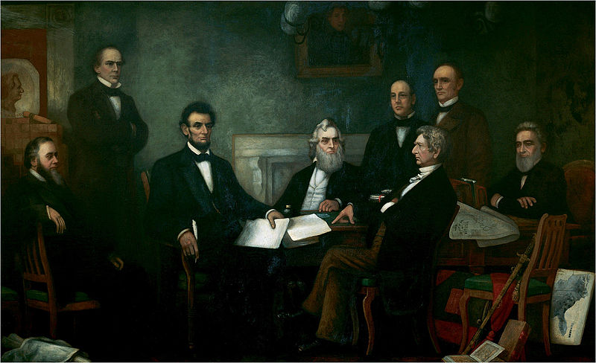
The Mobilization of the North Cont.
Early Emancipation:
  Confiscation Act (1861) – slaves used in Southern military effort would be considered free
  1862 law abolished slavery in DC
  Confiscation Act (1862) – president could use freed slaves as soldiers
Emancipation Proclamation:
  Executive order to free all slaves in areas of the Confederacy that were in rebellion
    Did NOT include areas under Union control nor the border states
  Changed the war effort to end slavery in addition to preserving the Union
  Helped keep Europeans from siding on behalf of the South

Slide 7
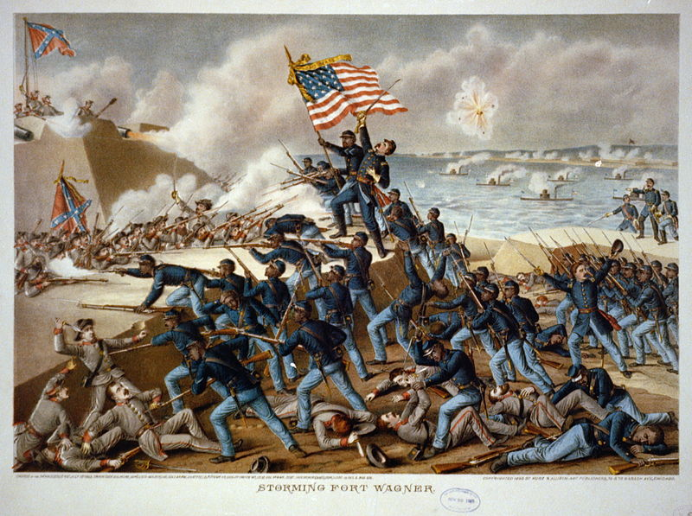
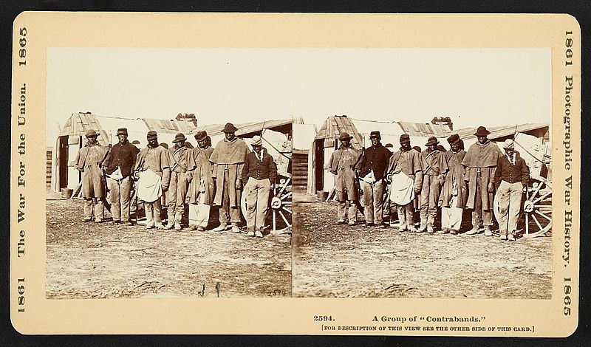
The Mobilization of the North Cont.
African Americans during the war:
  Escaped slaves were considered “Contraband” and would not be returned
  Black enlistment increased post-Emancipation Proclamation
  54th Infantry – black soldiers that fought for the North
    “Glory”
  Unfortunately, black soldiers were paid less and often did arduous manual labor
Women and the War:
  Most women entered nursing
  National Women’s Loyal League (1863)
    Founded by Elizabeth Cady Stanton and Susan B. Anthony hoped to eliminate slavery and gain women’s suffrage

Slide 8
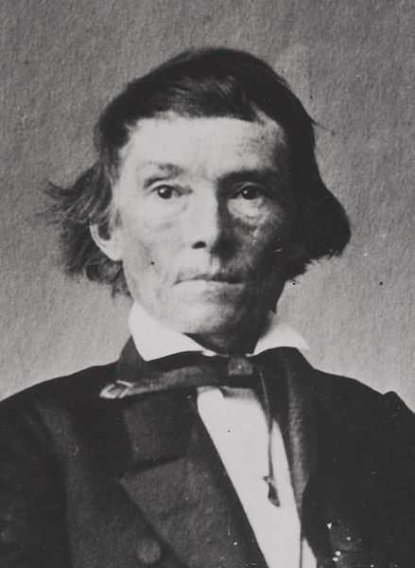
The Mobilization of the South
Government of the Confederacy:
  Most power resided in states
  President – Jefferson Davis, Vice-President – Alexander Stephens
Confederate Economics:
  No uniform currency system led to high inflation – 9,000% during the war!
The Confederate government authorized the impressment of slaves and a “food draft”
The role of Southern women changed drastically:
  Wives were put in charge of farming as husbands fought
  Widowed women had to find jobs to support themselves and families

Slide 9
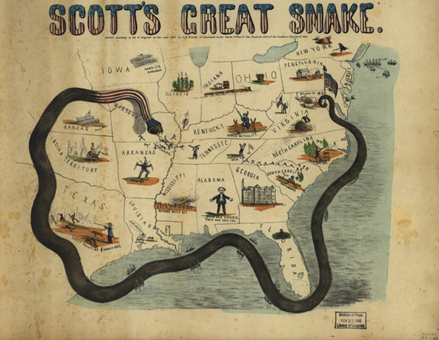
Strategy and Diplomacy
The South had better military leadership than the North
  Ulysses S. Grant was not in charge of the war effort until March 1864
Northern navy was vastly superior to the Southern navy
  North blockaded the South
  Navy aided in transportation of supplies and troops

Slide 10
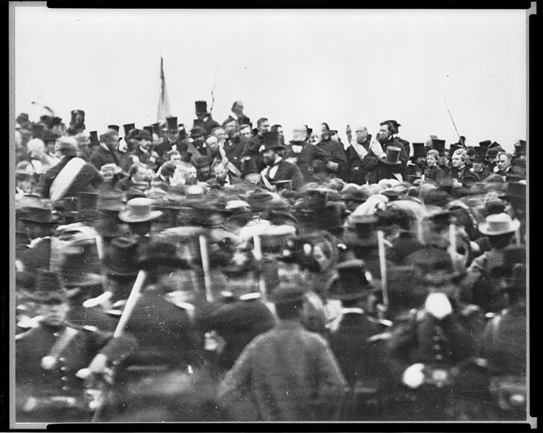
The Course of Battle
618,000 American died in the war
Key Battles:
  Antietam:
    Bloodiest day of the war, led to Emancipation Proclamation
  Gettysburg:
    July 1-3, 1863, led to the….
Gettysburg Address:
  Issued on November 19, 1863
    Dedicated the battlefield as a cemetery
  Referenced the Declaration of Independence
    4 score and 7 years ago (87 years ago)
  “we here highly resolve that these dead shall not have died in vain—that this nation, under God, shall have a new birth of freedom—and that government of the people, by the people, for the people, shall not perish from the earth.”
Sherman’s March to the Sea:
  Destroyed land and supplies of the South
  “War is Hell”
Appomattox Courthouse:
  Surrender of General Lee on April 9, 1865

Slide 11
Thanks for watching!
  Subscribe to my channel
  Press the “Like” button
Questions? Comments?
  Leave in comments
Subscribe
Down here!

