Slide 1
American History: Chapter 15 Review Video
www.Apushreview.com
Reconstruction And The New South

Slide 2
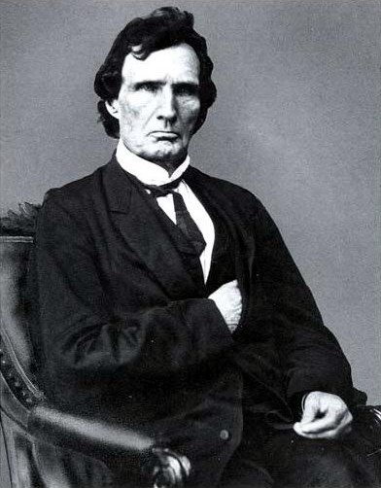
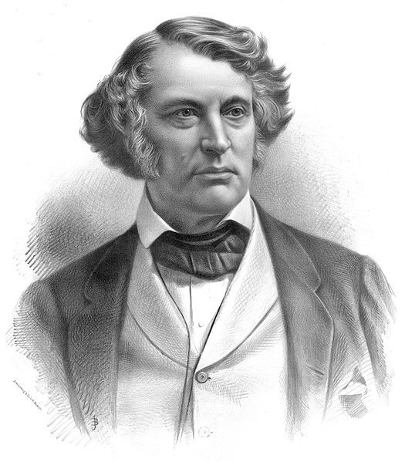
The Problem of Peacemaking
Reconstruction questions:
How should the South be readmitted?
Should leaders be punished?
Radical Republicans:
Thaddeus Stevens and Charles Sumner
Wanted harsh punishments for the South and its leaders
Wade-Davis Bill: (1864)
Majority of white males must pledge allegiance , abolish slavery in state constitutions, and disenfranchise Confederate leaders
Pocket-vetoed by Lincoln
Presidential Reconstruction plans
Lincoln’s 10% Plan: (1863)
Much more favorable than Radical Republicans
10% of voters in 1860 election took oath of loyalty
Lincoln hoped to extend suffrage to certain African-Americans
Johnson’s Plan: (1865)
Favored oath of allegiance, could pardon wealthy Confederates
Favored appointing a governor for each state
By end of 1865 all seceded states met requirements of Lincoln’s or Johnson’s plans

Slide 3
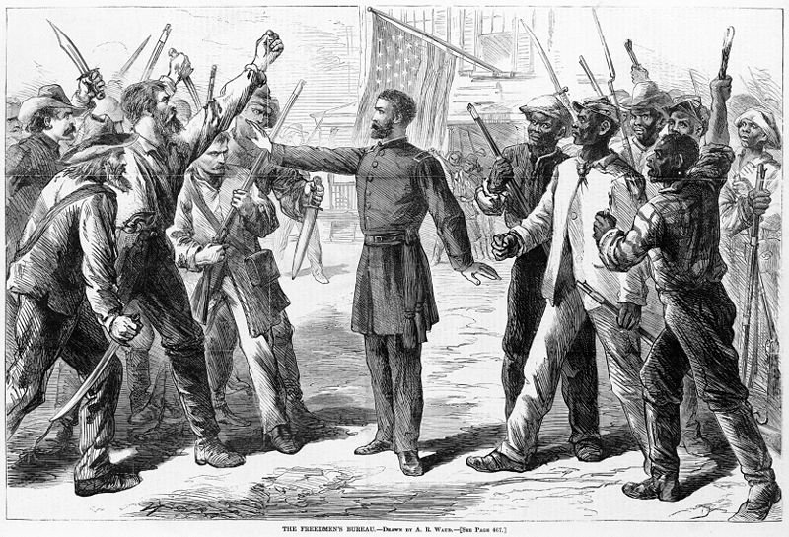
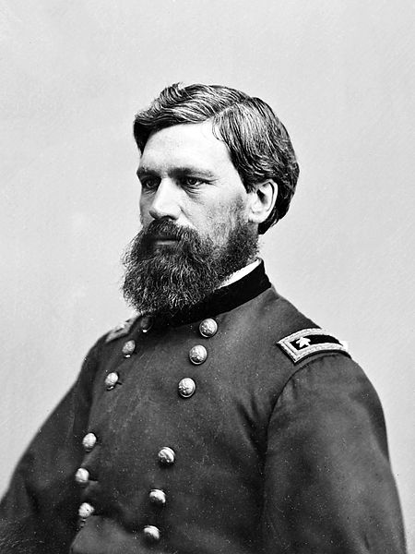
The Problem of Peacemaking
20% of the adult white male population died
“Lost Cause”:
Looking fondly at the South as it was pre-Civil War
Leaders were revered
Many whites wanted to preserve this culture and way of life
Differing views of “freedom”
Southern whites – freedom from the North and federal government
African Americans – same rights and protections as whites
Freedmen’s Bureau:
General Oliver Howard
Provided food, education, and assistance to former slaves and poor whites
Its biggest success was in EDUCATION!

Slide 4
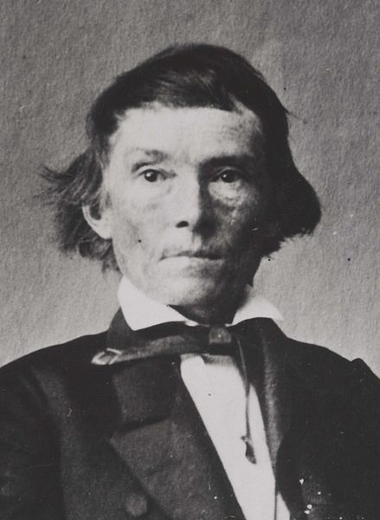
Radical Reconstruction
Why did Congress refuse to recognize Southern governments and begin “Radical Reconstruction?”
“Black codes”:
Harsh laws for African-Americans, could be arrested for being unemployed
Many Southern states elected high ranking Confederates to Congress
Alexander Stephens – Former VP of CSA became a Senator from GA
Civil Rights Act of 1866:
Like almost all acts, it was vetoed by Johnson, then overridden by Congress
Granted Citizenship to African Americans
13th Amendment:
Abolished slavery
14th Amendment:
Granted citizenship to those born in US, and guaranteed “privileges and immunities”
Would reduce representation in Congress if a state denied suffrage to adult males
Former Confederates could NOT hold office

Slide 5
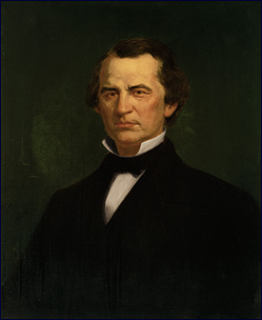
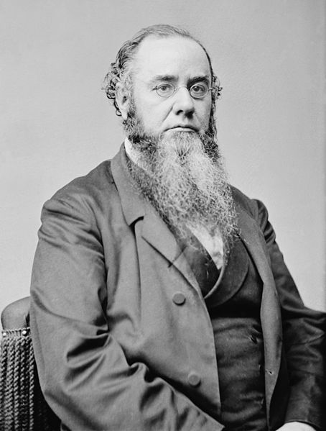
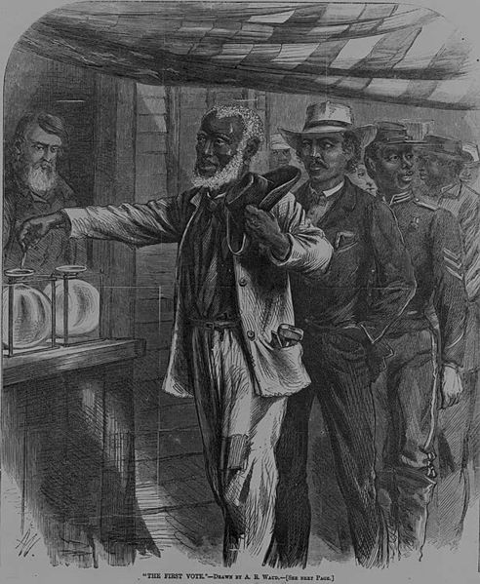
Radical Reconstruction
Congressional Reconstruction:
TN first state to be readmitted to Congress
The rest of the South was divided into 5 military districts
Congress must approve the state constitutions
3 states still not readmitted – (VA, TX, and MI)
15th Amendment:
Suffrage could not be denied based on “race, color, or previous condition of servitude”
Ex Parte Milligan:
Military courts were unconstitutional where civil courts could be used
Went against Reconstruction in the South
Radicals threatened to disrupt the Supreme Court
Johnson is impeached:
Violated the Tenure of Office Act:
President must get consent of Senate before removing cabinet members
Johnson is impeached, however, he is NOT removed from office

Slide 6
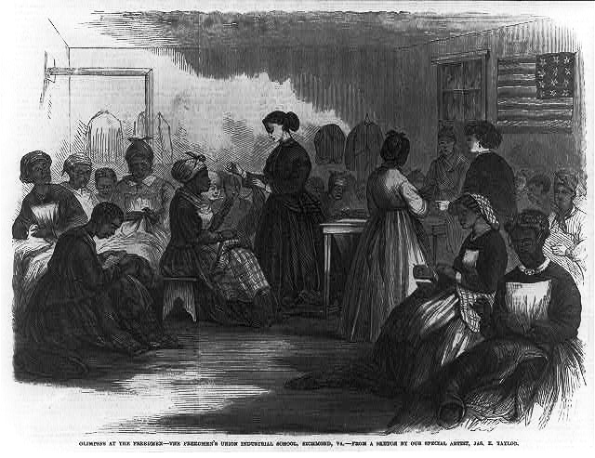
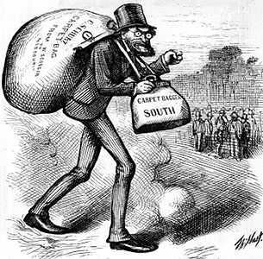
The South In Reconstruction
African-Americans made up a voting majority in SC, MI, LA, AL, and FL
Republicans benefited from this
Key terms to know:
Scalawags: Southerners that favored Reconstruction (mostly for economic reasons)
Carpetbaggers: Northerners that moved South during Reconstruction:
Doctors, lawyers, teachers
African-Americans:
Served as delegates to many state constitutions
20 became members of the House, and 2 in the Senate
Education:
Huge accomplishment during Reconstruction
By mid 1870s, 50% of white children, and 40% of black children went to school
South began to create segregated schools

Slide 7
The South In Reconstruction
“40 Acres and a Mule”
Never really happened, although some African Americans did gain land under the Freedmen’s Bureau
Sharecropping:
Renting land and paying via crops
If a drought or poor farming hit, tenants would be in trouble
Crop-Lien:
Receiving credit from a local store, usually at a HIGH rate (50-60%)
Usually led to debt for borrowers
African-American Women:
Usually worked in domestic tasks
50% of black women worked for money; most were married

Slide 8
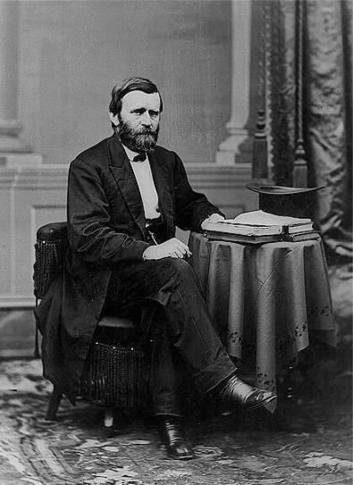
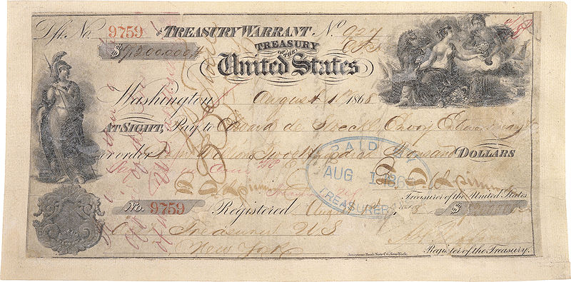
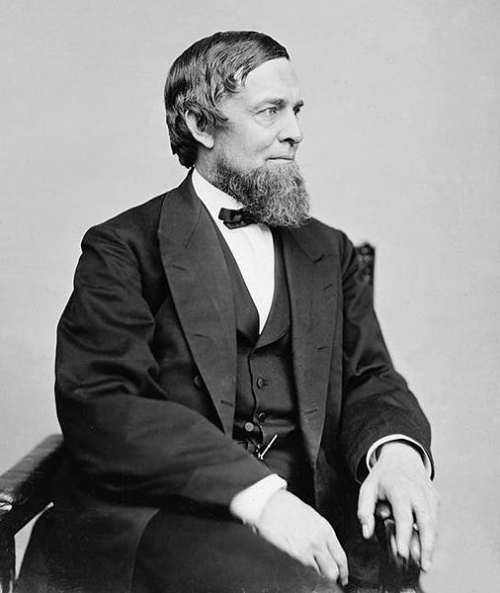
The Grant Administration
Most of his administration is associated with “scandal and corruption”
Regularly used the Spoils System
Republican Party split for the 1872 election over “Grantism”
In the end, Grant served two terms, 1869-1877 (tried for a third later)
Credit Mobilier:
Union Pacific RR company created bogus contracts to make $
Members of Congress, and Grant’s VP accepted bribes
Whiskey Ring:
Government officials were creating false tax reports
Secretary of War accepted bribes
Panic of 1873:
Worse depression of the century to that point
Began by over-investing in RRs
Debtors favored printing paper $ - increase money supply -> inflation -> easier to pay off debt
Specie Resumption Act:
New certificates would be based on gold; eliminate greenbacks
Seward’s Folly - 1867 (Not part of Grant)
William Seward purchased Alaska from Russia
Seen as a mistake by some, later produced large oil reserves

Slide 9
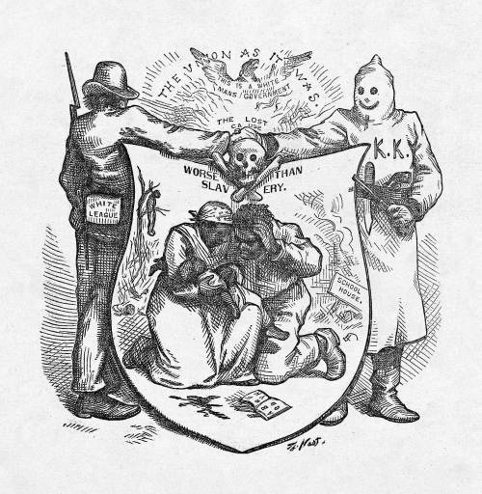
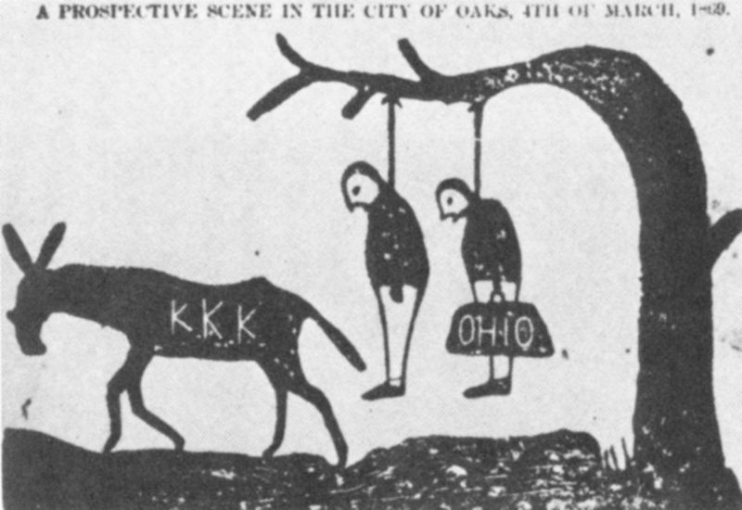
The Abandonment of Reconstruction
By 1877, Democrats “redeemed” 7 states in the South
Red Shirts and White League:
Forced whites to join the Democratic Party, monitored elections
KKK:
Terrorist organization that used to intimidate and prevent blacks from voting
Enforcement Acts: 1870-1871
Response to the KKK
Federal government could now prosecute criminals of federal law
President could use the military to protect individual rights
The Panic of 1873 weakened support for Reconstruction

Slide 10
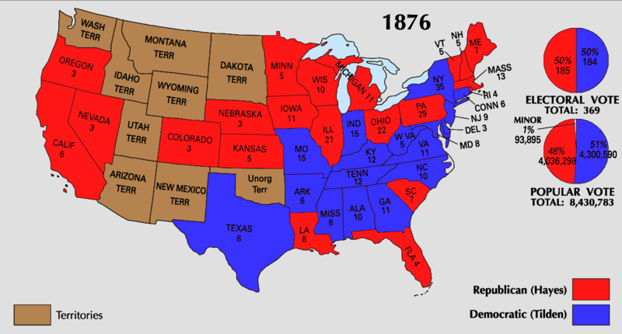
The Abandonment of Reconstruction
Compromise of 1877:
Hayes (Republican) v. Tilden (Democrat)
Tilden received 184 electoral votes to Hays 165; 185 needed to win
20 votes were in dispute
Eventually, all 20 were given to Hayes
Importance of the Compromise of 1877?
RECONSTRUCTION ENDS!
The military is withdrawn from the South
Many African-Americans felt betrayed
Legacy of Reconstruction:
Mostly a failure
Civil Rights not fully addressed

Slide 11
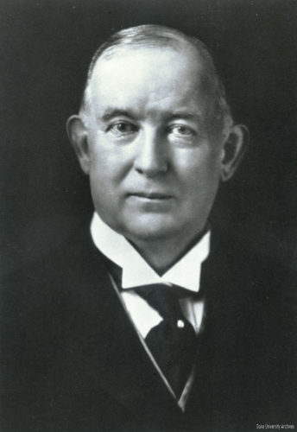
The New South
By 1878, all Southern states had been “redeemed” by Democrats
Education decreased
“schools are not a necessity”
Industrialization came slowly at first
James Duke – American Tobacco Company
RRs increased drastically in 1880s
Used the same gauge as the North (standard gauge)
Many factories refused to higher African-Americans
Those that did paid little and provided harsh jobs
Black colleges increased

Slide 12
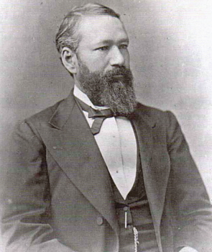
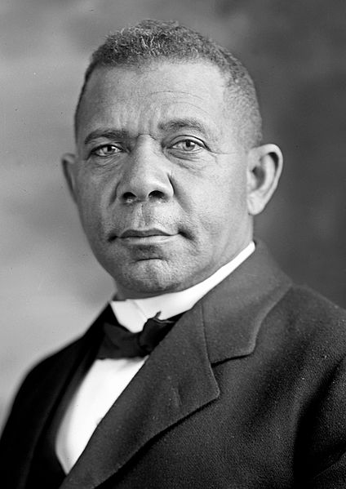
The New South
Booker T. Washington (former slave):
Tuskegee Institute
Advocated blacks to gain an education (vocational training)
Learning skills (today – plumbing, auto repair, etc.)
Believed African-Americans should “adopt the standards of the white middle class”
Economic gains before Social gains
The Atlanta Compromise:
African-Americans would NOT challenge segregation if they had economic opportunities
Civil Rights Cases of 1883:
14th Amendment did not prevent private discrimination, only government discrimination
Plessy v. Ferguson:
Established “Separate but equal”

Slide 13
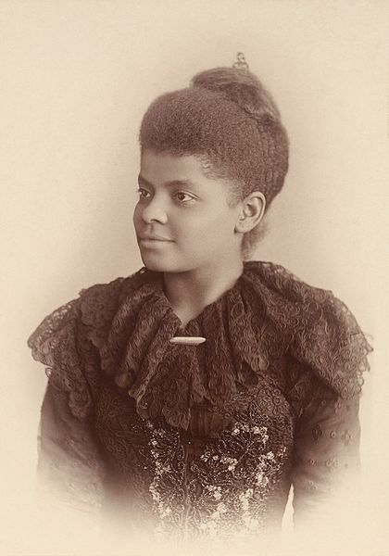
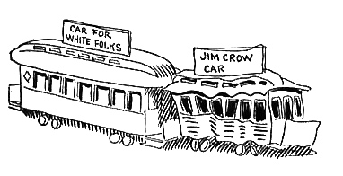
Disenfranchising African-Americans
Poll taxes:
Required a tax to vote
Literacy Tests:
Required to pass a test to vote
African-Americans often received a much harder test
Grandfather clause:
Poll taxes and literacy tests were not required to vote if their ancestors could vote in the election of 1860
Blacks could not vote in 1860
Jim Crow laws:
Legal segregation in the South
Upheld by Plessy v. Ferguson
Lynching:
Increased drastically in the 1890s
Ida B. Wells
Journalist that spoke out against lynching

Slide 14
Thanks for watching!
Subscribe to my channel
Help spread the word
Questions? Comments? Ideas for videos?
Leave in comments
Subscribe
Down here!

