Slide 1
American History: Chapter 16 Review Video
www.Apushreview.com
The Conquest of the Far West

Slide 2
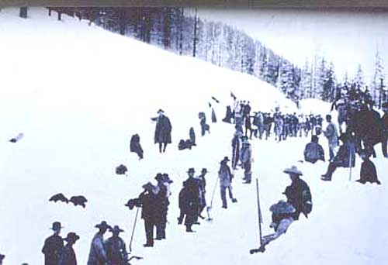
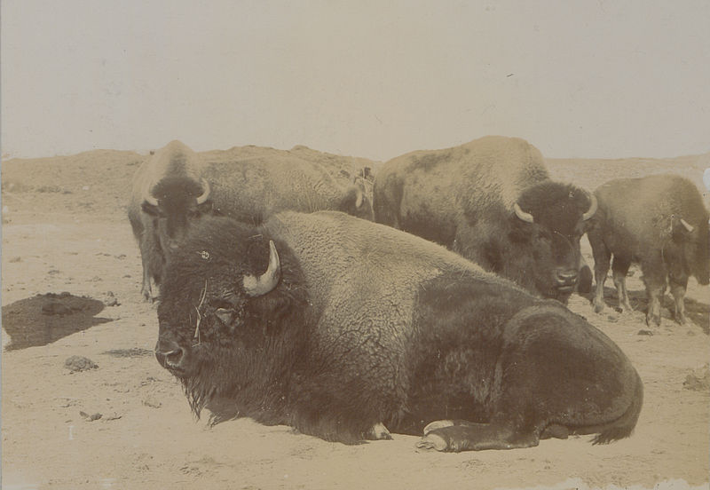
The Societies of the Far West
Plains Indians:
  Sioux – hunted buffalo
  Relied heavily on horses – introduced by Europe
Many Indians were still vulnerable to diseases
As railroads expanded (1880s – 1890s), Indian life was drastically altered:
  Lost land, buffalo almost became extinct
Chinese immigration:
  Settled in California, worked in gold mines and railroads
  Were discriminated against - hard to unionize – language barriers
  Lived and worked in cities

Slide 3
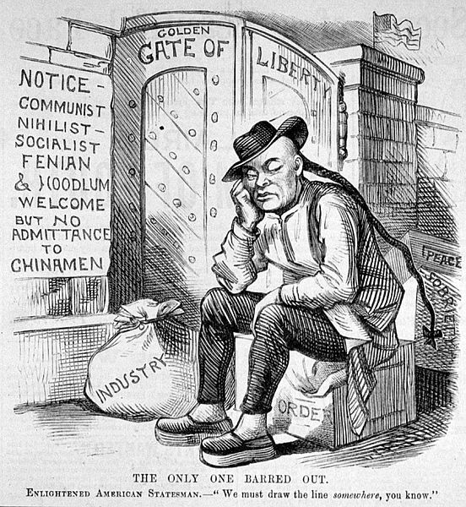
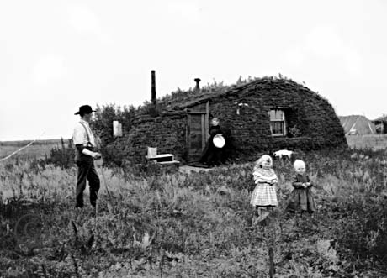
The Societies of the Far West
Anti-Chinese Sentiment:
  Anti-Coolie clubs:
    Wanted to ban Chinese employment
  Workingmen’s Party:
    Party that emerged based on hostility to Chinese
  Chinese Exclusion Act of 1882
    Banned Chinese immigration, made it harder for those in America to become citizens
Western Settlement:
  Homestead Act (1862):
    160 acres of low cost land, must live on and improve it for 5 years
    Not always the best land, fraud by corporations
  1869 – completion of the transcontinental RR
  Timberland Culture Act (1873), Desert Land Act (1877)
    Opportunities for additional land if improvements were made
Utah admitted as a state in 1896 – abandoned polygamy

Slide 4
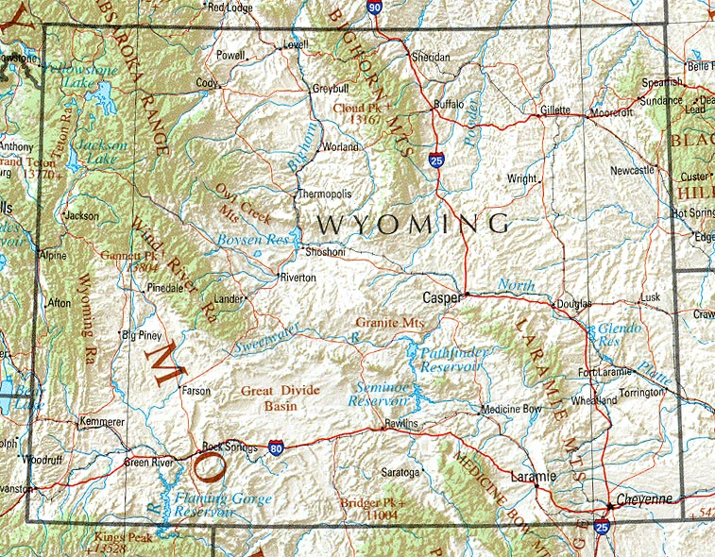
The Changing Western Economy
West became increasingly connected to east:
  RRs, cattle, mining, etc.
The West was often seen as a place of opportunity for all
  “safety-valve” theory – in tough economic times, one could always move West and start anew
Labor in mines was very arduous and dangerous
Cattle:
  Large business for some (TR tried in the 1880s)
  Could be unstable – winters of 1885-86 and 1886-87
Women’s suffrage was higher in the West than East:
  Wyoming was the first state to guarantee women’s suffrage

Slide 5
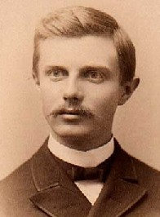
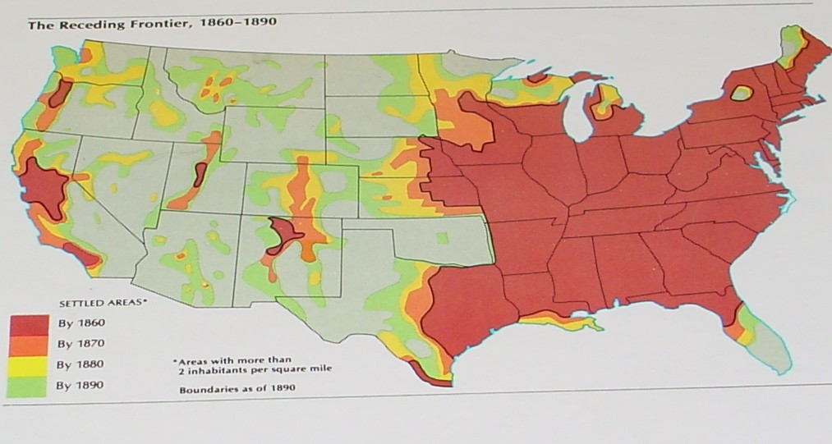
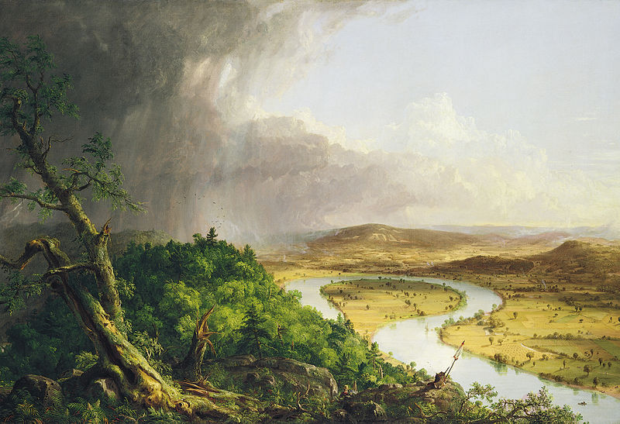
The Romance of the West
Rocky Mountain School
  Similar to ***Hudson River school**** - painted landscapes
Why was the West so appealing?
  The Virginian - romanticized the cowboy
  West was seen as the last frontier
***Frederick Jackson Turner***:
  The Significance of the Frontier in American History
    Frontier ended in 1890 (used census data)
    Frontier gave America a unique identity, promoted democracy

Slide 6
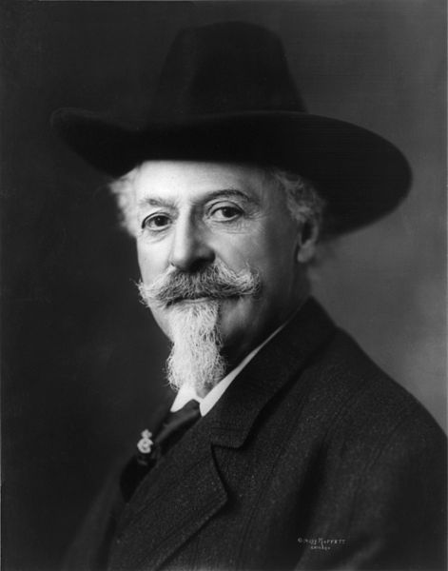
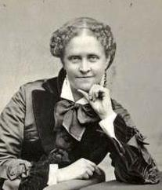
The Dispersal of the Tribes
***Helen Hunt Jackson***
  A Century of Dishonor – chronicled deceit, abuse, and broken treaties between federal government and Native Americans
During and after Civil War, conflicts increased between government and Natives
Indian Peace Commission:
  Recommended to move Plains Indians to reservations in Oklahoma and the Dakotas
Bureau of Indian Affairs:
  Created to distribute land and supplies; not very successful
Buffalo:
  Almost became extinct – RR companies, “Buffalo Bill Cody”

Slide 7
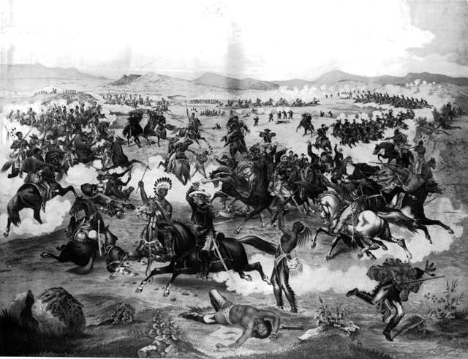
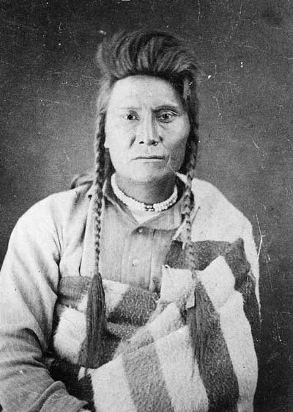
The Dispersal of the Tribes
  “I am tired. My heart is sick and sad…. I will fight no more forever.”
Conflicts with Native Americans
Sand Creek Massacre:
  133 Natives were killed, 105 were women and children
“Indian Hunting”
  California, 5,000 Natives were massacred between 1850 - 1880
  150,000 Natives in CA prior to Civil War, 30,000 in 1870
Battle of Little Bighorn (Custard’s Last Stand):
  George Custard and 264 members of regiment were killed
Nez Percé
  Chief Joseph urged members to flee, almost made it to Canada

Slide 8
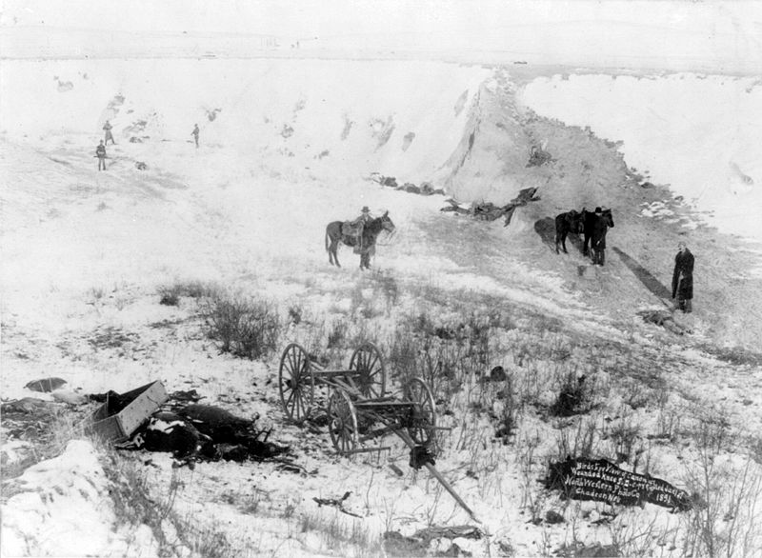
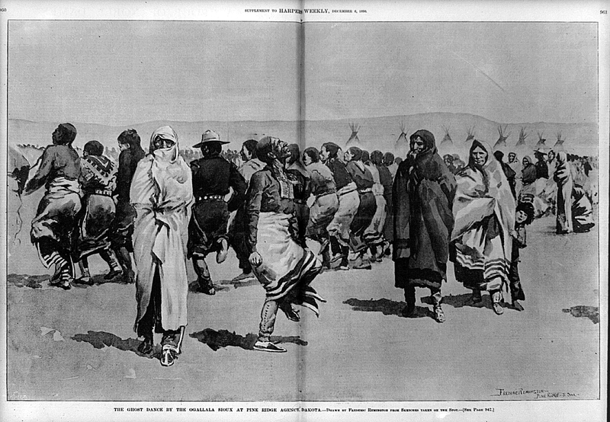
The Dispersal of the Tribes
***Ghost Dance***
  Ritual that believed buffalo would return and whites would leave Natives alone
  Government wanted to end the Dance
***Wounded Knee*** 1890
  Fighting between soldiers and Natives in South Dakota
  40 soldiers, 300+ Natives were killed (many women and children)
***Dawes Act***
  Purpose was to ***assimilate*** or “Americanize” Natives
  Eliminated tribal lands, provided 160 acres of land for individuals
  Some children sent to boarding school
  Promoted Christianity

Slide 9
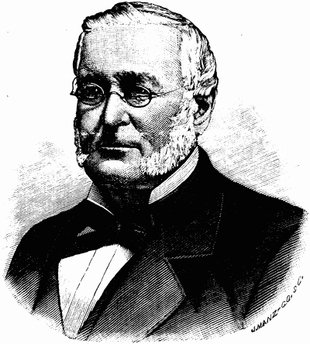
The Rise and Decline of the Western Farmer
1862, Congress authorized and subsidized transcontinental routes
  1869 – met in Utah
State governments encouraged RR development also:
  Financial aid and land
RR companies advertised to attract settlement of lands
Joseph Glidden and I.L. Ellwood:
  Developed and marketed barbed wire – hurt ranches
Farms produce so much, prices drop, bankrupting some farms
Farmers’ Grievances:
  RRs – unfair pricing, warehouse facilities
  High interest rates by banks
Farmers advocated increasing the money supply

Slide 10
Thanks for watching!
  Subscribe to my channel
  Help spread the word
Questions? Comments? Ideas for videos?
  Leave in comments
The Frontier may have ended, but APUSH Review videos will not!
Subscribe
Down here!

