Slide 1
American History: Chapter 17 Review Video
www.Apushreview.com
Industrial Supremacy

Slide 2
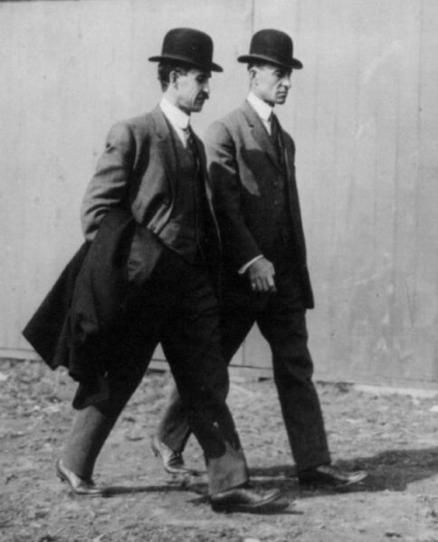
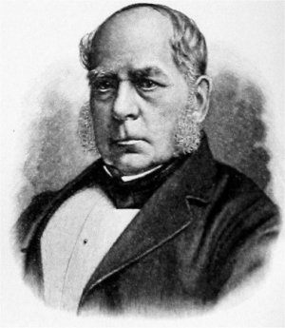
Sources of Industrial Growth
Henry Bessemer and William Kelly:
  Bessemer Process – converted iron into much stronger steel
  Steel used in RRs, construction, etc.
Steel industry booms in Ohio and PA
  Abundance of iron ore
Oil – Drake’s Folly - PA
  Originally used in lamps
Henry Ford:
  Made cars affordable – moving assembly line
  Raised wages for his workers
Wright brothers – from OH
  First in flight
  Lindberg’s flight in the 1920s boomed industry

Slide 3
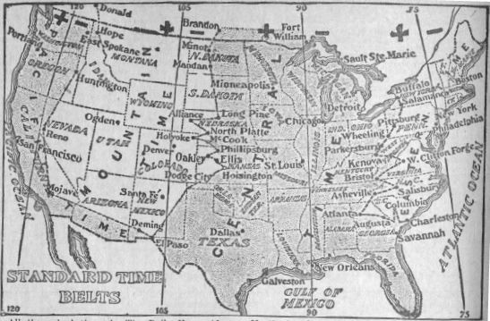
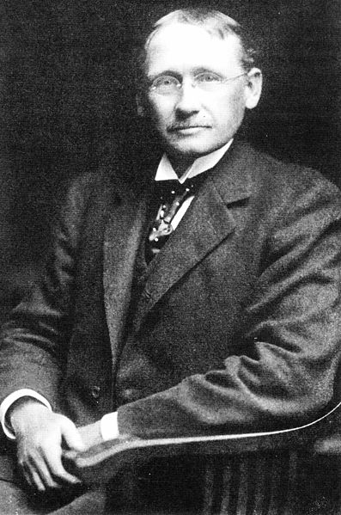
Sources of Industrial Growth
***Taylorism*** - Frederick Taylor
  Subdivided tasks, each individual had a specific task
  Made workers interchangeable, less reliance on skilled workers
RR expansion affected other industries
  Lumber industry cut down forests,
  Chicago became main hub - slaughterhouse
  Time zones

Slide 4
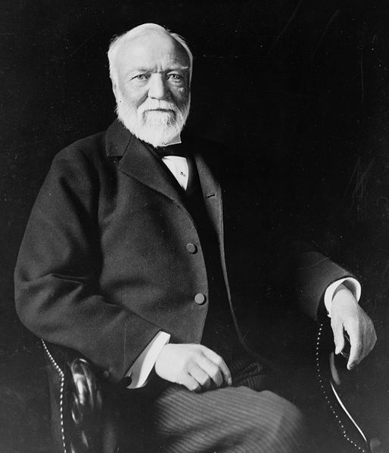
Sources of Industrial Growth
Corporations:
  Group of stockholders own a business
  Limited liability:
    Owners can only lose value of stock if company goes bankrupt
Carnegie:
  Steel – Pittsburgh
  Owned all aspects of steel production
***Horizontal Integration***
  Buying businesses in a similar industry
  Later deemed illegal - monopolies
  Ex. – Standard Oil
***Vertical Integration***
  Owning all aspects of production
  Ex. – Carnegie Steel

Slide 5
Sources of Industrial Growth
Pool arrangements:
  Businesses agreed to divide up markets amongst themselves – later illegal
Trusts:
  Originally had a different meaning, later associated with monopolies
“Holding Companies”:
  Would buy up stocks in other companies, thus gaining more power

Slide 6
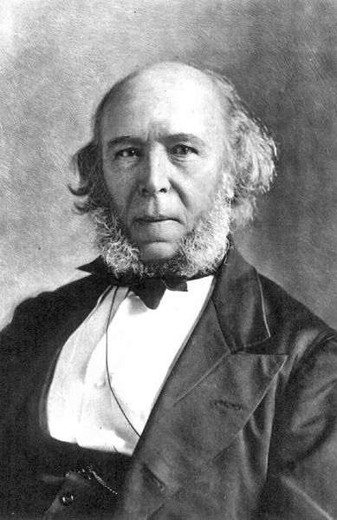
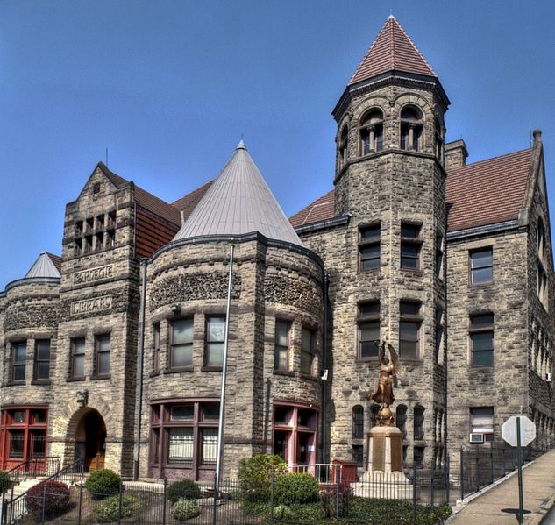
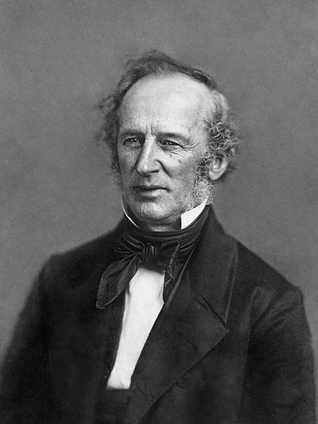
Capitalism and its Critics
Most millionaires were not self-made
Tycoons had tremendous influence:
  Financial contributions to politicians and parties
  “What do I care about the law? H’aint I got the power?”
Social Darwinism:
  Applied Darwin’s ideas to Humans
  Herbert Spencer
    Advocated that the fittest survived
  Appealed to business owners – justified their wealth
***Gospel of Wealth***
  Written by Carnegie
  Wealthy should donate money for the community

Slide 7
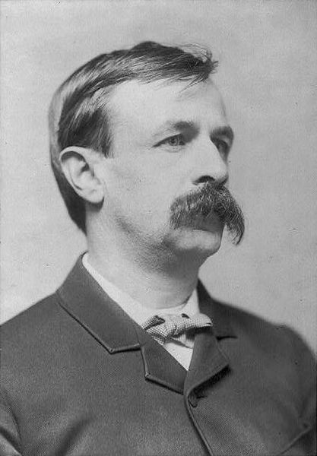
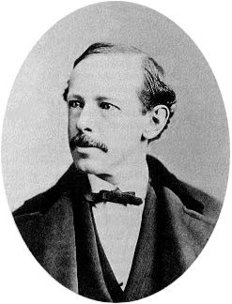
Capitalism and its Critics
Horatio Alger:
  Wrote “rags to riches” stories
  James Garfield
  Sold 100 million copies;
Henry George – Progress and Poverty
  Blamed monopolies for social problems
Edward Bellamy’s Looking Backward
  A man awakes in 2000 in a utopian society – no want, politics and vice
RRs came under attack from many groups
  Charged high rates – especially for farmers

Slide 8
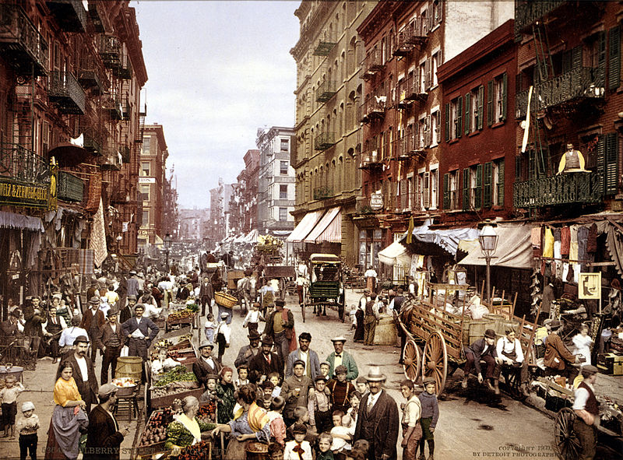
Industrial Workers in the New Economy
Individuals moved from rural to urban areas
  Hoped for new economic and social opportunities
  Immigrants moved to cities
25 million new immigrants between 1865 and 1915:
  ***New Immigrants were from Southern and Eastern Europe***
    Italians, Poles, Russians, Greeks, etc.
Labor Contract Law:
  Allowed employers to recruit laborers by paying for their passage

Slide 9
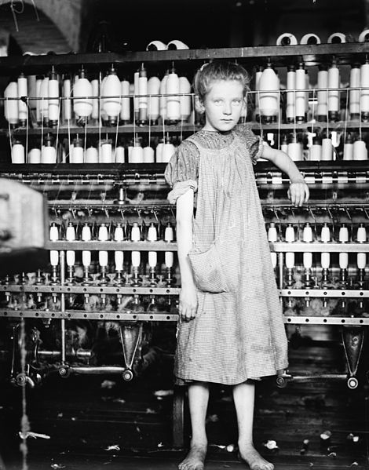
Industrial Workers in the New Economy
Working conditions:
  Long days – 10-12 hours
  Machines replaced some skilled workers
Factories hired more women and children
  Cheaper pay for unskilled work
  Textile industry had largest number of women

Slide 10
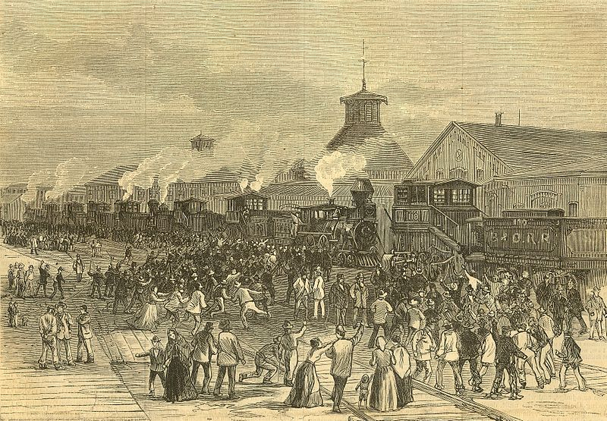
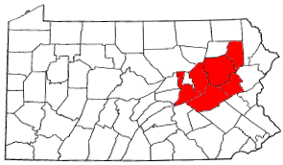
Industrial Workers in the New Economy
Unions (KNOW THIS SLIDE!!)
When in doubt, the government(s) and public will side with owners, not unions
National Labor Union (1866):
  Excluded women workers, feared that it would lower wages
“Molly Maguires”
  Labor organization in PA – used violence
Great RR Strike:
  RRs cut pay by 10%, Hayes ordered troops to stop the strike

Slide 11
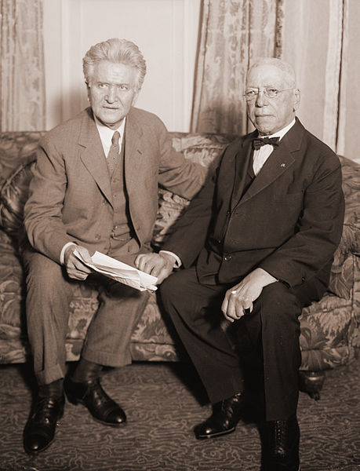
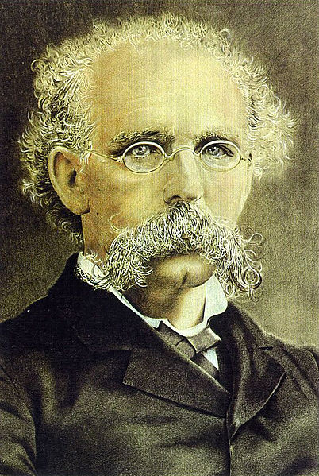
Industrial Workers in the New Economy
Still Know This Slide!
Knights of Labor:
  All workers – men, women, African Americans
    Skilled and unskilled
  Membership grew under Terence Powderly
  Hurt by the Haymarket Square Riot
AFL
  Samuel Gompers
  Only accepted SKILLED workers
  Advocated women should remain in the home
  Focused on “bread and butter issues”
    Collective bargaining, rarely used strikes

Slide 12
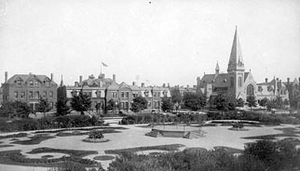
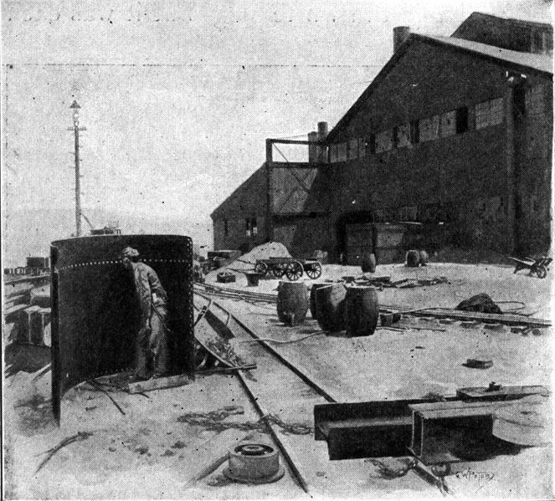
Industrial Workers in the New Economy
Still Know This Slide!
The Homestead Strike:
  Carnegie and Henry Clay Frick wanted to break the union at Homestead
  The plant was shut down, Pinktertons were called in, after fighting, Pinkertons left
  Governor of PA broke up strike with National Guard
Pullman Strike (1894):
  Pullman Palace Car Company cut wages, did not cut rent in towns
  American Railway Union – Eugene V. Debs went on strike
  President Cleveland sent troops to end strike

Slide 13
Thanks for watching!
  Subscribe to my channel
  Help spread the word
Questions? Comments? Ideas for videos?
  Leave in comments
Have you tried my original recipe?
Subscribe
Down here!

