Slide 1
American History: Chapter 18 Review Video
www.Apushreview.com
The Age of the City

Slide 2
The Urbanization of America
1920 Census – more people living in cities than rural areas – why?
Better-paying jobs, entertainment, and cultural experiences
New forms of transportation – RRs, ocean liners
Mechanized farming caused farmers to move – young women
Few good employment opportunities for African Americans

Slide 3
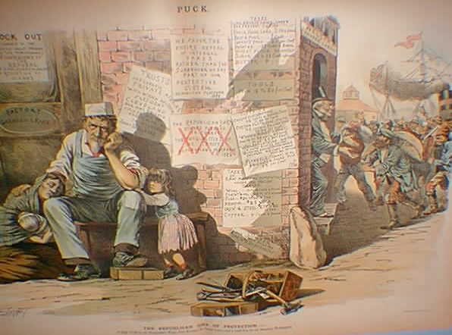
The Urbanization of America
***New Immigration***
1880 – 1920s
Southern and Eastern Europe – Poland, Italy, etc.
Moved to cities – little money to buy farming goods
Nativism increased – different languages, hard to unionize, worked for low wages, unskilled jobs, mostly Catholic
Assimilation:
Process of becoming “American”
2nd generation immigrants were more likely to assimilate
Public schools only taught English

Slide 4
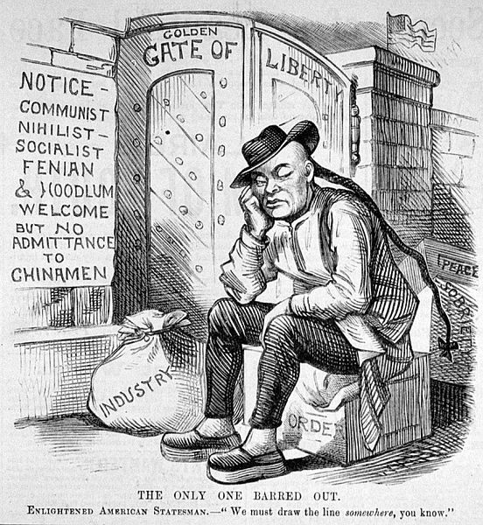
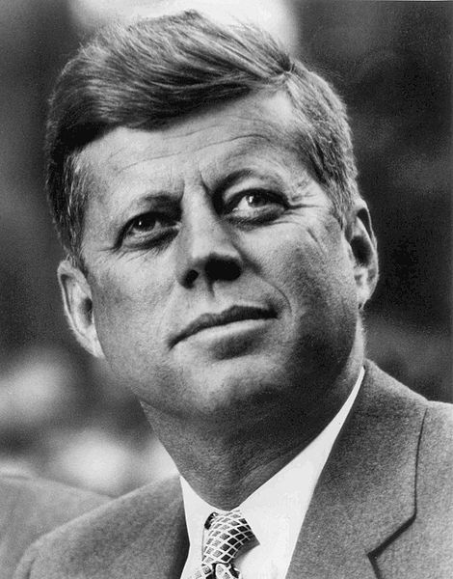
The Urbanization of America
American Protective Association:
Anti-Catholic
Wanted to stop immigration
Similar to the Know-Nothing Party from 1840s-1850s
Immigration Restriction League:
Advocated screening of immigrants
Chinese Exclusion Act – prohibited Chinese immigration
APA, why are you hating on Catholics bros?

Slide 5
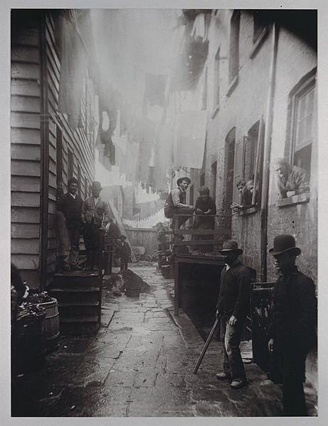
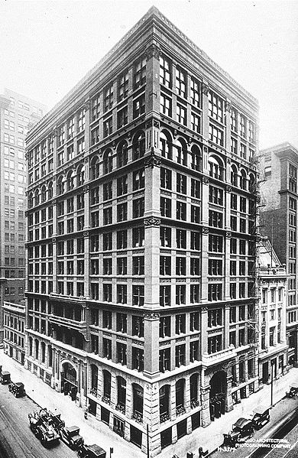
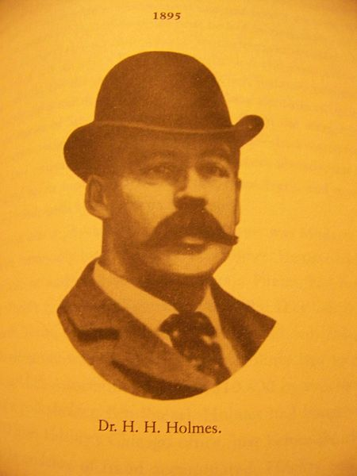
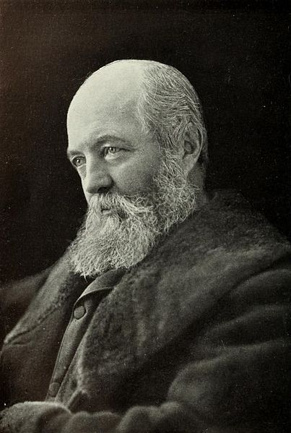
The Urban Landscape
Many parks began to develop
Central Park – Frederick Law Olmstead
Social Class differences over how parks should be used
1893 World’s Fair:
Chicago – “city beautiful” movement
Devil in the White City – Erik Larson
Immigrants lived in crowded cities
Often in poor conditions
Tenement houses – became known as slum houses
***Jacob Riis*** photographed tenement houses in NYC – How the Other Half Lives
New forms of transportation:
Elevated railway – NYC and Brooklyn Bridge
Skyscrapers:
Made possible by steel
Chicago

Slide 6
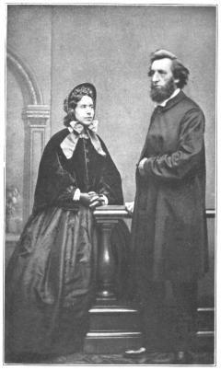
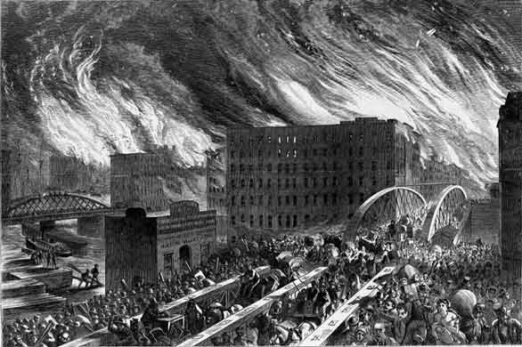
Strains of Urban Life
Disasters in cities:
Chicago and Boston (1871) fires
San Francisco (1906) earthquake -> fire
Disease in cities:
Unsanitary drinking water
Growing number of city residents were poor
Salvation Army (1879)

Slide 7
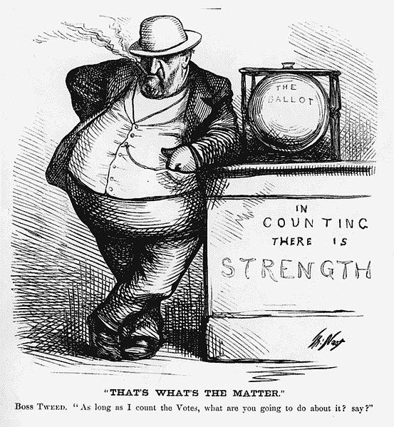
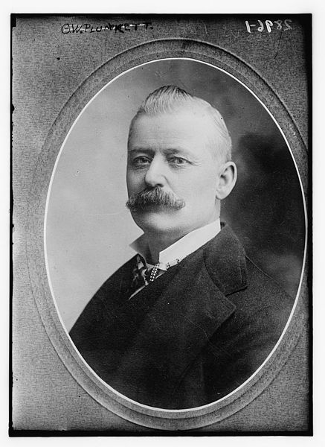
Strains of Urban Life
Political Machines: (Tammany Hall)
Provided jobs and assistance to constituents
Honest Graft:
Inside scoop on government projects
Buy land before government, then resell at a higher price
Dishonest Graft:
Stealing
William “Boss” Tweed
Stole roughly $200 million through fraud
Controlled elections
Ultimately captured due to Thomas Nast’s political cartoons

Slide 8
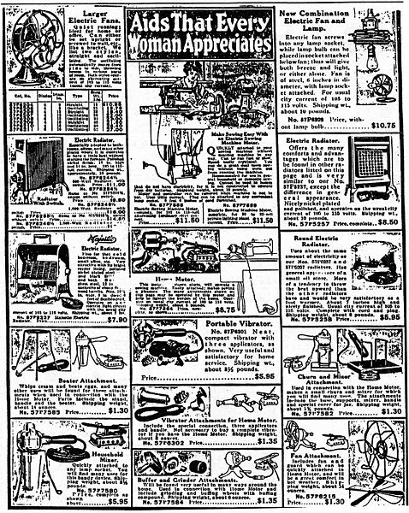
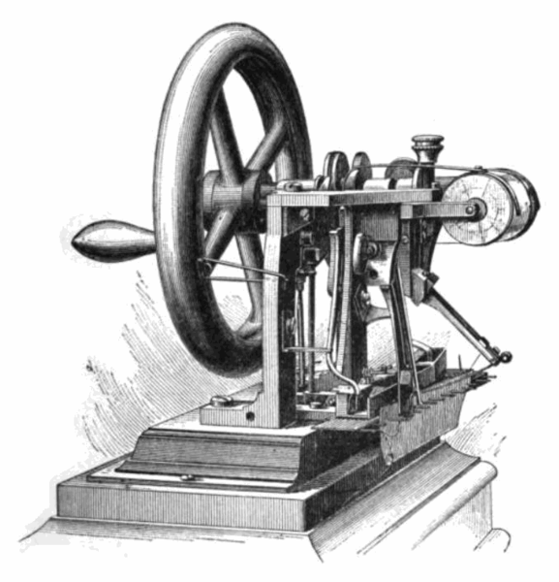
The Rise of Mass Consumption
Many jobs saw a rise in wages
Women, African Americans, and Mexicans were largely left out
Textiles, paper, laundries, etc.
Key inventions that affected industry:
Sewing Machine -> out of homes, into factories and stores
Refrigerated railcar -> farming industry
Changes in shopping
Chain and department stores:
Woolworth’s – dry goods
Montgomery Ward and Sears Roebuck catalogs – helped farmers
Macy’s Department Store
Impact of these new ways of buying goods?
Small businesses were affected
Women advocated consumer protection and improvement in wages and working conditions

Slide 9
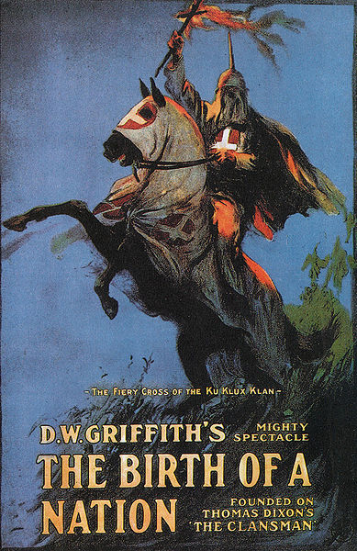
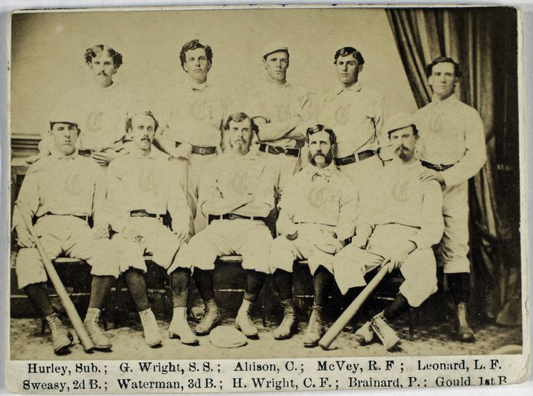
Leisure in the Consumer Economy
“8 hours for work, 8 hours for rest, 8 house for what we will”
Amusement parks – Coney Island
Sports:
Baseball
CINCINNATI RED STOCKINGS!!!! (1869)
1919 World Series Scandal – THE REDS WIN! Wooohoooo
Horse racing – Kentucky Derby
College Football – NCAA
Movies:
Silent films until the 1920s
D.W. Griffith – The Birth of a Nation

Slide 10
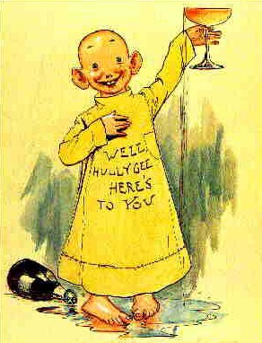
Leisure in the Consumer Economy
The Saloon:
Meeting place for working-class individuals
Important gathering place for political machines
Growth of Temperance:
Response to the saloon and immigrants
Anti-Saloon League:
Hoped to cut down on crime and political machines
Growth of Newspapers:
“Yellow Journalism” – sensationalizing news stories
William Randolph Hearst - Journal
Joseph Pulitzer - World

Slide 11
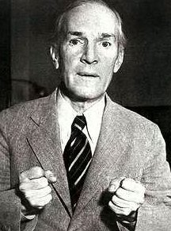
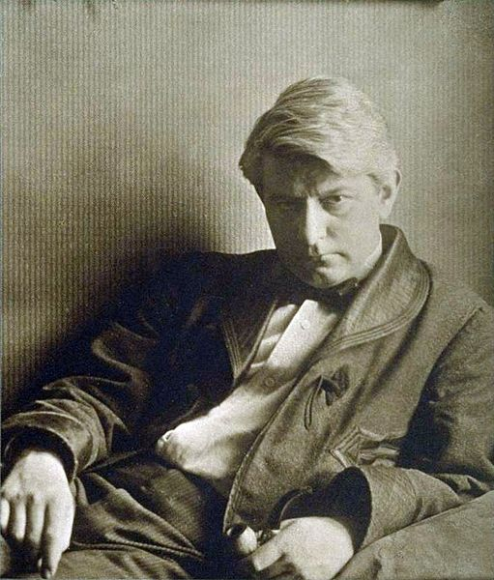
High Culture in the Age of the City
Important Writings:
Frank Norris – The Octopus
Depicted relationship between farmers and railroads
Upton Sinclair – The Jungle
Exposed horrors of meat packing industry
Pure Food and Drug Act, Meat Inspection Act (1906)
Ashcan School:
Artwork that depicted slums and “grim aspects of modern life”
Theory of Evolution (Darwin) challenged religion and schools
Scopes Trial in the 1920s
“Pragmatism”
Ideas were to be tested, not just based on theories

Slide 12
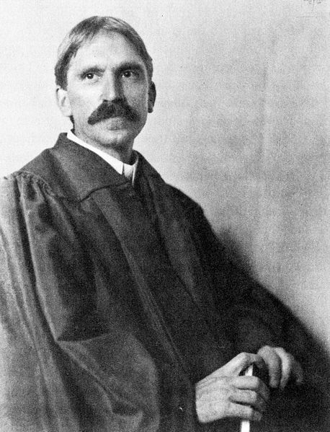
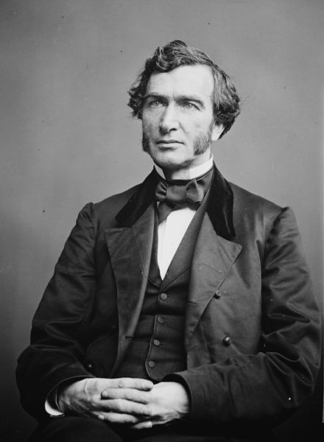
High Culture in the Age of the City
Education
John Dewey:
Hoped to change education
Less reliance on memorization, more on acquiring knowledge through experience
Growth of Education:
Increase in free primary and secondary education
Rural areas still lagged behind
Morrill Land Grant
Land set aside to states by federal government for colleges
Higher education opportunities for women were limited
Some institutions created separate female schools

Slide 13
Thanks for watching!
Subscribe to my channel
Help spread the word
Questions? Comments? Ideas for videos?
Leave in comments
Go Reds!
Subscribe
Down here!

