Slide 1
American History: Chapter 20 Review Video
www.Apushreview.com
The Progressives

Slide 2
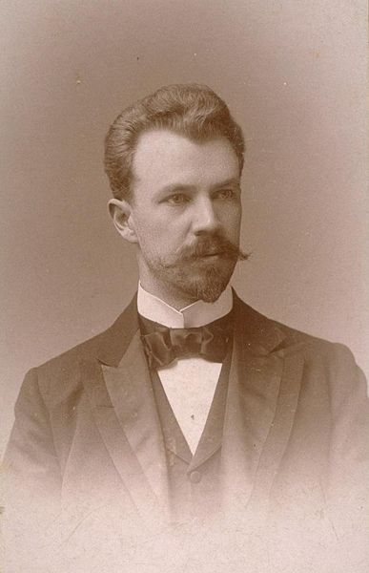
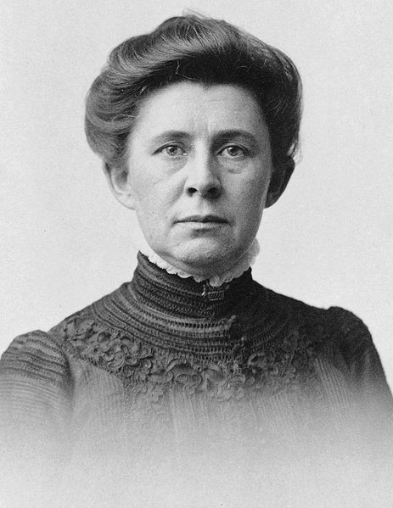
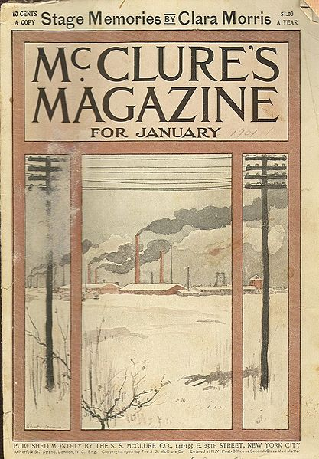
The Progressive Impulse
Who were progressives?
  Mostly middle-class, city-dwellers, women
Goals
  “Direct, purposeful human intervention in social and economic affairs.” (p. 569)
  To regulate and/or break up trusts
Muckrakers:
  Journalists who attempted to expose evils of society and corruption
  Famous Muckrakers?
    Ida Tarbell:
      published devastating writings about Standard Oil Company
    Lincoln Steffens:
      The Shame of the Cities – corruption of municipal government
    Upton Sinclair:
      The Jungle
        Meat Inspection Act
    David G. Phillips:
      “The Treason of the Senate”
Social Gospel:
  Powerful movement in Protestantism, goal was to improve cities

Slide 3
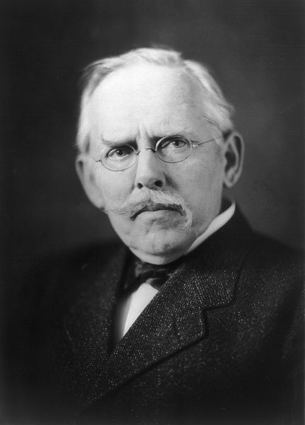
The Progressive Impulse Cont.
***Jacob Riis***:
  How The Other Half Lives
  Photographed poor, immigrant living conditions
Settlement Houses:
  Helped poor women, immigrants, and children adjust to American life
  Jane Addams – Hull House - Chicago
  Helped inspire the social work profession
New reforms for professions
  American Medical Association (AMA)
  States established bar associations
  National Farm Bureau Federation
Women were excluded from most professions
  Settlement houses, teaching, and social work

Slide 4
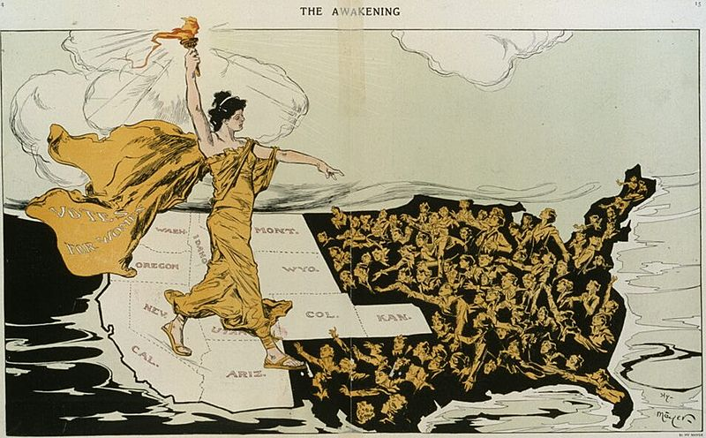
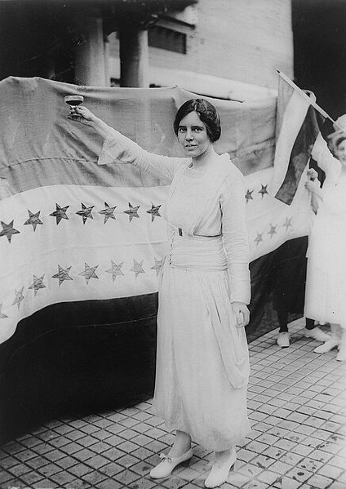
Women and reform
Single-women played a large role in reform movements
  Temperance and settlement houses
Women’s clubs:
  Organizations for women to meet
  Planted trees, supported schools, etc.
  Helped pass state and federal child labor laws, as well as “dry” laws
Suffrage for Women:
  Movement gained momentum when suffragists argued “separate spheres” would not be changed
  Temperance movement favored suffrage
  Women did not get the right to vote until 1920 (19th amendment)
Alice Paul:
  Advocated women’s suffrage
  Author of the Equal Rights Amendment

Slide 5
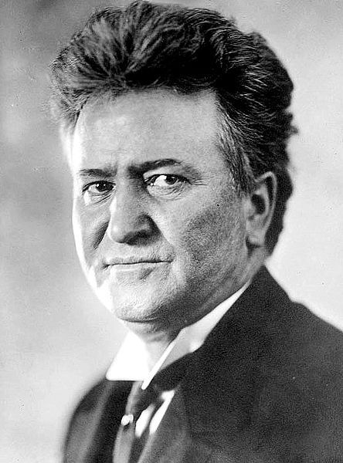
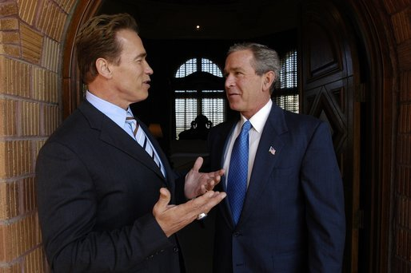
The Assault on Parties
Key voting reforms (state level):
  Initiative: voters could propose legislation
  Referendum: final approval of laws would be approved by voters
  Recall: voters could remove elected officials
  Secret Australian Ballot: No one would see who a voter would vote for
  Direct election of US Senators: instead of state legislatures, seen in 17th amendment
City reformers:
  Went after saloons, brothels, political machines
Robert La Follette:
  “Wisconsin Experiment”
    Income taxes on inheritances
    Initiatives and referendums; regulated railroads and industries
Decline of voter turnout:
  1900 – 73% voter turnout, 1912 – 59%
  Why the decline?
    Party bosses were less influential
I’m the Governator now!

Slide 6
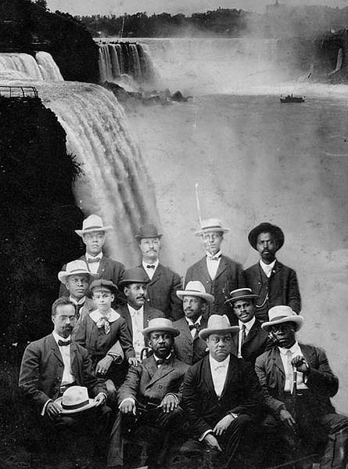
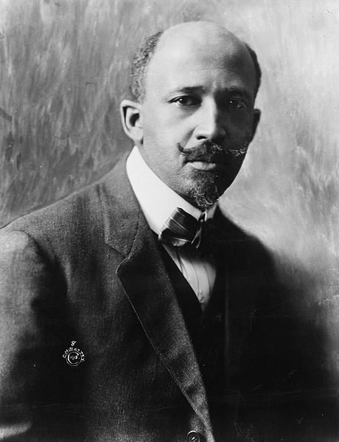
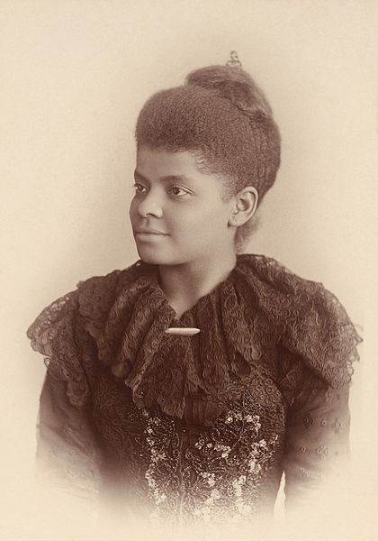
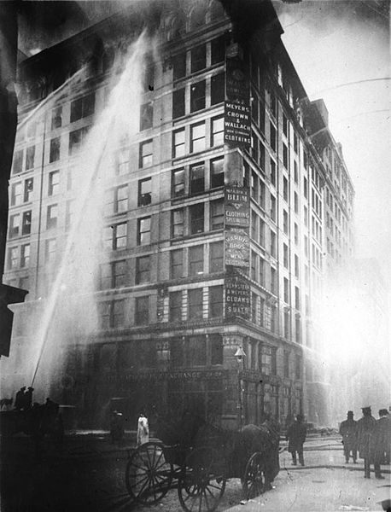
Sources of Progressive reform
Triangle Shirtwaist Factory Fire
  Mostly women, young girls, and immigrants
  10 story building
  Doors locked from outside, smoking around gas engines, narrow hallways
  146 workers died during fire in NYC
African American equality was mostly left out of Progressive goals
W.E.B. Du Bois
  Unlike Booker T. Washington, Du Bois did not favor accommodation
  “Talented Tenth” of African Americans should have full access to education
Niagara Movement:
  Niagara Falls, Canada
  Morphed into the NAACP
    Helped challenge many racial laws throughout the 20th century
Ida B. Wells:
  Journalist that was outspoken against and brought awareness to lynching in the south

Slide 7

Crusade for Social order and reform
Temperance and Prohibition:
  Reasons:
    Drunkenness, spousal abuse, industrial inefficiency
  Woman’s Christian Temperance Union (WCTU)
  Many dry laws were passed
  Gained prominence prior and during WWI
    Germans
  1919 – 18th amendment
Eugenics:
  Sterilization of certain individuals
    Mentally retarded, criminals, etc.

Slide 8
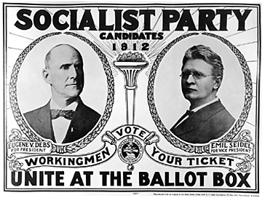
Challenging the Capitalist Order
Socialism:
  Growing force in the early 20th century
  Eugene V. Debs (person not a court case)
    Received almost 1,000,000 presidential votes in 1912
  Most socialists did not support WWI – hurt their cause
International Workers of the World
  “Wobblies,” “I won’t work”
  Hurt by striking during WWI
Regulating Trusts
  Many individuals advocated the distinction between “good and bad” trusts

Slide 9
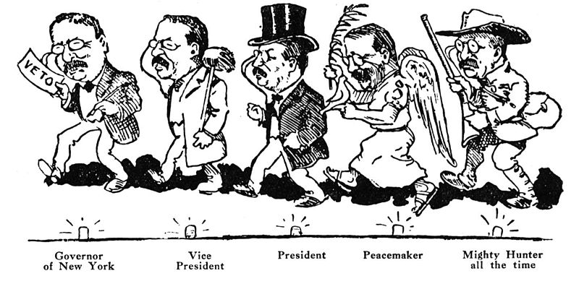
Theodore Roosevelt and the modern presidency
Background on Teddy:
  VP for McKinley – became President in Buffalo
“Square Deal”
  Focused on conservation, controlling corporations, and consumer protection
Sherman Antitrust Act:
  Used to break up the Northern Securities Company
  Upheld by the Supreme Court
Anthracite Coal Mines in PA:
  When workers went on strike, TR threatened to seize mine unless owners negotiated
    Virtually all other presidents sided AGAINST unions in strikes
Hepburn Act (1906):
  Expanded the power of ICC, limited RRs ability to give free passes
Pure Food and Drug Act (1906):
  Created Food and Drug Administration
  Required proper labels and restricted sale of certain medicines

Slide 10
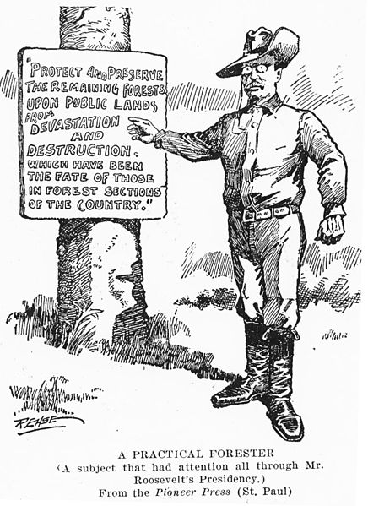
Theodore Roosevelt and the modern presidency Cont.
Conservation: (Not to be confused with conservative)
  Roosevelt’s most enduring achievement, preserving, or conserving land. Think environmentalism
  Forest Reserve Act:
    President can set aside forests and parks
  Newlands Act of 1902:
    D.C. could use money from sale of land for irrigation projects
Panic of 1907 – “Roosevelt Recession”
  JP Morgan purchased a TN Coal and Iron Company
    Roosevelt gave his blessing
  Later broken up by Taft

Slide 11
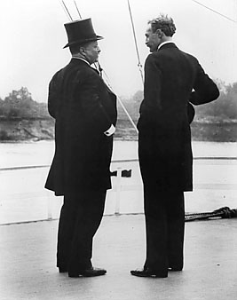
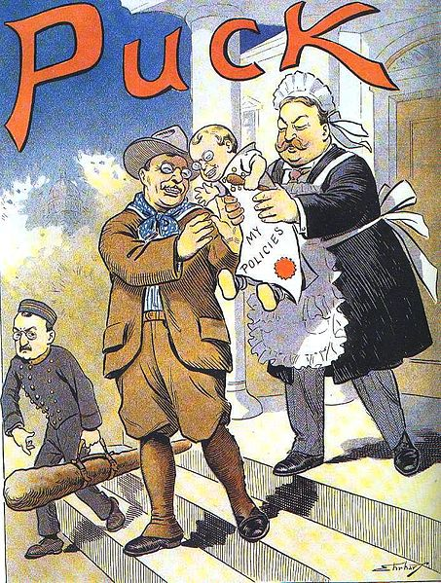
The Troubled Succession
TR handpicks William Howard Taft:
  From CINCINNATI!!!
  Former governor of Philippines
  Largest president ever (over 300 LBS!)
  Became 10th SC Chief Justice after presidency
  Taft one day sent a message that read "Went on a horse ride today; feeling good." Secretary of War Root replied, "How's the horse?"
  Busted more trusts than TR
Payne-Aldrich Tariff
  Barely lowered tariff rates (made many Progressives angry)
Taft fired Gifford Pinchot – TR’s buddy and head of Forest Service
  Makes TR angry
“New Nationalism”
  Called for increased federal government
  Favored individual taxes, worker’s compensation, tariff reduction, etc.

Slide 12
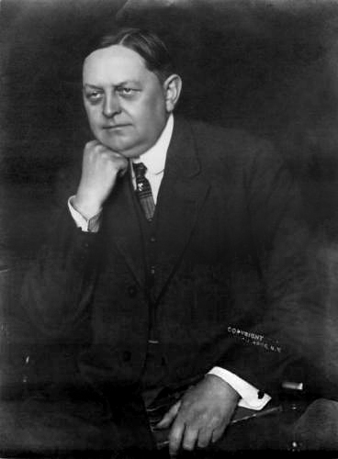
The Troubled Succession Cont.
The Bull Moose Party:
  Advocated women’s suffrage
Election of 1912:
  Two “Republicans” against each other all but guaranteed a victory for Wilson
Woodrow Wilson became president in 1913
  He was a Democrat, so………..
  He decreased the tariff rates – Underwood Tariff
    Coincided with the….
16th amendment:
  Graduated income tax
Federal Reserve Act (1913):
  Responsible for increasing and decreasing money supply
Clayton Antitrust Act:
  Essentially, gave more power to Sherman Anti-Trust Act
  Made interlocking directories illegal (same individuals serve as directors on boards of competing firms)
    JP Morgan is sad ☹
  **Made labor unions and agricultural organizations exempt from antitrust prosecution**
    Unlike Sherman Antitrust Act which was used AGAINST unions
Wilson did not support women’s suffrage

Slide 13
Thanks for watching!
  Subscribe to my channel
  Help spread the word
Questions? Comments?
Ideas for videos?
  Leave in comments
Apush Review
Subscribe
Down here!

