Slide 1
American History: Chapter 21 Review Video
www.Apushreview.com
America and the Great War

Slide 2
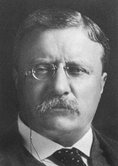
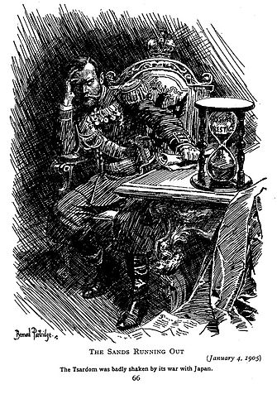
The “Big Stick”: America and the World, 1901 - 1917
Roosevelt, “civilized,” and “uncivilized” nations
  “civilized” could intervene in “uncivilized” nations
Japan and Russia fight in the Russo-Japanese War (1905)
  Japan humiliates Russia with a superior Navy
  Japan secretly asks TR to help reach peace agreement
    Wins Nobel Peace Prize in 1906
1906 San Fran school Board segregates Asian students
  Tensions between the US and Japan mount
TR and Japan reach “Gentlemen’s Agreement”
  Japan would stop immigrants from coming to US by withholding passports
  Yet another example of nativism

Slide 3
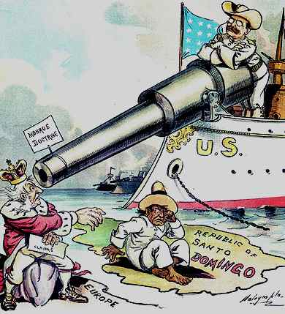
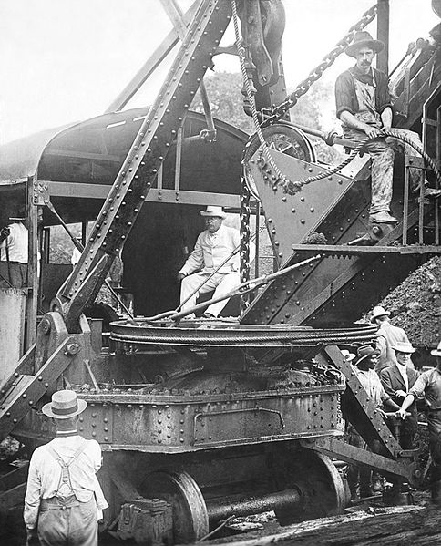
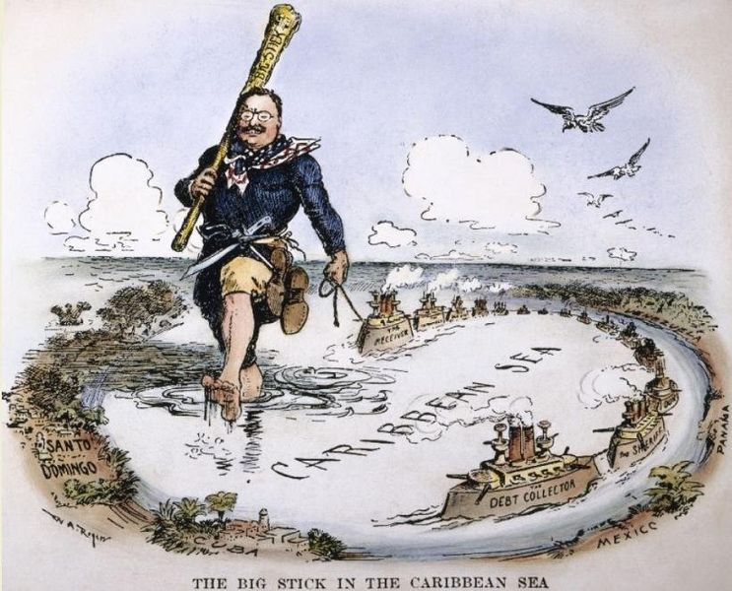
The “Big Stick”: America and the World, 1901 - 1917
Roosevelt Corollary to the Monroe Doctrine:
  Germany and Britain have a lot of $$ owed to them by LA countries
    TR feared they would become involved, violating the Monroe Doctrine. His response???
  Roosevelt Corollary:
    In future financial instances, US would intervene, pay off debts.
  Impact of Corollary?
    US now more involved in LA
    Resentment from many in LA
Panama Canal
  Canal was vital to US interests
    Cut down travel time for shipping and military
  Hay-Pauncefote Treaty of 1901
    Gave US right to build canal and right to fortify it
  Colombia (then controlled Panama) rejected treaty to give US right to build canal
  November 3, 1901 Rebellion starts in Panama (influenced by US)

Slide 4
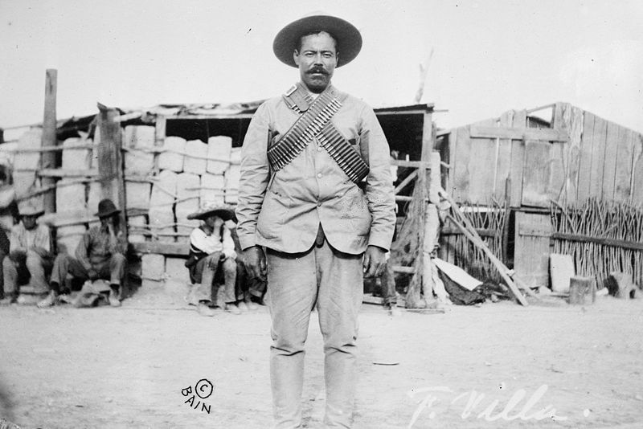
The “Big Stick”: America and the World, 1901 - 1917
Dollar Diplomacy:
  Wall Street bankers encourage to invest in areas of strategic concern to the US
  Helped other countries, while made $ for US
Wilson and Mexico:
  US had many financial interests in Mexico
  Mexico saw a series of leaders during a revolution beginning in 1910
  “Pancho” Villa:
    Planned his own rebellion
    Furious at Wilson for abandoning him
    Killed dozens of Americans
      General John Pershing crossed in to Mexico, never caught Villa

Slide 5
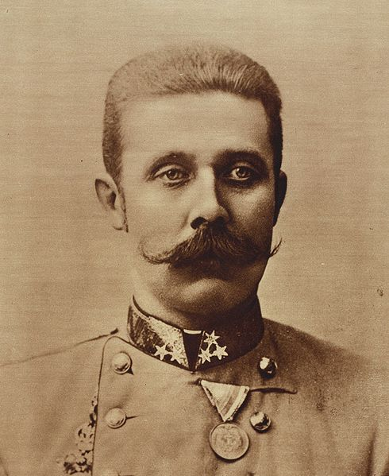
The Road to War
Allied Powers:
  Britain, France, and Russia
Central Powers:
  Germany, Austria-Hungary, and Austria-Hungary
Causes of WWI
  M ilitarism
  A lliances
  I mperialism
  N ationalism
Archduke Franz Ferdinand was killed on June 28, 1914

Slide 6
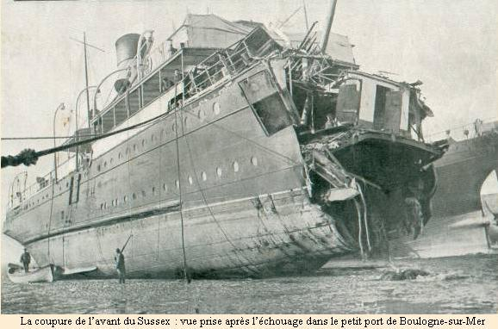
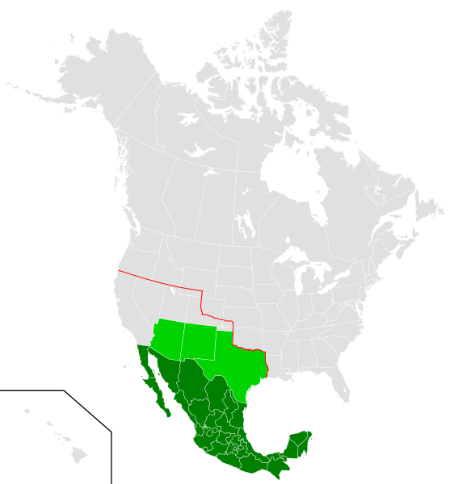
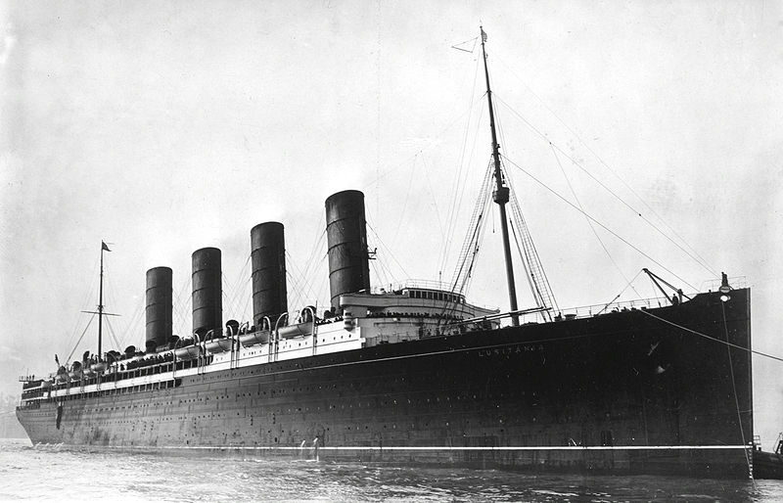
The Road to War
Wilson urged neutrality at the start
US traded significantly with Britain and France
Unrestricted submarine warfare:
  Germany sank all enemy ships
  Lusitania: 128 Americans died
  Sussex: French ship sank by Germany, leads to….
    Sussex Pledge: Germany pledged to not sink ships without a warning first
Election of 1916:
  “He kept us out of war”
Zimmermann telegram:
  Germany urged Mexico to attack US, Mexico would get land back from US
  The note, along with Germany re-instituting unrestricted submarine warfare, brought the US into the war
April 2, 1917, Wilson asked for declaration of war

Slide 7
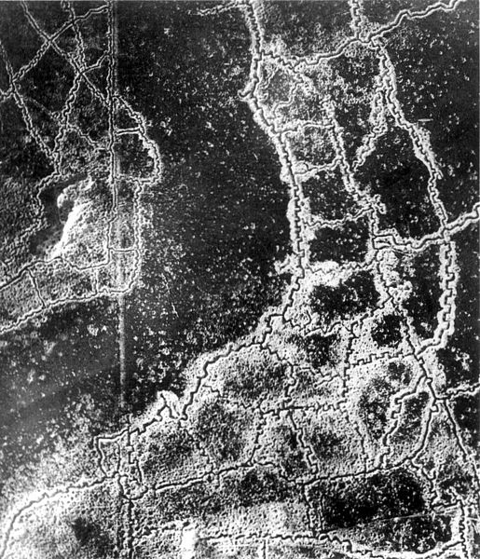
“War Without Stint”
Russia withdrew in 1918:
  Gave up significant amount of land
National draft instituted (1st time since Civil War)
  3 million men
  2 million volunteered
  5 million in American Expeditionary Force (AEF)
Women could enlist, although not in combat
400,000 African Americans enlisted
  Hoped to improve status
Trench warfare:
  “No-man’s land”
  Poisonous gas
  Flamethrowers
High casualty rates, especially from influenza

Slide 8
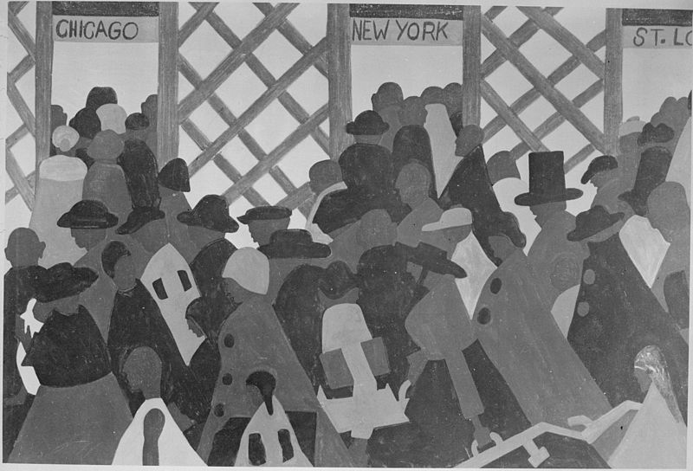
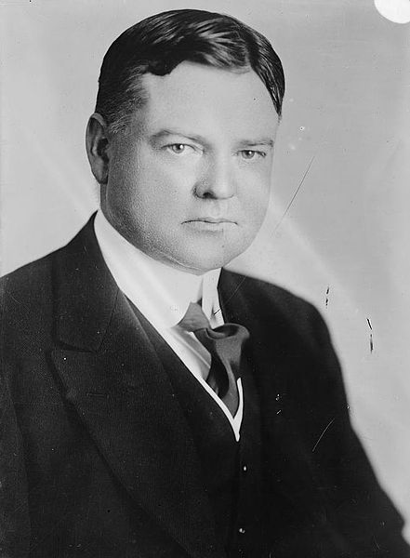
The War and American Society
How was the war financed?
  “Liberty Bonds”
  Income taxes – thanks 16th amendment!
Herbert Hoover:
  Relied on volunteering and rationing
National War Labor Board:
  Resolved labor disputes
Unions:
  IWW (Industrial Workers of the World):
    Nicknamed “I won’t work”, sabotaged factories
  AFL:
    Led by Samuel Gompers, favored the war
    Membership increases
“Great Migration”
  Mass movement of African Americans from the South to the industrial North (NY, Chicago, Cleveland)
Red Summer:
  Race riots of 1919

Slide 9
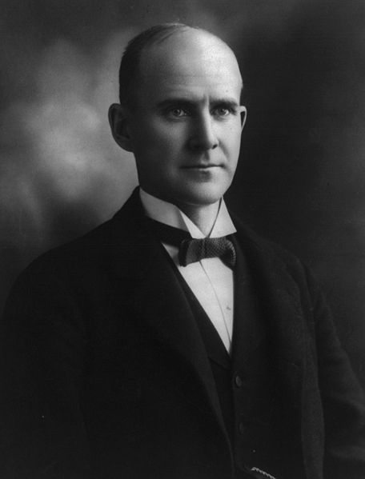
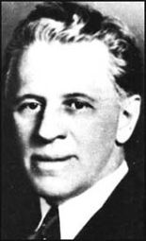
The Futile Search for Social Unity
Committee on Public Information (CPI)
  ***George Creel*** - pro-war material
  “4 minute men”
  Promoted self-censorship
Espionage Act of 1917
  Prosecuted anti-war individuals
  Upheld by Schenck v. US (1919)
  Eugene V. Debs (again 1 person) convicted and sentenced to ten years
Sedition Act of 1918
  Strengthened the Espionage Act
  Restricted free speech and ability to criticize government…… sound familiar?
Immigrants were most often targeted
  German Americans
  “liberty cabbage”

Slide 10
The Search for a New World Order
14 Points:
  Wilson’s plans for post-war world
  Self-determination, no alliance, freedom of the seas, etc.
  League of Nations:
    World organization committed to solving disputes
    US Senate disliked Article X - called for members to give assistance to others if needed
      Would take away Congress’ war-declaring powers, end isolation
Russian Civil War:
  “Reds” v. “Whites”
    Wilson and US supported the “Whites”
    Soviet Union was not recognized by US until 1933

Slide 11
The Search for a New World Order
To ratify the treaty or not…..
  Henry Cabot Lodge (Republican Senator) was against the treaty
    Wrote 14 reservations
  Many senators detested Article X
  Wilson went on a speaking tour across the country
    “Irreconcilables” followed his tour
  Senate never ratifies the treaty

Slide 12
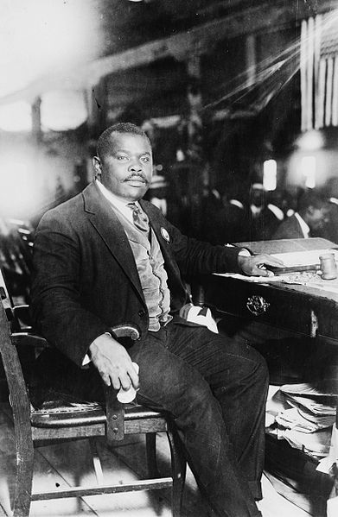
A Society in Turmoil
Postwar Recession: 1919 – 1920
The year of strikes, 1919:
  Strikes were associated with radicalism
  MA governor Calvin Coolidge was critical of strikes
African Americans didn’t gain rights after fighting
  Banned from parades in Europe
Red Summer (don’t confuse with communism):
  Race riots of 1919 - Chicago
Marcus Garvey:
  Promoted black nationalism
  United Negro Improvement Association (UNIA)
    Back to Africa movement

Slide 13
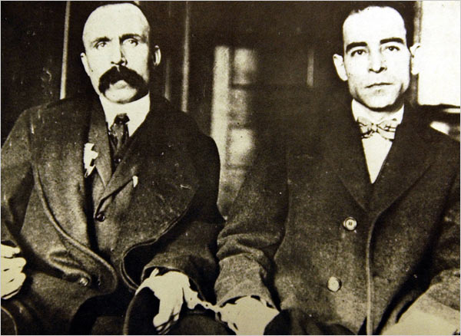
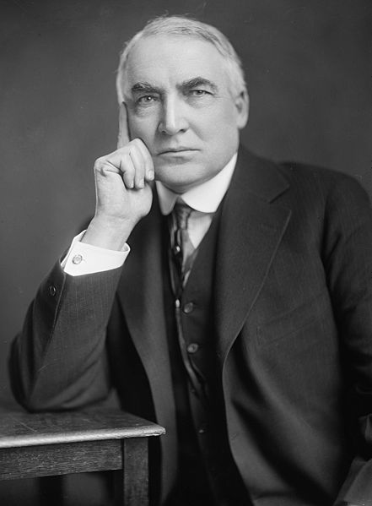
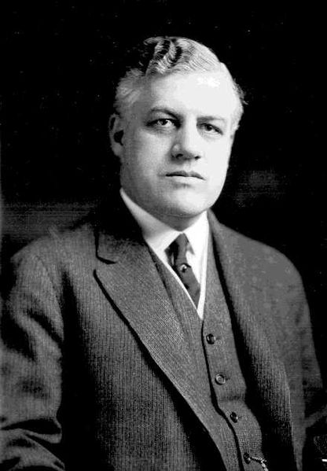
A Society in Turmoil Cont.
“Red Scare” of 1919-20 (1st Red Scare)
  Crusade led by Attorney General Mitchell Palmer against suspected communists
  1,000s of Americans were arrested:
    3 guns discovered
  Impact of the Red Scare:
    Business people used it to help break unions
Sacco and Vanzetti
  Two Italian immigrants (anarchists, atheists, draft dodgers) charged with murder, found guilty and executed
  Showed tensions between immigrants and nativists
Election of 1920:
  Push to “return to normalcy”

Slide 14
Thanks for watching!
  Subscribe to my channel
  Help spread the word
Questions? Comments?
Ideas for videos?
  Leave in comments
Subscribe
Subscribe
Down here!

