Slide 1
American History: Chapter 22 Review Video
www.Apushreview.com
The “New Era”

Slide 2
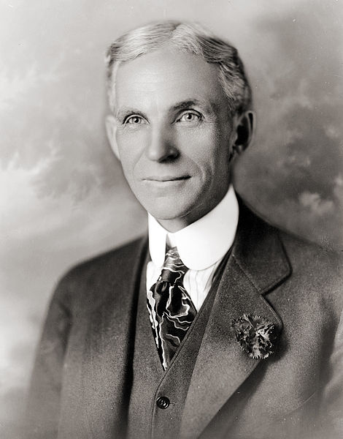
The New Economy
1920 census:
First time more people lived in urban areas
New Technology:
Radio: by the end of 1920s, most families had one
Trains: diesel engine – faster
Labor:
Standard of living rose for many workers
“Welfare Capitalism” (Henry Ford):
Shorter workweek, higher wages, paid vacations
The system ended after 1929 – Great Depression
Average income for workers was $1,500 a year, $1,800 was needed to “maintain a minimally decent standard of living.”
AFL:
Still did not include unskilled labor

Slide 3
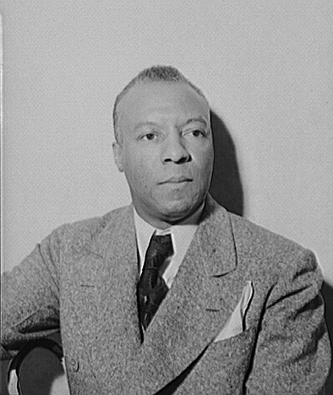
The New Economy Continued
Women:
“Pink-collar” jobs:
Secretaries, salesclerks, phone operators
Lower paying jobs
African Americans
Janitors, dishwashers, garbage collectors, etc.
Therefore, most were left out of AFL
A. Philip Randolph:
Brotherhood of Sleeping Car Porters
Increased wages, shorter working hours, etc.
Influential Civil Rights leader
Japanese Americans
California passed laws making it difficult for Japanese to buy land

Slide 4
The New Economy Continued
Businesses still associated unions with being subversive
1921, The Supreme Court upheld that picketing was illegal, and courts could issue injunctions
Farmers:
Production outweighed demand (WWI ended)
When in doubt, farmers NEVER decreased production of the crops (until the New Deal)
“Parity”:
Purpose was to ensure that farmers would get back their production costs
Passed by Congress, vetoed by Coolidge

Slide 5
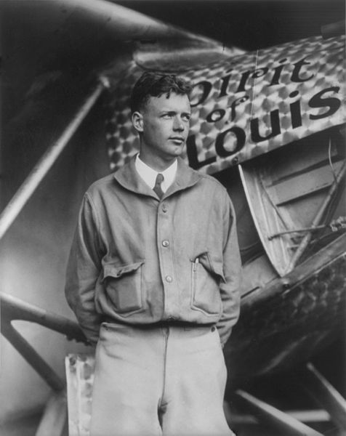
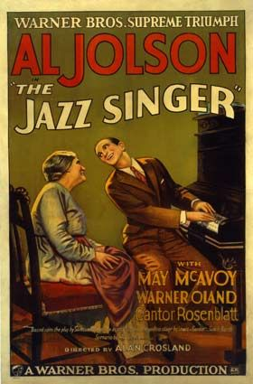
The New Culture
Consumer Culture:
Increase in spending on new appliances:
Refrigerators, washing machines, vacuum cleaners
Automobiles – 30 million by the end of the 1920s
Development of suburbs
Increase in travel and vacations
Charles Lindbergh:
First solo flight w/o radio from America to Europe
Becomes overnight sensation
Advertising:
New, booming industry, influenced by WWI propaganda
The Man Nobody Knows – Jesus was the first salesman
Newspapers increased in circulation
New magazines:
Time, Reader’s Digest
***The Jazz Singer***:
First “talkie” movie

Slide 6
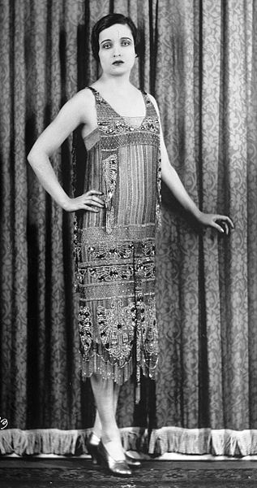
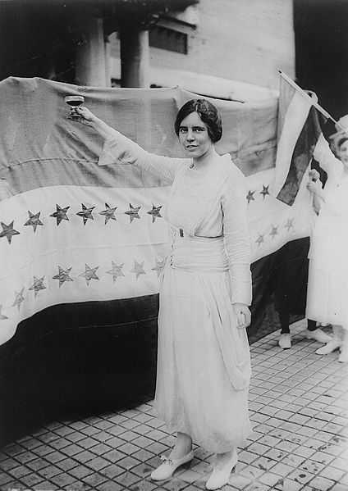
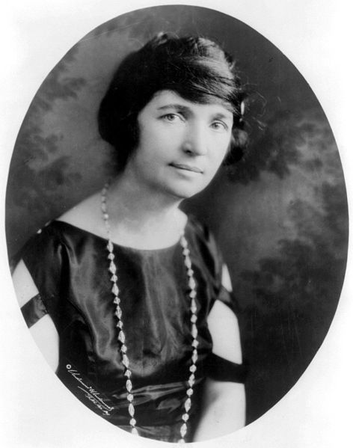
The New Culture Continued
Women in the 1920s
Professional jobs included: fashion, education, social work, and nursing
Most middle-class women did not work outside the home
Motherhood in the 1920s:
John B. Watson – believed mothers should rely on experts for raising children
***Margaret Sanger***:
Advocated birth control, contraceptives
Birth control was illegal in many places
Upset many fundamentalists
Flappers:
More of an image than reality
Short(er) dresses and short hair
Smoked, drank, and (gasp!) danced
National Woman’s Party
***Alice Paul*** - proposed Equal Rights Amendment (ERA)

Slide 7
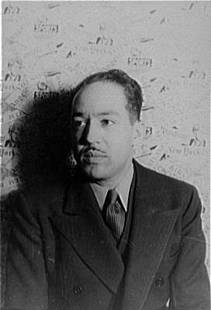
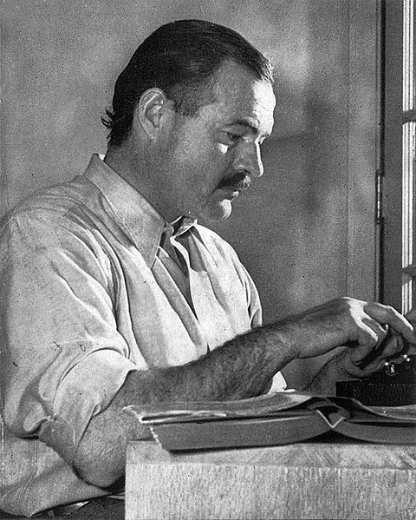
The New Culture Continued
Education:
High school and college attendance increased drastically
Schools played a large role in social development
***Lost Generation***
Resented middle-class ideals, felt betrayed by society
Ernest Hemingway – A Farewell to Arms
H.L. Mencken – Smart Set, American Mercury
Magazines that criticized middle-class values
Similar to the Beat Generation of the 1950s
Harlem Renaissance:
Promoted African American culture through poetry, music – jazz, literature, and art
Focused on discrimination that African Americans faced
Langston Hughes – “I am a Negro – and beautiful”

Slide 8
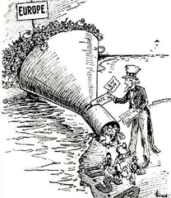
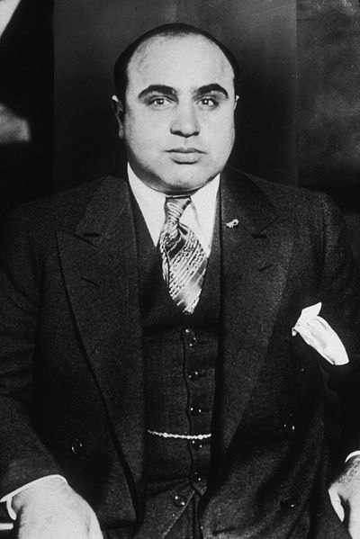
A Conflict of Cultures
Prohibition, The “Noble Experiment”:
Popular in South and West
Problems with prohibition
People liked to drink, weak enforcement, many people hostile to law
Many government officials were bribed -> Increase in organized crime
Huge demand for illegal alcohol.
Large cities, such as Chicago, flourished with crime
Al Capone, notorious gangster, was very popular
St. Valentine’s Day Massacre: 7 gang members killed
Nativism:
Emergency Quota Act of 1921:
Restricted number of immigrants from a country to 3% of total people from that country living in US in 1910
Favored Southern and Eastern Europe
Immigration Act of 1924:
Quotas for foreigners was cut from 3% to 2%, used 1890 census instead, hurt “New Immigrants”
Shut out Japanese immigrants:
Marked an end of era of unrestricted immigration

Slide 9
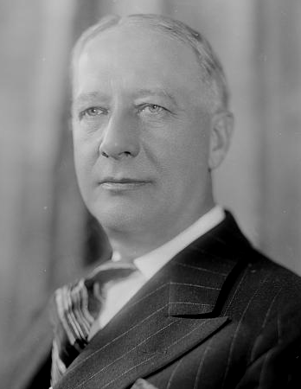
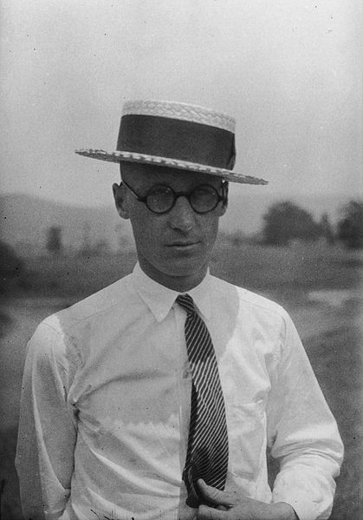
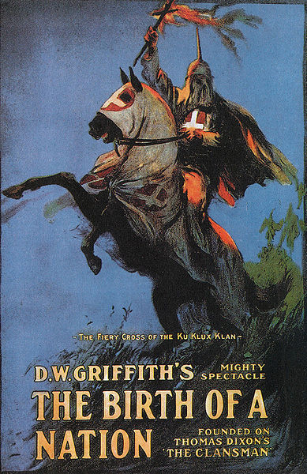
A Conflict of Cultures Continued
The Ku Klux Klan
Re-emerged in the 1920s
Birth of a Nation – full-length film that glorified the KKK
By mid-1920s, 5 million Americans paid dues as members
Scandals, including embezzlement, helped lead to the decline of the clan
“Monkey Trial”
John Scopes, biology teacher from Dayton Tennessee, violated a law by teaching evolution
Prosecutor: William Jennings Bryan, Defense Attorney: Clarence Darrow
Scopes found guilty, paid $100 fine
Helped fuel religion vs. secularism for many more years
Democrats in the 1920s
Democrats: Alfred Smith -> Roman Catholic

Slide 10
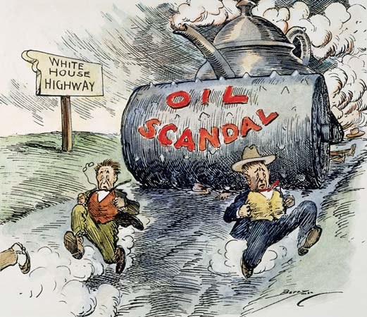
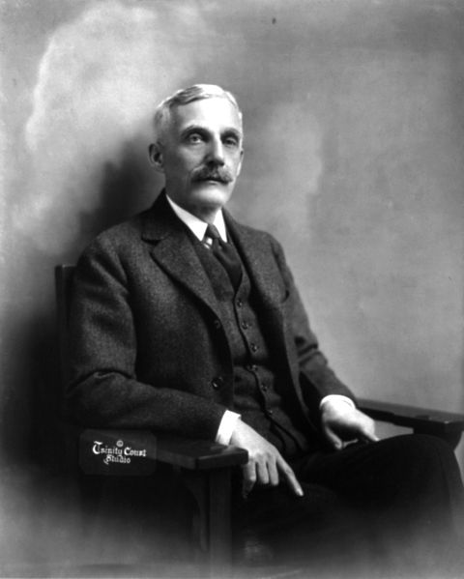
Republican Government
1920s sees an end to Progressive legislation, including the Supreme Court
“Return to Normalcy” with Warren G………
***Teapot Dome Scandal***:
Secretary of Interior Fall transferred land to his department, leased land to oil companies, and took $100,000s in bribes
Just like President Grant, Harding was associated with Corruption and Scandal
Calvin Coolidge:
Warren G……….’s VP, becomes president when Warren G….. dies
Advocated “Laissez-faire” government
***Secretary of Treasury Andrew Mellon***
Tax cuts for the wealthy, “Trickle-down economics”
Later advocated by Ronald Reagan

Slide 11
Thanks for watching!
Subscribe to my channel
Help spread the word
Questions? Comments?
Ideas for videos?
Leave in comments
Subscribe
Down here!

