Slide 1
American History: Chapter 24 Review Video
www.Apushreview.com
The New Deal

Slide 2
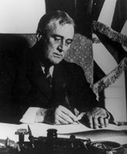
Launching of the new deal
March 4, 1933: FDR inaugurated
“The only thing we have to fear is fear itself”
100 days, Congress passed large number of legislation
Relief: provide relief for individuals
Recovery: Help improve the economy
Reform: new laws such as child labor
“Fireside Chats”
Weekly radio addresses, assured public it was safe to put money back in banks
Banks:
“Bank Holiday”
FDR closed all banks for days to calm Americans’ fears
Emergency Banking Act:
Government must inspect banks before they could be reopened
21st Amendment (1933):
Prohibition was repealed

Slide 3
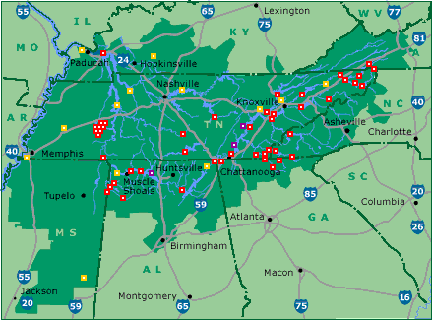
Launching of the new deal
Agricultural Adjustment Act:
Paid farmers not to grow crops (too much supply)
Declared unconstitutional in Butler v. US
National Industrial Recover Act (created National Recovery Administration)
Set minimum wages and maximum hours (wanted to spread employment around)
Gave rights to labor unions (Section 7a)
Outlawed “Yellow Dog Contracts”
Schechter vs. US:
Declared the NRA unconstitutional
Legislative powers could not be delegated to president
Public Works Administration (PWA)
Provided industrial recovery and unemployment relief
Built Grand Coulee Dam
Tennessee Valley Authority (TVA):
Hydroelectric Power could be huge source of energy
TVA helped reform monopolies and provide jobs; revitalized area
Encouraged hydro-electric development of other areas as well

Slide 4
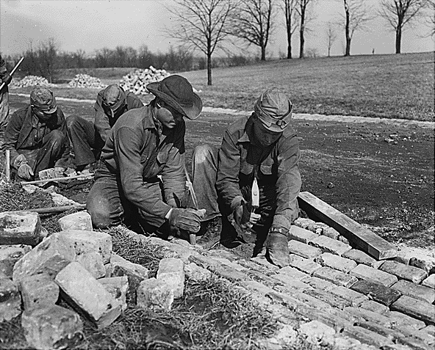
Launching of the new deal
Stock Market and Banks:
Glass-Steagall Act:
Set up FDIC, guaranteed individual banking deposits
“Truth in Securities Act”
Could not lie about “soundness of stocks”
Securities and Exchange Commission (SEC)
Regulated the stock market
Watchdog of NYSE
More work programs:
Civil Works Administration (CWA)
Provided temporary jobs during harsh winter
Civilian Conservation Corps (CCC)
Government camps for young men, reforestation, firefighting, etc.

Slide 5
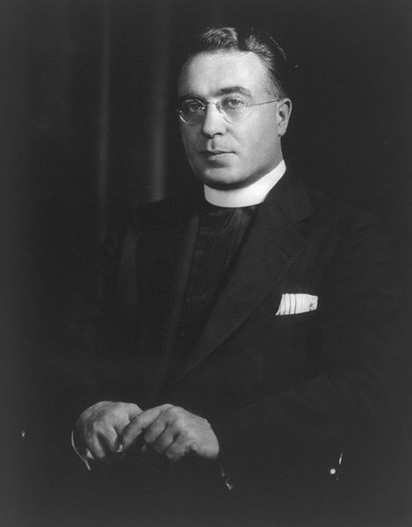
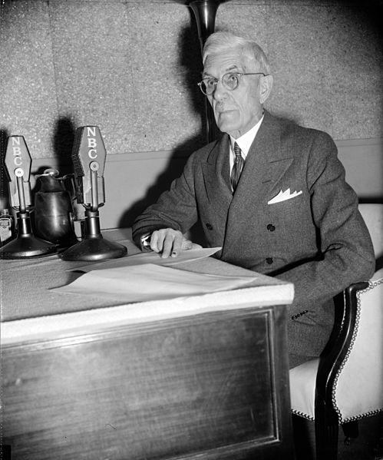
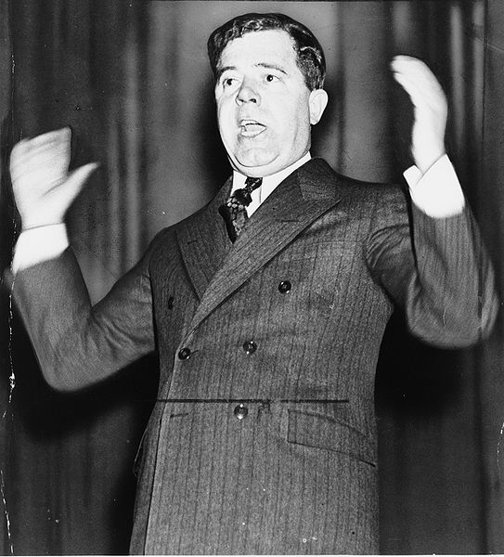
The New Deal in Transition
Demagogue: someone who appeals to people based on popular desires and wants, rather than using rational argument
Dr. Francis Townsend:
Appealed to senior citizens
Created a plan for pensions for individuals over 60
Helped inspire Social Security
Father Charles Coughlin:
Enormous radio audience
Wanted to change the banking system
Huey Long:
Senator from LA, promoted “sharing the wealth”
Providing $ for individuals by taxing the wealthy
National Labor Relations (Wagner Act):
Huge boost to labor movement
Reassured right to collectively bargain
John C. Lewis:
Formed Committee for Industrial Organization (CIO)
General Motors sit-in strike which did not allow strike breakers to work

Slide 6
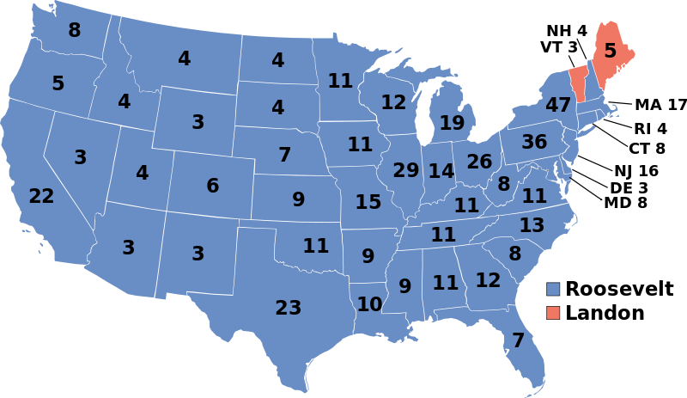
The New Deal in Transition
***Social Security Act of 1935***
Provided federal-state unemployment insurance
Provided $ for senior citizens, disabled, etc.
Collected by creating a new payroll tax
Works Project Administration (WPA):
Spent $11 billion on buildings, bridges, roads, etc.
9 million people were given jobs
Most aid for men came in the form of work relief; women received cash
1936 Election:
FDR wins in a landslide
CIO and other labor groups contributed large amounts of $ to FDR’s campaign chest

Slide 7
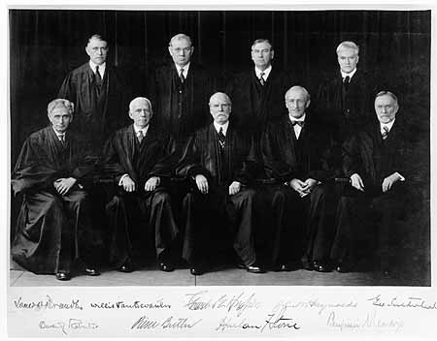
The New Deal in Disarray
In 9 New Deal cases, S.C. overturned 7
FDR wanted a court in favor of his programs
His proposal? The ability to add 1 new judge for every judge over 70
Congress, his party, and the American public do NOT support this. Fear of “dictator”
Court begins to come around to his programs
Fair Labor Standards Act:
Minimum wage and 40-hour work week
Limited child labor

Slide 8
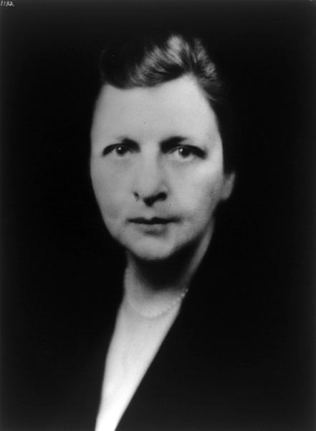
Limits and Legacies of the new deal
African Americans and the New Deal:
90 percent of African Americans voted Democratic
African Americans gained little rights:
Poll taxes still existed
Segregation in CCC
Blacks paid less than whites through the NRA codes
Indian Reorganization Act (1934):
“New Deal” for Natives
Reversed the Dawes Act
Women and the New Deal:
Few programs advanced women’s rights
Many believed women should not work during tough times
Frances Perkins – Secretary of Labor – first female cabinet member

Slide 9
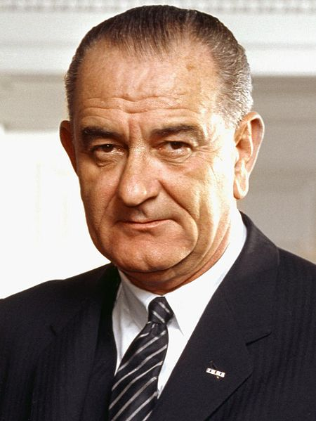
Limits and Legacies of the new deal
New Deal programs did not “challenge prevailing racial norms”
Segregation in CCC camps
Whites received more money than minorities
West benefitted from the New Deal
Need for improvements and $
Dams, etc.
Grand Coulee Dam – largest public project in history until that point
South did benefit as well
TVA – electricity for many in the South
New Deal impacts?
Government increased its power and role in the federal government
Beginning of a federal welfare state (strengthened under LBJ’s “Great Society”)

Slide 10
Test Tips
Essay Topics:
Determining if the New Deal was successful
How the role of the government changed
Deficit spending – Keynesian Economics
Government should spend more money than it brings in to stimulate the economy
Tips for Multiple-Choice questions:
Political Cartoons – Court Packing Plan
New Deal Agencies
CCC was outdoors – recognize pictures of workers outdoors
Key people – Townsend, Coughlin, and Lewis
Good Luck!

Slide 11
Thanks for watching!
Subscribe to my channel
Press the “Like” button
Questions? Comments?
Ideas for videos?
Leave in comments
Share the Wealth by subscribing!
Subscribe
Down here!

