Slide 1
American History: Chapter 25 Review Video
www.Apushreview.com
The Global Crisis, 1921 - 1941

Slide 2
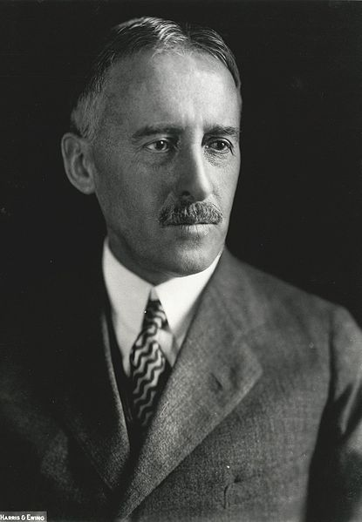
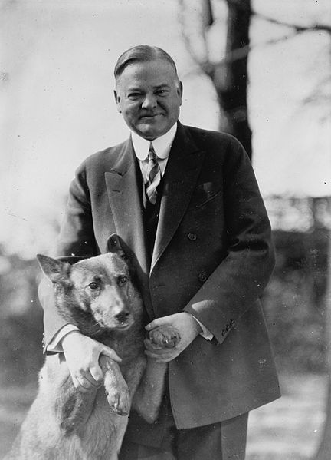
The Diplomacy of the New Era
Washington Conference of 1921:
  Several nations agree to reduce militaries
  5 Power Pact: US, Britain, Japan, France, and Italy:
    5 tons of ships for US, 3 for Japan, 1.75 for France and Italy
  Nine-Power Pact:
    Continued the Open Door Policy in China
Kellogg-Briand Pact:
  Agreement that outlawed war
  No enforcement mechanism
Dawes Plan: (Not to be confused with Dawes Act)
  US banks loaned $ to Germany -> pays Britain and France -> pays loans back to US Treasury
  Simply a circle of $ - ends with stock market crash of 1929
President Hoover:
  Did not enforce the Roosevelt Corollary
Overseas Expansion
  Lebensraum – Germany sought “living space”
  Japanese invasion of Manchuria -> Stimson Doctrine
    US refused to recognize Japanese gains

Slide 3
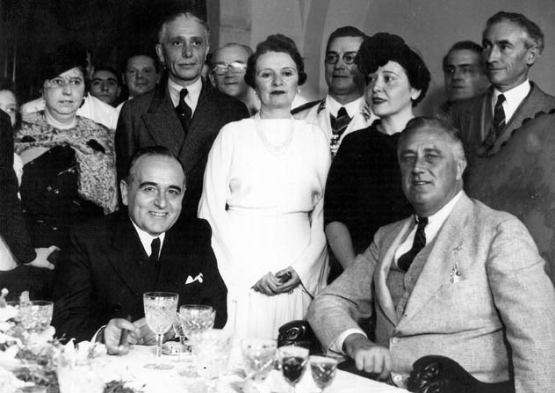
Isolationism and internationalism
World Economic Conference: London, 1933
  FDR did not favor the Gold Standard
Reciprocal Trade Agreement:
  US could lower tariffs on foreign countries that do the same
US recognition of the Soviet Union in 1933:
  US hoped the USSR would help contain Japan’s growing power
  USSR promised to stop propaganda in the US
Good Neighbor Policy:
  FDR sought improved relations with Latin America
  Less of a focus on military force

Slide 4
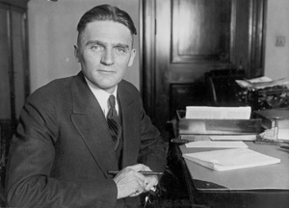
Isolationism and internationalism Continued
Isolation
Nye Committee:
  Senate Committee that alleged the US became involved in WWI so businesses could profit
  Believed as truth by many at the time; not so much today
1935 invasion of Ethiopia by Italy
  Fear that another world war was close
Neutrality Acts 1935 – 1937:
  US could not sell weapons to warring (belligerent) countries
    Did not matter who was the aggressor or who was the victim
    Non-military goods could be sold via a “cash and carry” policy
  US could not provide loans to belligerent nations
  US citizens could not travel on ships from warring nations
Quarantine Speech:
  FDR’s speech in response to Japanese aggression
  Encouraged economic sanctions

Slide 5
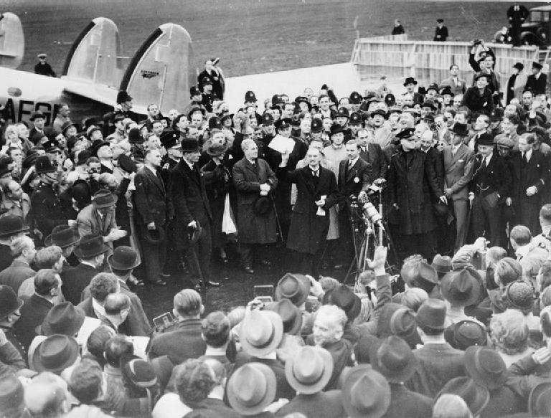
Isolationism and internationalism Continued
Munich Conference:
  Germany invaded areas of Czechoslovakia (clear violation of Treaty of Versailles)
  Many countries were fearful of another world war
    Followed a policy of appeasement – giving in to the demands of an aggressor (Hitler)
  At Munich, France and Britain allowed Hitler to have parts of Czechoslovakia
    Prime Minster Chamberlain stated it would provide “peace in our time”
    Hitler violated the agreement within 6 months

Slide 6
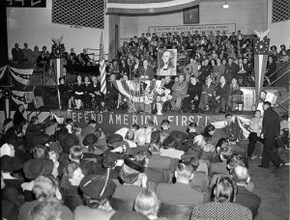
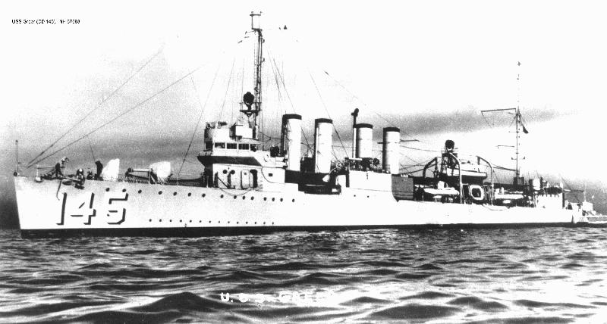
From Neutrality to intervention
Neutrality Act of 1939:
  Passed after Germany’s invasion of Poland
  Designed to help France and Britain
  US could sell weapons to democracies via “cash and carry”
    Countries must pay in cash in full and pick up goods themselves
Two Important US Groups
  Committee to Defend America – Interventionists - favored aid
  America First Committee – Isolationists (Charles Lindbergh)
Arsenal of Democracy Speech:
  FDR speech that claimed the US should aid European countries resisting Germany
  Arsenal refers to the US’ ability to make war materials for Allied countries
Lend-Lease Act (1941):
  Drastically increases US’ involvement in WWII
  US could lend crucial supplies to countries the president deems vital
  US would transport goods as far as Iceland
“Shoot-On-Sight” Policy:
  Reaction to a conflict between a US boat and German submarine
  US ships could shoot German submarines upon seeing them
Atlantic Charter (August, 1941)
  First wartime meeting between US (FDR) and Britain (Churchill)
  Outlined the goals for post-WWI, including: self-determination, lower trade barriers, economic cooperation, etc.

Slide 7
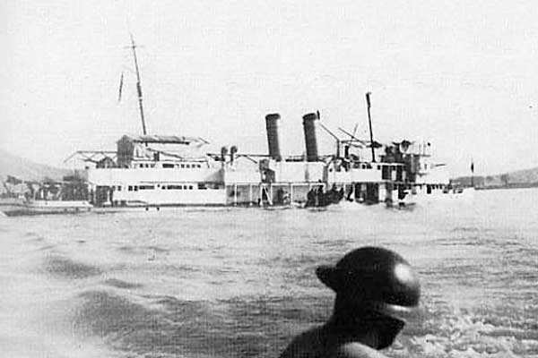
From Neutrality to intervention Continued
US – Japan Relations:
Panay Incident (1937):
  Japan attacked a US ship
  Japan apologized, American isolationists urged the US to move on
US and Japan:
  US froze Japanese assets in response to aggression (1940s)
  US instituted an embargo
December 7, 1941:
  Pearl Harbor was attacked by Japanese
  US declared war on Japan and Germany immediately after

Slide 8
Thanks for watching!
  Subscribe to my channel
  Press the “Like” button
Questions? Comments?
Ideas for videos?
  Leave in comments
Subscribe
Down here!

