Slide 1
American History: Chapter 26 Review Video
www.Apushreview.com
America In A World At War

Slide 2
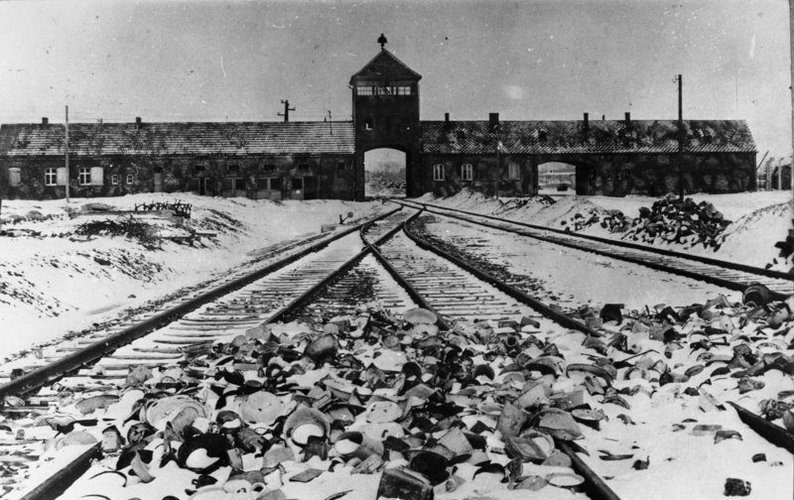
War On Two Fronts
After Pearl Harbor, the Japanese attacked US bases in Manila
Battle of Midway, US was victorious
By mid-1943, US gained an edge in the Pacific theater
Delays in a French invasion upset Stalin
The Soviets had the most casualties – 20 million!
Leaders of the Soviet Union felt the delay of an invasion was done so USSR could absorb the most casualties
Holocaust:
11 million deaths – 6 million Jews
US had some knowledge early on in the war
St. Louis – US turned away 1,000 escaped Jews, even though they had room under the quota system

Slide 3
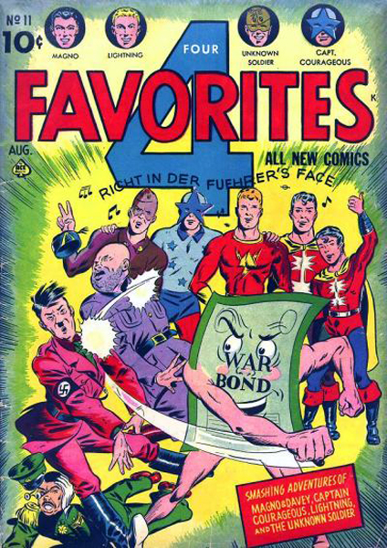
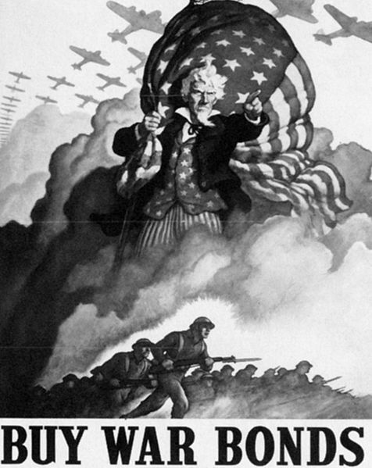
The American People In Wartime
The war ended the Great Depression
Federal spending increased drastically
Shortage of consumer goods = increased savings
15 million men and women were part of forces
Increased need for labor
Major unions did not strike
Smith-Connally Act – unions had to wait 30 before striking
2 ways the government paid for the war
TAXES!
War bonds
War Production Board:
Purpose was to have broad economic powers
In reality, did not have as much power

Slide 4
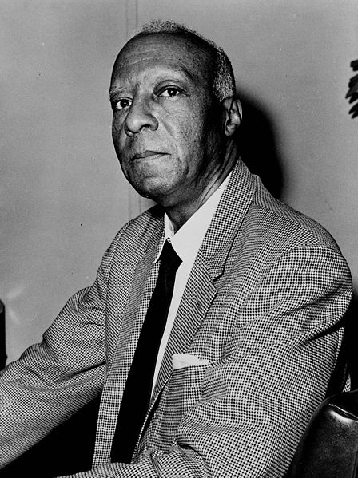
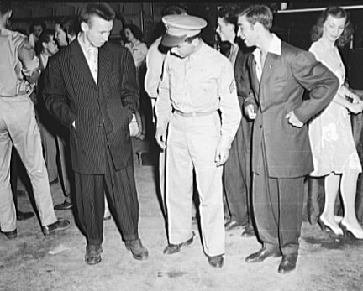
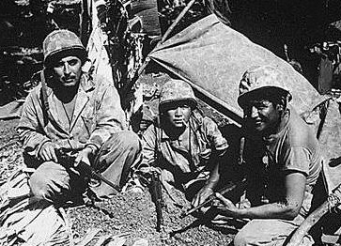
The American People In Wartime Cont.
Technology in the war:
Car assembly lines turned into military assembly lines
Radar and sonar improved dramatically
Americans During The War
African Americans:
Generally supported the war – hoped for more rights
A. Philip Randolph – proposed a demonstration in DC
Fair Employment Practice Commission: could investigate discrimination in war industries
Large migration of blacks from the South
Native Americans:
“Code-talkers”
Mexican Americans:
Bracero program: Mexican workers came to the US
Zoot Suit Riot: conflict between American sailors and young Mexicans in Los Angeles

Slide 5
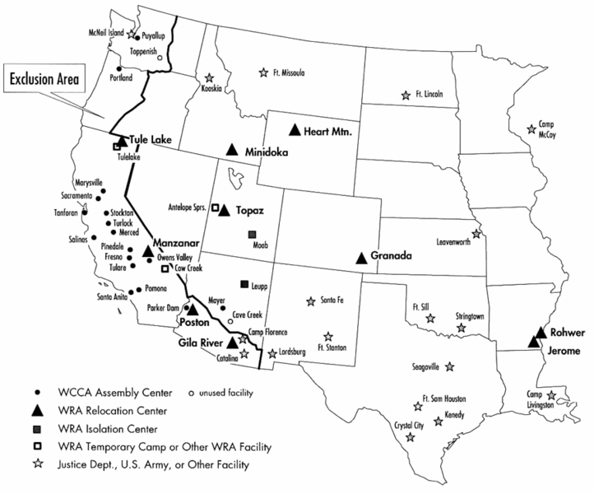
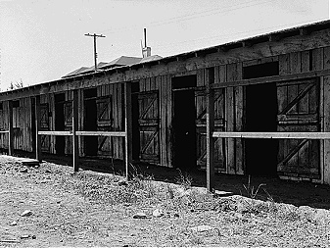
The American People In Wartime Cont.
Women and children in the war:
Women in the workforce increased by 60%
“Rosie the Riveter”
Many children became “latchkey kids”
1/3 of teenagers were employed
Japanese Americans:
Executive Order 9066 – relocation of Japanese from the West Coast
Korematsu v. US – upheld Internment Camps
Check out my video in the description

Slide 6
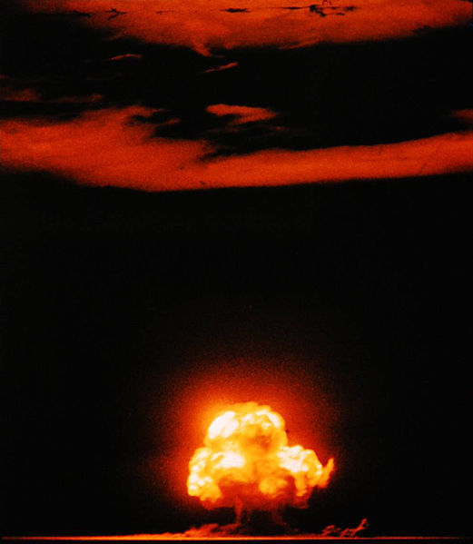
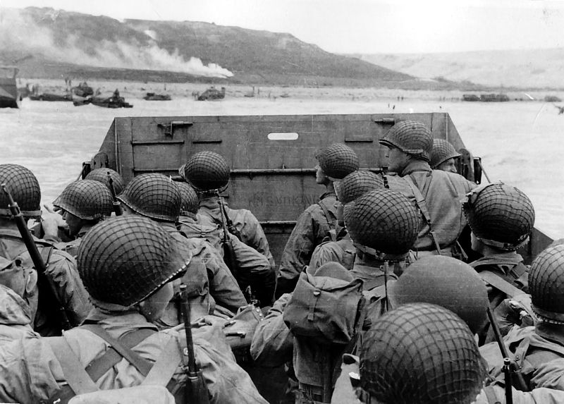
The Defeat of the Axis
D-Day:
June 6, 1944: Invasion at Normandy – Dwight Eisenhower
The Soviets pushed the Germans back, allowed them to occupy Eastern Germany
Play a key role after the war
Manhattan Project:
Led by Robert Oppenheimer, the US developed nuclear weapons
Check out Rush’s The Manhattan Project
Hiroshima and Nagasaki:
US dropped two atomic bombs – 100,000s of deaths
Why did the US drop the bombs?
Many, but to save American lives

Slide 7
Quick Recap
The war was paid by taxes and bonds
Women worked in large numbers
A. Philip Randolph
Zoot Suit Riots
Korematsu v. US
Truman dropped the bombs to save lives

Slide 8
Thanks for watching!
Subscribe to my channel
Press the “Like” button
Questions? Comments?
Ideas for videos?
Leave in comments
Subscribe
Down here!
SUBSCRIBE TO ADAM NORRIS!

