Slide 1
American History: Chapter 27 Review Video
www.Apushreview.com
The Cold War

Slide 2
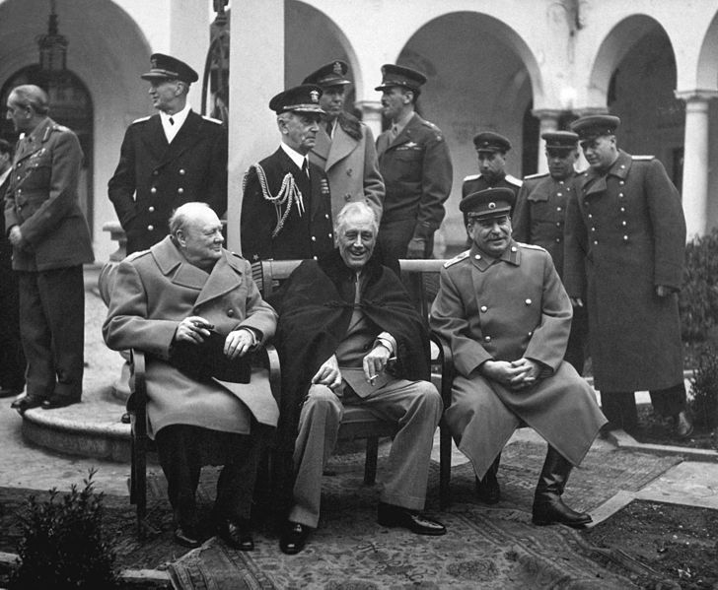
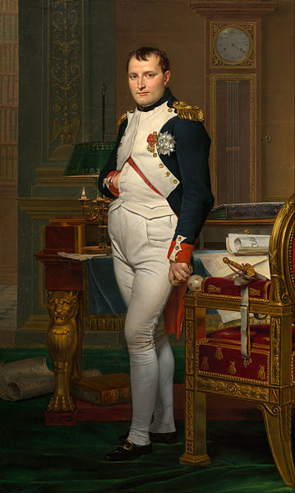
Origins Of The Cold War
Reasons for US-Soviet Tensions
  The Soviet Union wanted a “buffer zone” after WWII
    Twice since 1800 the Soviet Union was invaded
  The US and Britain delayed opening a second front
Yalta Conference:
  Last meeting of the “Big Three”
  Stalin agreed to free elections in Eastern Europe
    Promised elections in Poland – never came true
  USSR would join the UN
  Germany would be divided into different zones

Slide 3
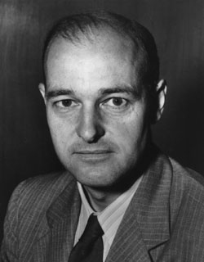
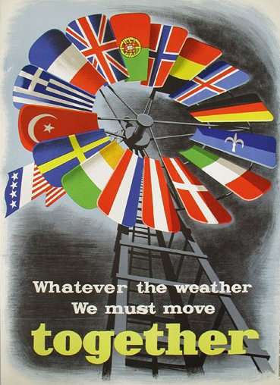
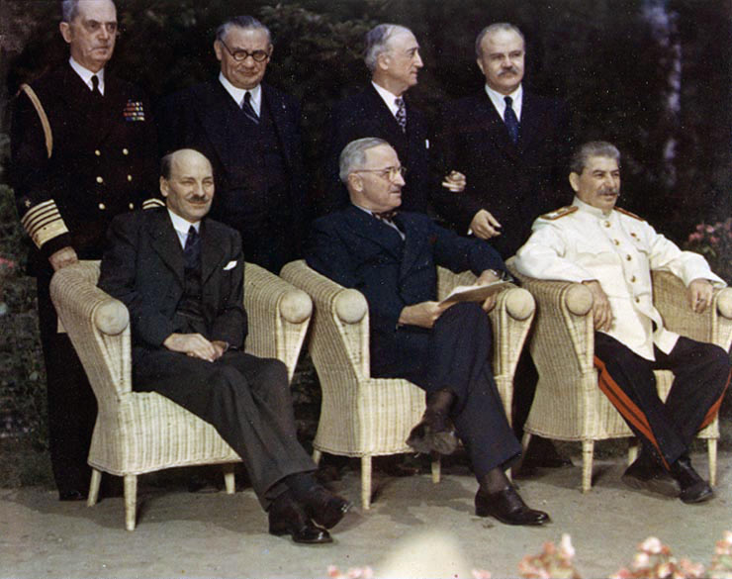
The Collapse of the Peace
Potsdam Conference (July, 1945):
  Japan given an ultimatum to surrender
    Truman hinted to Stalin about a new weapon
  Truman wanted to hold Stalin to agreements at Yalta
    He saw it as a “pact”
Chinese Civil War:
  Nationalists (Chiang Kai-shek) v. Communists (Mao Zedong)
  US supported the Nationalists
***Containment***
  George Kennan, believed the Soviet threat of expansion should be “contained”
Two forms of Containment:
  Truman Doctrine:
    $400 million in aid to Turkey and Greece
  Marshall Plan:
    $12 billion in economic aid to Europe
National Security Act:
  Created the Department of Defense, CIA, and increased powers of the president

Slide 4
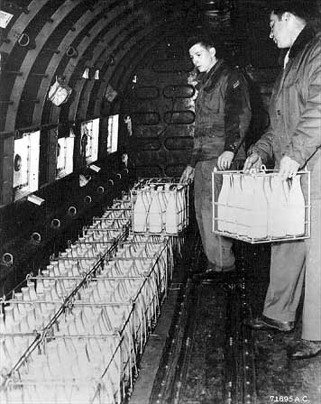
The Collapse of the Peace
Berlin Blockade (1948):
  Stalin cut off all roads/trains to Berlin (located in East Germany)
  US provided food, goods, etc. to citizens of Berlin
  Helps lead to the formation of…..
North Atlantic Treaty Organization (NATO):
  First peace-time alliance in US History
  “An attack on one is an attack on all”
  The Soviet Union later responded with the Warsaw Pact
1949: A bad year for the US’ foreign policy
  “Fall” of China
  Soviet Union detonates its own nuclear weapon
**NSC-68**
  Urged for a more aggressive foreign policy and increase in defense spending

Slide 5
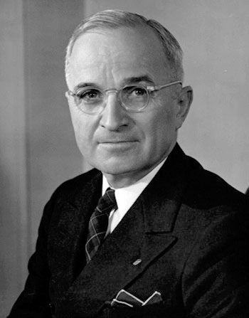
American Society And Politics After the War
Why was the economy better post WWII than post WWI?
  Consumer demand was high – little spending during the war
  Servicemen’s Readjustment Act of 1944 (G.I. Bill)
    Education and economic aid to veterans returning from war
Women, blacks, and Hispanics were pushed out of jobs for returning white soldiers
Truman’s “Fair Deal”:
  Proposed more Social Security, increased minimum wage, national insurance, etc.
  Biggest success came in minimum wage and housing
Taft-Hartley Act:
  Passed over Truman’s veto
  Outlawed the “closed-shop”

Slide 6
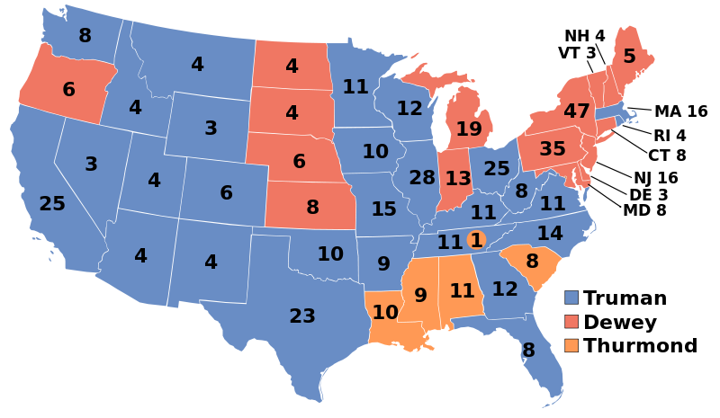
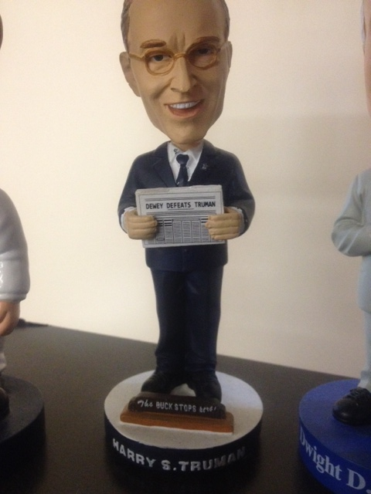
American Society And Politics After the War
Election of 1948:
  Dewey does NOT defeat Truman
  Truman campaigned via RR
Truman did not achieve many gains in Civil Rights
  Southern Congressmen did not support his plans, which included:
    Federal protection of black rights
    Abolishing poll taxes
Executive Order 9981 (1948):
  Desegregated the US military

Slide 7
The Korean War
In June, 1950, N. Korea invaded S. Korea
  Took over almost all of S. Korean
  Truman saw the invasion as an act by the Soviet Union
US drastically increased its military size and spending
  NSC-68
Eventually N. Korea is pushed back beyond the 38th
China intervened on November 25, on behalf of North Korea
    General MacArthur wanted to fight a large-scale war, attack the Chinese
MacArthur criticized Truman’s plans
  Truman fired MacArthur
July, 1953: Ike agreed to a division of North Korea at the 38th parallel; demilitarized zone
  36, 940 Americans were killed, 103,284 were wounded

Slide 8
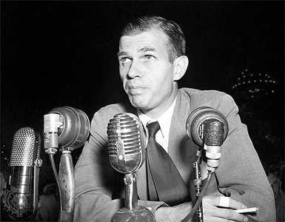
The Crusade Against Subversion
HUAC (created in 1945)
  House Committee on Un-American Activities
    Prominent member was Richard Nixon – NOT JOSEPH McCarthy!
  Alger Hiss:
    One-time aide to FDR
    Accused of sharing 65 classified documents
    Indicted and sentenced to 5 years in jail for perjury
  “Hollywood Ten”
    10 screenwriters that refused to testify before HUAC; sentenced to jail
Many activities became associated with Communism: declining religious sentiment, increased sexual freedom, agitation for civil rights
Truman’s Loyalty Program:
  Truman issued an executive order (9835) for federal employees to take a loyalty oath
McCarran Internal Security Act:
  Required Communist organizations to register with the government

Slide 9
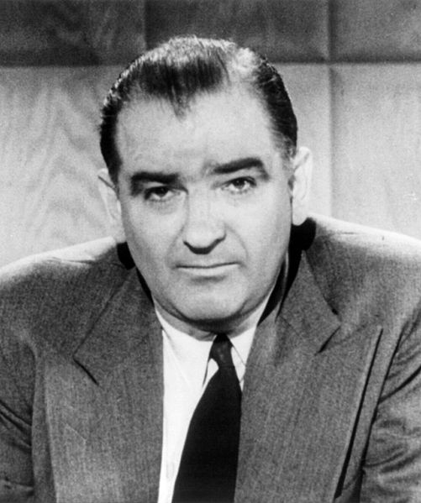
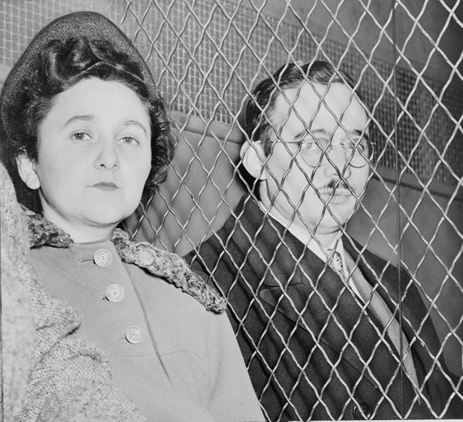
The Crusade Against Subversion
Rosenbergs
  Husband and wife convicted of giving a-bomb secrets to the Soviets
  2008 – Revealed that the prosecution knew Ethel was innocent
McCarthyism
  Seen as a demagogue
    Leader that capitalizes on prejudices and false claims to gain power
  Joseph McCarthy (R – Wisconson)
  Accused state department officials of being communists
  Downfall happened when he attacked the army
    Seen by many as a bully on tv
  Arthur Miller’s The Crucible was an allegory to McCarthyism

Slide 10
Quick Recap
GI Bill
Containment
  George Kennan
  Truman Doctrine
  Marshall Plan
“Loss” of China
Rosenbergs
McCarthyism
NSC – 68
“Fair Deal”
Yalta Conference
HUAC
NATO

Slide 11
Thanks for watching!
  Subscribe to my channel
  Press the “Like” button
Questions? Comments?
Ideas for videos?
  Leave in comments
Subscribe
Down here!
Dewey didn’t subscribe

