Slide 1
American History: Chapter 28 Review Video
www.Apushreview.com

Slide 2
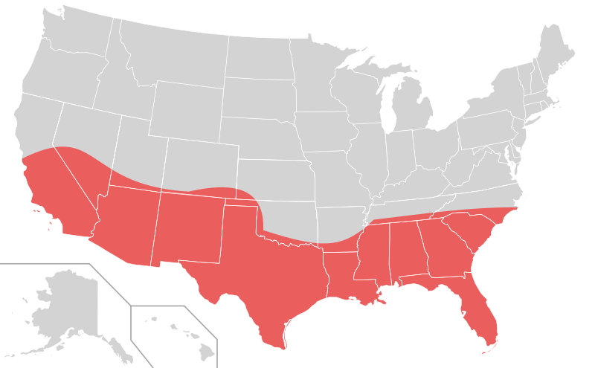
“The Economic Miracle”
Why was there economic success after WWII? (Minus inflation in the immediate years)
  Government spending – Interstate Highway System
  Baby Boomers (1946 – 1964) – created consumer demand
  Growth of suburbs -> increased home and automobile purchases
Industries affected by the automobile:
  Housing and oil, especially in Texas
Growth of the Sunbelt:
  15 state area from VA, through FL, all the way to CA
  Grew at a rate twice as fast as the Northeast (Frostbelt)
Unions:
  “Escalator-clauses” – automatic pay increases in line with CPI (inflation)
  Strikes became less frequent
  AFL-CIO merged into one union
  Taft-Hartley Act hurt unions:
    Outlawed the “Closed-shop”

Slide 3
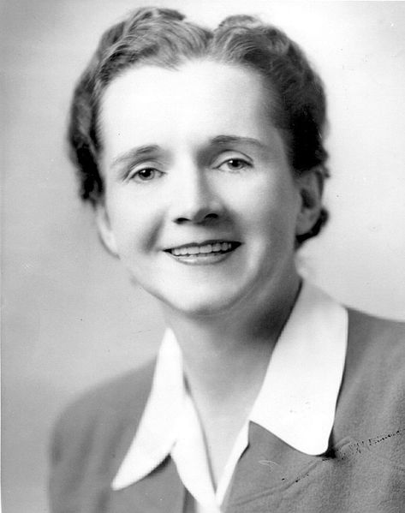
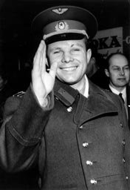
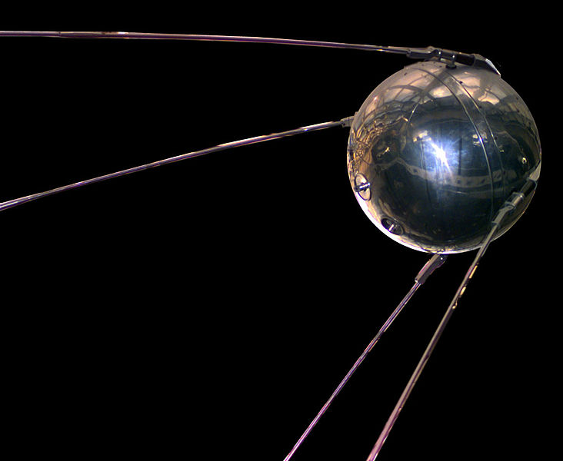
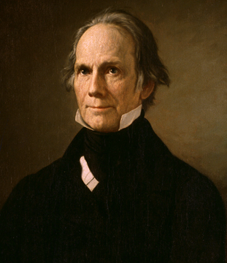
The Explosion of Science and Technology
New medical advancements:
  Many before the 1950s including: antiseptic solutions, penicillin
  1954 Polio vaccine – Jonas Salk – provided free vaccines
DDT Pesticide – harmful to insects
  Rachel Carson’s Silent Spring in 1962 exemplified the harmful effects of pesticides
1952 hydrogen bomb test:
  Much more powerful than atom bomb
  Soviet Union successfully tested their own the next year
Space Program:
  1957 – Soviet Union launched Sputnik
    ***US Responded by increasing spending on science and education***
  In 1958, NASA was created
  Yuri Gagarin became first person in outer space on April 12, 1961
  Soviet Union 2, US 0
Happy 185th birthday to me!

Slide 4
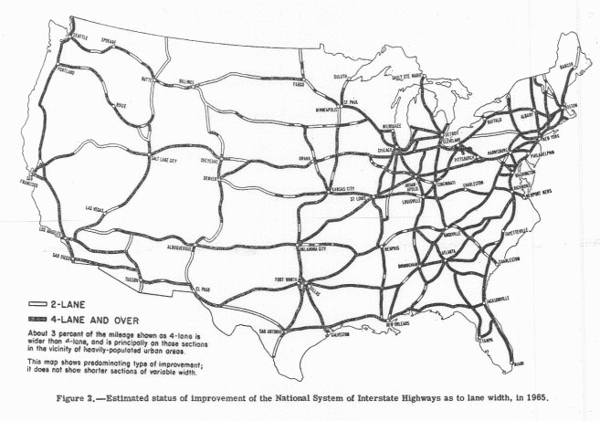
People Of Plenty
Rise in consumerism
  Consumer credit increased drastically in the 1950s
    Credit cards, store cards
  Car manufacturers produced newer, more stylish cars
  New appliances included: dishwashers, garbage disposals, and TVs
  Disneyland became very popular
Federal Highway Act of 1956:
  Created more than 40,000 miles of highways
  Largest government works project
  Would be beneficial incase of a nuclear evacuation
Impact of Highways?
  Railroad industry was negatively affected
  Hotel and motel industry drastically increased
  Growth of fast-food industries – McDonald’s
  Growth of suburbs -> could travel farther
How would Henry Clay feel? Why?

Slide 5
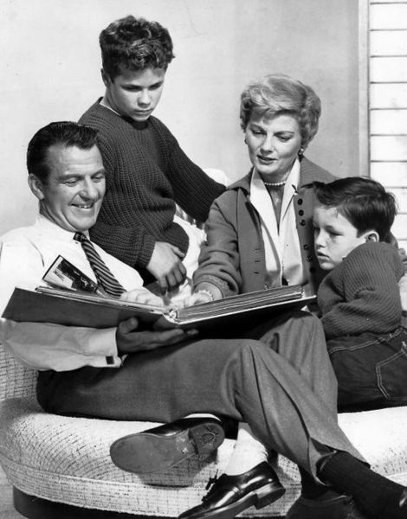
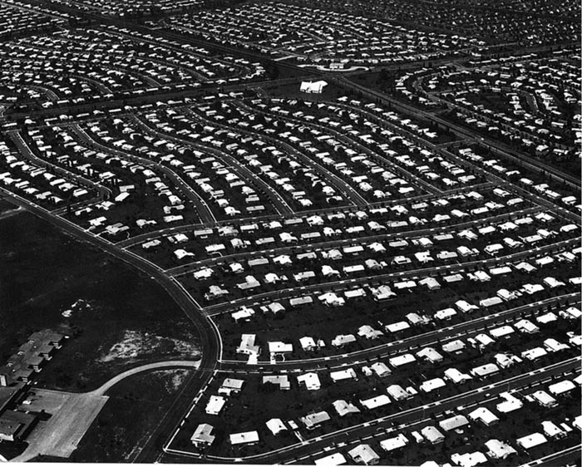
People Of Plenty Continued
Suburbs:
  Levittown:
    Cookie-cutter houses in suburban Long Island, duplicated in many other cities
    African Americans were forbidden from buying homes in Levittown
  “White Flight”
    Many White families moved to the suburbs
    Blacks (especially from the South, moved to cities)
Middle-Class Families:
  Many married women did not work
    Seen in television shows – “Leave it to Beaver”
  Dr. Benjamin Spock’s Baby and Childcare: raising children should be child-centered
  “Cult of domesticity”
    Women were expected to stay home, raise a family
TV
  40 million TVs in America by 1957 – more than refrigerators!
  Advertising industry increases
  TV “was also contributing to the sense of alienation and powerlessness among groups excluded from the world it portrayed.” (page 790)

Slide 6
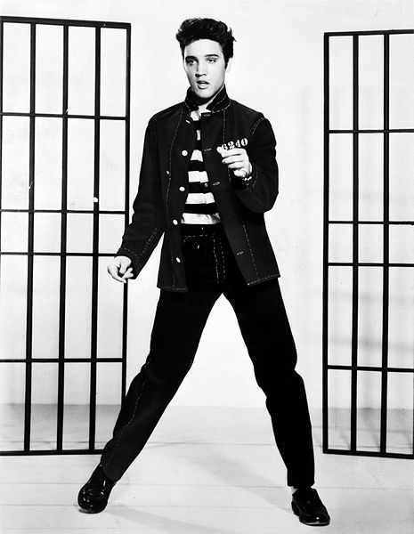
People Of Plenty Continued
White collar (office jobs) outnumbered blue collar (manufacturing) in the 1950s
Schools increased focus on math and science (thanks Sputnik)
***The Beat Generation***
  Authors that criticized middle-class values and conformity in the 1950s
  Jack Kerouac’s On The Road
  ***The Beats were similar to the Lost Generation of the 1920s***
Rock ‘N’ Roll Music
  Influenced by African American music
  Elvis Presley – brought sexuality to the forefront of American society

Slide 7
The “Other America”
The Other America – Michael Harrington
  Book that brought attention to poverty
  Influenced LBJ’s “Great Society”
  Argued 25% of nation and 40% of African Americans lived in poverty
  Native Americans were the poorest group in America
Inner Cities:
  Due to the growth of suburbs, many cities became rundown, or “ghettos”
  “Urban Renewal”
    Effort to rebuild poor areas of cities

Slide 8
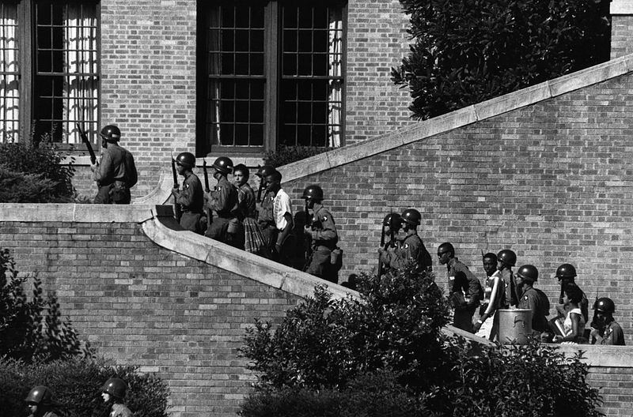
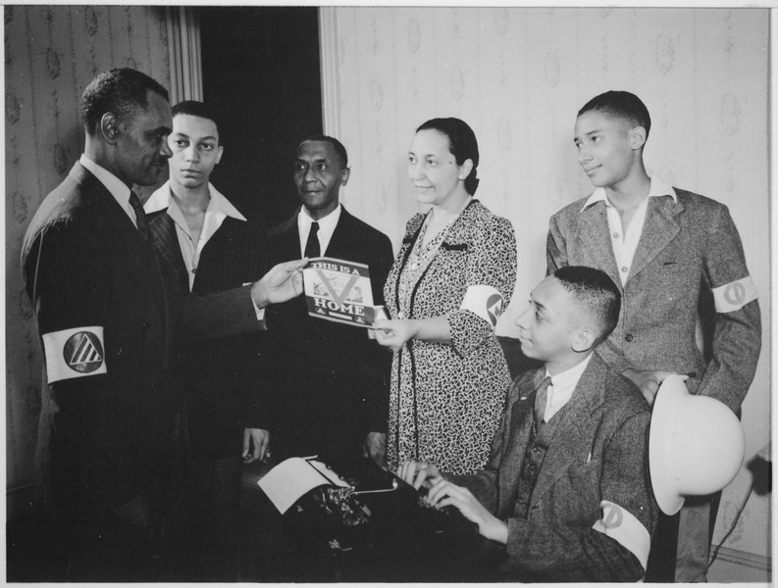
The Rise of the Civil Rights Movement
1948: Truman desegregated military (9981)
Double V campaign (WWII):
  Victory over fascism abroad, victory over racism at home
***Brown v. Board (1954)***
  Ended “Separate but Equal” established by Plessy
  Schools must be desegregated with “All deliberate speed”
Massive Resistance:
  Many southern schools shut down rather than desegregate
  “Southern Manifesto”
    Signed by over 90 members of Congress, stated the Supreme Court overstepped its boundaries
    Nowhere in the Constitution is education mentioned
“Little Rock Nine”
  Arkansas: Eisenhower sent troops to escort “Little Rock 9” to school

Slide 9
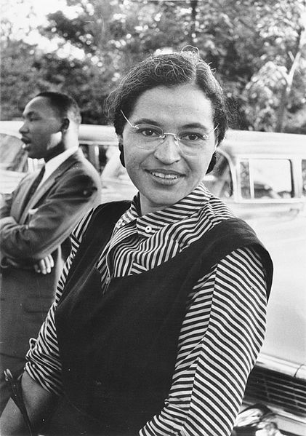
The Rise of the Civil Rights Movement
Montgomery Bus Boycott:
  December 1, Rosa Parks refused to give up her seat
  Martin Luther King, Jr. – 26 years old
    Drew on ideas from Jesus, Thoreau, and Gandhi
  1 year after Rosa Parks was arrested, Montgomery busses were desegregated
TV and Civil Rights:
  Demonstrated how whites lived, inspired activism to achieve similar living conditions
The Cold War Helped contribute to the Civil Rights Movement
  Is the US “better” than the Soviet Union if there is discrimination and racism?

Slide 10
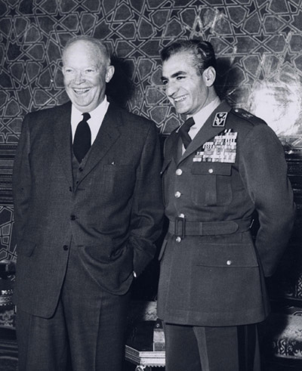
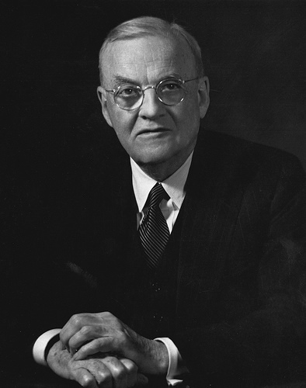
Eisenhower and Republicanism
Secretary of State – John Foster Dulles
  Massive Retaliation:
    Brinkmanship
Dien Bien Phu Falls (1954), Rock the clock, Einstein, James Dean…….
  France leaves Vietnam, fear that Vietnam could turn Communist…..
  US increases its presence
Eisenhower Doctrine:
  Fear that Communism could progress to Middle East countries (oil)
  President could provide military and economic aid to nations resisting communism
Iran:
  Moussadegh was overthrown
  The Shah was instituted as leader by the CIA
Suez Crisis
  Egyptian President Nasser nationalized the Suez Canal
  France, Britain, and Israel attacked Egypt
  US did NOT support the attack, France, Britain, and Israel withdrew
Guatemala President Arbenz was overthrown after he nationalized land owned by a US fruit company

Slide 11
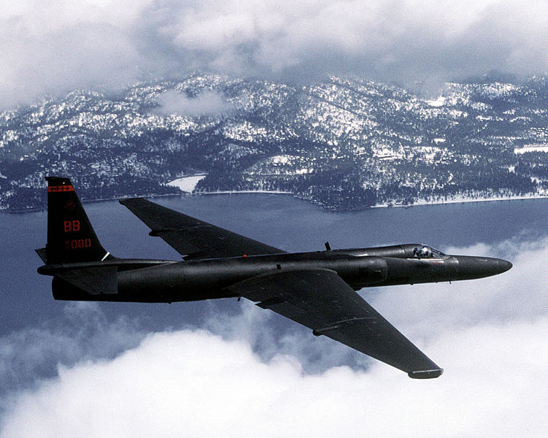
Eisenhower and Republicanism
Cuba:
  US businesses owned a significant amount of land and resources
  January 1, 1959: Fidel Castro comes to power
  Castro and the USSR grew close, US cut ties with Cuba
Hungarian Revolt:
  Hungarian citizens sought democratic reforms
  The Soviet Union quickly crushed the revolution
  US did not intervene
U-2 Spy plane, May 1, 1960:
  The US and Soviet Union planned a series of planned summits
  USSR shot down a US spy plane
  Khrushchev cancelled further summits

Slide 12
Quick Recap
Levittowns, suburbs, and “white flight”
Sputnik and the Space Race
Interstate Highway System
Beat Generation
Double V Campaign
Brown v. Board
Massive Resistance
Southern Manifesto
Eisenhower Doctrine
Fall of Dien Bien Phu
Iran
U2 Spy Plane
Cuba!

Slide 13
Thanks for watching!
  Subscribe to my channel
  Press the “Like” button
Questions? Comments?
Ideas for videos?
  Leave in comments
Don’t forget to subscribe!
Subscribe
Down here!

