Slide 1
American History: Chapter 29 Review Video
www.Apushreview.com
Civil Rights, Vietnam, And The Ordeal Of Liberalism

Slide 2

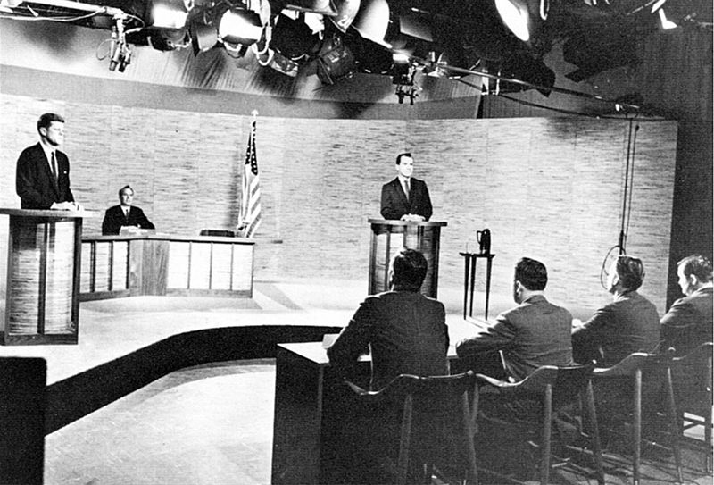
Expanding the Liberal State
Election of 1960:
  Kennedy (D) v. Nixon (R)
  TV played an important role
  Kennedy won in a close election
New Frontier – urban renewal, civil rights, health care
LBJ’s “Great Society”
  Focused on domestic programs including civil rights, poverty, and education
  Built on ideas and programs laid forth from The New Deal
War on Poverty:
  Office of Economic Opportunity:
    Administered money to various programs and areas of the country, particularly lower-income areas
Medicare:
  Medical assistance and insurance for elderly Americans
Medicaid:
  Health care for lower income families and individuals
Housing and Urban Development (HUD)
  Cabinet position created during LBJ’s administration
  Focused on urban development and renewal
  (Still around today)

Slide 3
Expanding the Liberal State
Immigration Act of 1965:
  Eliminated quotas from 1920s
Impact of the Great Society?
  Several programs are still around today
  Poverty was reduced in the 1960s
  Vietnam and the Great Society competed with each other for government funds

Slide 4
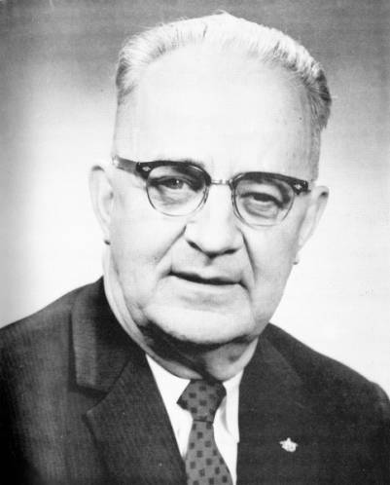
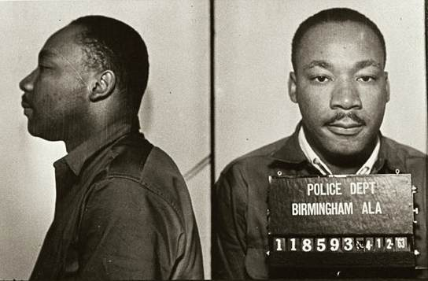
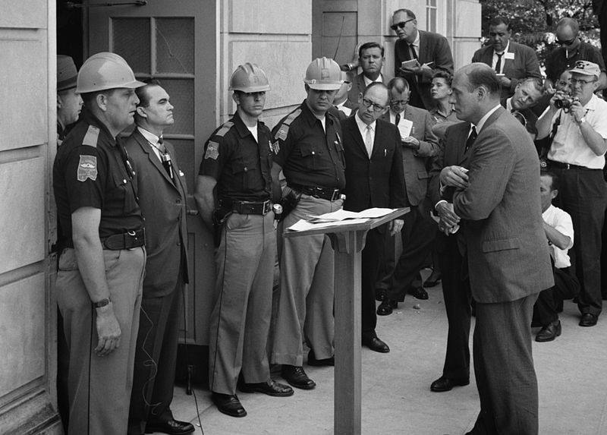
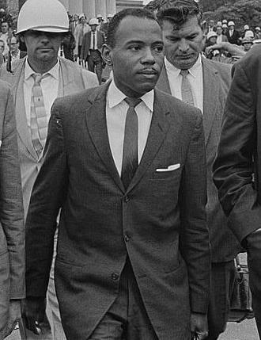
The Battle For Racial Equality
Greensboro, North Carolina Sit-in, February 1, 1960
  4 black students sat at a segregated counter of a Woolworth’s
  Inspired sit-ins across the country
Congress of Racial Equality (CORE)
  “Freedom riders” wanted to challenge segregation on interstate buses in the South
James Meredith:
  28 year old black Air Force Veteran registered at University of Mississippi
  Kennedy ordered 30,000 troops to restore order
Eugene “Bull” Connor:
  Used fire hoses and dogs to break up protests
“Letter from a Birmingham Jail”
  Drew on Thoreau’s and Gandhi’s ideas of civil disobedience
Governor George Wallace
  Vowed to avoid desegregation at the University of Alabama
Kennedy realized he could no longer negotiate the issue of civil rights
August 28, 1963:
  “I have a dream”
Civil Rights Act of 1964:
  Guaranteed equal access to public accommodations
  Government could cut off funds where discrimination occurred
Voting Rights Act of 1965:
  Federal government could register voters
  Eliminated literacy tests for voting
24th Amendment:
  Eliminated poll taxes

Slide 5
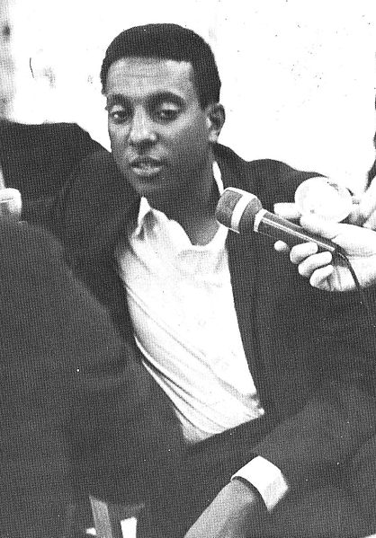
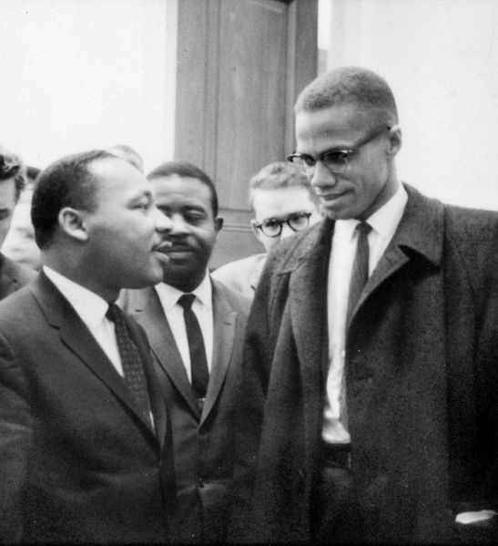
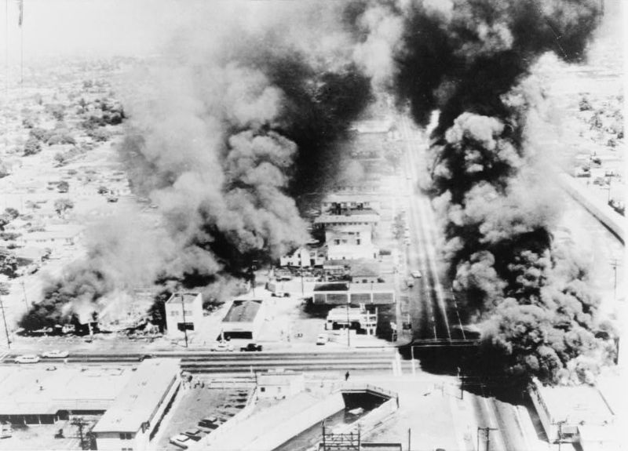
The Battle For Racial Equality
De Jure Discrimination:
  Discrimination by laws
De Facto Discrimination:
  Discrimination by custom and tradition
Watts Riots (1965):
  6 day riot in August; 34 people died; other racial riots occurred in other cities
“Black Power”:
  Movement “away from interracial cooperation and toward increased awareness of racial distinctiveness.” (p. 816)
  Inspired by Marcus Garvey from the 1920s
Student Nonviolent Coordinating Committee (SNCC)
  Later, under the leadership of Stokely Carmichael, SNCC focused on black power
Black Panthers (1966):
  Huey Newton and Bobby Seale
  Advocated the arming of blacks against white police
Malcolm X:
  Advocated “black revolution” and black separatism
  Appealed to frustrated African Americans
  Assassinated in February, 1965

Slide 6

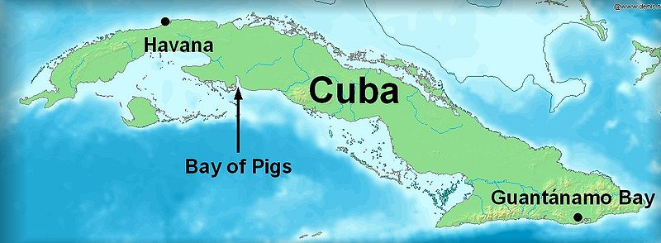
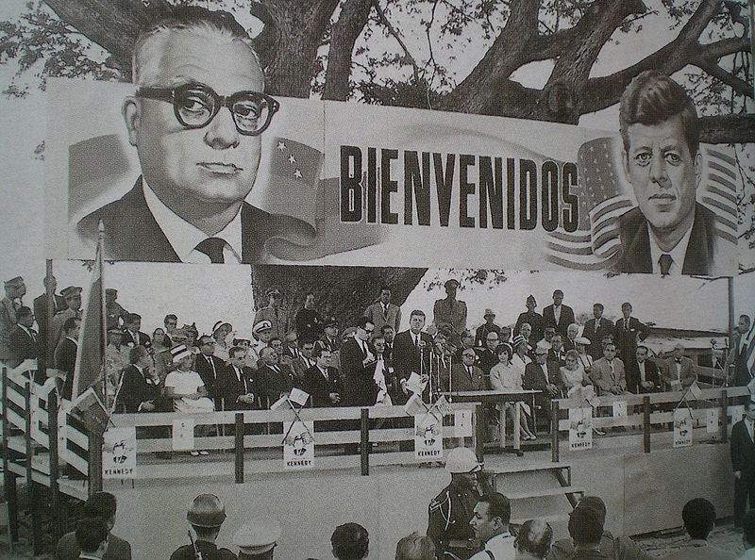
“Flexible Response” and The Cold War
“Flexible Response”
  Developed a plan to find new ways of combating the Cold War
  Covert operations
  Green Berets developed under JFK
Alliance for Progress:
  $ billions were pledged to improve the economy in Latin America
Peace Corps: Created in 1961
  Young Americans that would serve 24 months over seas
    Doctors, teachers, etc.
    Focused on social and economic development
  Hoped to improve countries and resist communism
Bay of Pigs Invasion
  Cuban exiles (trained by US) would invade Cuba
  April, 1961 the invasion takes place
    US does not directly get involved
    The invasion is a HUGE failure
  Impact:
    Cuba and USSR worry about future invasions

Slide 7
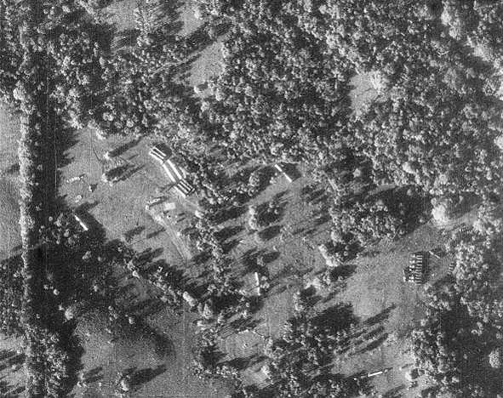
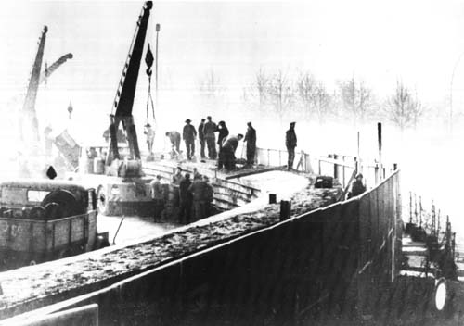
“Flexible Response” and The Cold War
Berlin Wall:
  Between 1949 and 1961, over 2.5 million East Germans fled Soviet-controlled East Germany through West Berlin
  August 13, 1961, Soviets began construction of the Berlin Wall
Cuban Missile Crisis
  On October 14, US surveillance discover missiles with nuclear capabilities in Cuba
    Could destroy most of the US
  JFK quarantined Cuba
    Would not allow other Soviet ships in
  Eventually, the Soviet Union withdrew missiles
    US promised not to attack Cuba
    US would withdraw missiles from Turkey
  Impact?
    “hot line” established

Slide 8
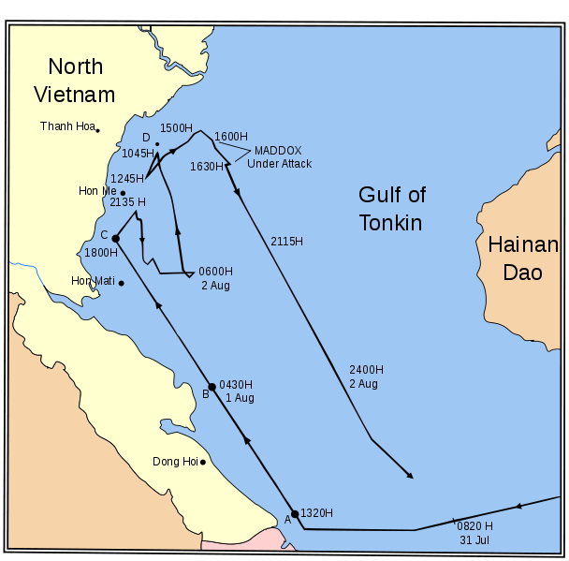
The Agony of Vietnam
Dien Bien Phu Falls (1954):
  France withdrew from French Indochina (Vietnam)
  US presence in Vietnam increases
North Vietnam = Communist
South Vietnam = Noncommunist
  Divided at the 17th parallel
***Gulf of Tonkin Resolution***
  American ships were supposedly attacked
  Provided a “blank check” to Johnson in Vietnam
  Increase in presidential powers during war

Slide 9
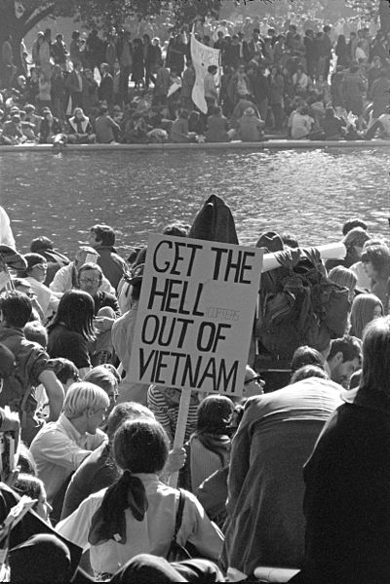
The Traumas of 1968
Tet Offensive:
  Attack by North Vietnam during the Vietnamese New Year
  Led to an increase of opposition to the US in the war
Johnson declares he won’t run for re-election in 1968:
2 assassinations:
  April 4 – Martin Luther King Jr.
    Riots broke out throughout the country
  June 6 – Robert Kennedy
The Democratic Convention of 1968:
  Protests over the Vietnam war
  Police and demonstrators clashed
The Election of 1968
  George Wallace – 3rd party candidate:
    Ran on a segregation, anti-Great Society, and anti-protesting platform
  Richard Nixon campaigned on “Peace with honor”
  Nixon defeated Hubert Humphrey, 301 - 191

Slide 10
Quick Recap
Great Society, Medicare, Medicaid
Sit-ins
James Meredith
Civil Rights Act of 1964
Voting Rights Act of 1965
Letter from a Birmingham Jail
Flexible Response
Bay of Pigs
Cuban Missile Crisis
Gulf of Tonkin
Tet Offensive
George Wallace

Slide 11
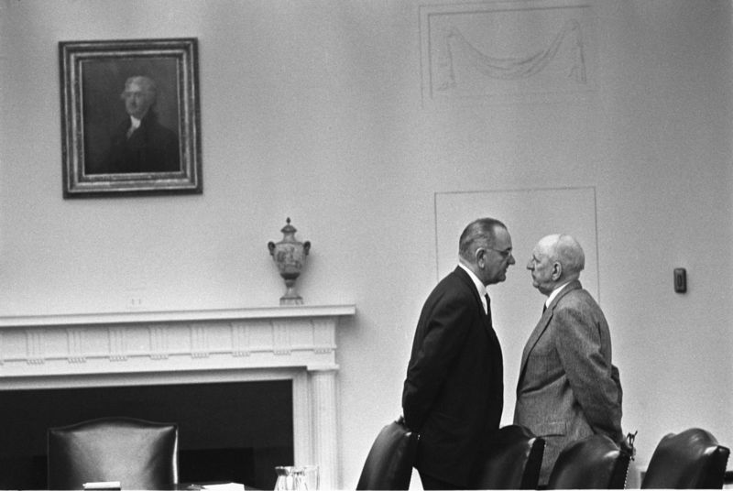
Thanks for watching!
  Subscribe to my channel
  Press the “Like” button
Questions? Comments?
Ideas for videos?
  Leave in comments
Subscribe, now…..
Subscribe
Down here!

