Slide 1
American History: Chapter 30 Review Video
www.Apushreview.com
The Crisis of Authority

Slide 2
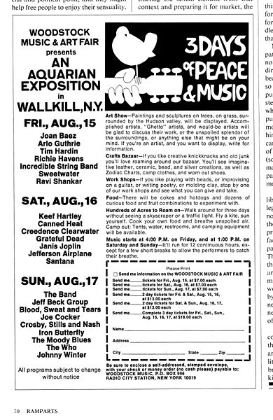
The Youth Culture
New Left:
Many whites that championed rights for minorities
Students for a Democratic Society (SDS):
Antiwar activists that used terrorism by the end of the 60s
UC Berkeley:
Free Speech Movement
Objected to not being allowed to use school grounds for political debate
Counterculture:
“hippies” – focused on sexual revolution, music, and drugs
Woodstock – 1969
Music concert in NY – 400,000 attended

Slide 3
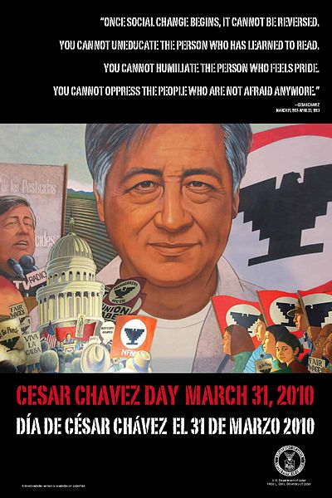
The Mobilization of Minorities
Native Americans:
Post – WWII, focus on “assimilating” Native Americans
1961: Declaration of Indian Purpose:
Self-determination for Natives
1968 – Indian Civil Rights Act:
Recognized tribal laws within reservations
Latinos:
Cesar Chavez:
United Farm Workers (UFW) – union of farmworkers, demanded higher wages
Cesar went on a hunger strike
Gay Liberation:
Stonewall Riots:
Police arrested patrons of a gay bar, clashed with patrons
New activist groups emerged across the nation

Slide 4
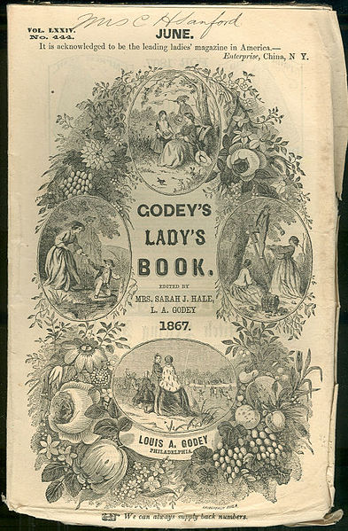
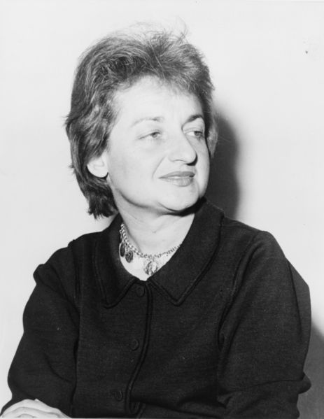
The New Feminism
“Cult of domesticity”
Women were expected to stay home, raise a family
“Leave it to Beaver”
2 children, suburban house, stay at home mom
***Betty Friedan***
Author, The Feminine Mystique, bestselling book that launched modern women’s movement
Argued that many housewives in suburbs were not happy and lived unfulfilled lives
National Organization for Women (NOW):
Founded in part by Friedan, influential feminist organization
Helped bring attention to lack of women in certain professions and politics
Many women faced discrimination in antiwar and civil rights organizations
1971 – affirmative action guidelines included women
1972: an important year
Title IX: No person in the United States shall, on the basis of sex, be excluded from participation in, be denied the benefits of, or be subjected to discrimination under any education program or activity receiving federal financial assistance
Equal Rights Amendment – passed Congress, never ratified (more on that later)

Slide 5
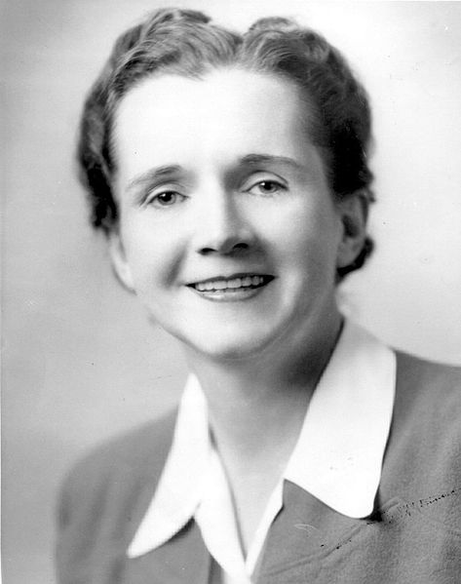
Environmentalism In A Turbulent Society
***Silent Spring***
Written by Rachel Carson
Exposed the impact of insecticides on the environment
1970:
April 22 – 1st Earth Day
Environment Protection Agency (Nixon)
Clean Air Act (Nixon)
Clean Water Act – 1972 (Nixon again)

Slide 6
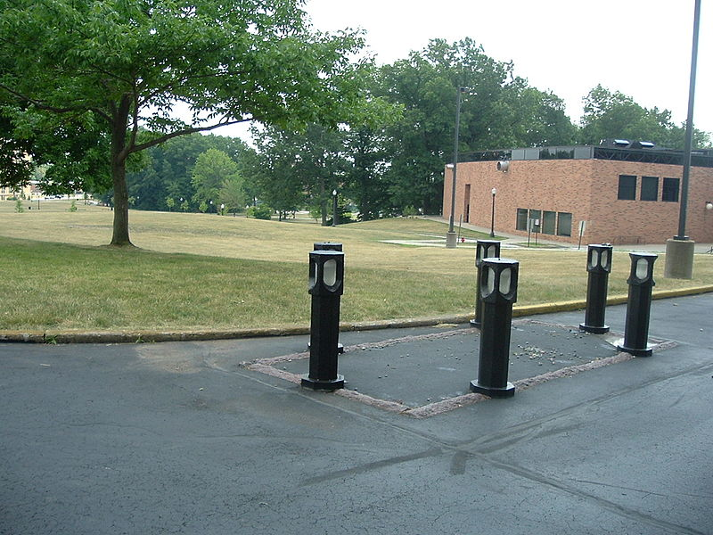
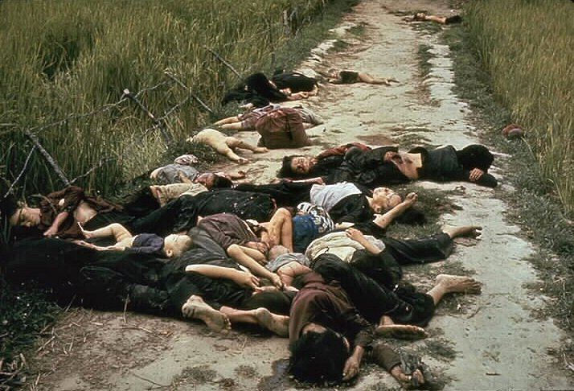
Nixon, Kissinger, and the War
Vietnamization:
Gradually withdrawing US troops from Vietnam
Transitioning the military burden to the South Vietnamese
“Using weapons, training, and advice”
April, 1970:
Nixon ordered the US begin attacking Cambodia, a neighboring, neutral country
The Cambodia bombings led directly to……
Kent State Protests:
Student protests
4 students died, many more injured
The Cambodia Bombings made many Americans question the government
Senate repealed the Gulf of Tonkin Resolution
Pentagon Papers:
Revealed mistakes and deception of JFK and LBJ regarding Vietnam
My Lai Massacre 1968:
Killing of Vietnamese women and children

Slide 7
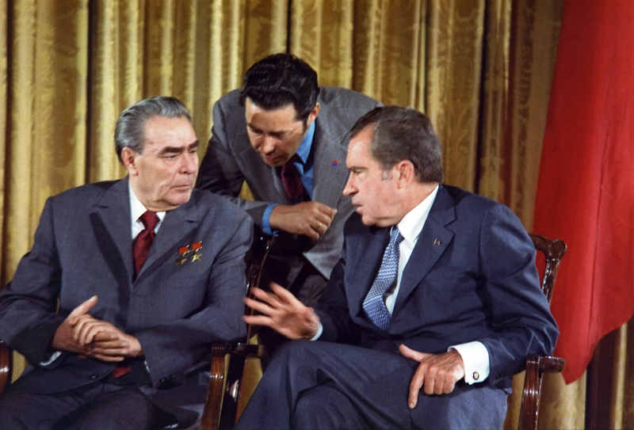
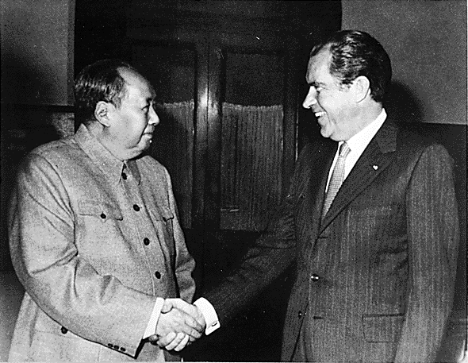
Nixon, Kissinger, And The World
February 21, 1972: (MY BIRTHDAY! – 1982)
Nixon visits China
Improvement in relations between China and US; led to…..
Détente:
Easing of Cold War tensions
Anti-ballistic missile treaty
Strategic Arms Limitations Talks (SALT):
Limited the number of long-range nuclear weapons
Nixon Doctrine:
US would honor current commitments, but in the future, Asian countries would defend themselves without American troops
Syria and Egypt attacked Israel
US provided $2 billion in aid to Israel
Arab nations responded with an oil embargo
Oil and gas prices increase

Slide 8
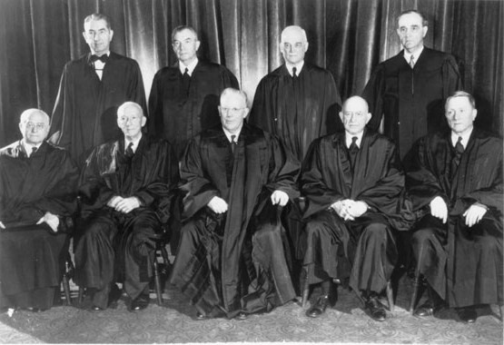
Politics and Economics Under Nixon
“Silent Majority”:
Nixon’s belief that most Americans supported the war, but were not vocal
Believed they also wanted to reduce federal interference
Warren Court:
Led by Chief Justice Earl Warren (1953 – 1969)
Decisions affected rights of criminals and the accused, religion, civil rights, and women
Mapp v. Ohio (search warrants)
Gideon v. Wainwright (right to lawyer, even if you can’t afford one)
Escobedo v. Illinois (Right to lawyer from time of arrest)
Miranda v. Arizona (Right to remain silent)
Engel v. Vitale (School sanctioned prayer is unconstitutional)
Griswold v. Connecticut (Birth control is legal)
Tinker v. DesMoines (Free speech is fine in school)
Nixon, upset with the court’s decisions, appointed judges he felt would “strictly” interpret the Constitution
Appointed Warren Burger as new Chief Justice
Roe v. Wade (1973) – legalized abortion
Bakke v. Board of Regents - Giving preferential treatment based solely on race was not allowed…
However, race could be one of several factors in admitting students

Slide 9
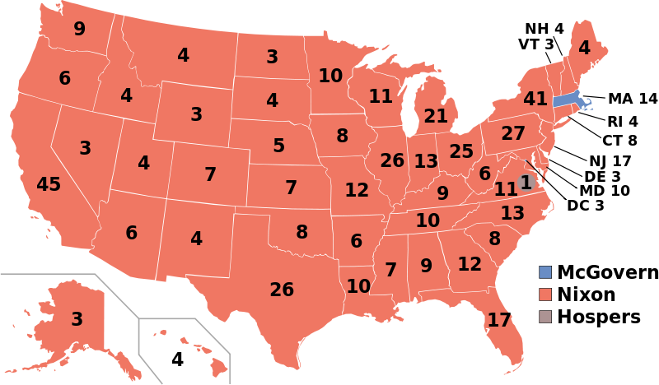
Politics and Economics Under Nixon
Election of 1972:
George McGovern (D) promised to end war in 90 days
Nixon wins in a landslide
Cease-fire in Vietnam on January 23, 1973
Nixon claimed he achieved “Peace with Honor”
Reasons for economic downturn:
High cost of Vietnam War
Rising oil prices
Inflation
High funding for Great Society
Stagflation:
Inflation plus economic downturn (unemployment)
War Powers Act (1973)
Essentially overturned “Gulf of Tonkin” Resolution
Limited the President’s involvement in wars
Must inform Congress within 48 hours of taking war actions

Slide 10
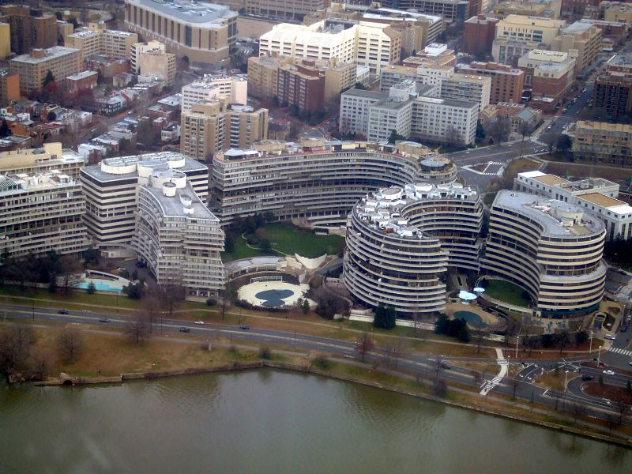
The Watergate Crisis
June 17, 1972:
5 men broke into Democratic headquarters in Watergate
CREEP – Committee to Re-Elect the President
VP Agnew:
Resigned over taking bribes
Led to the appointment of Gerald Ford
Nixon secretly recorded most Oval Office Conversations
“Saturday Night Massacre”
Nixon fired a special prosecutor, Attorney General, and deputy Attorney General
Nixon claimed right of “Executive Privilege”
Supreme Court stated he could not withhold evidence and tapes
House drew up impeachment charges, Nixon resigned
US v. Richard Nixon:
Nixon must turn over the tapes, did not have “executive privilege”

Slide 11
Quick Recap
Stonewall riots
Détente
War Powers Act overturns Gulf of Tonkin Resolution
Cambodia Bombings led to Kent State Protests
Warren Court
***Rachel Carson and Silent Spring***
Betty Friedan and ***The Feminine Mystique***
Stonewall Riots
Watergate

Slide 12
Thanks for watching!
Subscribe to my channel
Press the “Like” button
Questions? Comments?
Ideas for videos?
Leave in comments
You both agree to limit nukes AND subscribe to Adam Norris
Subscribe
Down here!

