Slide 1
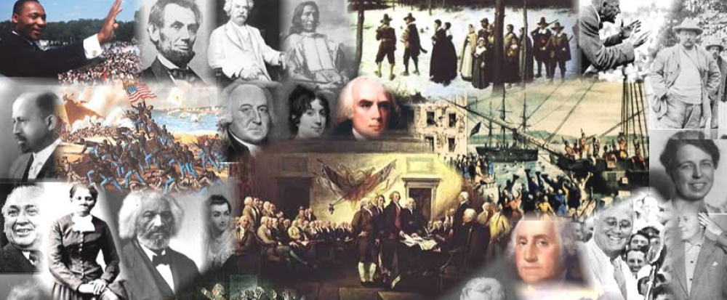
www.Apushreview.com

Slide 2
Religion in the British Colonies
Everything You Need To Know About Religion In The British Colonies To Succeed In APUSH

Slide 3
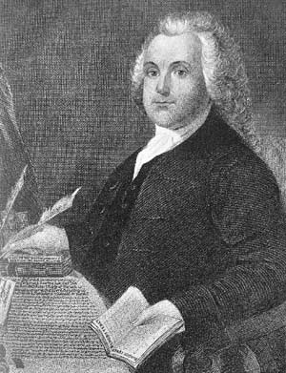
Puritans and Separatists
Puritans:
  Were Calvinists
  Wanted to Purify the English (Anglican Church) of ALL Catholic rituals
  Believed that only “Visible Saints” should be admitted to Church Membership
  Famous Puritan: John Winthrop
Separatists: Extreme Puritans who wanted to break away from Church of England all together
  Harassed and want to leave England
  Famous Separatists: Roger Williams and the Pilgrims (Plymouth)

Slide 4
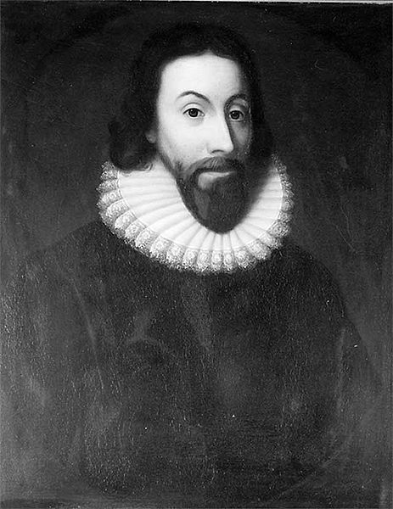
Massachusetts Bay Colony
Puritans
John Winthrop
  Governor of MBC
  Declared that the purpose of the colony was to “be a city upon a hill” (COMMIT THIS TO MEMORY!!!)
      Did not extend religious toleration to others in the colonies
Town Governments:
  “Town Hall Meeting”:
    Elected officials on a yearly basis
    White, land-owning, male, church members could vote
    Women, African-Americans, poor, and non-church members were left out of voting

Slide 5
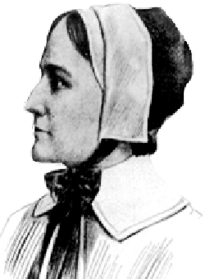
Banished from MBC!
Roger Williams
    Extreme Separatist, advocated for a clean break from the Anglican church (Church of England)
    Challenged Bay colony charter and condemned Bay for not paying Natives for their land
    Banished to Rhode Island
Anne Hutchinson
    Known for challenging the authority of the clergy in the Bay Colony
    Challenged gender roles in the Church
    Banished to RI, later NY
    Church became more strict on women afterwards

Slide 6
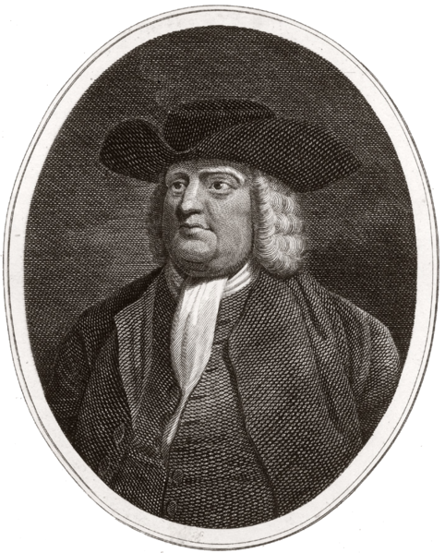
Pennsylvania
Characteristics of Quakers:
  Pacifists, did not pay taxes for churches – no paid clergy, did not take oaths, rights for women
William Penn (Quaker)
  Established Pennsylvania as a haven for Quakers
  Paid Natives for their land
“Holy Experiment”
  Religious toleration for many different religions and obtain a profit

Slide 7
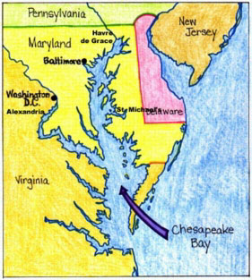
Maryland
Maryland founded by Lord Baltimore as a safe haven for Catholics
Maryland Acts of Toleration (1649):
  Guaranteed religious toleration to Catholics
  Did not extend to non-Christians

Slide 8
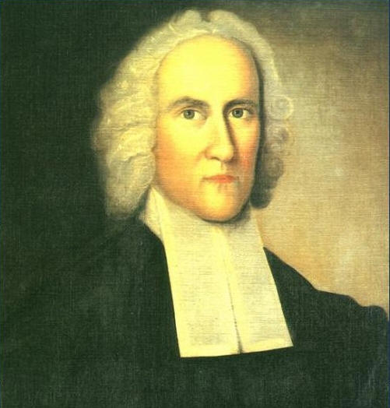
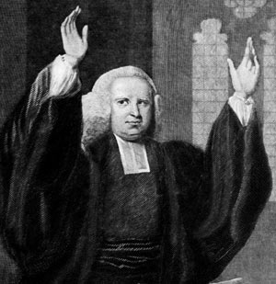
The 1st Great Awakening
When?
  1730s – 1740s
What was it?
  Religious revival
  Reaction to Enlightenment, easing of church membership/salvation
Key characteristics:
  Highly emotional, individual experiences
Key People:
  George Whitefield
    Influential orator
  Jonathan Edwards
    Against easy salvation
  “Old Lights”
    Did not embrace the revivals as easily
  “New Lights”
    Focused on the individual experience
Effects?
  New branches emerged
  Major social movement on a large scale

Slide 9
Past Essay Topic (2002)
Compare the ways in which religion shaped the development of colonial society (to 1740) in TWO of the following regions:
  New England
  Chesapeake
  Middle Atlantic
http://www.collegeboard.com/prod_downloads/ap/students/ushistory/ushist_frq_02.pdf

Slide 10

That’s it!
  Subscribe to my channel
  Help spread the word
Questions? Comments? Ideas for videos?
  Leave in comments
Subscribe
Down here!

