Slide 1
APUSH Review: Key People Associated With The Great Depression And New Deal
www.Apushreview.com
Everything You Need To Know Key People Associated With The great depression and New Deal To Succeed In APUSH

Slide 2
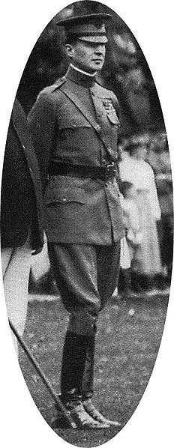
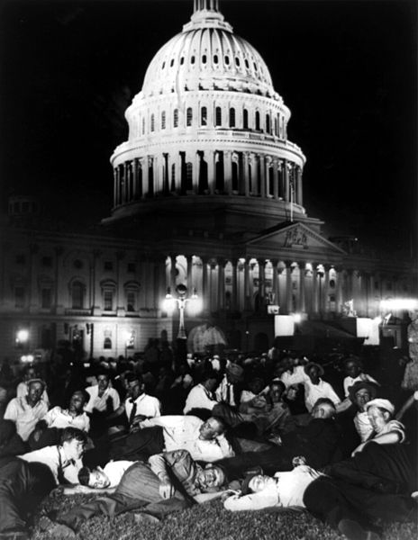
The Bonus Army
Bonus Expeditionary Force” (BEF)
  Promised a bonus for their service at a later date (1945)
  Descended upon D.C. in 1932 in hopes of receiving their bonuses
  Set up “Hoovervilles”
Hoover ordered army (led by Douglas MacArthur) to break up “Bonus Army”
  Many Americans resented Hoover for his actions

Slide 3
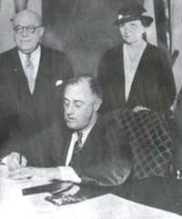
Frances Perkins
Part of FDR’s “Brain Trust”
  FDR’s inner circle
  Similar to Andrew Jackson’s “Kitchen Cabinet”
Who was Frances Perkins?
  Secretary of Labor
  First woman Secretary in US History

Slide 4
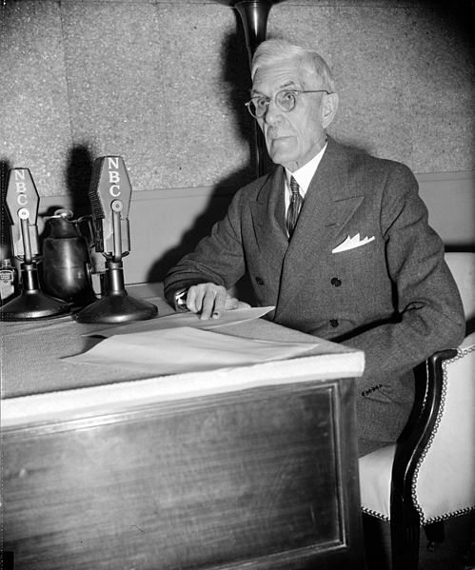
Dr. Francis Townsend
Activist for elderly Americans
Creator of the “Townsend Plan”
  Favored giving Senior Citizens $200 a month
  Money would be financed by a new tax
Instrumental in establishing Social Security

Slide 5
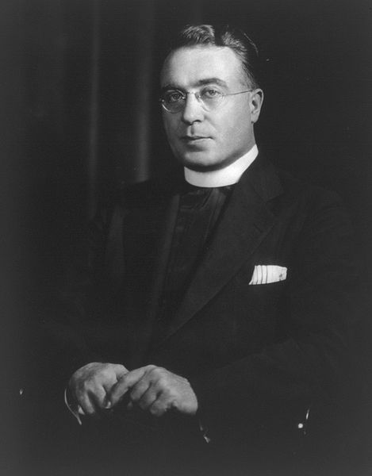
Father Charles Coughlin
Incredibly popular radio host
Originally supported the New Deal, later became a critic
  Wanted to change the banking system
Eventually, his anti-Semitic feelings helped get his radio show cancelled

Slide 6
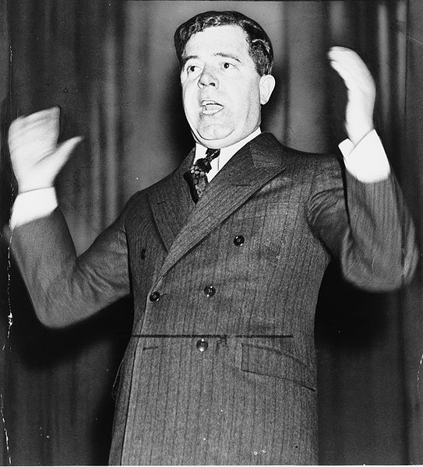
Huey Long
Senator from Louisiana
Share Our Wealth Program
  Proposed giving each family $5,000 by taxing the wealthy
  Example of redistribution of wealth
Assassinated in 1935
  Could have been a challenge to FDR in 1936 Democratic Primary

Slide 7
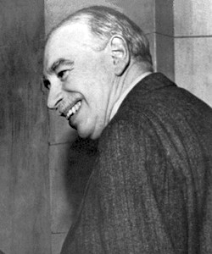
John Maynard Keynes
British Economist
Advocated that the government should run a deficit to “prime the pump”
  Government should spend more money than it takes in (short-term)
Roosevelt instituted this philosophy during the recession in 1937-1938

Slide 8
Thanks for watching!
  Subscribe to my channel
  Help spread the word
Questions? Comments? Ideas for videos?
  Leave in comments
Subscribe
Down here!

