Slide 1
APUSH Review: Key Progressive Reformers and Amendments To Know
www.Apushreview.com
Everything You Need To Know About Key Progressive Figures and Amendments To Succeed In APUSH

Slide 2
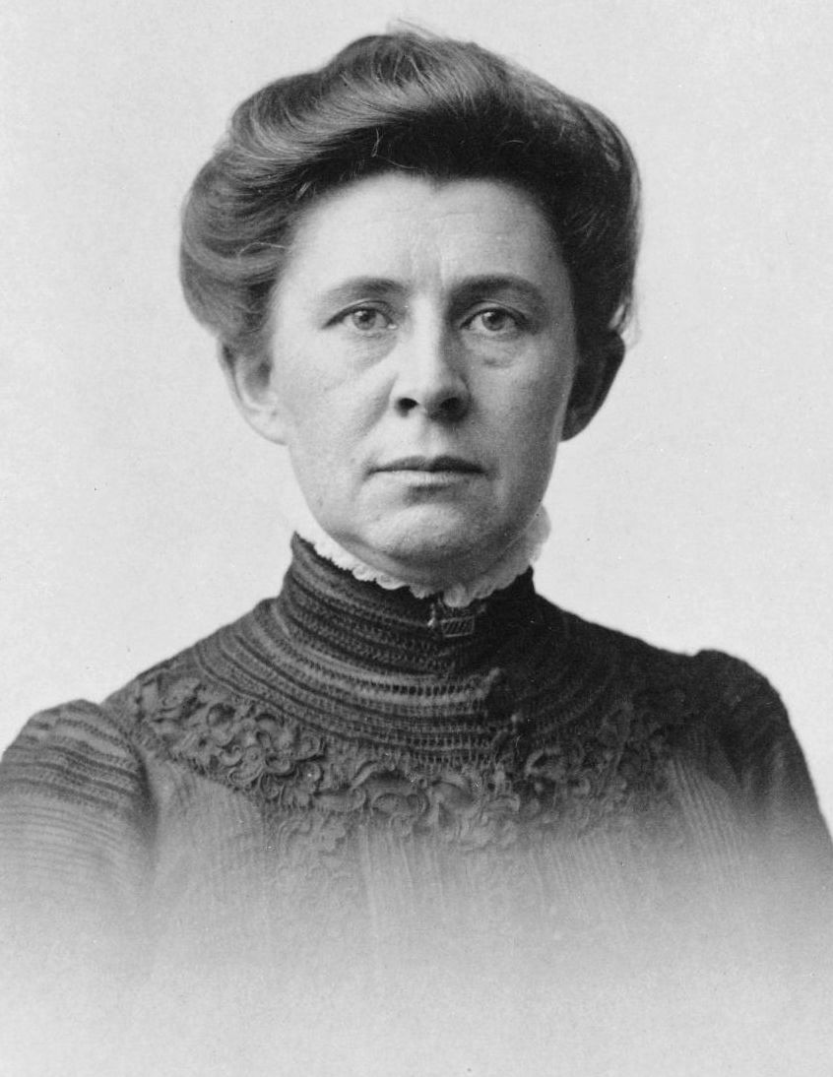
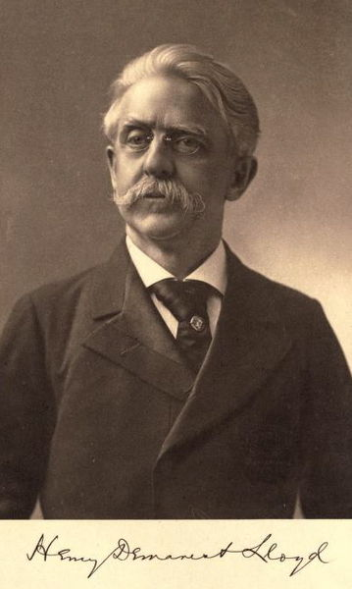
Standard Oil Critics
Henry Demarest Lloyd – Wealth Against Commonwealth
Exposed practices of the Standard Oil Company
Ida Tarbell – The History of the Standard Oil Company
2 volume book written about unfair practices of Standard Oil
7 years later, in 1911, Standard Oil was broken up into several smaller companies

Slide 3
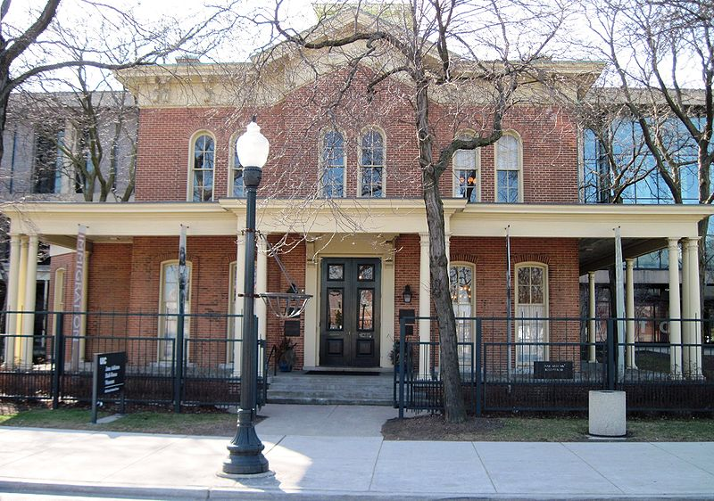
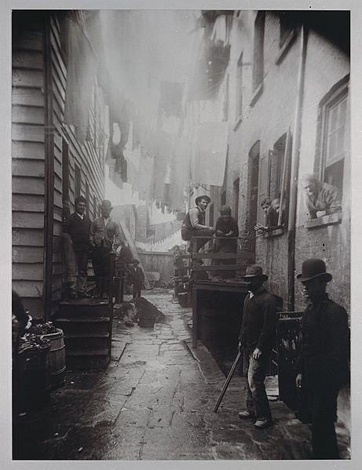
City Life Reformers
Jacob Riis – How the Other Half Lives
Photographer/ good buddy with TR
Photographed immigrant housing in NYC
Public reaction called for improved conditions
Jane Addams – Hull House
Chicago, most famous settlement house
Helped women and immigrants adjust to life
Provided education, housing, and food

Slide 4
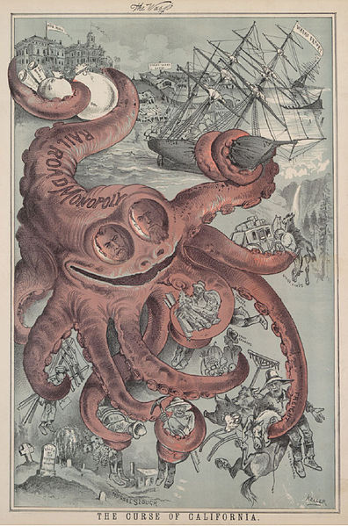
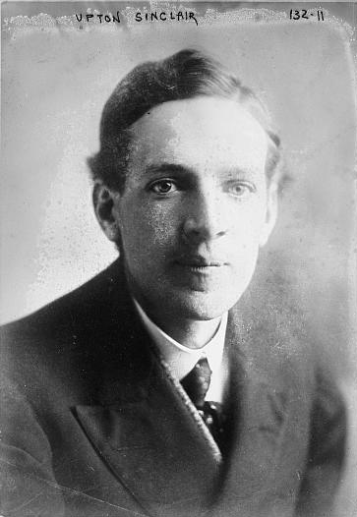
Industry Reformers
Upton Sinclair – The Jungle
Exposed the horrors of the meatpacking industry
Led to the passage of:
Pure Food and Drug Act:
Required labels on food
Meat Inspection Act:
Federal government could inspect meat shipped across state lines
Frank Norris – The Octopus
Novel about the relationship between railroads and California famers

Slide 5
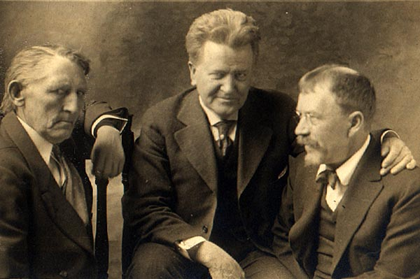
Government Reformers
Lincoln Steffens – The Shame of Cities
Claimed that businesses corrupted Municipal (city) government
David Phillips: “The Treason of the Senate”
Exposed corruption in the Senate
Relationship between Senators and corporations
Robert La Follette – Governor of Wisconsin – “Wisconsin Idea”
Regulation of public utilities
Introduced many Progressive reforms to Wisconsin
Initiative
Referendum
Recall

Slide 6
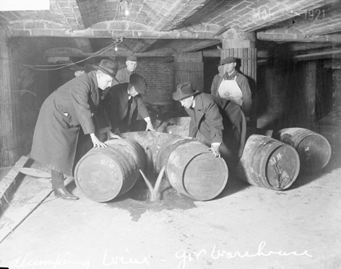
Progressive Amendments
16:
Graduated income tax
17:
Direct election of Senators
Individuals vote instead of state legislatures
18:
Prohibition of alcohol
19:
Women’s suffrage

Slide 7
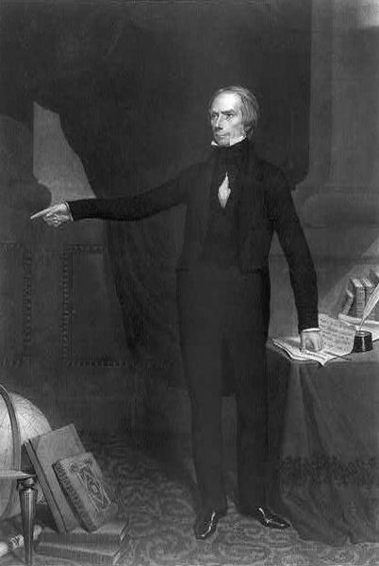
Thanks for watching!
Subscribe to my channel
Help spread the word
Questions? Comments? Ideas for videos?
Leave in comments
When I was Senator, I was elected by the Kentucky state legislature
Subscribe
Down here!

