Slide 1
APUSH Review: The Progressive Era
Everything You Need To Know For Your APUSH Exam

Slide 2
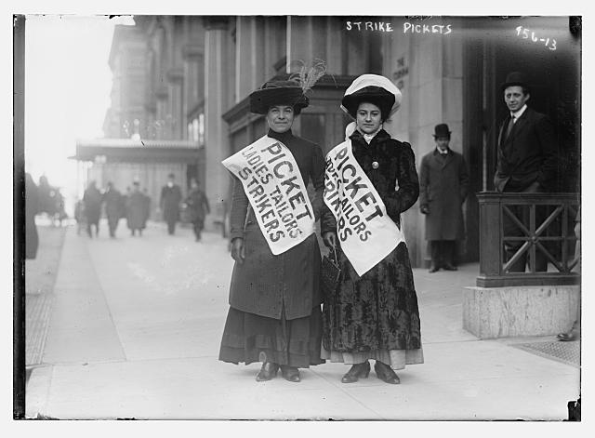
The Progressive Era: An Intro
What was The Progressive Era?
  A period of reform on national and state levels from 1900 – 1920
Who were Progressives?
  Women, members of the Middle-Class, and people that lived in urban areas
Progressives also carried ideas over from the Populist Era (farmers)
  Direct election of senators, railroad regulation, secret ballot, income tax

Slide 3
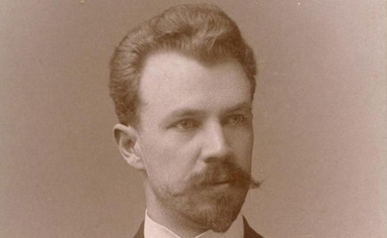
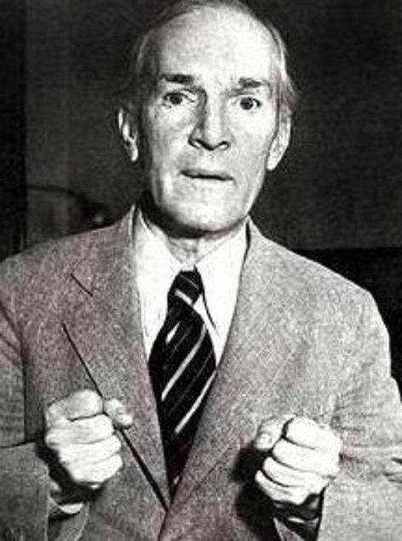
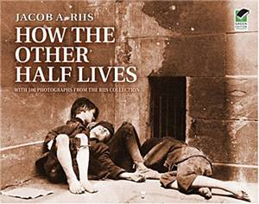
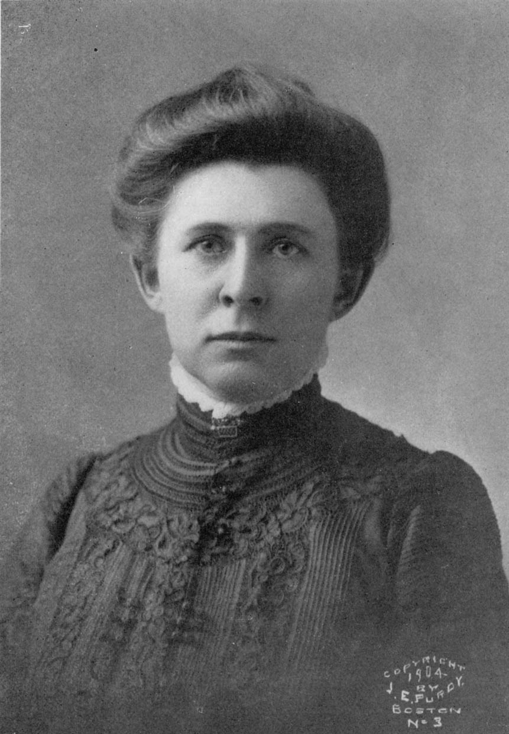
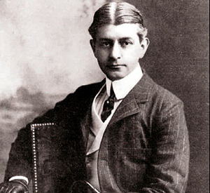
Muckrakers
Who were they?
  Authors and journalists that exposed societal ills
Famous Journalists?
  Upton Sinclair – The Jungle
    Helped lead to the Pure Food and Drug Act and Meat Inspection Act
  Jacob Riis – How the Other Half Lives
    Photographs that exposed poor living conditions for immigrants in NYC
  Lincoln Steffens – The Shame of Cities
    Exposed corruption between city (municipal) government and businesses
  Ida Tarbell:
    Wrote about the harsh treatment of other businesses by Standard Oil Company
  Frank Norris – The Octopus
    Wrote about Railroad corruption

Slide 4
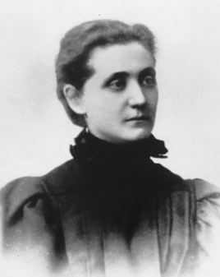
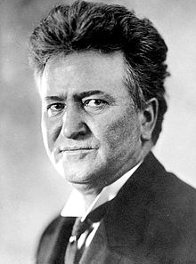
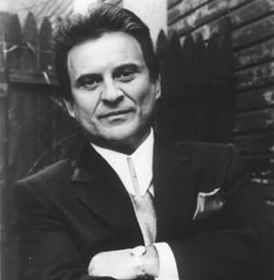
Famous Progressives
Robert La Follette:
  Governor of Wisconsin
  Direct primary, initiative, referendum, and recall (state reforms)
Jane Addams:
  Founder of the Hull House in Chicago
  Aided women, children, and immigrants
Florence Kelley:
  Advocated increased rights for women, children, and African-Americans
  National Consumer League
    Led boycotts of goods made by children

Slide 5
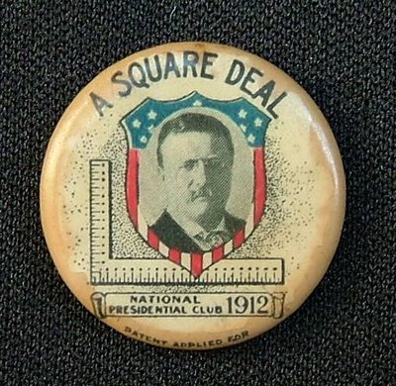
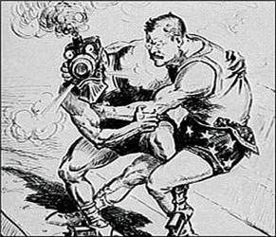
Roosevelt as a Progressive President
Square Deal
  3 C’s:
    Consumer Protection:
      Pure Food and Drug Act
      Meat Inspection Act
    Corporate Regulation:
      Northern Securities Decision
      Hepburn Act – increased power of ICC – could regulate prices
    Conservation of Natural Resources:
      Newlands Reclamation Act – use $ from sale of lands to use towards irrigation projects
Anthracite Coal Strike
  Roosevelt sided AGAINST the owners and threatened to seize the mines

Slide 6
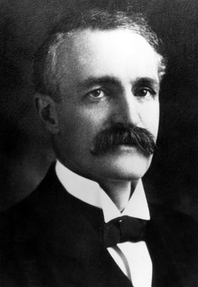
President Taft
Taft was the real “Trust Buster”
Falling out between Teddy and Taft, because Taft:
  Broke up “good trusts”
  Fired Gifford Pinchot

Slide 7
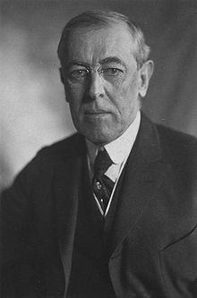
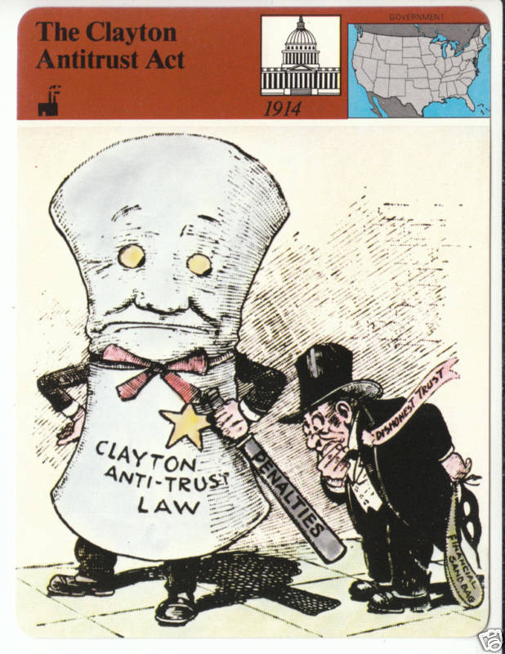
Wilson as a Progressive President
New Freedom
  Lower Tariffs
    Underwood Tariff
  Eliminate trusts (no distinction between good or bad)
    Clayton Anti-Trust Act
      Labor unions were exempt from
      prosecution
  Reform banking system
    Federal Reserve Act

Slide 8
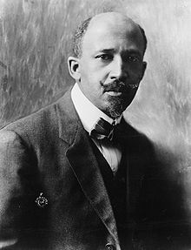
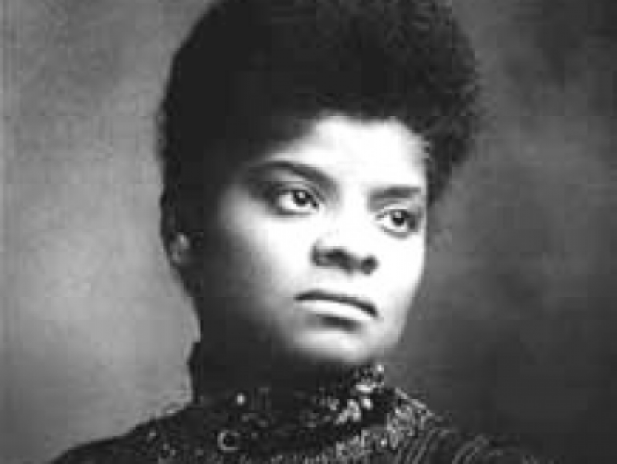
African Americans in the Progressive Era
African Americans were left out of government reforms during the Progressive Era
W.E.B. Du Bois:
  Demanded immediate end to segregation
  Helped form the NAACP
Ida B. Wells-Barnett:
  Advocated an end to lynching
Many African Americans fought in WWI and sought more rights upon returning

Slide 9
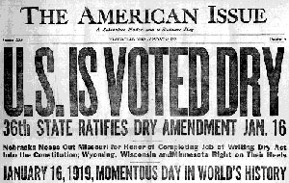
Key Progressive Amendments
16th: Graduated Income Tax
  The higher an income, the more tax one pays
17th: Direct Election of Senators
  Senators previously were elected by state legislatures
18th: Prohibition
  Alcohol is illegal
  Influenced by WCTU
  Considered a Progressive failure
19th: Women’s Suffrage
  Alice Paul

Slide 10
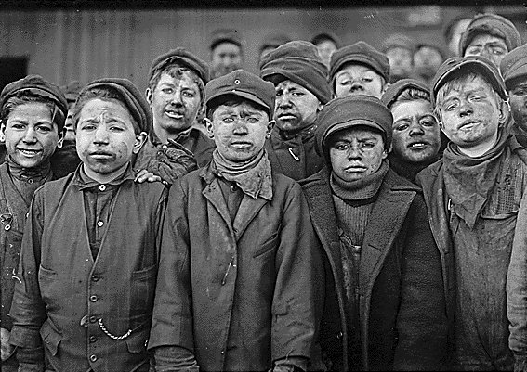
Progressive Era: An Analysis
How could it be seen as effective?
  Reforms: child labor, women’s labor
  Increased participation in politics
    17th amendment, 19th amendment, initiative, referendum, reform
  Trusts were broken up
How could it be seen as ineffective?
  Lack of civil rights reforms
  19th amendment came at end
  Prohibition

Slide 11


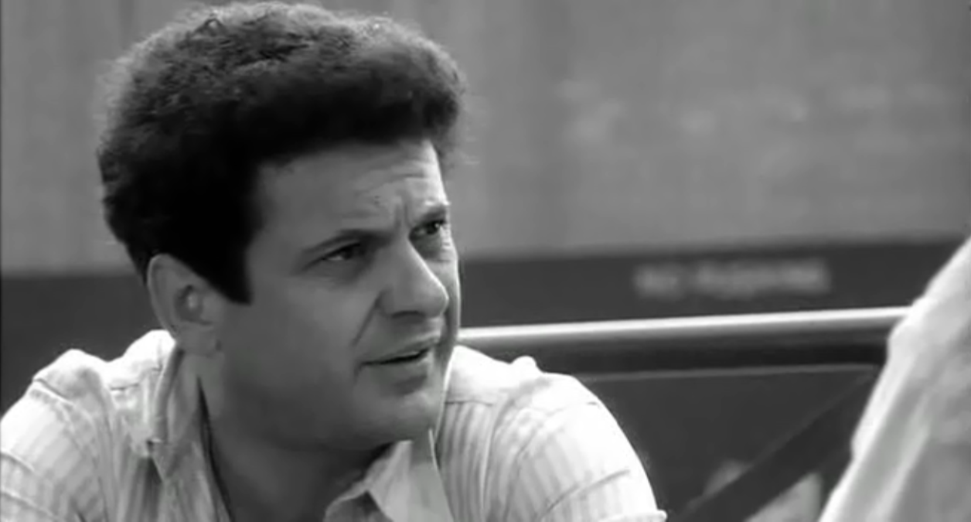
Thanks for watching!
  Subscribe to my channel
  Help spread the word
  Good luck on your tests!
Am I Robert La Follette or Joe Pesci?
Subscribe
Down here!

