Slide 1
APUSH Review: The Taft Hartley Act (1947)
WWW. APUSHREVIEW.COM
Everything You Need To Know About The Taft Hartley Act To Succeed In APUSH

Slide 2

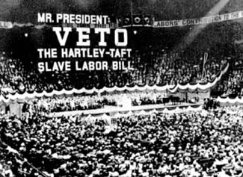
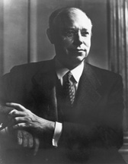
Background on the Act
1946: millions of workers went on strike
Labor Management Relations Act
  “Slave labor bill”
Sponsored by Robert Taft
  Son of President Taft
  From CINCINNATI!
Passed over Truman’s veto
  2/3 of Congress needed to override a veto
Helped reverse some gains from the Wagner (National Labor Relations Act – 1935)

Slide 3
Key Aspects of the Act
Made the closed shop union illegal
  Closed shop required hiring of only union members
Right to work laws”
  Nonunion members could work in unionized jobs
President could appoint a panel to investigate labor disputes
80 day “cooling off period” for strikes
“Union leaders had to pledge they were non-communists

Slide 4
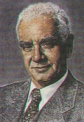
Impact of Taft-Hartley Act
Certain strikes and boycotts were made illegal
However, union membership still was high throughout the 1940s and 1950s
The Act helped Truman get re-elected in 1948
  Truman promised, but did not, repeal the act
  Many unions backed Truman and opposed Republicans
Philip Murray – CIO President

Slide 5
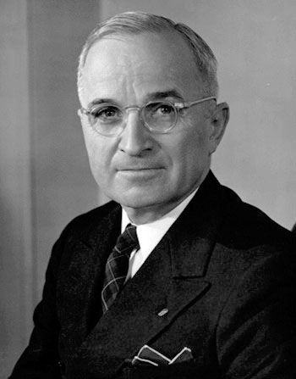
Thanks for watching!
  Subscribe to my channel
  Help spread the word
Questions? Comments? Ideas for videos?
  Leave in comments
Pledge your loyalty by subscribing!
Subscribe
Down here!

