Slide 1
American Pageant Chapter 39
www.Apushreview.com
The Stormy Sixties: 1960 – 1968

Slide 2
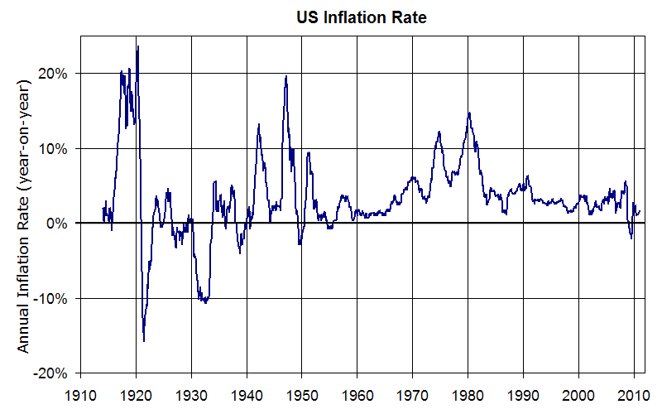
Sources of Stagnation
Reasons for economic downturn:
  High cost of Vietnam War
  Rising oil prices
  Inflation
  High funding for Great Society

Slide 3
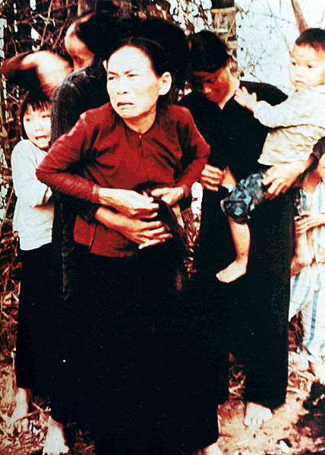
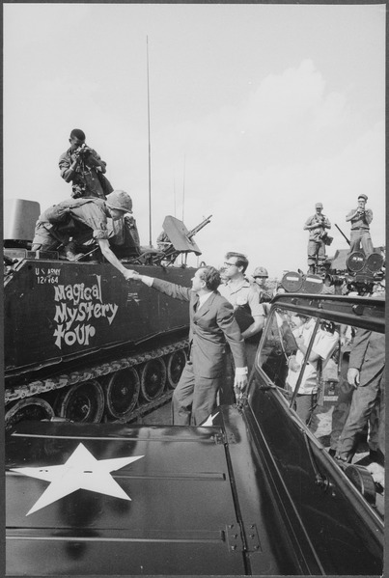
Nixon “Vietnamizes” the War
Vietnamization:
  Gradually withdrawing US troops from Vietnam
  Transitioning the military burden to the South Vietnamese
    “Using weapons, training, and advice”
Nixon Doctrine:
  US would honor current commitments, but in the future, Asian countries would defend themselves without American troops
Doves:
  Those that favor peace
“Silent Majority”:
  Nixon’s belief that most Americans supported the war, but were not vocal
My Lai Massacre 1968:
  Killing of Vietnamese women and children

Slide 4
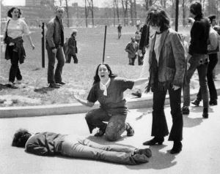
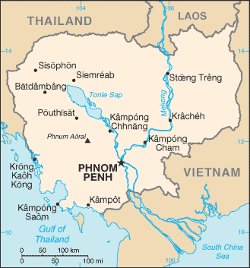
Cambodianizing the Vietnam War
April 29, 1970:
  Nixon ordered the US begin attacking Cambodia, a neighboring, neutral country
  The Cambodia bombings led directly to……
Kent State Protests:
  Student protests
  4 students died, many more injured
The Cambodia Bombings made many Americans question the government
Senate repealed the Gulf of Tonkin Resolution
Pentagon Papers:
  Revealed mistakes and deception of JFK and LBJ regarding Vietnam

Slide 5
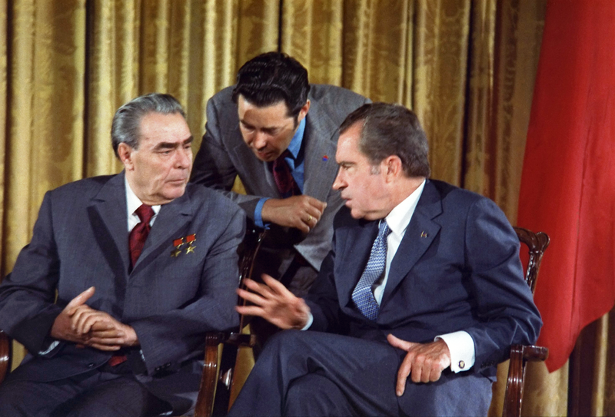
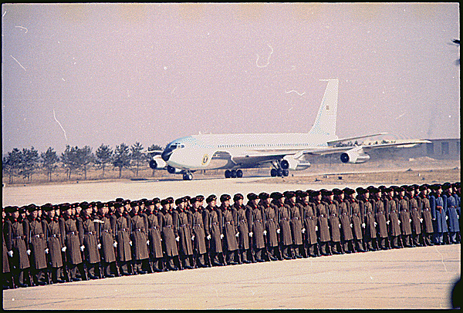
Nixon’s Détente with Beijing and Moscow
February 21, 1972: (MY BIRTHDAY! – 1982)
  Nixon visits China
  Improvement in relations between China and US
Détente:
  Easing of Cold War tensions
    Anti-ballistic missile treaty
    Strategic Arms Limitations Talks (SALT):
      Limited the number of long-range nuclear weapons

Slide 6
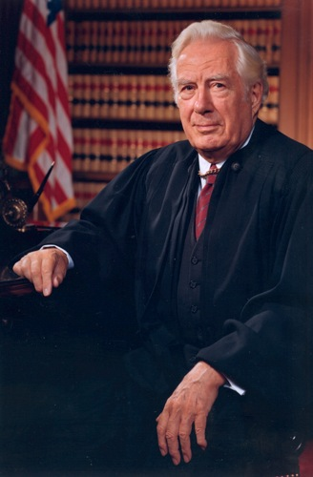
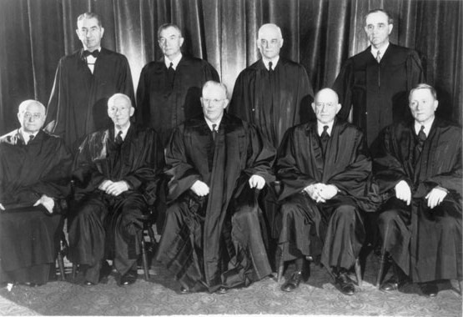
A New Team on the Supreme Bench
Warren Court:
  Led by Chief Justice Earl Warren (1953 – 1969)
  Decisions affected rights of criminals and the accused, religion, civil rights, and women
    Mapp v. Ohio (search warrants)
    Gideon v. Wainwright (right to lawyer, even if you can’t afford one)
    Escobedo v. Illinois (Right to lawyer from time of arrest)
    Miranda v. Arizona (Right to remain silent)
    New York Times v. Sullivan (public figures had to prove malice in order to sue for libel)
    Engel v. Vitale (School sanctioned prayer is unconstitutional)
    Griswold v. Connecticut (Birth control is legal)
    Tinker v. DesMoines (Free speech is fine in school)
Nixon, upset with the court’s decisions, appointed judges he felt would “strictly” interpret the Constitution
  Appointed Warren Burger as new Chief Justice
  Roe v. Wade (1973) – legalized abortion

Slide 7
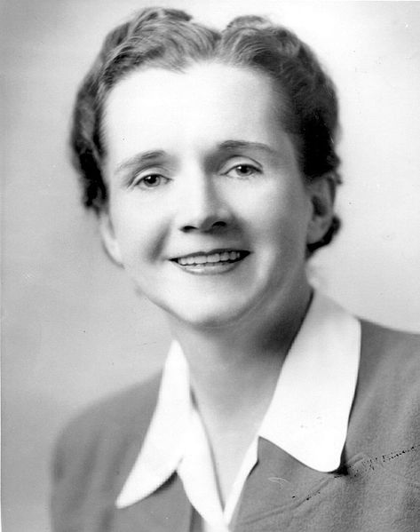
Nixon on the Home Front
Increased spending on Great Society Programs:
  Food stamps and Medicaid
“Philadelphia Plan”:
  Construction unions had to provide a timetable for hiring black apprentices
  Implemented in all federal contracts
New definition of affirmative action:
  Privileges for certain groups (minorities)
Nixon and the Environment:
  Environmental Protection Agency (EPA)
    Influenced in part by Rachel Carson’s ***Silent Spring***
Nixon and the economy:
  90 day wage and price freeze
  Ended the Gold Standard

Slide 8
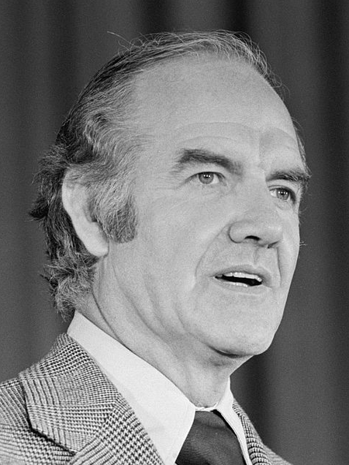
The Nixon Landslide of 1972:
Spring of 1972:
  North Vietnam crossed the DMZ
  US responded with bombings on North Vietnamese cities
Election of 1972:
  George McGovern (D) promised to end war in 90 days
  Nixon wins in a landslide
Cease-fire in Vietnam on January 23, 1973
  Nixon claimed he achieved “Peace with Honor”

Slide 9
The Secret Bombing of Cambodia and the War Powers Act
March 1969 – May 1970:
  US secretly bombed Cambodia 3,500 times
  During that time, US pledged it was respecting Cambodia’s neutrality
  Americans question the government
War Powers Act:
  Essentially, it reversed the Gulf of Tonkin Resolution
  Drastically reduced the war-time powers of the president
    President must report to Congress within 48 hours of sending troops to a conflict
    Must limit combat to 60 days unless Congress extended it to 90

Slide 10
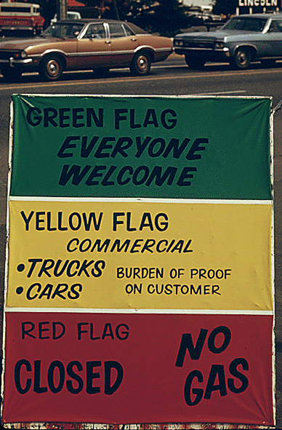
The Arab Oil Embargo and the Energy Crisis
Syria and Egypt attacked Israel
  US provided $2 billion in aid to Israel
Arab nations responded with an oil embargo
  Oil and gas prices increase

Slide 11
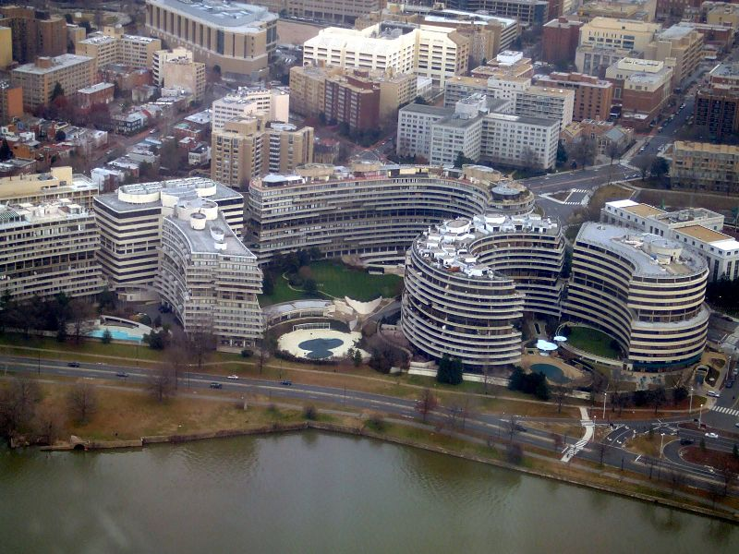
Watergate and the Unmaking of a President
June 17, 1972:
  5 men broke into Democratic headquarters in Watergate
CREEP – Committee to Re-Elect the President
VP Agnew:
  Resigned over taking bribes
    Led to the appointment of Gerald Ford
Nixon secretly recorded most Oval Office Conversations
“Saturday Night Massacre”
  Nixon fired a special prosecutor, Attorney General, and deputy Attorney General
Nixon claimed right of “Executive Privilege”
  Supreme Court stated he could not withhold evidence and tapes
House drew up impeachment charges, Nixon resigned

Slide 12
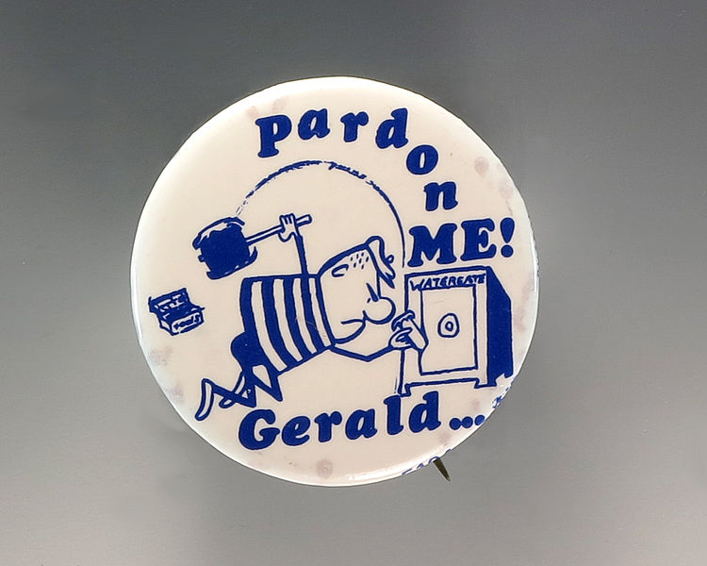
The First Unelected President
Pardon of Nixon:
  Many Americans were upset, some believed there was a “deal”
  Hurt Ford’s re-election chances in 1976
Helsinki Accords:
  Improved relations between Western nations and Communist nations
  Example of détente
Defeat in Vietnam
US withdrew troops in 1973
$118 billion cost
56,000 deaths, 300,000 wounded

Slide 13

Feminist Victories and Defeats
Title IX:
  Prohibited sex discrimination in education
  More opportunities for women’s and girls’ athletics
Equal Rights Amendment:
  Idea had been around for a long time (1920s – Alice Paul)
  Congressional Approval in 1972
  Amendment did not achieve ratification; fell 3 states shy
    ***Phyllis Schlafly*** was an outspoken critic
Roe v. Wade:
  Supreme Court legalized abortion, citing a woman’s right to privacy

Slide 14
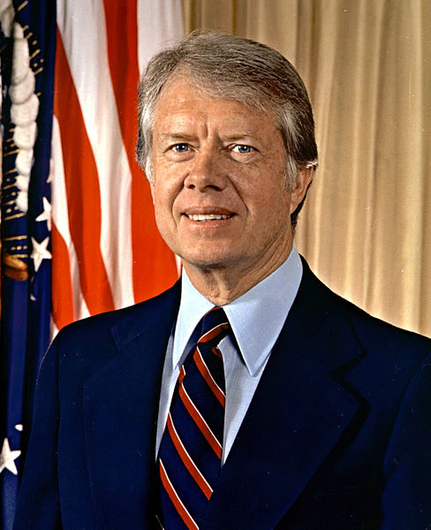
The Seventies in Black and White
“White Flight””
  Movement of whites from cities to suburbs
Regents of the University of California v. Bakke
  Giving preferential treatment based solely on race was not allowed…
  However, race could be one of several factors in admitting students
The Bicentennial Campaign and the Carter Victory
Jimmy Carter:
  Campaigned as a Washington “outsider”
  Pardoned draft dodgers from the Vietnam War

Slide 15
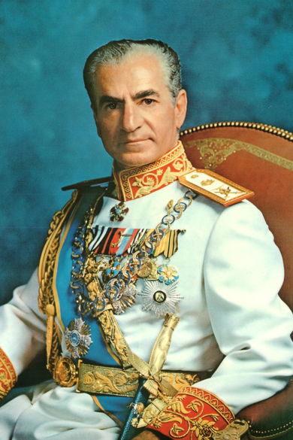
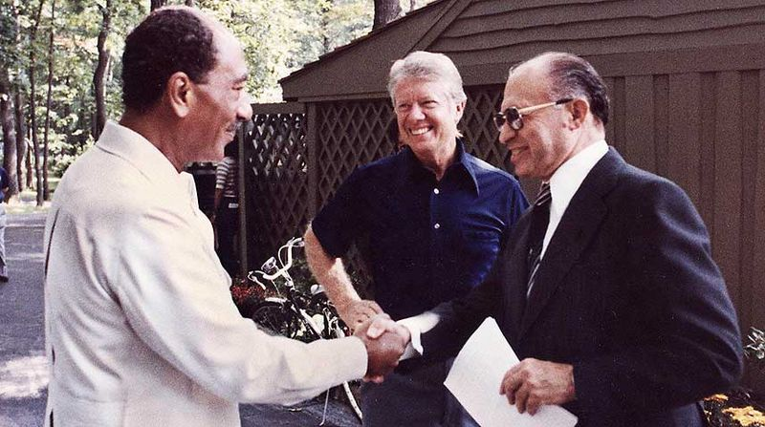
Carter’s Humanitarian Diplomacy
Camp David Accords:
  September, 1978
  Peace agreement between Israel (Begin) and Egypt (Sadat)
Panama Canal:
  US promised to return the canal to Panama by 2000
Economic and Energy Woes
Inflation increased rapidly
Problems in Iran:
  US backed Shah Pahlevi (CIA helped install him in 1953)
  Shah was overthrown in 1979, has cancer; US provides treatment

Slide 16
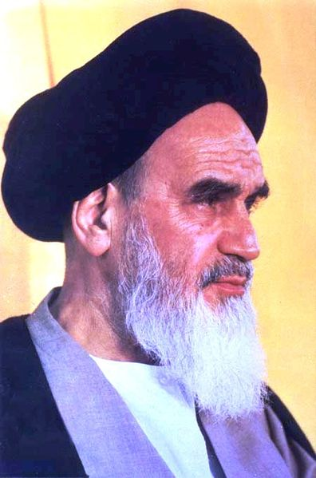
Foreign Affairs and the Iranian Imbroglio
November 4, 1979:
  Iranians were upset, took over the US Embassy
  Botched rescue plan killed 8 soldiers
Soviet invasion of Afghanistan
  December 27, 1979:
  US boycotted Olympic games in Moscow
  The war is seen as the Soviet’s Vietnam

Slide 17
Quick Review
War Powers Act overturns Gulf of Tonkin Resolution
Cambodia Bombings led to Kent State Protests
Warren Court
***Rachel Carson and Silent Spring***
Phyllis Schlafly and protesting the ERA
Ford’s pardon of Nixon
Camp David Accords
Iran Hostage Crisis

Slide 18

Thanks For Watching!
  Subscribe to my channel
  Help spread the word
Questions? Comments?
  Leave in comments
Now, both of you promise to subscribe
Subscribe
Down here!

