Slide 1
American Pageant Chapter 40
www.Apushreview.com
The Resurgence of Conservatism

Slide 2
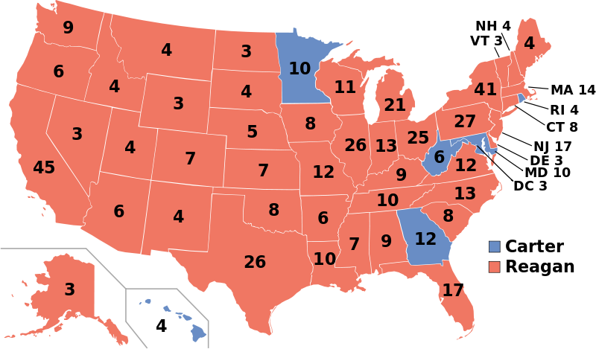
The Election of Ronald Reagan, 1980
Reagan was a member of the New Right:
  Believed large government was a failure
Advocated free markets, anti-Soviet foreign policy, against government programs
Election of 1980:
  Reagan (R) v. Carter (D)
  Reagan won 489 - 49

Slide 3
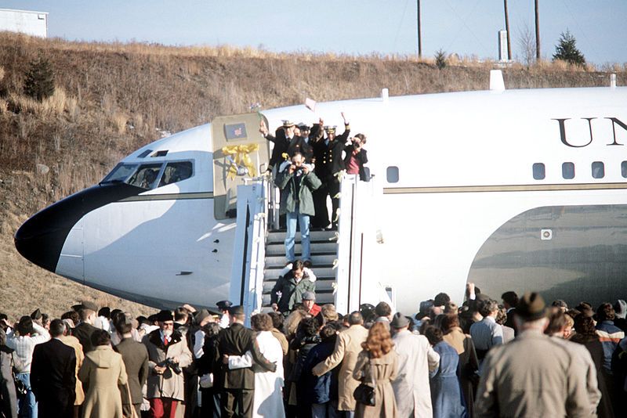
The Reagan Revolution
Iran Hostage crisis ended on January 20, 1981
“Government is not the solution to our problem. Government is the problem.”
  Government spending increased between 1960 and 1980
  Money spent on entitlement programs increased
  Reagan proposed a budget that would cut $35 billion

Slide 4
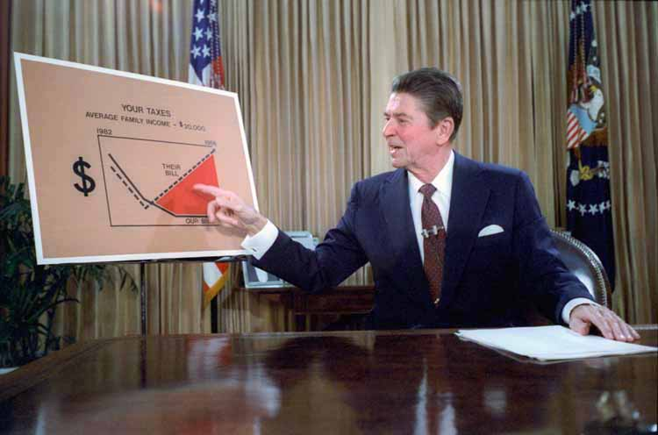
The Battle of the Budget
Supply-side economics (Reaganomics)
  Tax cuts for the wealthy
  In theory, the rich would use this money to invest and spend money to improve the economy
  Very similar to Andrew Mellon’s tax policy from the 1920s
Increase in military spending
  $2 trillion for the Pentagon in the 1980s
  Helps contribute to federal deficits

Slide 5
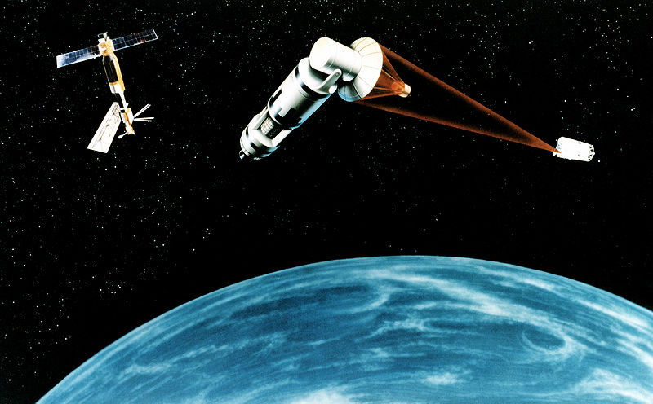
Reagan Renews the Cold War
Why did Reagan increase military spending?
  Belief that the Soviet Union could not compete, Soviet leaders would favor peace talks
Strategic Defense Initiative (SDI) (Star Wars)
  Reagan’s nuclear defense plan
  Space stations could use lasers to defend against nuclear attacks
  Never occurred
Increased tensions in the 1980s:
  Solidarity in Poland
  Korean airliner shot down by the Soviets
  Soviet Union boycotted the 1984 Olympic Games in LA

Slide 6
Troubles Abroad
Sandinistas:
  Anti-American revolutionaries in Nicaragua
  Reagan believed they were an extension of the Soviet Union; 1st of many Latin American countries to follow
Reagan used covert aid in Latin America
  Nicaragua – aid to the Contras who were against the Sandinistas
  El Salvador – sent the military to bolster the Pro-American government

Slide 7
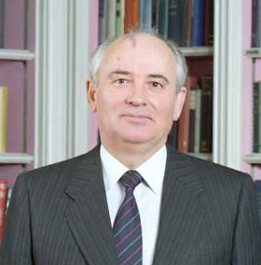
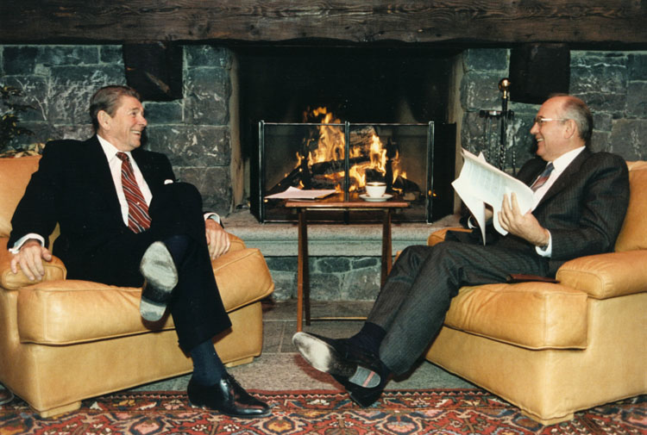
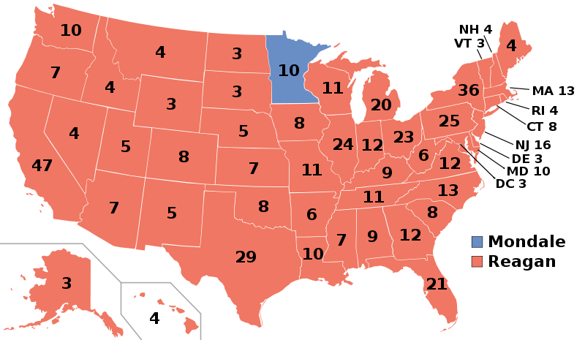
Round Two for Reagan
Election of 1984:
  Reagan v. Mondale
  Reagan wins 525 – 13
Mikhail Gorbachev “Gorby!”
  Glasnost – openness, allowed some freedoms for Soviet citizens
  Perestroika – economic restructuring to improve the Soviet economy
The Soviet Union could not keep pace spending with the US
Reagan and Gorby signed treaties limiting weapons

Slide 8
The Iran-Contra Imbroglio
Iran-Contra Affair
  American hostages were held in Lebanon
  Contras were rebels fighting the Sandinistas
The Reagan administration sold weapons to the Contras
That money was sent to Iran
Iran would then help free the hostages
Why is this a problem?
  Congress forbid providing aid to the Contras
  Reagan stated he refused to negotiate with terrorists
Effects of the scandal?
  Reagan claimed he was innocent
  Tarred his administration

Slide 9
Reagan’s Economic Legacy
Reagan did not balance the budget
  Increase in military spending
Spending on social programs was reduced
The Religious Right
“Moral Majority” led by Reverend Jerry Falwell– “against sexual permissiveness, abortion, feminism, and the spread of gay rights.” (977)
1980s saw an increase in “right-to-life” movement

Slide 10
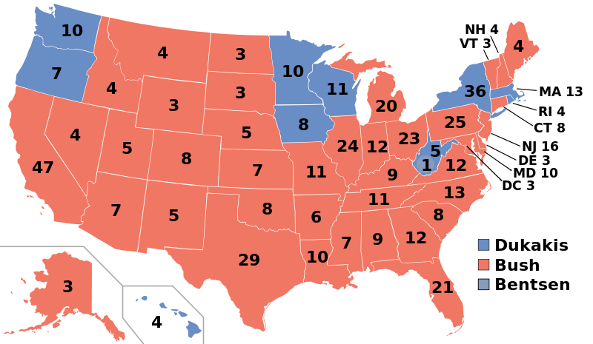
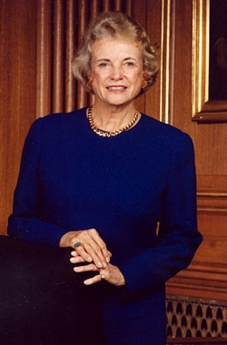
Conservatism in the Courts
Sandra Day O’Connor – first woman named to the Supreme Court
The court reversed some affirmative action gains from previous decades
Webster v. Reproductive Health Services:
  Some restrictions were placed on Abortion
Referendum on Reaganism in 1988
Black Monday – October 19, 1987:
  Dow Jones dropped over 500 points (22%)
Election of 1988
  George H.W. Bush (R – Reagan VP) v. Michael Dukakis (D)
  Bush won 426 - 111

Slide 11
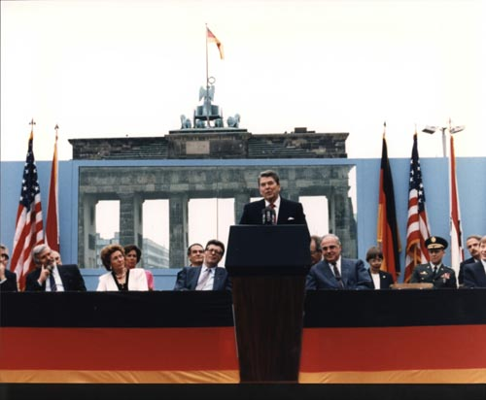
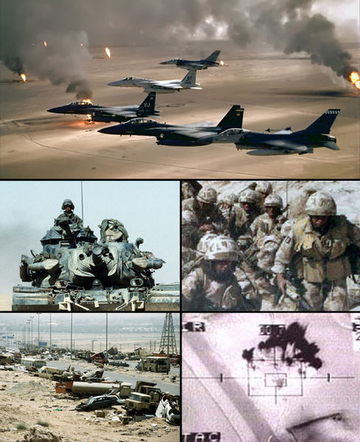
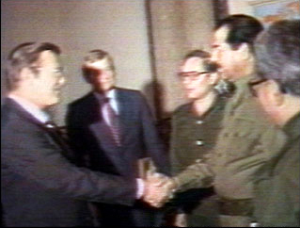
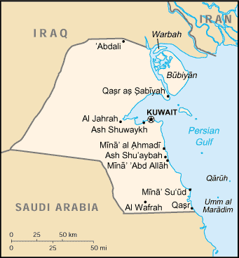
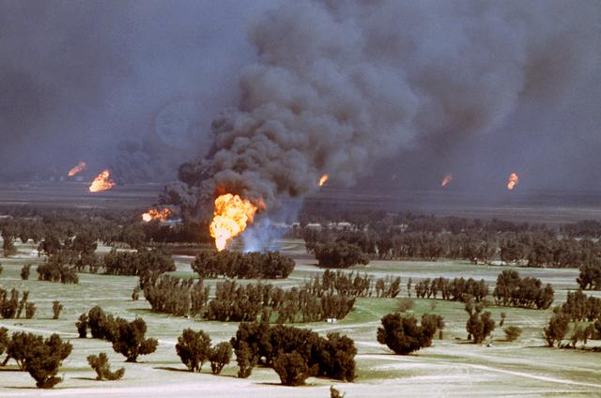
George H.W. Bush and the End of The Cold War
Tiananmen Square Massacre
1989 and the Cold War
  Solidarity Movement:
    Toppled the Polish Communist government
  Fall of the Berlin Wall
Germany was reunited in 1990
The end of the Cold War saw cuts to the defense industry
The Persian Gulf Crisis
August 2, 1990 – Saddam Hussein and Iraq invaded Kuwait
US and UN allies used advanced technology to crush Iraq
Saddam withdrew from Kuwait
  Scorched-earth policy
“By God, we’ve licked the Vietnam syndrome once and for all”

Slide 12
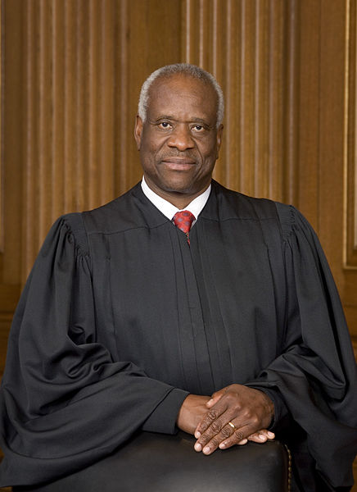
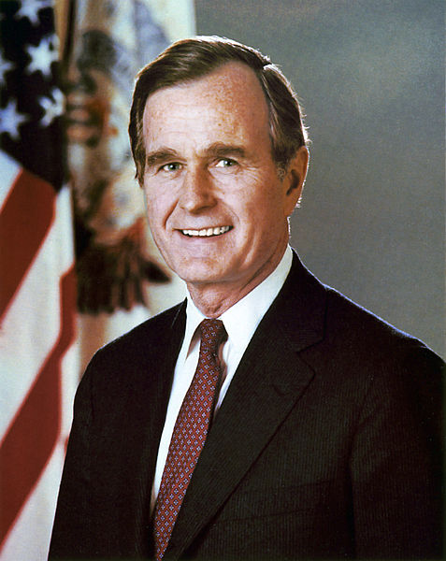
Bush on the Home Front
Americans with Disabilities Act (ADA)
  Prohibited discrimination against individuals with physical and/or mental disabilities
Clarence Thomas
  Conservative Supreme Court Justice appointed by Bush
  Confirmed by a vote of 52 – 48
Pro-choice women began voting Democratic
Bush campaigned in 1988 by saying “Read my lips. No new taxes.”
  Too soon bro….
“Read my lips, NO NEW TAXES.”

Slide 13
Quick Review
Iran Hostage Crisis
Supply-Side Economics, “Reaganomics”
Star Wars
Gorby
Iran Contra
Persian Gulf War

Slide 14

Thanks For Watching!
  Subscribe to my channel
  Help spread the word
Questions? Comments?
  Leave in comments
Subscribe
Down here!
“Read my lips, SUBSCRIBE.”

