Slide 1
American Pageant Chapter 41
www.Apushreview.com
America Confronts the Post-Clod War Era

Slide 2
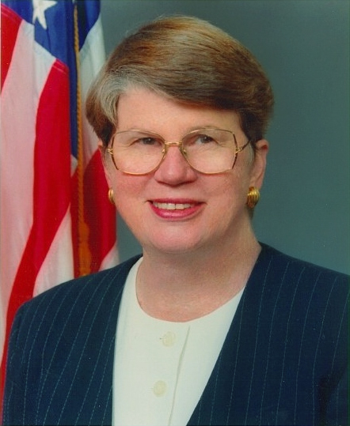
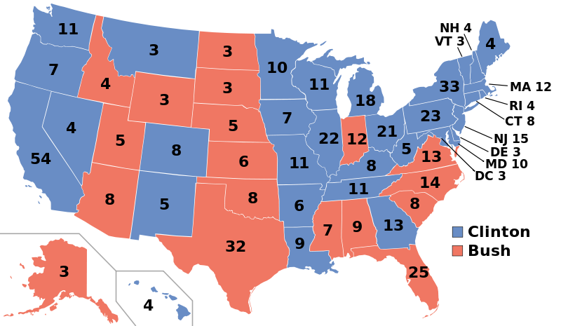
Bill Clinton: The First Baby-Boomer President
Clinton was a “New” Democrat:
  Movement towards the center politically
    Tougher on crime, pro-defense, welfare reform
Election of 1992:
  George H. W. Bush (R), Bill Clinton (D), and Ross Perot (Independent)
  “It’s the economy, stupid”
    Bad economy hurt Bush’s reelection bid
  Perot received nearly 20,000,000 votes
  Clinton won, Democrats controlled Congress
Clinton’s appointments:
  Janet Reno – Attorney General, Ruth Bader Ginsburg – 2nd female on the Supreme Court

Slide 3
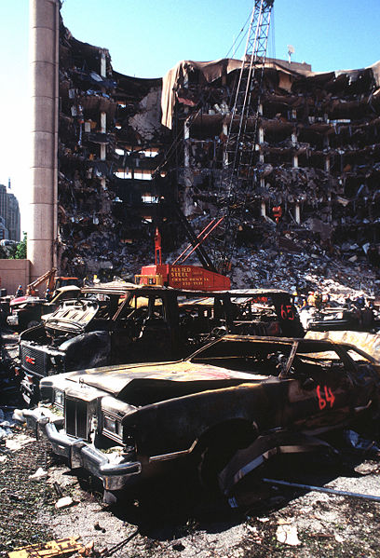
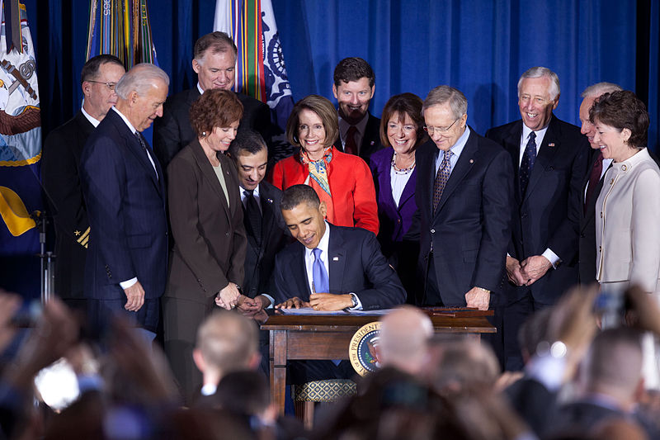
A False Start For Reform
Clinton advocated ending the ban on homosexuals in the military
  Eventually settled on “don’t ask, don’t tell”
Brady Bill:
  Gun-control law
April 19, 1995:
  Oklahoma City bombing
  Timothy McVeigh and Terry Nichols
  168 people were killed
April 20, 1999:
  Columbine High School shooting
  Helped bring attention to weapons

Slide 4
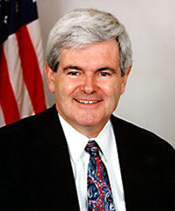
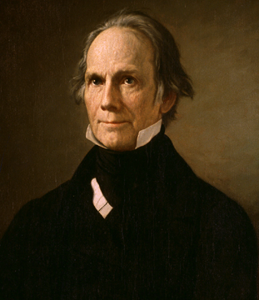
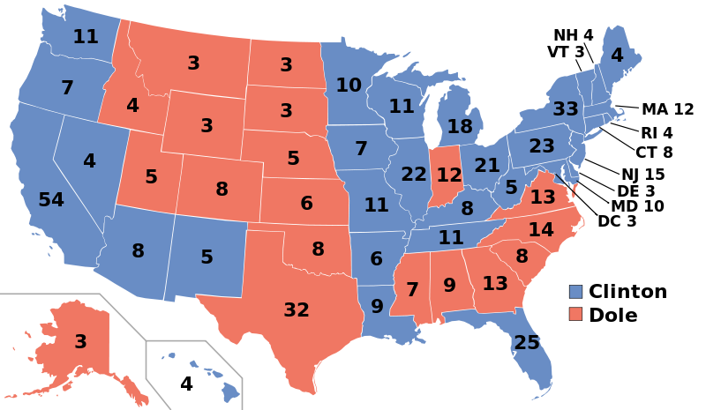
The Politics of Distrust
Newt Gingrich:
  Speaker of the House
    Other famous speakers of the House………
  “Contract with America”
    Promised reduction in deficits and welfare programs
1994 Midterm elections:
  All Republicans in Congress were re-elected, gained many more seats
  Republicans challenged “unfunded mandates”
Welfare Reform:
  Massive cuts for benefits
  Cut benefits for immigrants
Although Clinton alienated some in his party, he gained a lot of support for moving towards the middle
Election of 1996:
  Clinton (D), Dole (R), Perot (Independent)
  Clinton won 379 - 159

Slide 5
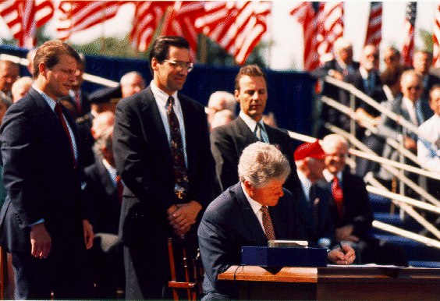
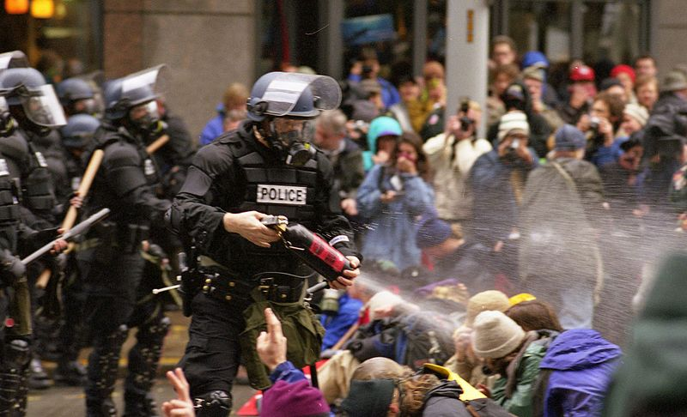
Clinton Again
Setbacks for Affirmative Action:
  California Proposition 209
    Prohibited AA in government and higher education
  Clinton did not approve of the setbacks
Economic Issues:
  Dot.com businesses boomed
  Stock market increased drastically
  The 1990s economy was unprecedented
North Atlantic Free Trade Agreement (NAFTA):
  1993 – eliminated tariffs between Canada, US, and Mexico
  Many argued it helped promote outsourcing
World Trade Organization (WTO):
  Hoped to promote free trade throughout the world
  Protests in Seattle turned violent
Clinton scandals:
  Allegations that individuals donated money in exchange for staying overnight at the White House

Slide 6
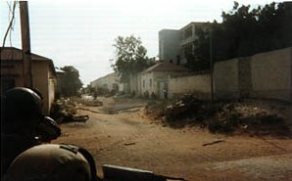
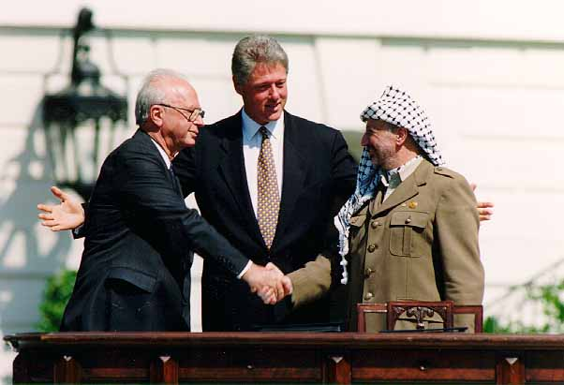
Problems Abroad
Somalia, October, 1993:
  18 Americans were killed on a special mission
Improved relations with China:
  Large market, Clinton wanted to improve trade relations
  May, 2000 China became a major trading partner of the US
Serbia:
  “Ethnic Cleansing” by Slobodan Milosevic
  US and NATO led a bombing campaign
Middle East, 1993:
  Clinton held a meeting with Yitzhak Rabin (Israel) and Yasir Arafat (PLO)
  Sought to promote self-rule for Palestinians

Slide 7
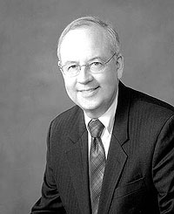
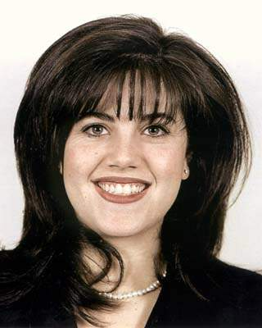
Scandal And Impeachment
Monica Lewinsky:
  White-House intern that had an affair with Clinton
  Clinton initially denied any wrongdoing under oath
  Later, he admitted he had an “inappropriate relationship”
Kenneth Starr, a special prosecutor, provided 11 possible charges of impeachment
The House impeached Clinton on two charges
  Obstruction of Justice, Perjury
The House vote was partisan
The Senate failed to convict Clinton, voted mostly down party lines as well

Slide 8
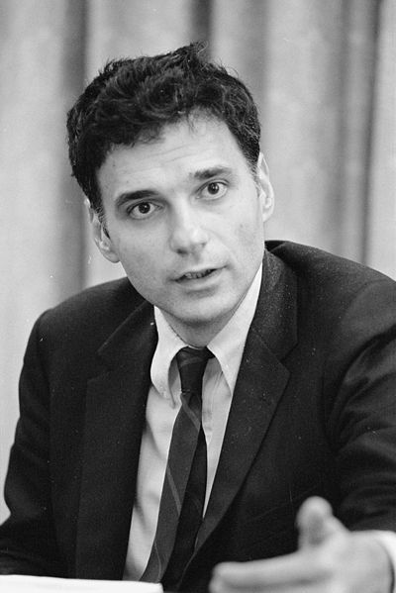
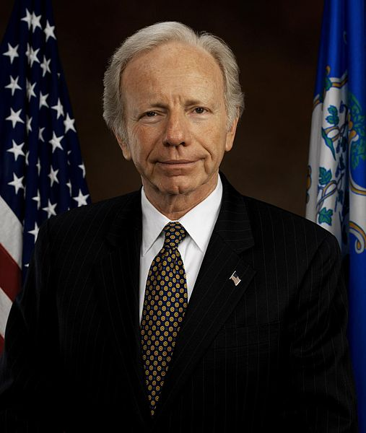
Clinton’s Legacy
Budget surpluses during Clinton’s last years
  Debates between Republicans and Democrats over how to use surpluses
    R – tax cutes
    D – Medicare and Social Security
1990s saw a decrease in unemployment, poverty, and rise in income
The Bush-Gore Presidential Battle
Gore – Clinton’s VP
  Chose Joseph Lieberman – first Jewish person on a national ticket
  Wanted to use budget surpluses on debt, Social Security, and Medicare
Bush – 2 time governor of Texas
  “restore dignity to the White House”
  Dick Cheney selected as his running mate
  Wanted to use budget surpluses on tax cuts
Ralph Nader:
  Consumer advocate – Unsafe At Any Speed

Slide 9
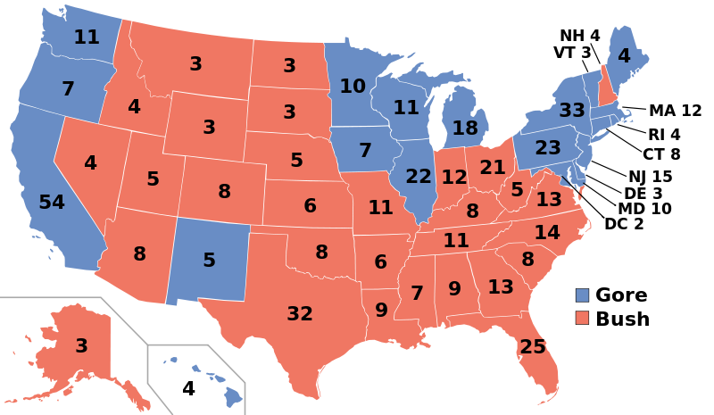
The Controversial Election of 2000
Issues in Florida:
  Vote was so close, automatic recount went into effect
  Ballots and voting machines may have caused confusion
    “hanging chads”
BUSH v. Gore:
  Supreme Court stopped further recounts, declared Bush the winner in Florida
  Bush won the electoral majority without winning the popular majority
  Similar to Hayes-Tilden in 1876
Bush Begins
Government changes under Bush:
  Cutback on stem cell research
  Did not enforce the Kyoto Treaty

Slide 10
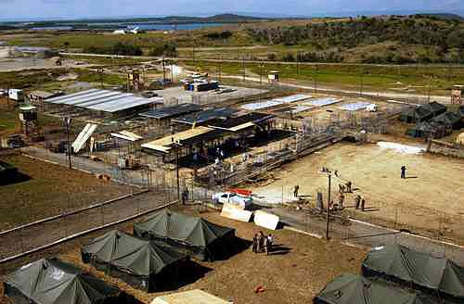
Terrorism Comes to America
September 11, 2001:
  NYC, DC, and PA attacks
  Over 3,000 individuals died
Al Qaeda
  Osama bin Laden, Islamic fundamentalist
  Resented Western presence in the Middle East
PATRIOT Act:
  Passed in response to attacks
  Increased powers for the federal government
    More phone and email surveillance
Guantanamo Bay, Cuba
  Suspected terrorists have been held

Slide 11
Bush Takes the Offensive Against Iraq
Saddam Hussein in 1998:
  Kicked out UN weapons inspectors
“Axis of Evil”
  Bush declared Iraq, Iran, and North Korea were a danger to American security
March 19, 2003:
  US invaded Iraq
Why did US invade Iraq?
  Bush argued Iraq had WMDs, was developing nuclear weapons, and had ties to terrorism
What do we know today?
  No WMDs have been found, no connection to Al Qaeda either
Owning Iraq
139 Americans died during the invasion, many more died during occupation

Slide 12
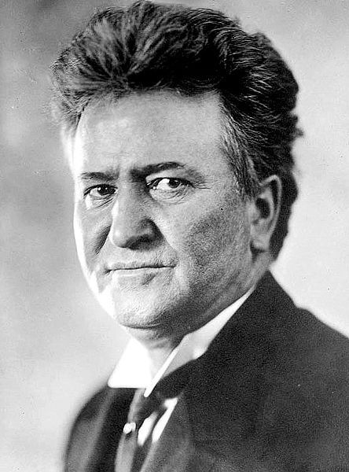
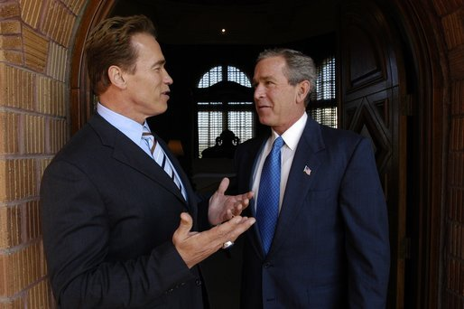
A Country In Conflict
Corporate problems:
  Fraud at Enron and WorldCom
California:
  Recalled Governor Davis, replaced with……
  Arnold Schwarzenegger
  What state made recall popular during the Progressive Era?
    Wisconsin – Robert La Follette
Reelecting George W. Bush
No Child Left Behind – 2002:
  Provided for federal standards in schools
Bush advocated an amendment banning gay marriage
Election of 2004:
  John Kerry (D) v. Bush (R)
  Kerry came across as a “flip-flopper”
  Bush won, 286 – 252
    Gained support from the “Bible Belt”

Slide 13
Thanks For Watching!
  Subscribe to my channel
  Help spread the word
Questions? Comments?
  Leave in comments
Good luck in May!
Subscribe
Down here!

