Slide 1
APUSH Review: Labor Unions
Everything You Need To Know About Labor Unions To Succeed In APUSH

Slide 2
An Important Court Case
Commonwealth v. Hunt, 1830
  Massachusetts Supreme Court Case
  Labor unions are legal, as long as they were not violent

Slide 3
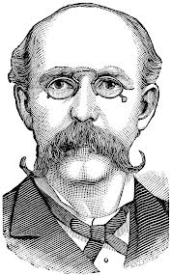
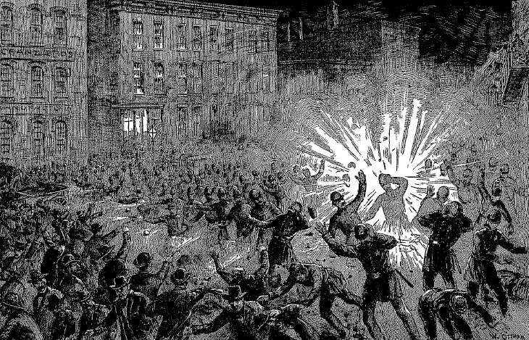
Knights of Labor
Leader?
  Terrence Powderly
When?
  1870s and 1880s, 730,000 members
Members?
  Skilled AND unskilled
  Women and African Americans
Downfall?
  Haymarket Square Riot
    Knights unfairly associated with anarchists

Slide 4
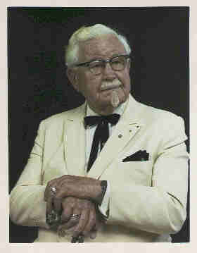
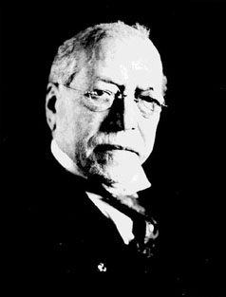
American Federation of Labor (AFL)
Leader?
  Samuel Gompers
When?
  Beginning in 1886
Members?
  Consisted of SKILLED workers only
Issues?
  “Bread and Butter”
    8 hour workdays
    Higher wages

Slide 5
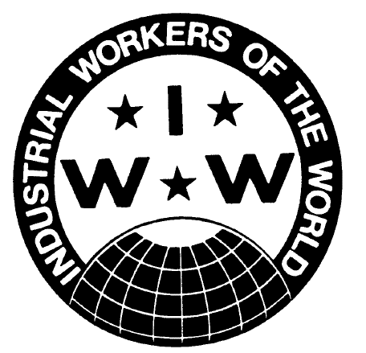
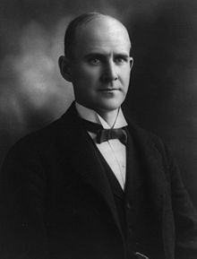
Industrial Workers of the World
Leaders?
  Eugene Debs
  Mother Jones
When?
  Early 1900s
Members?
  Wanted to include skilled AND unskilled workers
Tactics?
  Strikes
  Embraced class conflict
Downfall?
  World War I
  “I Won’t Work”

Slide 6
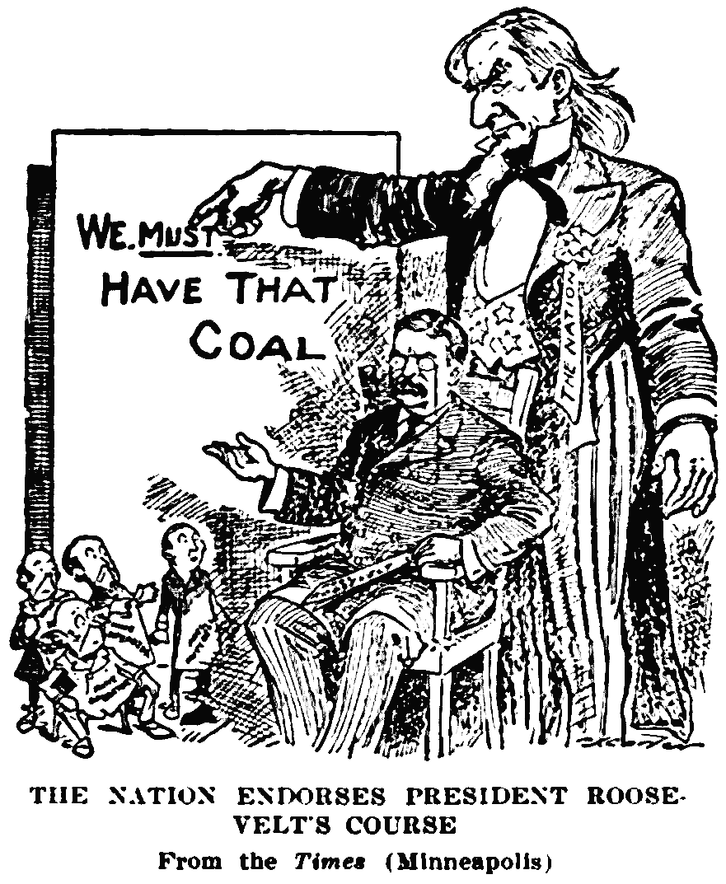
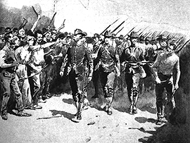
Key Strikes to Know
Great Railroad Strike (Great Upheaval) (1877)
  Reaction to wage cuts
  Hayes used federal troops to end the strike
Homestead Strike (1892)
  Carnegie Steel Plant
  Workers clashed with security guards
Pullman Strike (1894)
  Reaction to wage cuts
  Cleveland used troops to end the strike
Anthracite Coal Mine Strike (1902)
  Coal workers went on strike
  Roosevelt threatened to seize mines if the owners would not negotiate

Slide 7
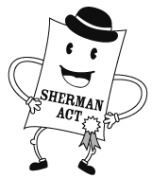
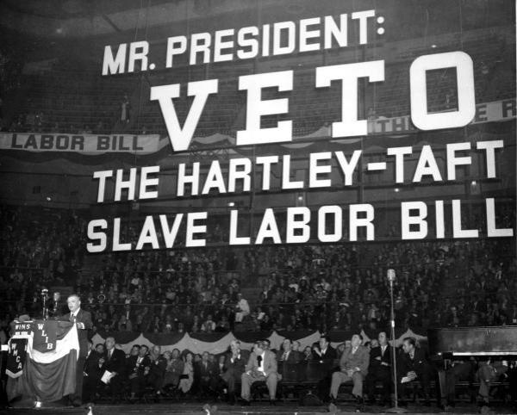
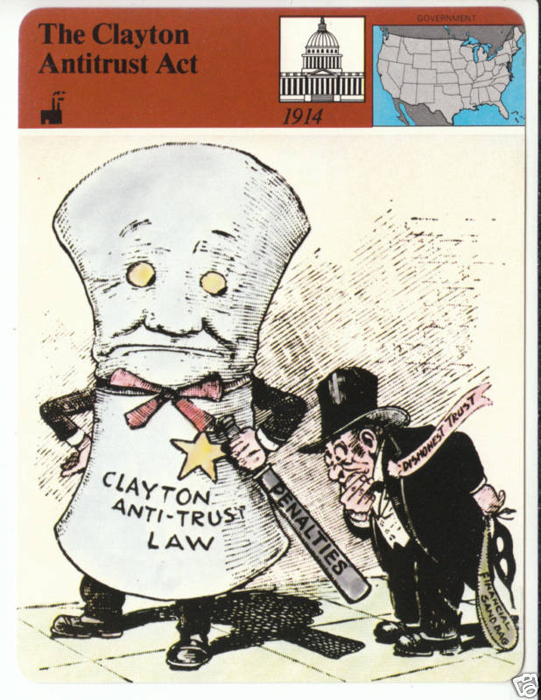
Key Acts Involving Labor
Sherman Antitrust Act (1890)
  Established to break up trusts
  In actually, used to break up unions
Clayton Antitrust Act (1914)
  Strengthened the Sherman Antitrust Act
  Exempted labor unions from prosecution
Wagner Act (1935)
  National Labor Relations Act
  Guaranteed workers the right to strike
  Increased union membership
Taft – Hartley Act (1947)
  Passed over Truman’s veto
  Outlawed “Closed shop”
  Led to a decrease in union membership

Slide 8
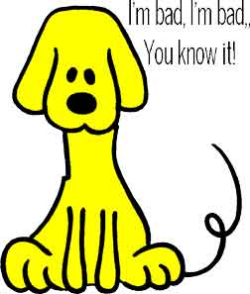
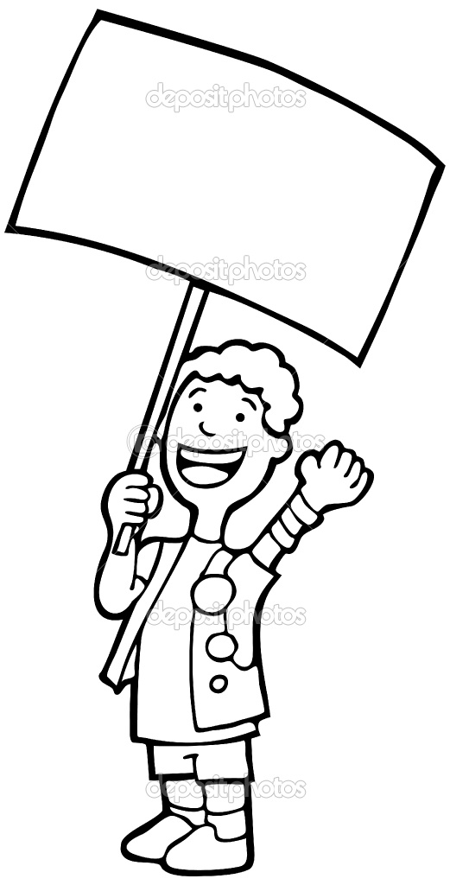
Key Terms Associated With Labor
Strike:
  Refusal to work
Picket:
  Protesting, carrying signs
Boycott:
  Refusal to buy goods
Scabs:
  Strike breakers
  Often were immigrants
Injunction:
  Court order, often used to force workers to stop striking
“Yellow Dog Contracts”:
  Agreement that workers will NOT join a union

Slide 9


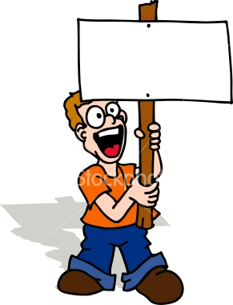
Thanks for watching!
  Subscribe to my channel
  Help spread the word
  Good luck on your tests!
Subscribe Now!!
Subscribe
Down here!

