Slide 1
APUSH Review: Civil Rights in the 1950s
www.Apushreview.com
Everything You Need To Know About Civil Rights in the 1950s To Succeed In APUSH

Slide 2
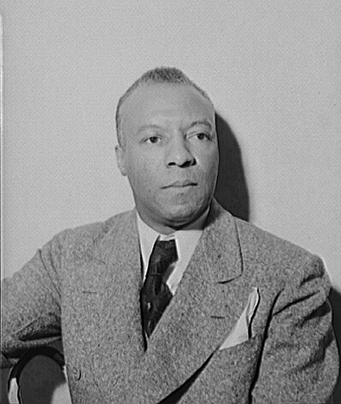
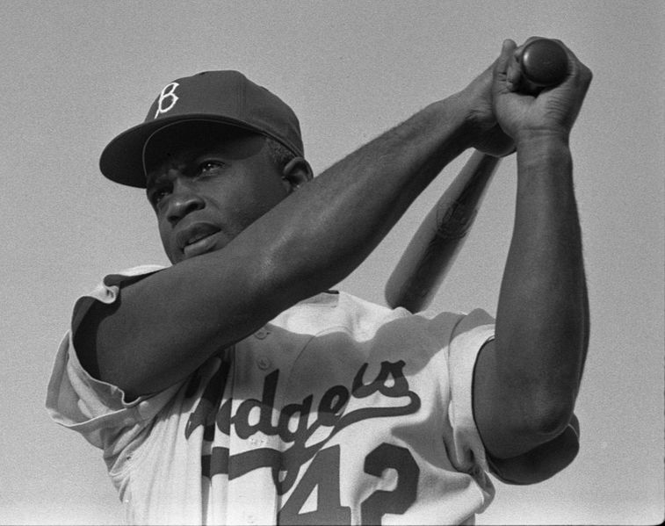
Key Civil Rights Achievements Prior to 1950
Jackie Robinson:
Broke the MLB color barrier on April 15, 1947
Executive Order 9981 (1948):
Desegregated the US military
A. Phillip Randolph:
Civil Rights advocate
Led to FDR banning segregation in defense industries (Executive Order 8802)

Slide 3
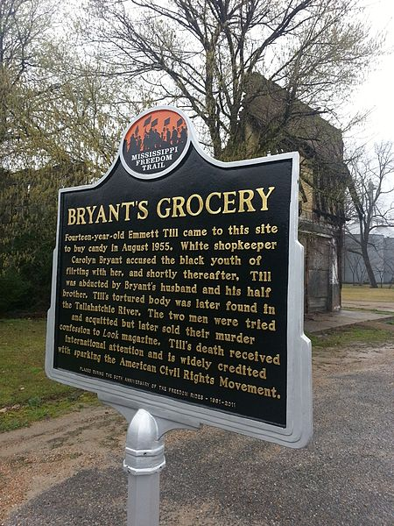
Emmett Till
August, 1955, 14 year old Till visited family in Mississippi
After allegedly saying “Bye baby” to the white clerk, he was kidnapped and murdered
His mother insisted on an open casket
The defendants were found not guilty via an all-white jury

Slide 4
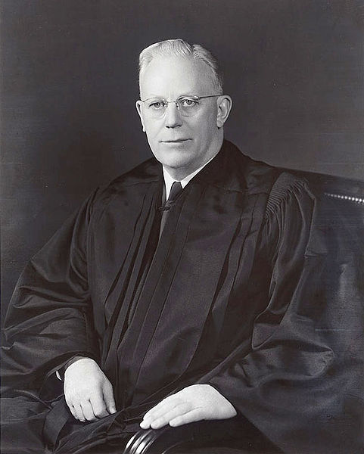
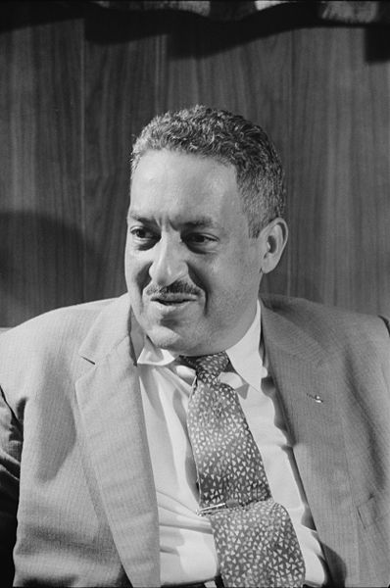
Brown v. Board of Education (1954)
Thurgood Marshall
NAACP lawyer, argued on behalf of Brown, future justice
Earl Warren
Chief Justice of the Supreme Court
States must desegregate schools with “all deliberate speed”

Slide 5
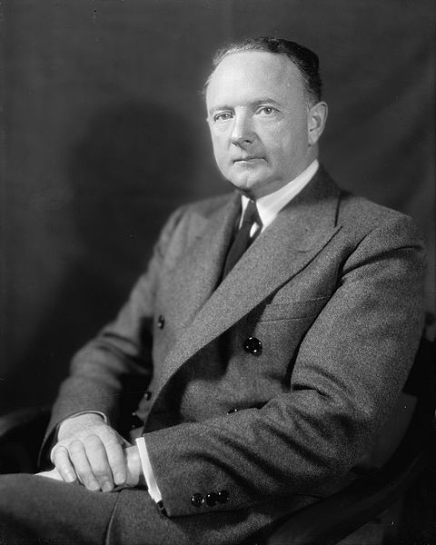
Southern Resistance to Brown
Massive Resistance:
Senator Harry Byrd of Virginia
Many Southern schools were shut down, rather than desegregate
Southern Manifesto (March, 1956):
Signed by 96 members of Congress
Argued that the Supreme Court abused its power – education was NOT mentioned in the Constitution
"The original Constitution does not mention education. Neither does the 14th Amendment nor any other amendment.”

Slide 6
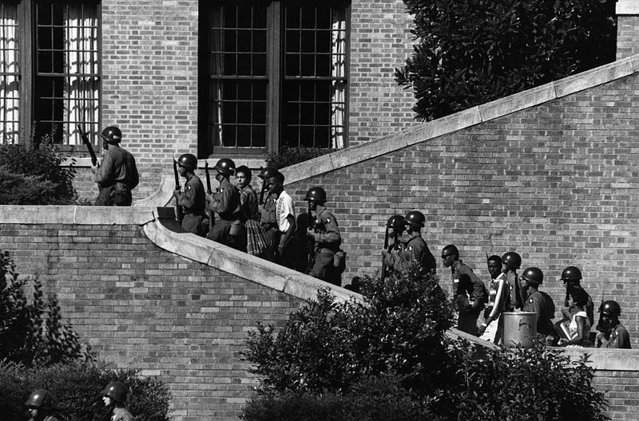
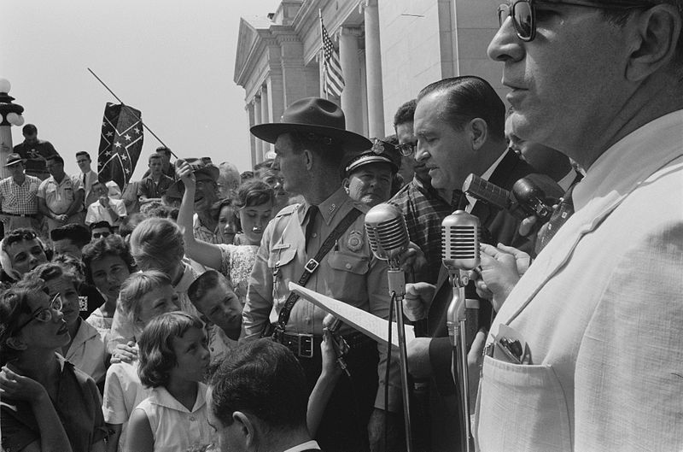
“Little Rock Nine”
Governor Orville Faubus of Arkansas resisted desegregation of Little Rock High School
Used the National Guard to keep black students from entering the school
After a court ruled the Guard to leave, students were harassed by a mob
Eisenhower sent federal troops to allow the students in
“We are a nation in which laws, not men, are supreme.”
1st time since Reconstruction the military intervened to protect African American rights

Slide 7
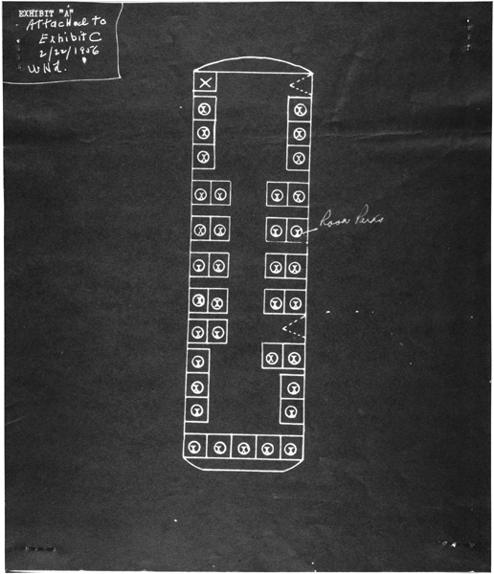
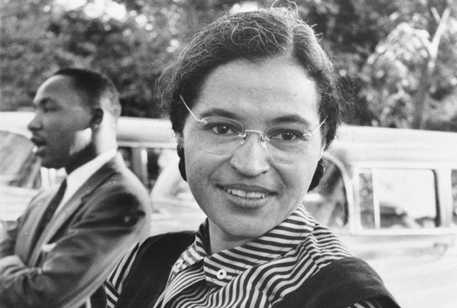
The Montgomery Bus Boycott (1955)
December 1, Rosa Parks refused to give up her seat
Black churches played a large role in organizing the boycott
Women’s Political Council (WPC):
Telephone tree
Martin Luther King, Jr. – 26 years old
Drew on ideas from Jesus, Thoreau, and Gandhi
1 year after Rosa Parks was arrested, Montgomery busses were desegregated

Slide 8
Test Tips
Essay Topics:
Types of protest – civil rights, wars, etc.
Comparing 1950s – 60s with previous time periods
Tips for Multiple-Choice questions:
Brown reversed Plessy
Eisenhower’s response to Little Rock
King was influenced by Thoreau and Gandhi
Good Luck!

Slide 9
Thanks for watching!
Subscribe to my channel
Help spread the word
Questions? Comments? Ideas for videos?
Leave in comments
Subscribe
Down here!

