Slide 1
APUSH Review: The Presidency of Dwight “Ike” Eisenhower
www.Apushreview.com
Everything You Need To Know About The Presidency of Dwight Eisenhower To Succeed In APUSH

Slide 2
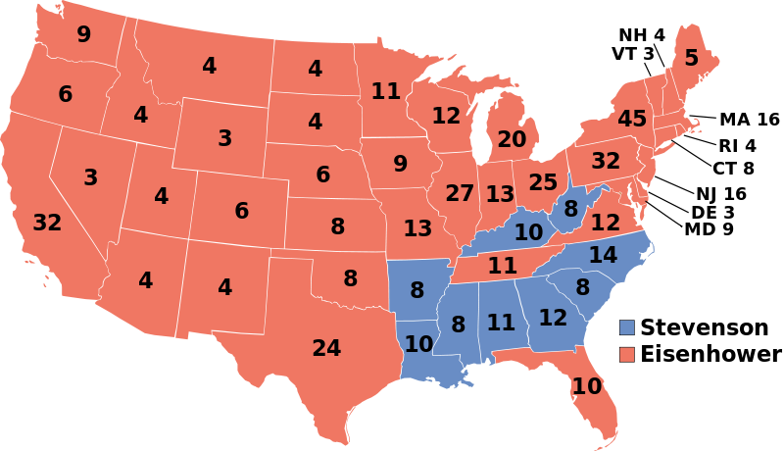
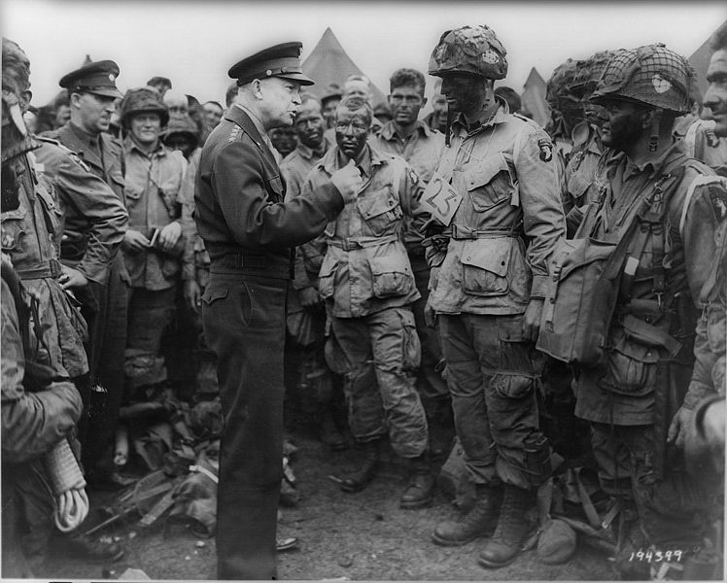
Background on Ike
General during WWII
  D-Day Invasion
“Dynamic Conservatism”
  Continuation of key New Deal Programs
  Fiscally conservative, socially liberal

Slide 3
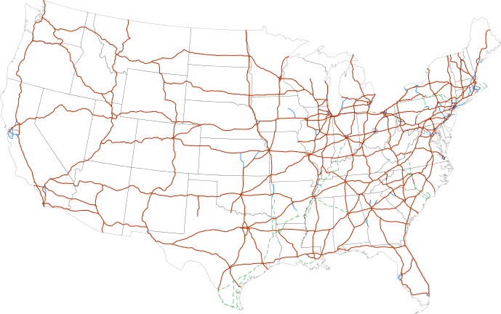
Domestic Policies Under Ike
***Interstate Highway Act***
  Largest public works project to date
  Created 42,000 miles of highways
  Cost $27 billion
  Could be used for evacuation in case of nuclear war
  Helped spur the growth of suburbs in the 1950s
Alaska and Hawaii admitted in1959 and 1960

Slide 4
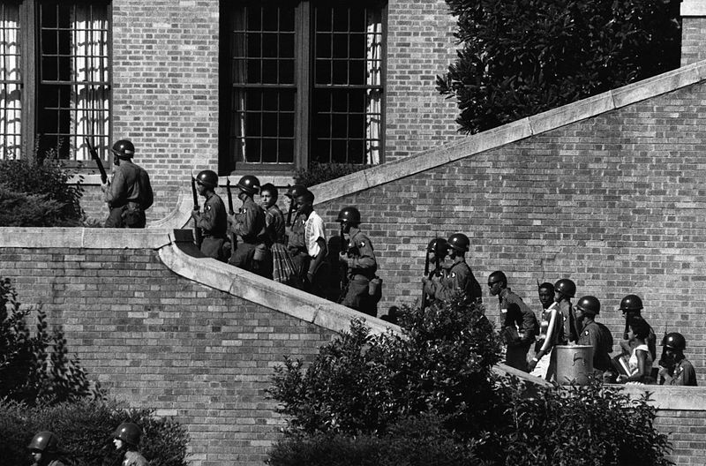
Ike and Civil Rights
Brown v. Board
  Thurgood Marshall (future Supreme Court justice) represented Linda Brown
  Overturned Plessy v. Ferguson
  Separate but equal is inherently unequal
Little Rock Nine (1957):
  Governor Faubus tried to block 9 African American students from entering Little Rock H.S.
  Eisenhower sent troops and took over Arkansas National Guard
  “We are a nation in which laws, not men, are supreme.”

Slide 5
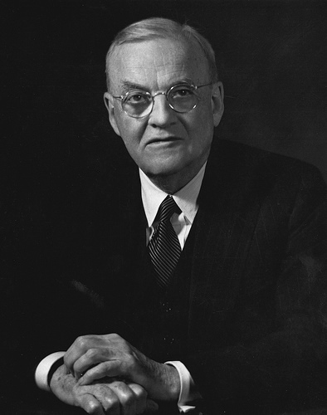
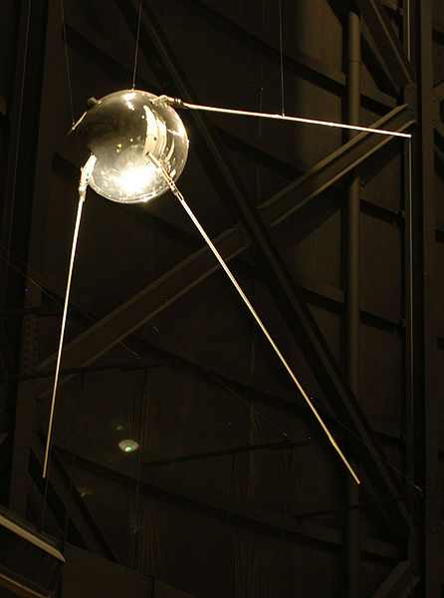
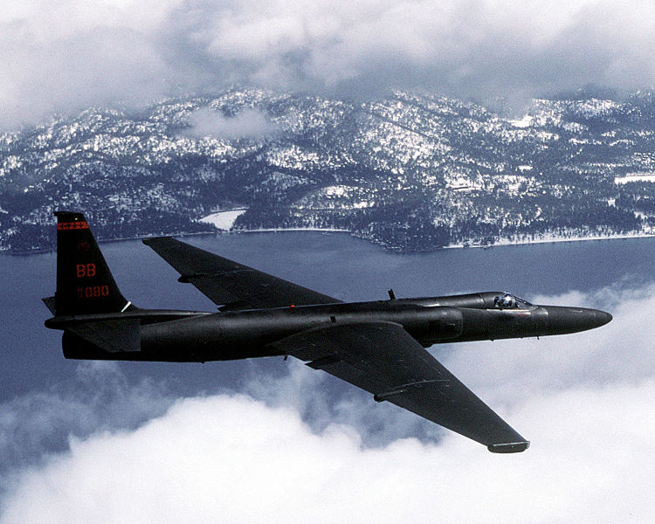
Ike and The Cold War
Korean War ended under his administration
Secretary of State – John Foster Dulles
  Massive Retaliation:
    Brinkmanship
    Mutually Assured Destruction (MAD)
Sputnik – launched by USSR
  Increase in spending on science and education in US
U2 Spy plane
  US plane shot down by Soviets
  Increased tensions

Slide 6
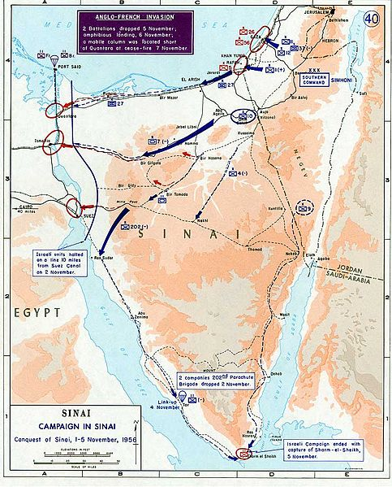
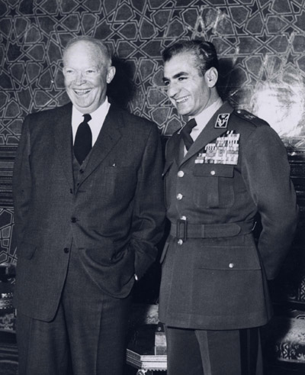
Ike and Foreign Policy
Eisenhower Doctrine
  Fear that Communism could progress to Middle East countries (oil)
  President could provide military and economic aid to nations resisting communism
Iran
  Moussadegh was overthrown
  Shah was instituted as leader by the CIA
Suez Crisis
  Egyptian President Nasser nationalized the Suez Canal
  France, Britain, and Israel attacked Egypt
  US did NOT support the attack, France, Britain, and Israel withdrew
Guatemala President Arbenz was overthrown after he nationalized land owned by a US fruit company

Slide 7
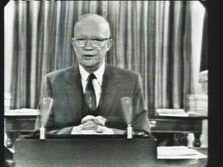
Ike’s Farwell Address
Eisenhower warned of deficit spending and military spending
“Our military organization today bears little relation to that known by any of my predecessors in peacetime, or indeed by the fighting men of World War II or Korea.”
“Until the latest of our world conflicts, the United States had no armaments industry. American makers of plowshares could, with time and as required, make swords as well. But now we can no longer risk emergency improvisation of national defense; we have been compelled to create a permanent armaments industry of vast proportions. Added to this, three and a half million men and women are directly engaged in the defense establishment. We annually spend on military security more than the net income of all United States corporations.”

Slide 8
Thanks for watching!
  Subscribe to my channel
  Help spread the word
Questions? Comments? Ideas for videos?
  Leave in comments
Subscribe
Down here!

