Slide 1
APUSH Review: The Presidency of Lyndon b. Johnson
www.Apushreview.com
Everything You Need To Know About The Presidency of Lyndon b. Johnson To Succeed In APUSH

Slide 2
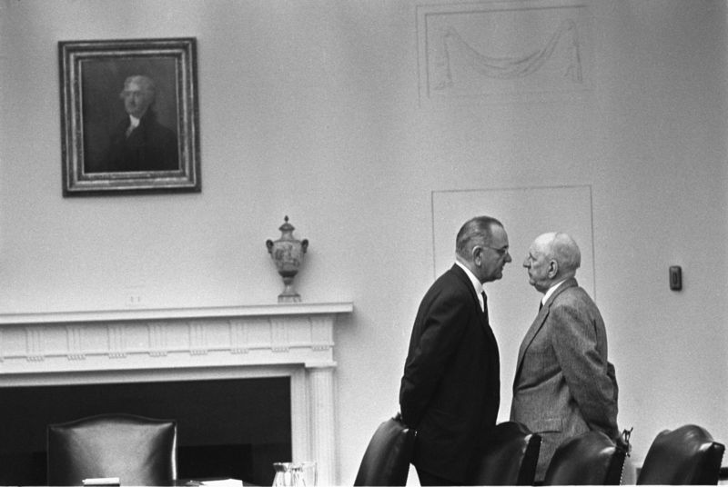
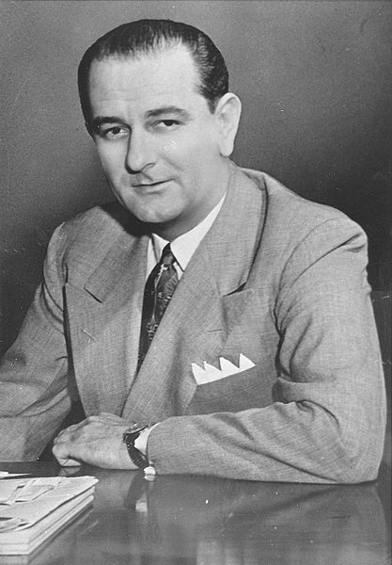
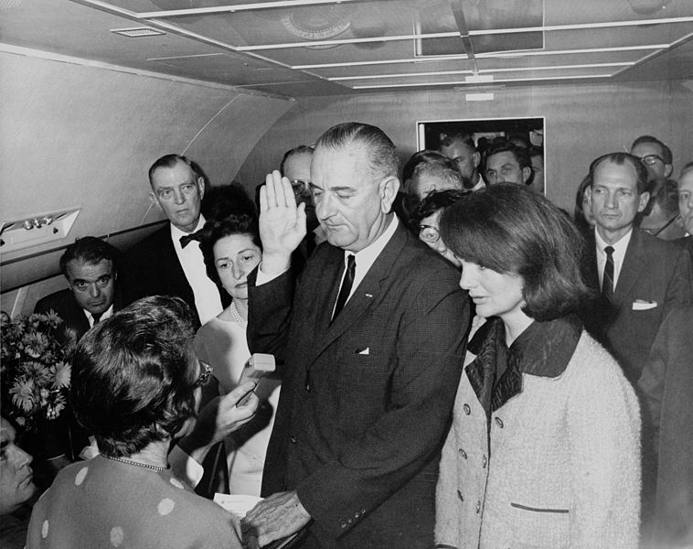
Background on LBJ
Former Senator from Texas
Chosen as JFK running mate in 1960
Became president on November 22, 1963
Very liberal, believed the federal government could positively impact Americans
Known for giving the “Johnson Treatment”

Slide 3
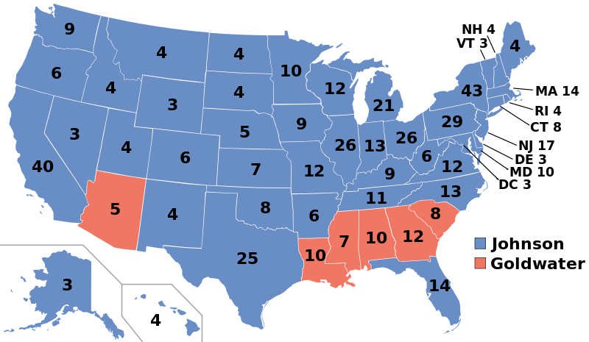
Election of 1964
LBJ runs for re-election
LBJ v. Barry Goldwater
LBJ wins by a landslide

Slide 4
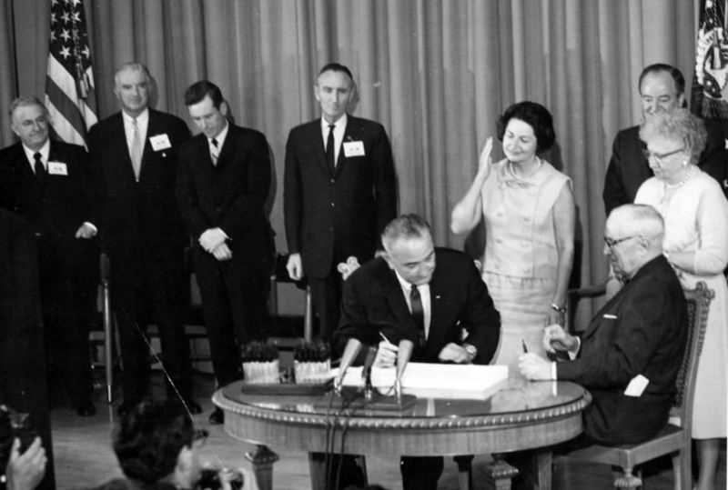
The Great Society
Focused on domestic programs including civil rights, poverty, and education
Built on ideas and programs laid forth from The New Deal
Examples of programs:
  Medicare:
    Medical assistance and insurance for elderly Americans
  Medicaid:
    Health care for lower income families and individuals
  Food Stamp Act:
    Provides food assistance for low-income individuals and families

Slide 5
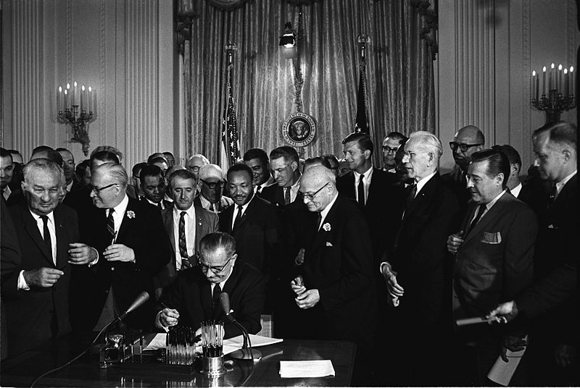
LBJ And Civil Rights
Laws passed during his administration helped right the wrongs of Reconstruction
  Civil Rights Act of 1964:
    Guaranteed equal access to public accommodations
    Government could cut off funds where discrimination occurred
    Title VII:
      Discrimination in workplaces is illegal
  24th Amendment:
    Made poll taxes illegal
  Voting Rights Act of 1965:
    Federal government could register voters
    Eliminated literacy tests for voting

Slide 6
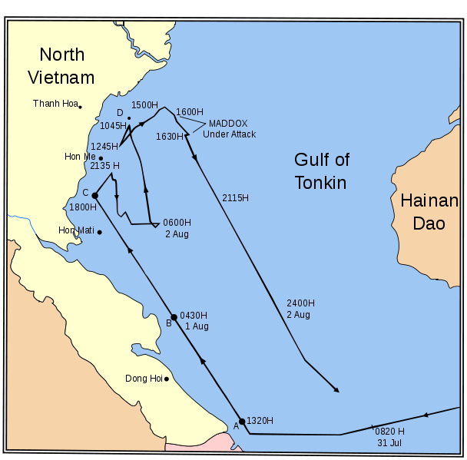
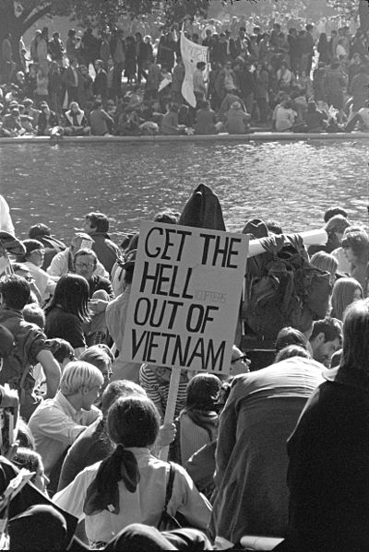
LBJ and the Vietnam War
“Domino Theory”
  Idea that if Vietnam became communist, surrounding countries will also
***Gulf of Tonkin Resolution***
  Background info:
    US alleged that American ships were attacked by North Vietnam
    Different accounts of what happened
  What did the resolution do?
    Allowed Johnson to do anything necessary to prevent future attacks
  Impact of the resolution?
    Increases power of president
    Johnson escalates US involvement in Vietnam
After the Gulf of Tonkin Resolution, LBJ drastically increased US involvement in Vietnam
The average age of draftees and volunteers was 19
  Many were minorities and lower class
  Protests mount
    “Hey hey LBJ, How many kids did you kill today?”

Slide 7
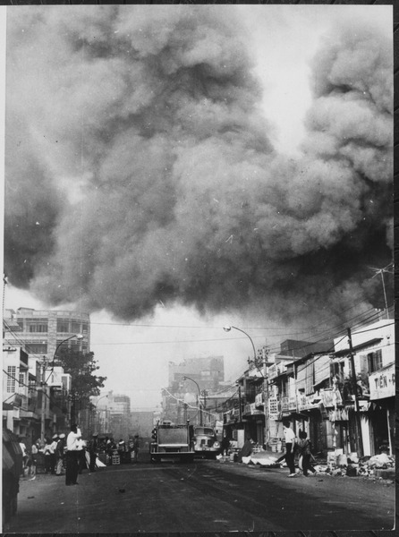
1968
Tet Offensive (January 30, 1968):
  North Vietnam launched a surprise attack on the Vietnamese New Year
  Public opinion on the war decreased and protests increased
  War seemed unwinnable
Johnson does NOT seek re-election in 1968

Slide 8
An Analysis of the LBJ Administration
Positives:
  Civil Rights for African Americans
  Aid for elderly and the poor
  Aid for education
  Increase government involvement
Negatives:
  Escalation of Vietnam – Gulf of Tonkin
  Federal spending drastically increased
  The Vietnam War took money from The Great Society and vice versa
  Increase government involvement

Slide 9
Test Tips
Essay Topics:
  Effectiveness of his administration
  How did society change as a result?
Tips for Multiple-Choice questions:
  Gulf of Tonkin Resolution
  Civil Rights Act, Voting Rights Act, and 24th Amendment
Good Luck!

Slide 10
Thanks for watching!
  Subscribe to my channel
  Help spread the word
Questions? Comments? Ideas for videos?
  Leave in comments
You need to subscribe right now!
Subscribe
Down here!

