Slide 1
APUSH Review: The Second Red Scare
www.Apushreview.com
Everything You Need To Know About The Second Red Scare To Succeed In APUSH

Slide 2
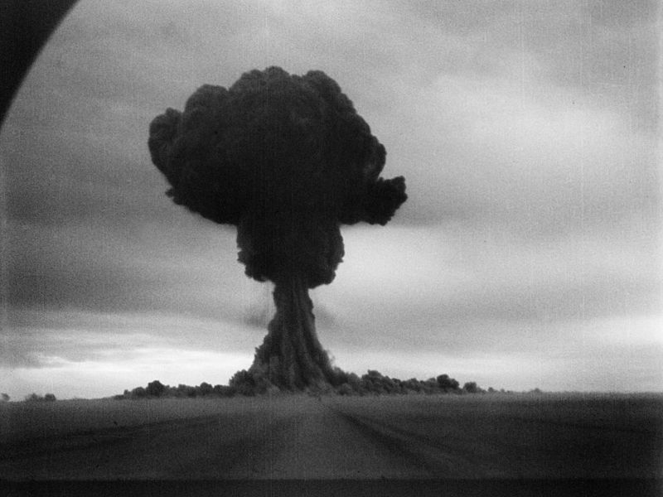
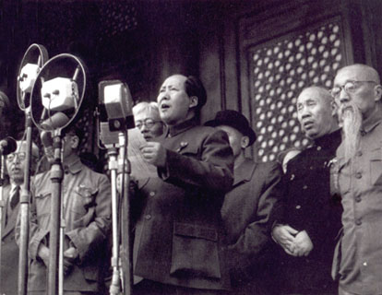
What was the Second Red Scare?
Fear and hysteria over communism that swept the country in the 1940s and 1950s
Many individuals feared the US government was infiltrated by communists
Reasons for the 2nd Red Scare:
  USSR actions after WWII in Eastern Europe
  “Fall of China” in 1949
  Soviet development of nuclear weapons

Slide 3
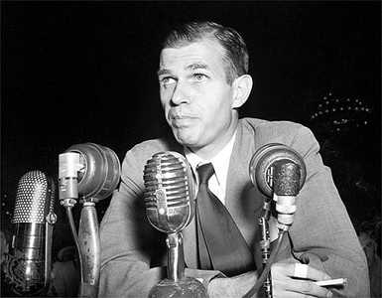
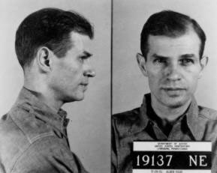
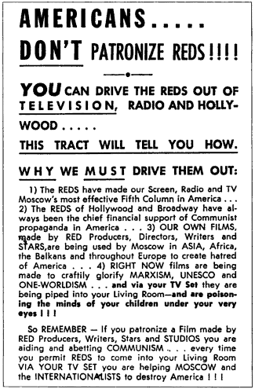
Red Scare in the 1940s
HUAC (created in 1945)
  House Committee on Un-American Activities
    Prominent member was Richard Nixon – NOT JOSEPH McCarthy!
  Alger Hiss:
    One-time aide to FDR
    Accused of sharing 65 classified documents
    Indicted and sentenced to 5 years in jail for perjury
  “Hollywood Ten”
    10 screenwriters that refused to testify before HUAC; sentenced to jail
Truman’s Loyalty Program:
  Truman issued an executive order (9835) for federal employees to take a loyalty oath

Slide 4
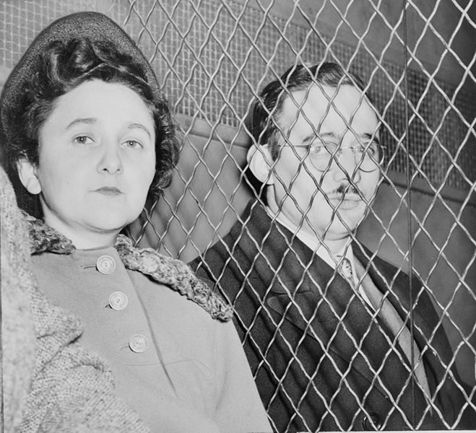
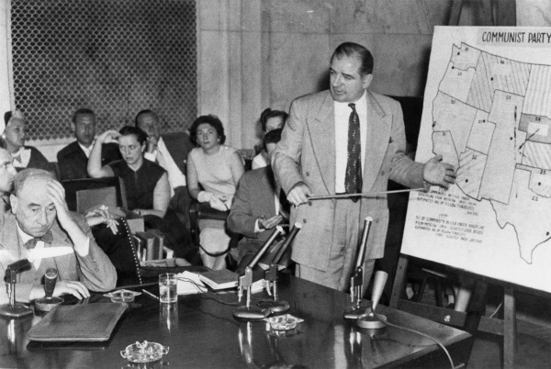
Red Scare in the 1950s
McCarran Internal Security Bill
    Passed over Truman’s Veto
    Communist organizations must register with the government
McCarthyism
  Seen as a demagogue
    Leader that capitalizes on prejudices and false claims to gain power
  Joseph McCarthy (R – Wisconson)
  Accused state department officials of being communists
  Downfall happened when he attacked the army
  Arthur Miller’s The Crucible was an allegory to McCarthyism
Rosenbergs
  Husband and wife convicted of giving a-bomb secrets to the Soviets
  2008 – Revealed that the prosecution knew Ethel was innocent

Slide 5
Effects of the Second Red Scare
Blacklisting:
  Refusal to hire certain workers (100s in Hollywood were never hired for alleged ties to communism)
Violation of constitutional rights
  Remember, in times of war and crisis, individual rights decrease
Cincinnati Reds changed their name to the Cincinnati Redlegs to avoid associations with Communism
Dennis v. US (1951):
  Upheld the Smith Act (1940)
  Made it illegal to teach the violent overthrow of the government

Slide 6
Test Tips
Essay Topics:
  Comparing 1st Red Scare with 2nd Red Scare
  2nd Red Scare as it relates to domestic policy during The Cold War
Tips for Multiple-Choice questions:
  McCarthy was NOT part of HUAC
  Individual rights are limited (McCarthyism, Hollywood 10)
Good Luck!

Slide 7
Thanks for watching!
  Subscribe to my channel
  Help spread the word
Questions? Comments? Ideas for videos?
  Leave in comments
Subscribe
Down here!

