Slide 1
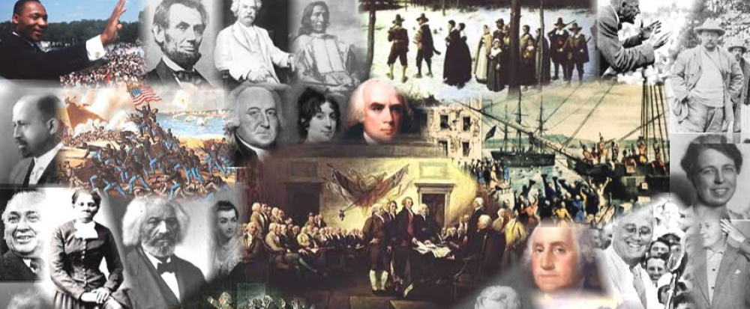
www.Apushreview.com

Slide 2
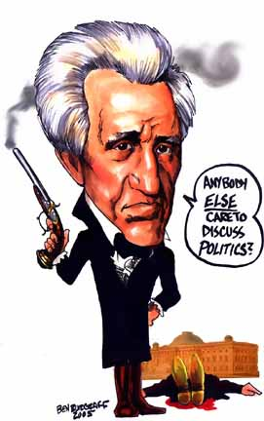
APUSH Review: The Presidency of Andrew Jackson
Everything You Need To Know About Andrew Jackson To Succeed In APUSH

Slide 3
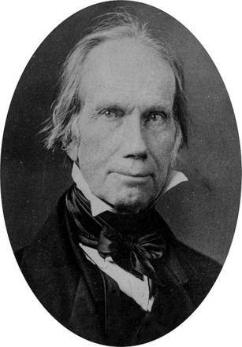
Key Events Leading to Jackson’s Presidency
Battle of New Orleans (January 1815)
“Corrupt Bargain of 1824”
Election of 1828

Slide 4
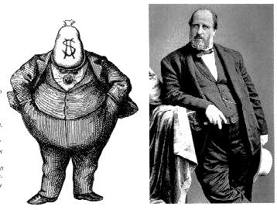
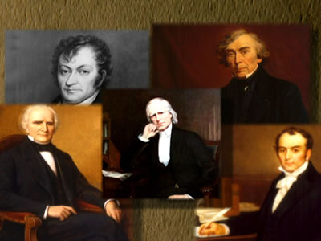
Key Ideas During Jackson’s Presidency
“Common Man”
  First president from the West
Universal White Male Suffrage
  Elimination of property requirements for white male voting
Patronage/Spoils System
  Argued that it was very democratic
  “Rotation in Office”
Kitchen Cabinet:
  Group of unofficial advisors to Jackson

Slide 5
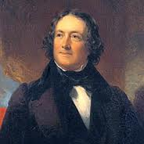
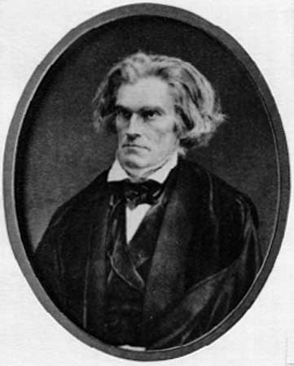
Crises During Jackson’s Presidency
Tariff of Abominations (1828)
  Protective tariff, hurt the South
Nullification Crisis
  South Carolina Exposition and Protest
    Sitting VP John C. Calhoun
    Argued that states should nullify the tariff, Drew inspiration from Virginia and Kentucky Resolutions
“Bank War”
  Nicholas Biddle (President of BUS)
  Jackson believed it was a monopoly that only benefited the rich
  Jackson vetoed the BUS re-charter
  Removed deposits to state “pet” banks
  Helped lead to the Panic of 1837
Specie Circular:
  Land must be purchased with Hard money

Slide 6
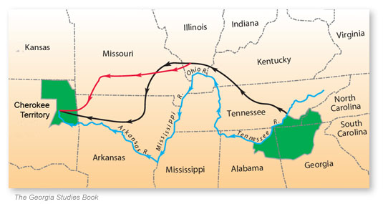
Jackson and Natives Americans
Worcester v. Georgia (1831)
  Stated that Native Americans did NOT have to move West
  Jackson ignores the Supreme Court’s decision
  “John Marshall has made his decision, now let him enforce it.”
Trail of Tears
  1837 – forced removal of Native Americans to land west of Mississippi River

Slide 7

Jackson and Texas
During his presidency, Texas declares independence
Jackson does not recognize independence until his last few days in office (1837)
He did not want to absorb Texas due to the fear of sectional tensions over slavery

Slide 8

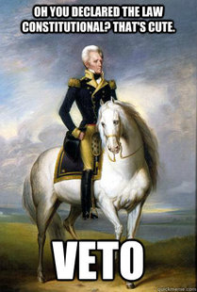
Thanks for watching!
  Subscribe to my channel
  Help spread the word
Questions? Comments? Ideas for videos?
  Leave in comments
Subscribe
Down here!

