Slide 1
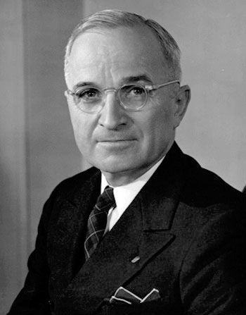
APUSH Review: The Presidency of Harry Truman
www.Apushreview.com
Everything You Need To Know About Harry Truman To Succeed In APUSH

Slide 2
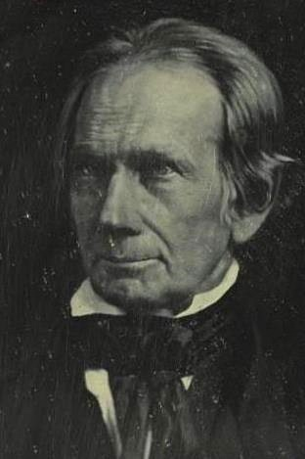
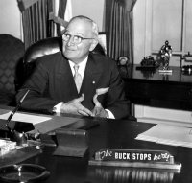
Background on Truman
Happy 168th Birthday to me! Don’t I look that old?
FDR’s VP during his 4th term
Becomes president upon FDR’s death on April 12, 1945
  Henry Clay’s Birthday!
Truman was mostly left out of FDR’s inner circle
Viewed the Yalta Conference as a pact by Stalin
“The Buck Stops Here”

Slide 3
The “Fair Deal”
Wanted to expand the New Deal
  Called for higher minimum wage, increase civil rights for African Americans, national health insurance, and education aid
Many of Truman’s goals were not met
  Biggest success was increasing the minimum wage
  Essentially, New Deal programs were continued, nothing else was added

Slide 4
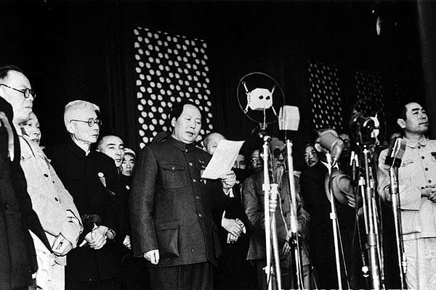
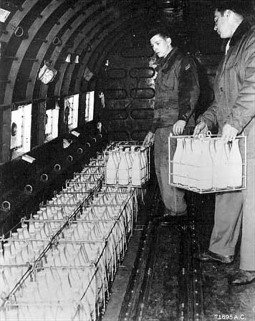
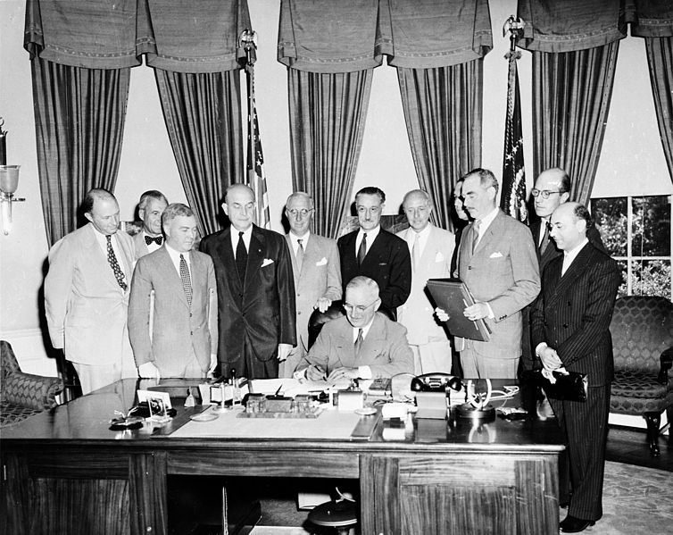

1949: An Important Year
North Atlantic Treaty Organization (NATO)
  Originally the US and 11 other members
  A threat to any NATO nation would involve all NATO nations
  USSR responded by forming the Warsaw Pact
Soviet Union detonates an atomic bomb:
  US no longer has sole control
  Arms race begins
“Fall of China”
  Mao and the Communists took control of China
  Truman was blamed for “loss” of China
Berlin Blockade – 1948 – 1949
  USSR cuts off access to Berlin (located in East Germany)
  US and allies drop supplies

Slide 5

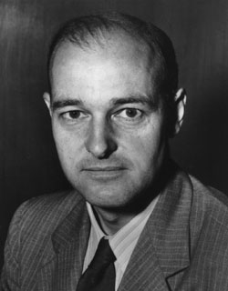
Containment
Influenced by George Kennan
Goal was to keep communism from spreading
Truman Doctrine
  US provided $400 million of economic and military aid to Greece and Turkey
Marshall Plan:
  US provided aid to Europe
  USSR refused aid and forbid certain countries from accepting it

Slide 6
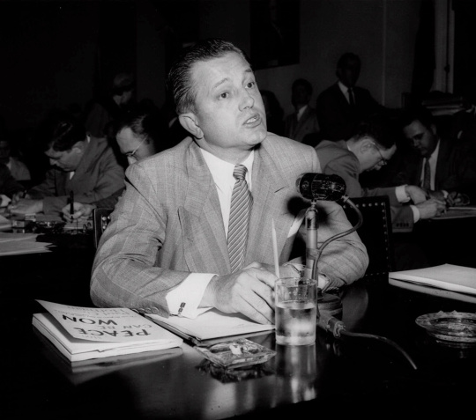
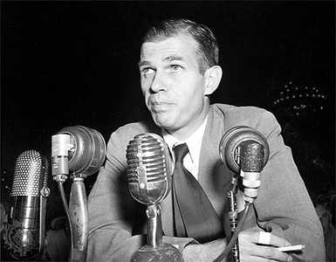
Domestic Issues
Taft-Hartley Act
  Passed over Truman’s Veto
  Outlawed “Closed Shop” Unions, 80 day cooling off period
2nd Red Scare
  HUAC
    House committee - Nixon prominent leader; Alger Hiss found guilty of perjury
  McCarran Internal Security Act
    Passed over Truman’s Veto
    Communist organizations must register with the government
  Loyalty Program
    Truman issued an executive order for federal employees to take a loyalty oath
  Hollywood Ten
    Accused of being associated with Communists; refused to testify before HUAC, went to jail
    Blacklisted

Slide 7
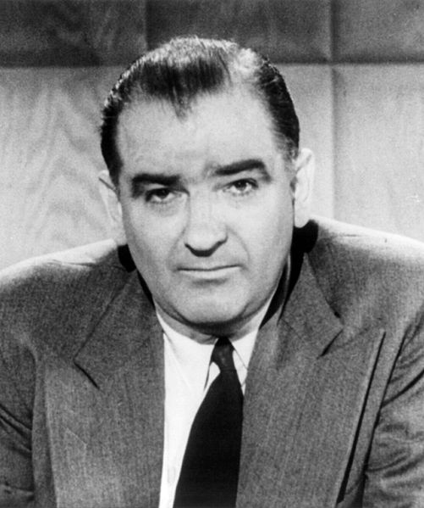
Domestic Issues Continued
  McCarthyism
  Senator Joseph McCarthy (Republican – Wisconsin)
  1950, accused state department officials of being communists
National Security Act
  Established the Department of Defense
  Created the CIA
Civil Rights:
  Biggest success was Executive Order 9981
    Desegregated the military (1948)

Slide 8
Thanks for watching!
  Subscribe to my channel
  Help spread the word
Questions? Comments? Ideas for videos?
  Leave in comments
Pledge your loyalty by subscribing!
Subscribe
Down here!

