Slide 1
The Presidency of James K. Polk
www.Apushreview.com
Everything You Need To Know About The Presidency of James K. Polk To Succeed In APUSH

Slide 2
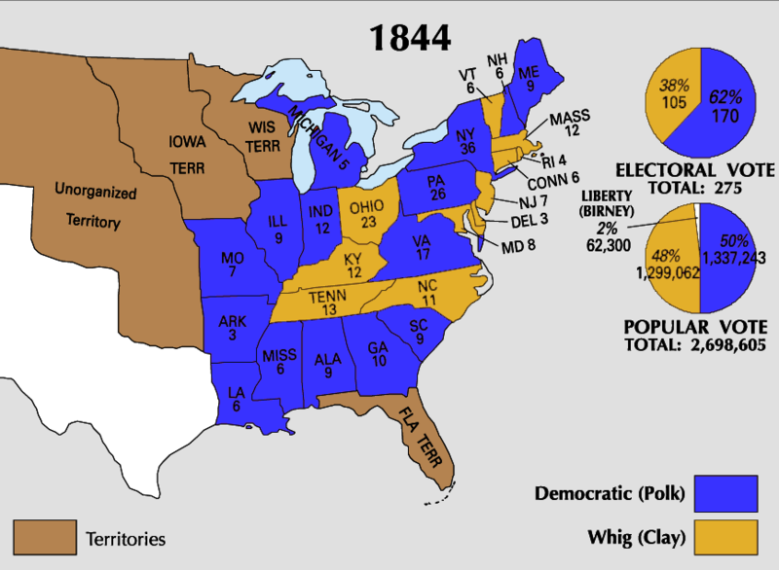
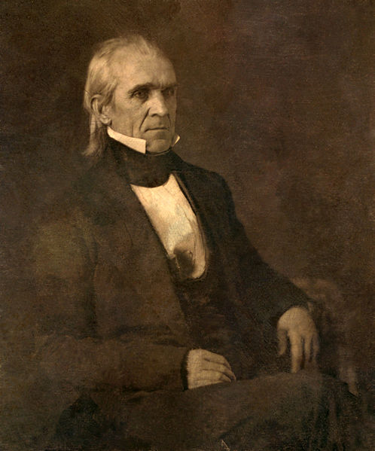
The Election of 1844
James K. Polk becomes the 1st “Dark-Horse” Candidate in US History
  Surprise candidate at the Democratic Convention
Henry Clay was nominated by the Whigs
Polk was an avid expansionist
Defeats Clay
  “Young Hickory” becomes president
Check out They Might Be Giants’ “James K. Polk”

Slide 3

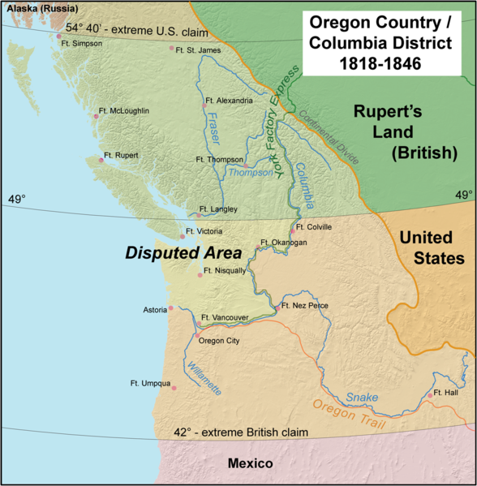
Oregon and Texas
Oregon:
  The US and Britain jointly occupied the Oregon Territory
  Polk advocated “54⁰40 or Fight”
  Eventually, the two sides settled on the 49th parallel
    Continuation of the border between US and Canada
Texas:
  Texas declared independence from Mexico in 1836
  Polk campaigned on admitting Texas into the Union

Slide 4
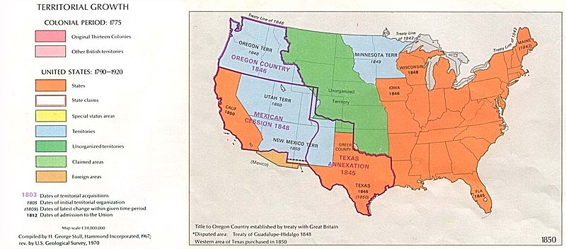
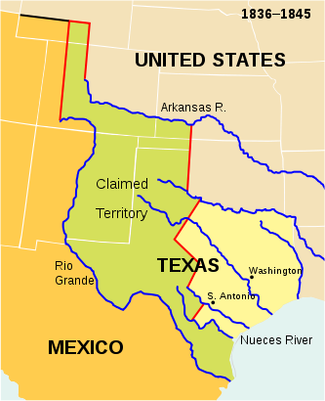
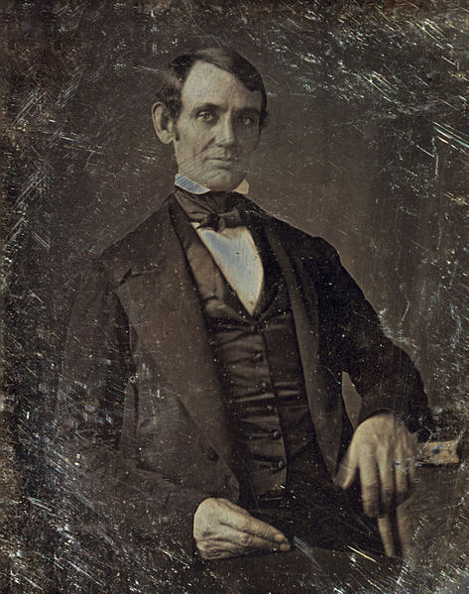
The Mexican-American War
US and Mexico recognized different boundaries for Texas
  Dispute was between Nueces and Rio Grande Rivers
“Spot Resolutions”
  Abe Lincoln
Treaty of Guadalupe Hidalgo
  US gains Mexican Cession
  US pays Mexico $15

Slide 5
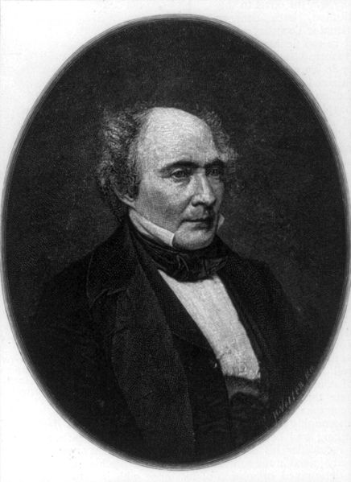
A Tariff and A Treasury
Remember, Polk was a Democrat
  Democrats want to see the tariff rates go Down
Walker Tariff:
  Reduced the tariff rates substantially
  Helped lead to an increase in trade with other countries
Independent Treasury:
  Democrats answer to not having a BUS
  All government money would be held in the Treasury building and sub-treasuries in cities
  No government money would be held in banks

Slide 6
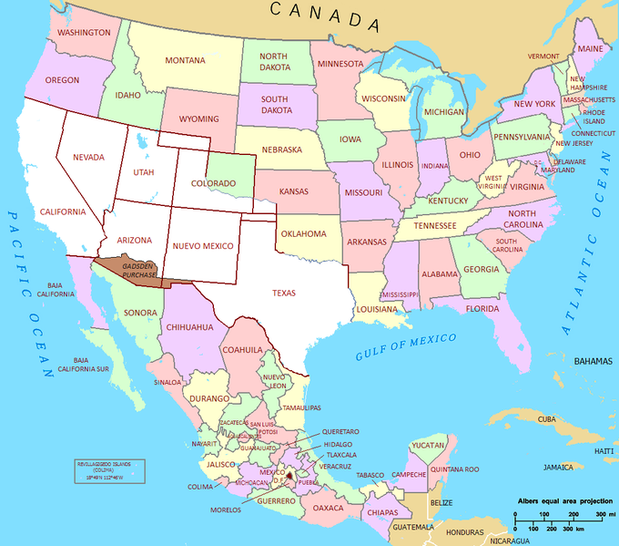
Impact of Polk’s Presidency
Few Presidents have done as much in one term
Manifest Destiny is complete
Tensions between the North and South increase
  Wilmot Proviso
  Compromise of 1850

Slide 7
Thanks for watching!
  Subscribe to my channel
  Help spread the word
Questions? Comments? Ideas for videos?
  Leave in comments
Subscribe
Down here!

