Slide 1
The Presidency of John F. Kennedy
www.Apushreview.com
Everything You Need To Know About The Presidency of John F. Kennedy To Succeed In APUSH

Slide 2
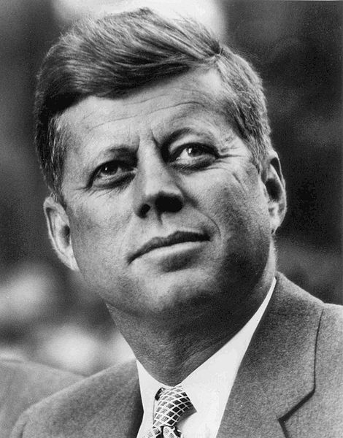
Background on JFK
WWII Veteran
  PT109
  Profiles of Courage
Senator:
  Part of a committee that chose 5 greatest Senators ever
    Henry Clay was chosen!
First Catholic President

Slide 3
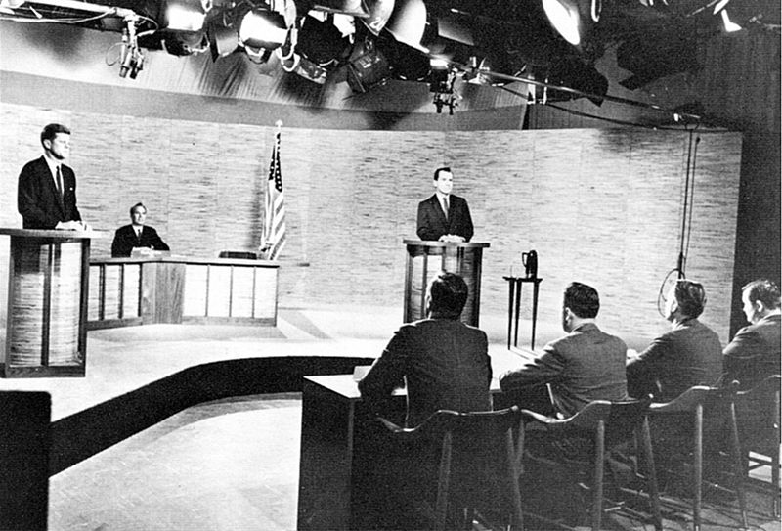
The Election of 1960
Nixon (Republican) v. Kennedy (Democrat)
First election in history that televised debates nationally
  Two interpretations:
    Those who watched TV felt Kennedy “won” the debate
      Nixon looked pale, uncomfortable, and sweaty
    Those who listened on the radio felt Nixon “won”
The “New Frontier”
  Acceptance speech at Democratic convention
  Called for individuals to achieve their greatness
    Focused science, space, eliminating prejudice, etc.

Slide 4
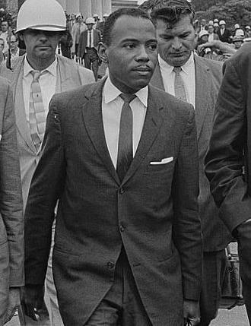
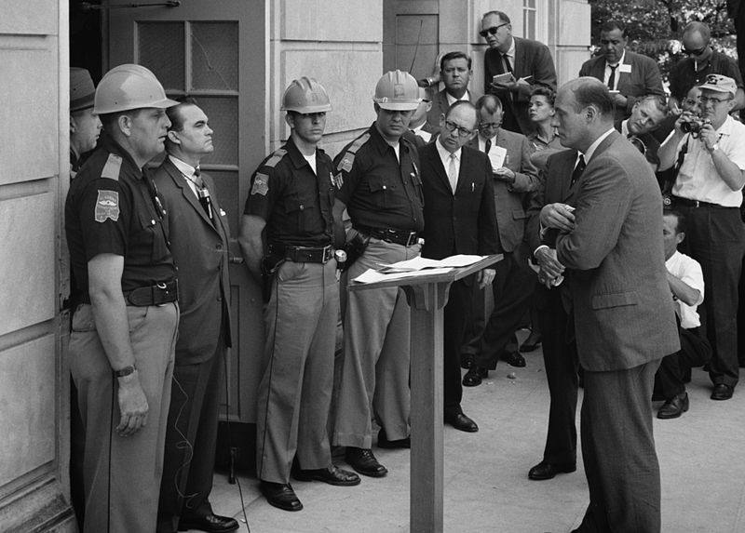
JFK and Civil Rights
For most of JFK’s first two years, he did little with Civil Rights
Key Civil Rights milestones under his presidency:
  Freedom Riders
  James Meredith
  “Letter From a Birmingham Jail”
  March on Washington
June, 1963:
  JFK used Alabama national guard to enroll two black students at the University of Alabama
Proposed Civil Rights Bill:
  JFK was assassinated prior to its passage
  Civil Rights Bill of 1964

Slide 5
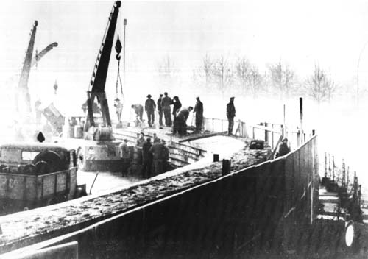
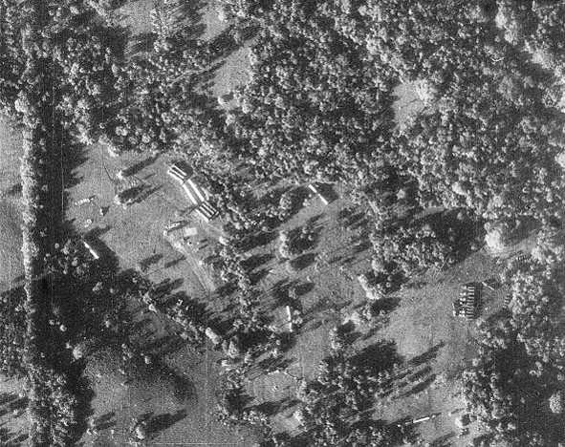
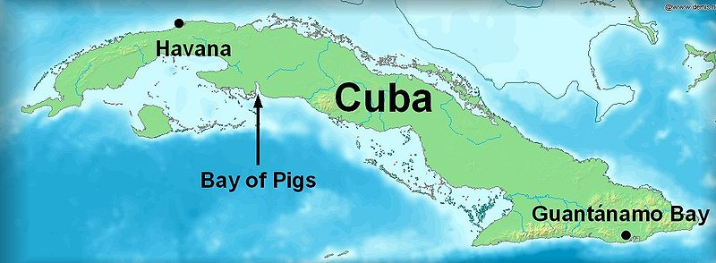
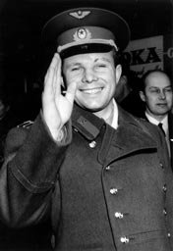
JFK and The Cold War
“Flexible Response”
  JFK criticized “missile gap” between US and USSR under Eisenhower
  Developed a plan to find new ways of combating the Cold War
Space Race:
  April 12, 1961 (Henry Clay’s 184th birthday!), Yuri Gagarin (USSR) became first man in space
  May 25, 1961: Kennedy pushed for a man on the moon by the end of the decade
Berlin Wall:
  Between 1949 and 1961, over 2.5 million East Germans fled Soviet-controlled East Germany through West Berlin
  August 13, 1961, Soviets began construction of the Berlin Wall
Bay of Pigs:
  US trained Cuban exiles in a hope to overthrow Castro
  Colossal failure
Cuban Missile Crisis
  August, 1962, the US Soviet discovers weapons in Cuba
  Closest two sides ever came to war

Slide 6
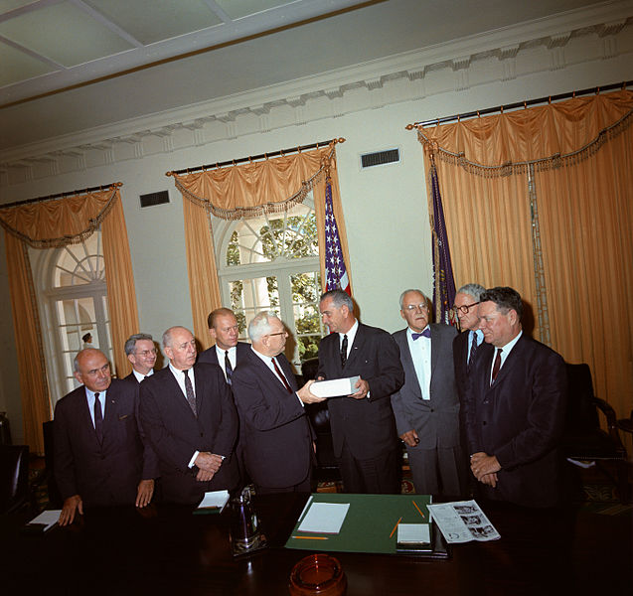

Other Notable Info
Peace Corps:
  Created in 1961
  Young Americans that would serve 24 months over seas
    Doctors, teachers, etc.
    Focused on social and economic development
  Hoped to improve countries and resist communism
Alliance for Progress:
  $ billions were pledged to improve the economy in Latin America
Warren Commission:
  Chief Justice Earl Warren
  Investigated the JFK assassination
  Stated that Lee Harvey Oswald acted alone

Slide 7
Thanks for watching!
My greatest achievement was not being in outer space, but subscribing to Adam Norris!
  Subscribe to my channel
  Help spread the word
Questions? Comments? Ideas for videos?
  Leave in comments
Subscribe
Down here!

