Slide 1
APUSH Review: The Great Society
www.Apushreview.com
Everything You Need To Know About The Great Society To Succeed In APUSH

Slide 2
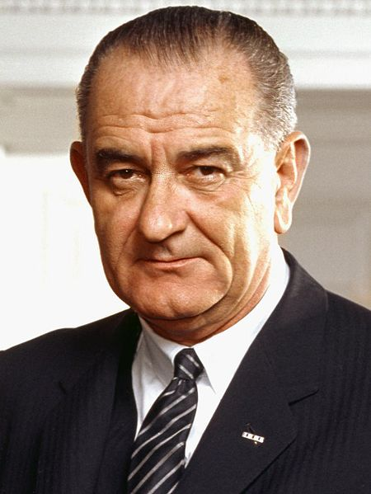
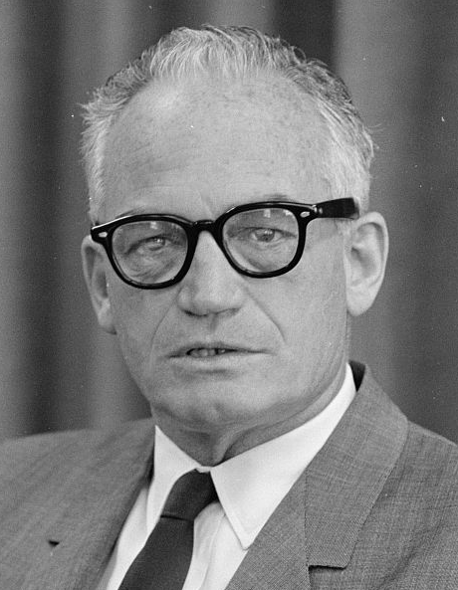
Background on The Society that was Great
Election of 1964:
  LBJ v. Barry Goldwater
  LBJ’s platform included “The Great Society”
Heavily influenced by The Other America
  Michael Harrington
  Argued 25% of nation lived in poverty
  Believed the federal government could alleviate poverty

Slide 3

What is The Great Society?
Speech at two colleges (Ohio University and Michigan State)
Focused on domestic programs including civil rights, poverty, and education
Built on ideas and programs laid forth from The New Deal

Slide 4
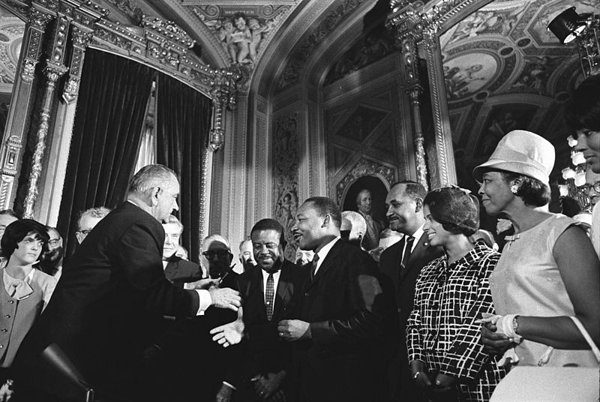
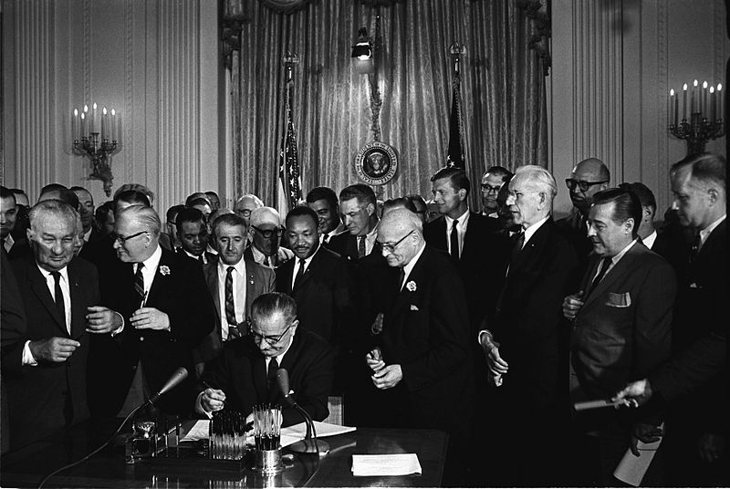
The Great Society and Civil Rights
Civil Rights Act of 1964:
  Guaranteed equal access to public accommodations
  Created Equal Employment Opportunity Commission
  Government could cut off funds where discrimination occurred
  Title VII:
    Discrimination in workplaces is illegal
24th Amendment:
  Made poll taxes illegal
Voting Rights Act of 1965:
  Federal government could register voters
  Eliminated literacy tests for voting
  The number of African Americans registered to vote in the South skyrocketed

Slide 5
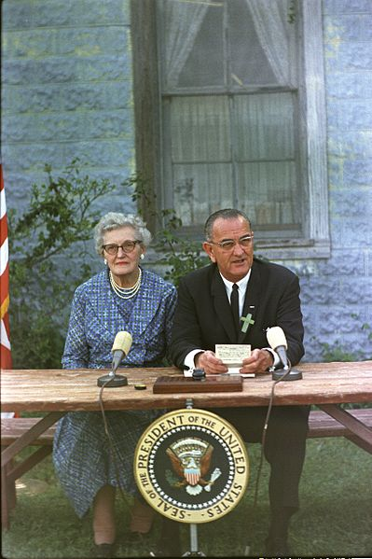

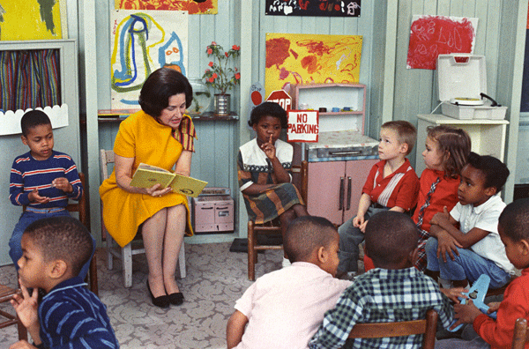
The Great Society and Poverty
War on Poverty:
  Office of Economic Opportunity:
    Administered money to various programs and areas of the country, particularly lower-income areas
Housing and Urban Development (HUD)
  Cabinet position created during LBJ’s administration
  Focused on urban development and renewal
  (Still around today)
Elementary and Secondary Education Act
  Billions of dollars were given to assist primary and secondary education in the US
Head Start:
  Early childhood education

Slide 6
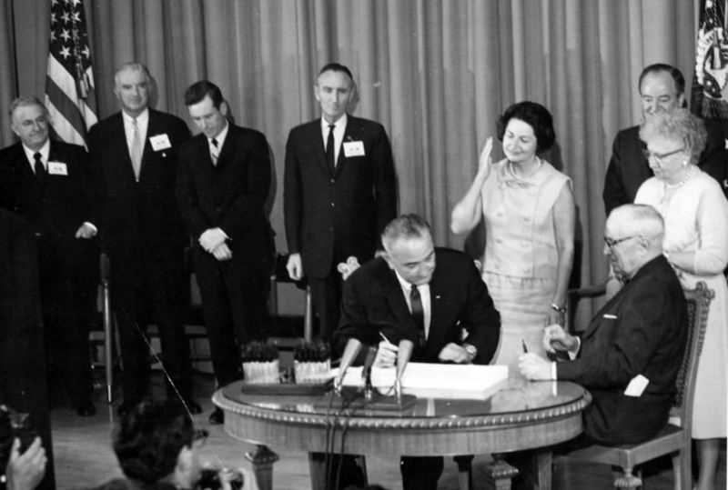
Other Aspects of The Great Society
Medicare:
  Medical assistance and insurance for elderly Americans
Medicaid:
  Health care for lower income families and individuals
Food Stamp Act:
  Provides food assistance for low-income individuals and families

Slide 7
Thanks for watching!
  Subscribe to my channel
  Help spread the word
Questions? Comments? Ideas for videos?
  Leave in comments
Stop messing around and subscribe!
Subscribe
Down here!

