Slide 1

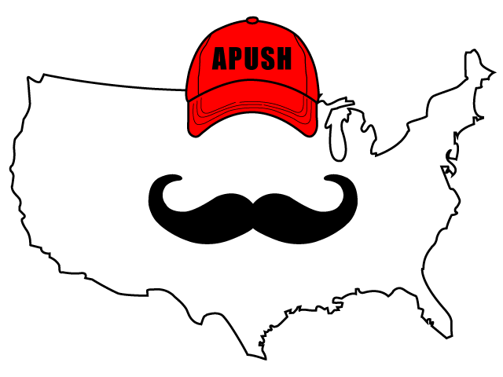
APUSH Review: The Chesapeake Colonies
Shoutout time: Shout outs to Mr. Rauch’s Class at Gautier High School, and the APUSH Class watching in Bermuda!
Everything You Need To Know About The Chesapeake Colonies To Succeed In APUSH

Slide 2

Brief Intro
What is the Chesapeake?
  Maryland and Virginia
Located on the Chesapeake Bay

Slide 3
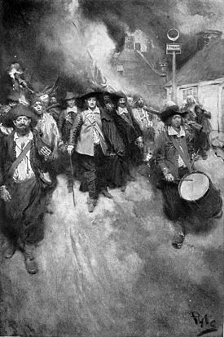
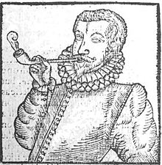
Chesapeake Economy
Predominantly agriculture - rural settlements
  Cash crops - tobacco
Indentured servants (prior to 1676 - Bacon’s Rebellion)
  Headright System benefited wealthy land owners
After 1676, African slave labor replaced indentured servants

Slide 4
Chesapeake Demographics
Some families, many white male indentured servants
Lower life expectancy than New England and Middle Colonies
Many died at 20
Midlife Crisis at 10!!!!

Slide 5
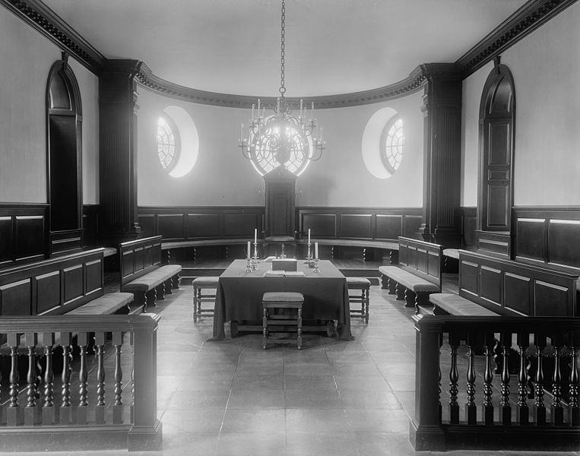
Chesapeake Politics
VA House of Burgesses
  1619 - First Representative Assembly
Governor was appointed by England
Voting requirements - mostly landowning men (housekeepers - heads of households)
Elite, wealthy planters dominated politics

Slide 6
Religion In The Chesapeake
Maryland Acts of Toleration
  Religious freedom to Christians only
  Aimed at protecting Catholics

Slide 7
Test Tips
Multiple-Choice and Short Answer:
  BE ABLE TO COMPARE/CONTRAST WITH OTHER REGIONS
Essays:
  COMPARING!
Good luck!!

