Slide 1


APUSH Review: The New England Colonies
Everything You Need To Know About The New England Colonies To Succeed In APUSH
Shoutout Time: Mr. O’Donnell’s Class in Niagara Falls and Mr. Feliz’s Class in the Dominican Republic!

Slide 2

A Brief Intro
What were they?
  Massachusetts, Rhode Island, Connecticut, New Hampshire

Slide 3
New England Economy
Small towns
Family farms (not plantations like the South)
Mixed economy - agriculture and commerce
  Merchants, shipbuilding, whaling, etc.
Slavery DID exist, although on a smaller scale

Slide 4
New England Demographics
More likely to see families than other regions
  Grandparents too!
Higher life expectancy than other regions

Slide 5
New England Politics
Town Hall Meetings
  In order to vote:
    Member of the church, white, land-owning male
    Members of community could attend, but not speak or vote
  Early form of democracy

Slide 6
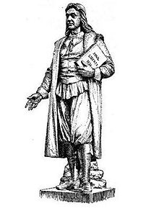
Religion In New England
Massachusetts - dominated by Puritans
  “City Upon A Hill”
  NOT religiously tolerant ->
Rhode Island (Roger Williams)
  Separation of Church and State
  Religious freedom

Slide 7
Test Tips
Multiple-Choice and Short Answer:
  Religion affecting development
  Comparing/Contrasting with other regions
Essays:
  Compare with other regions (especially influence of religion)
Good Luck!

