Slide 1
APUSH Review: Key Concept 1.2
(The Columbian Exchange)
www.Apushreview.com
Period 1: 1491 - 1607
Shout-out Time: Shout-out to Ms. Peinado’s class. You are brilliant!
Everything You Need To Know About Key Concept 1.2 and The Columbian Exchange To Succeed In APUSH
Updated for the 2015 revisions

Slide 2
The New Curriculum and The Columbian Exchange
Key Concept 1.2 “Contact among Europeans, Native Americans, and Africans resulted in the Columbian Exchange and significant social, cultural, and political changes on both sides of the Atlantic Ocean.”
  Page 26 of the Curriculum framework
The Columbian Exchange revolutionized life in the Americas, Europe, and Africa.
Big Ideas:
  What were positives and negatives of the Columbian Exchange on both hemispheres?
  What were reasons that led to European exploration?

Slide 3
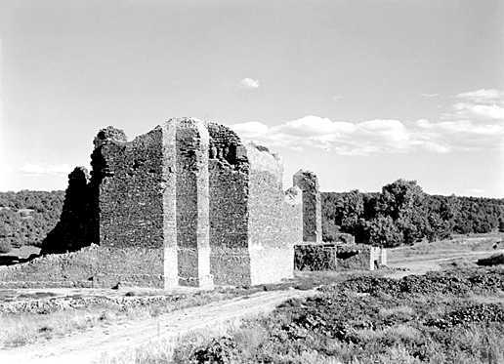
Key Concept 1.2, I
Key Concept 1.2, I: “European expansion into the Western Hemisphere generated intesnse social, religious, political, and economic competition and changes within European societies.”
  Page 26 of the Curriculum framework
A) Reasons for European exploration:
  Countries sought new sources of wealth – gold and silver
  Economic and military competition – glory (defeat of the Spanish Armada by the English)
  Spread Christianity – Spain
The Spanish often tried to convert Natives to Christianity
  Spanish Mission System:
    Outposts throughout the Americas to help convert Natives
    Outposts were often military bases as well
3 G’s – Gold, Glory, Gospel

Slide 4
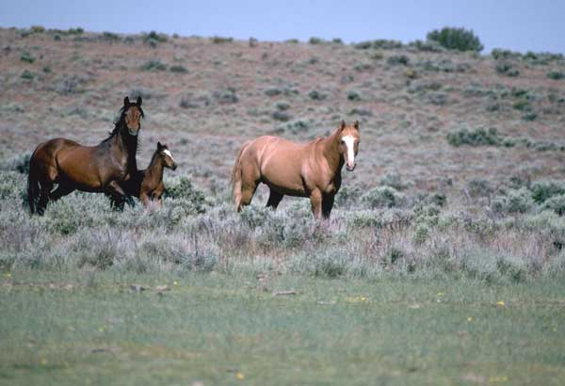
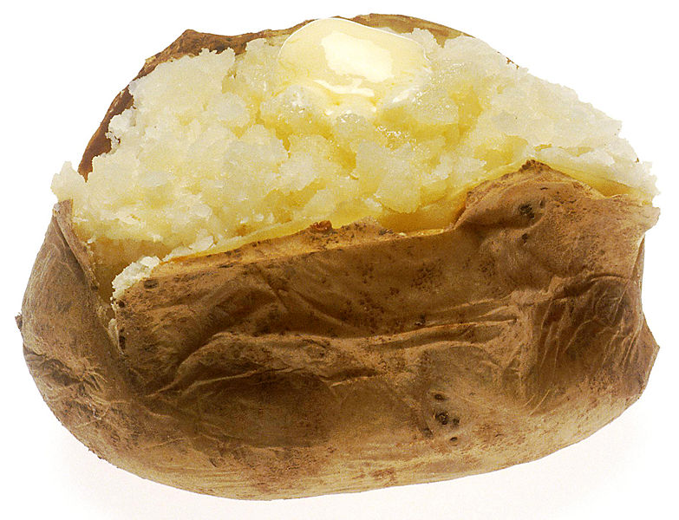
Key Concept 1.2, I
B) Columbian Exchange and its impacts
  What was it?
    The exchange of plants, animals, culture, humans, diseases, etc. between the Americas, Europe, and Africa
  Examples of goods:
    Americas to Europe and Africa: potatoes, maize (corn), tomatoes
    Europe to the Americas: wheat, rice, horses, chickens, oxen
  Impact of exchange?
    In Europe and Asia: massive population growth due to new food; increase in wealth; decrease in feudalism and a rise of capitalism
    In Africa: Spanish and Portuguese used Africans from West Africa to be used as slaves in the Americas
    In the Americas: spread of diseases (smallpox and measles), social classes (Mestizos), horse transformed Native life (made hunting easier), Encomienda system

Slide 5
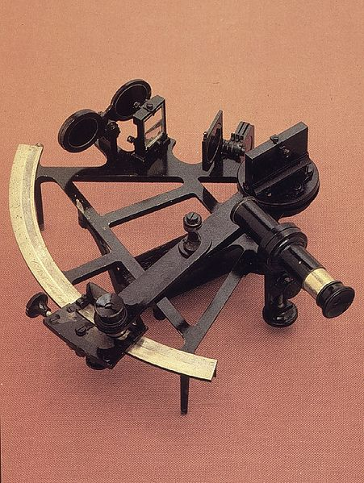
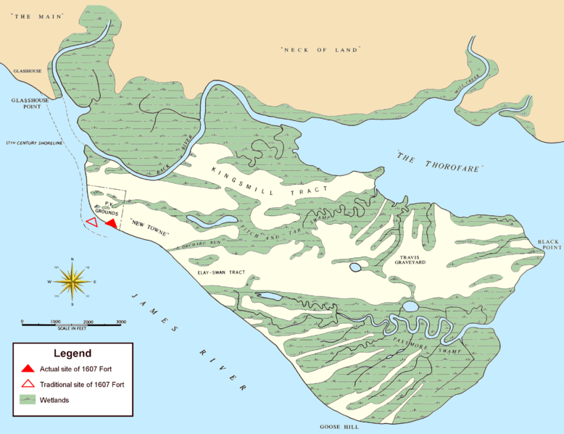
Key Concept 1.2, I
C) Technology and trade
  New technology aided exploration:
    Sextant – could be used to find exact position on earth – more precise sailing
    Caravel, compass, and quadrant improved sailing efficiency
  Economic improvements:
    Joint-stock companies – used to raise $ for explorations
      Used in Jamestown (1607)

Slide 6
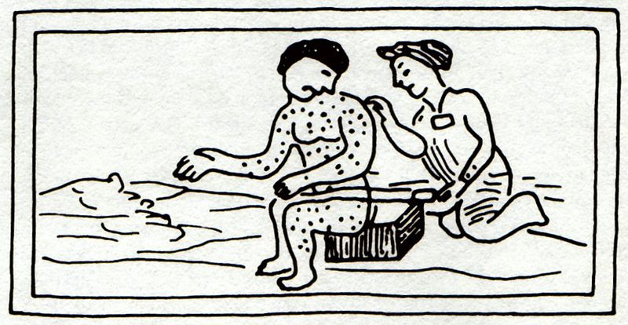
Key Concept 1.2, II
Key Concept 1.2, II: “The Columbian Exchange and development of the Spanish Empire in the Western Hemisphere resulted in extensive demographic, economic, and social changes.”
  Page 27 of the Curriculum framework
A) Impact of Spanish exploration:
  Deadly diseases:
    Smallpox, malaria
      Killed as many as 90% of Natives in some areas – not immune to European diseases
  Introduction of new animals and crops:
    Horse – transformed Native life on the Great Plains
    Crops – wheat, rice, and sugar

Slide 7
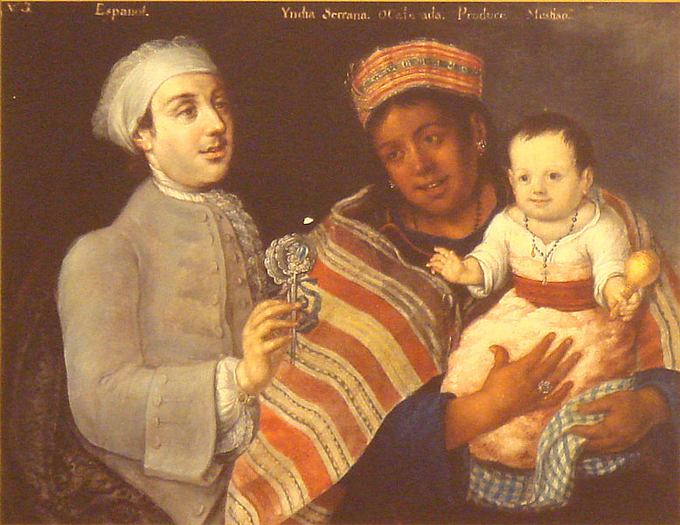
Key Concept 1.2, II
B) Encomienda System (Check out video in the description)
  Native American labor was marshaled (arranged, assembled) on plantations
  The goal was to use labor for agriculture and gain precious metal
  Eventually, the encomienda system was replaced by African Slave Labor
    New Laws of 1542 outlawed the encomienda system
C) Spanish and Portuguese traders acquired slaves from some West African groups
  Slaves were used by the Spanish on plantations and mines
D) Spanish Caste System:
  Incorporated Europeans, Africans, Natives
    Europeans were at the top (peninsulares and creoles)
    Mestizo and mulatos (mixed European and Native, European and African ancestry)

Slide 8
Key Concept 1.2, III
Key Concept 1.2, II: “In their interactions, Europeans and Native Americans asserted divergent worldviews regarding issues such as religion, gender roles, family, land use, and power.”
  Page 28 of the Curriculum framework
A) Misunderstandings between each group
  Gender – many Natives societies were matrilineal
  Land – Natives did not own individual land
  Religion – Natives believed in animism, polytheistic; shamans held power
Some useful aspects of each other’s cultures were eventually adapted:
  Natives adapted technology
  Europeans adapted agriculture techniques

Slide 9
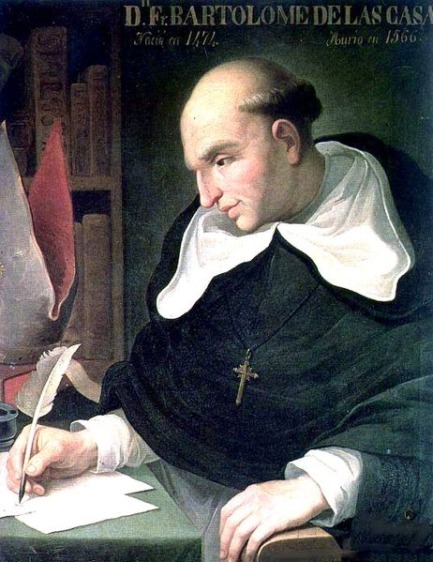
Key Concept 1.2, III
B) Native resistance to European encroachment and labor:
  Natives sought to preserve political, economic, and religious autonomy (independence, self-rule)
    Diplomatically and/or militarily
C) Debates over how non-Europeans should be treated:
  Many Europeans saw Natives and Africans as “savages”
    Juan de Sepulveda:
      Advocated harsh treatment of Natives
      Claimed slavery for Natives was justified under Christianity
    Bartolome de Las Casas:
      Argued that Natives deserved the same treatment as all other men
      Played an instrumental role in the ending of the encomienda system
      Contributed to the “Black Legend”
  Arguments used to subjugate Africans and Natives?
    Racism, religious - spread of Christianity, Natives and Africans were seen as “barbaric”

Slide 10
Test Tips
Multiple-Choice Questions and Short Answer:
  Be familiar with the impacts of the Columbian Exchange – not just food
    Increase in world trade, permanently connecting two hemispheres
  Identify specific goods and their impacts – horse and potato
  Encomienda System
  Impact on Africans – drastic growth in slavery
Essay Questions:
  European interactions with Native Americans
  Could be part of larger topic – comparing Spanish colonization with other European countries (Period 2)

Slide 11
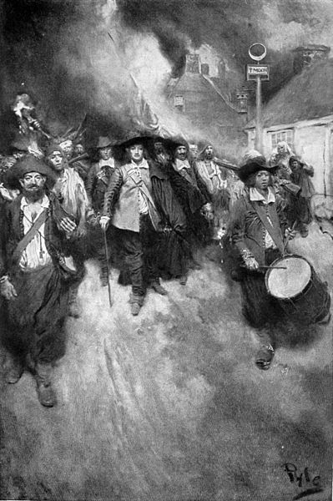
See You Back Here For Key Concept 2.1!
Thanks for watching!
Good luck in May
Please subscribe and share
Check out APUSHReview.com for many more resources
  Practice Multiple-Choice Questions
  New Short Answer Question every Monday!

