Slide 1
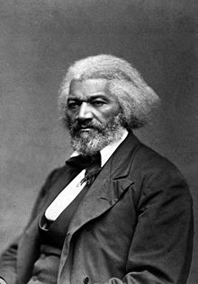
APUSH Review: Abolitionism
A Brief Overview Of Abolitionism To Succeed In APUSH

Slide 2
Early Abolitionism
Throughout most of early American history, abolitionists consisted of a small portion of the population
18th-century:
  Free blacks
  Slaves
  Quakers

Slide 3
Colonization
Prior to 1830, many politicians supported colonization efforts of former slaves in Africa
  Henry Clay, John Marshall, Daniel Webster
1816 - American Colonization Society was founded
  Called for gradual emancipation and movement of blacks to Africa
  Liberia was established on the West Coast of Africa

Slide 4
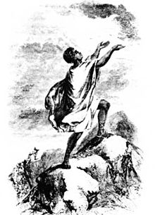
David Walker
Creator of An Appeal to the Coulored Citizens of the World
  Wanted to mobilize blacks in the Abolitionist movement
  Critic of colonization
  Used the Bible and Declaration of Independence in his writings

Slide 5
Nat Turner
Led one of the largest slave rebellions in history (1831)
As with virtually all slave rebellions, slave codes became more strict afterwards

Slide 6
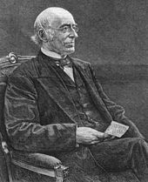
William Lloyd Garrison
Creator of The Liberator (1831 - 1865)
  Weekly newspaper calling for the immediate and uncompensated end to slavery
Against colonization
Criticized the Constitution because it was complicit with slavery

Slide 7
Frederick Douglass
Former slave from Maryland
Incredible orator, supporter of women’s rights, and staunch abolitionist
Creator of the North Star
4th of July Speech - “What, to the American slave, is your 4th of July?”

Slide 8
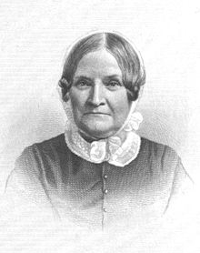
Lydia Maria Child
Published An Appeal in Favor of That Class of Americans Called Africans (1833)
  Advocated immediate end to slavery WITHOUT compensation
Believed women’s rights and abolitionism were intertwined

Slide 9
Theodore Weld
Minister that preached throughout the North the evils of slavery
Argued slavery was a sin
  Instrumental in reshaping the movement away from gradual emancipation to immediate emancipation

Slide 10
Henry Highland Garnet
Escaped from slavery in his youth
Advocated slaves to rebel to achieve freedom
Member of the American Anti-Slavery Society
Founder of the American and Foreign Anti-Slavery Society

Slide 11
American Anti-Slavery Society (1833-1870)
250,000 members nationwide
Several African Americans served on the board of directors
  Theodore S. Wright - co-founder
    Attended Princeton Theological Seminary
    Conductor on the Underground Railroad
    Used religious arguments against slavery

Slide 12
John Brown
Pottawatomie Creek Massacre in 1856
Raid at Harpers Ferry in 1859
  Hoped to inspire a massive slave rebellion
Brown and his followers were caught
Increased tensions between North and South - cause of the Civil War

Slide 13
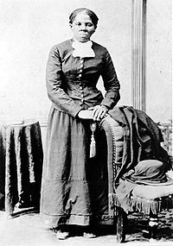
Underground Railroad
Organization that helped slaves escape
“Conductors” helped lead slaves to safe houses
Harriet Tubman helped over 70 slaves escape
Although the number of slaves that escaped was small, it was a powerful symbol loathed by the South

Slide 14
Abolitionists’ Methods
Moral arguments against slavery
  Douglass, Garrison, Weld
Violence
  Turner, Brown
Assisting slaves’ escapes
  Underground railroad, Harriet Tubman

Slide 15
Test Tips
Multiple-Choice and Short Answer:
  Identify and describe different tactics used
  Documents - Douglass’ 4th of July Speech
Essays:
  Sectional tensions prior to the Civil War

Slide 16
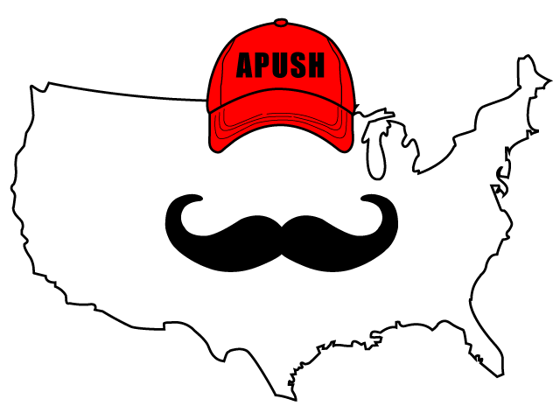
Thanks For Watching!
Best of luck in May!

